Slide 1
SWAP Measurements on Approach to and at the Termination Shock
Heather Elliott and SWAP Team
May 15, 2024

Slide 2
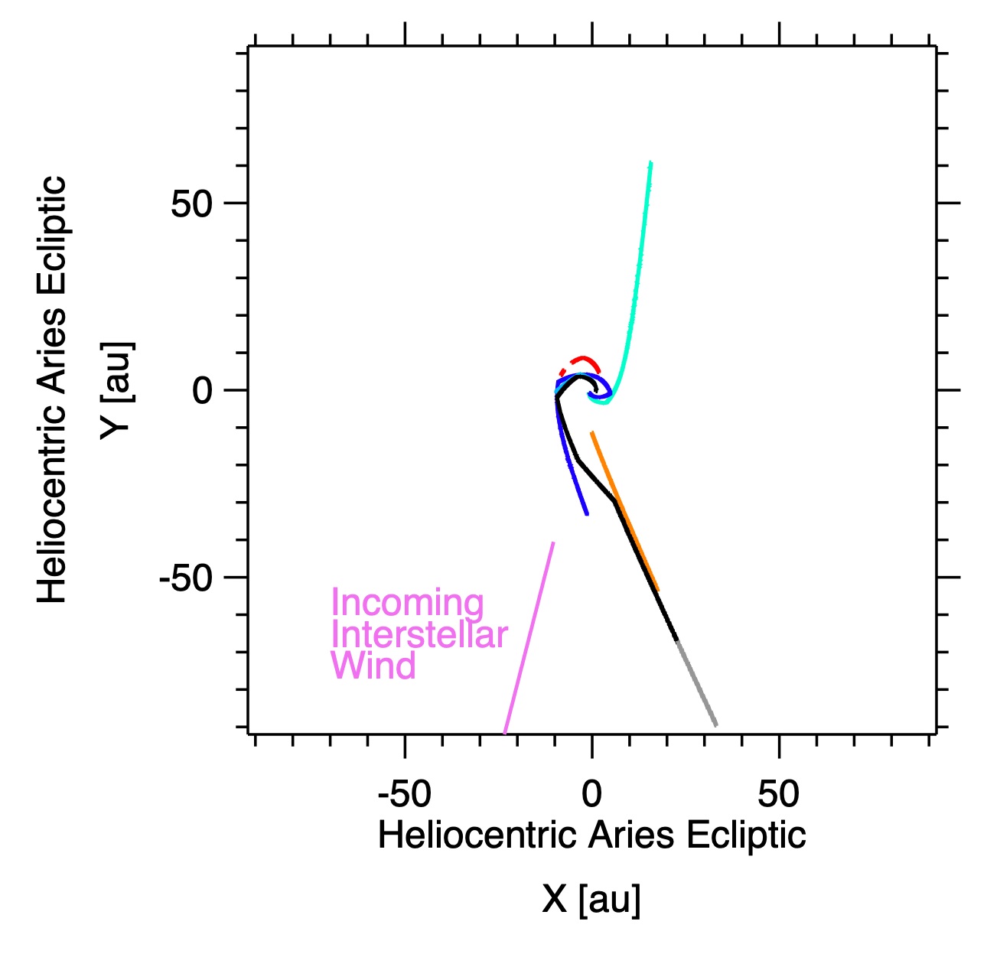
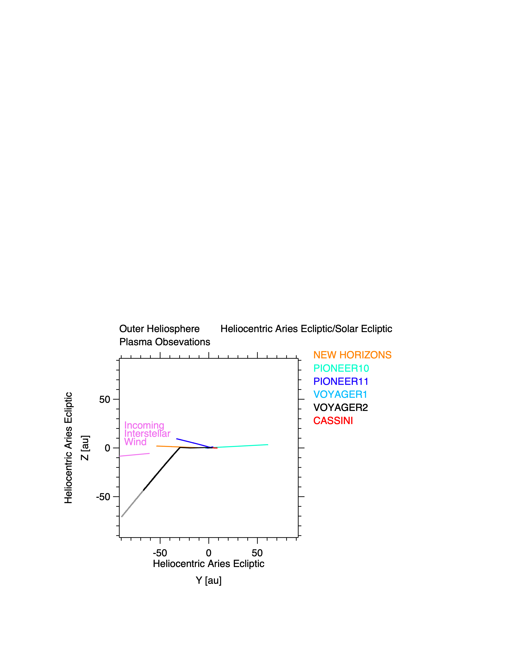
Outer Heliospheric Solar Wind Coverage
Heliocentric Aries Ecliptic/Solar Ecliptic
TS
TS
Figure 1

Slide 3
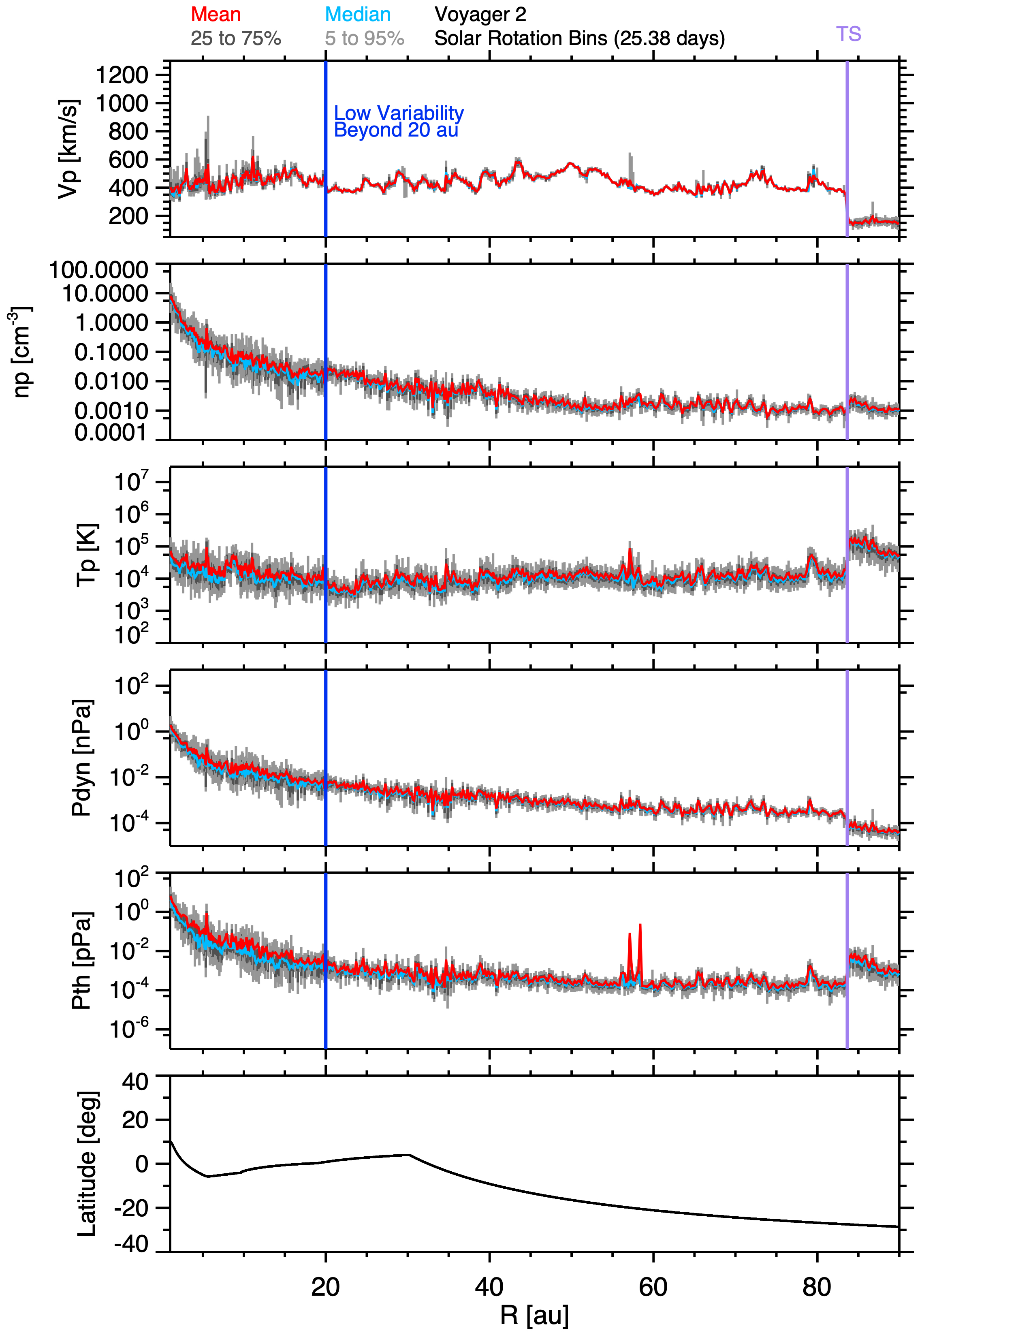
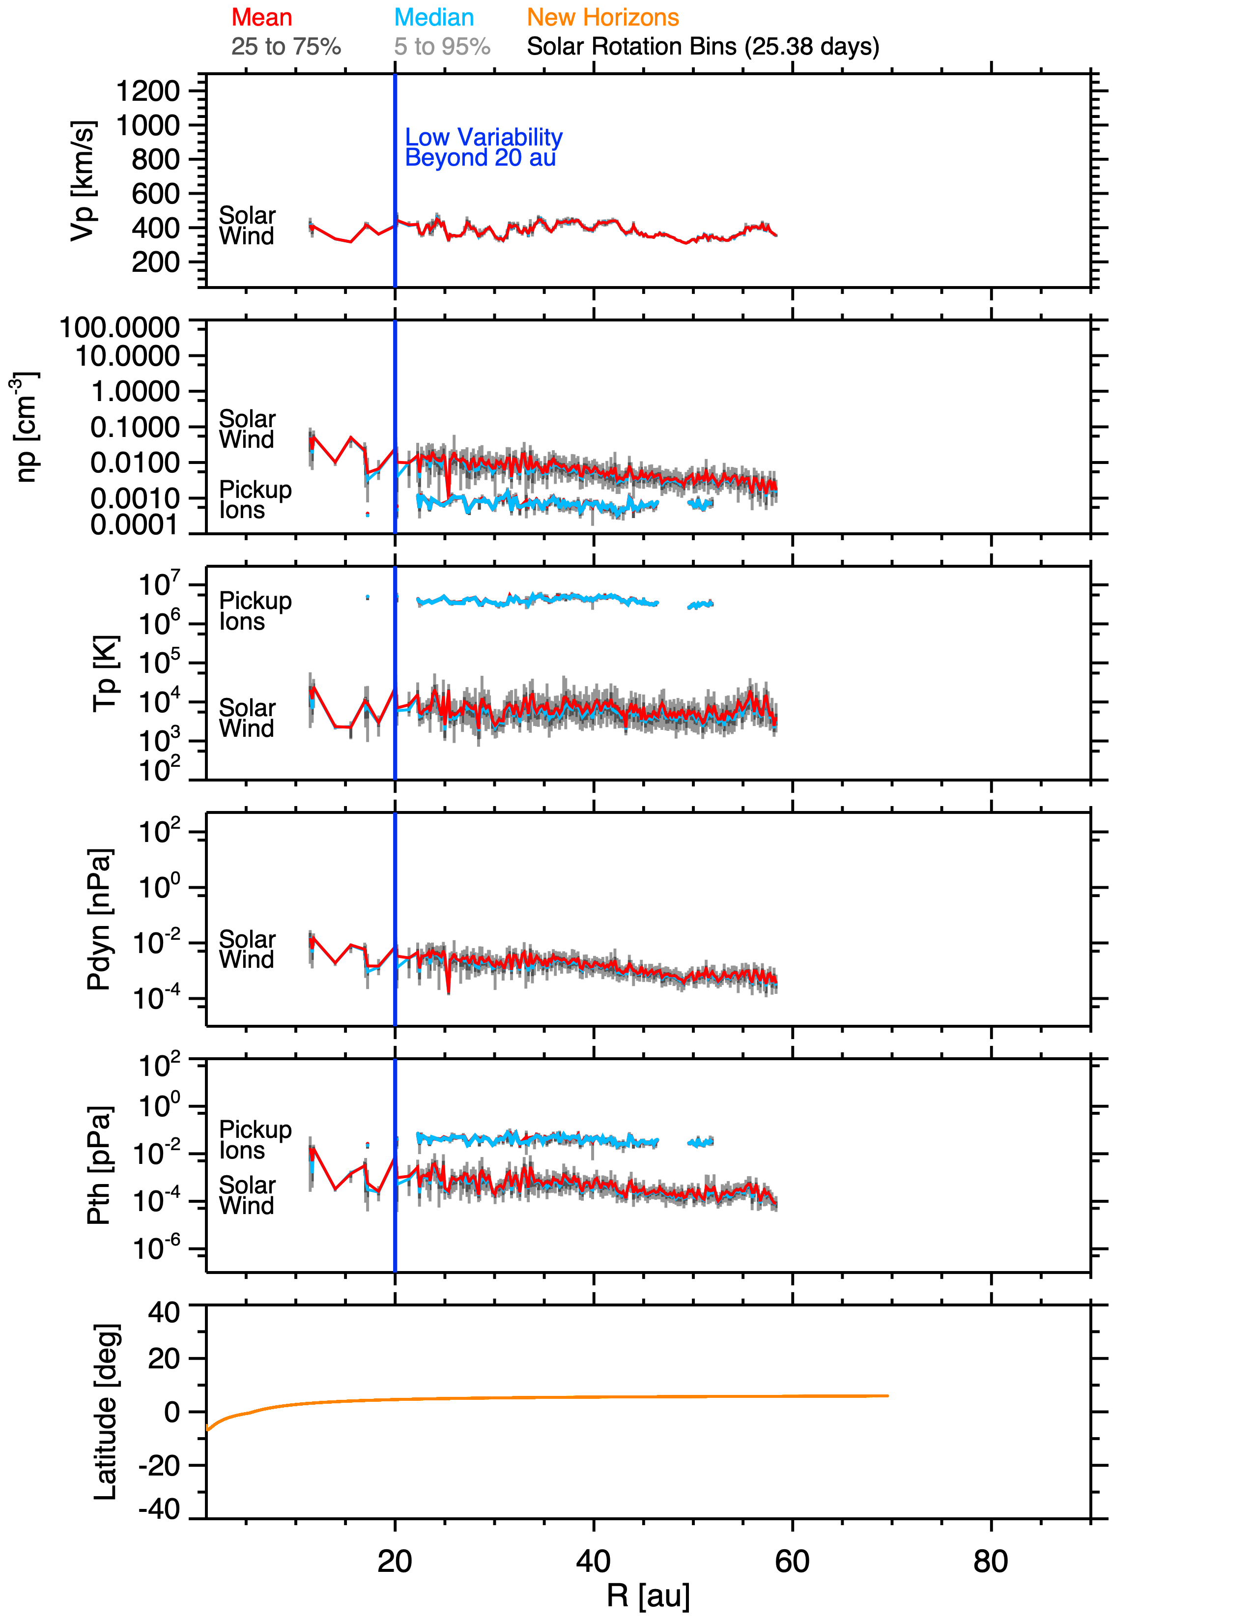

Radial Profiles for Voyager 2 and New Horizons
Voyager 2
Solar Rotation Bins (25.38 Days)
1200
Low Variability
Beyond 20 au
TS
1200
Low Variability
Beyond 20 au
Vp [kms⁻¹]
1000
1000
Vp [kms⁻¹]
800
800
600
600
400
400
200
100
100
np [cm⁻³]
np [cm⁻³]
1
0.01
0.01
0.0001
0.0001
7
6
Log₁₀(Tp) [K]
Log₁₀(Tp) [K]
5
4
3
2
40
40
20
20
Lat [deg]
Lat [deg]
0
0
New Horizons
-20
Voyager 2
-20
-40
-40
20
40
R [au]
60
80
20
40
R [au]
60
80
Beyond 20 the variability of the solar wind has decreased significantly such that individual structures at 1 au are not readily apparent and have merged and worn down.

Slide 4
Increasing Interstellar H+ Pickup Ions Importance
PUI Density
New Horizons
The proton interstellar PUI density gradually decreases with distance, but the fraction relative to the total increases with distance.
The interstellar PUI thermal temperature increases with distance.
The interstellar PUI thermal pressure decreases slightly with distance, but the fraction relative to the solar wind dynamic pressure increases.
Ratio PUI to Total Density
PUI Thermal Temperature
PUI Thermal Pressure
Ratio PUI Thermal to SW Dynamic Pressure
McComas et al., 2021

Slide 5
Voyager 2 Termination Shock Crossing
Voyager 2
TS
3 minute resolution solar wind data
No pickup Ion data from Voyager
Data Link: https://spdf.gsfc.nasa.gov/pub/data/voyager/voyager2/plasma/hires/heliosheath/v2_keys_2007.241_2018.309
Slow decrease in speed on approach to Termination Shock (TS).
Sharp drop in speed at the TS.
Density and temperature elevated at beyond the TS.
V [km/s]
Speed decrease prior to TS
n [cm⁻³]
T [K]
|B| [nT]
DOY of 2007
Richardson & Stone 2009

Slide 6
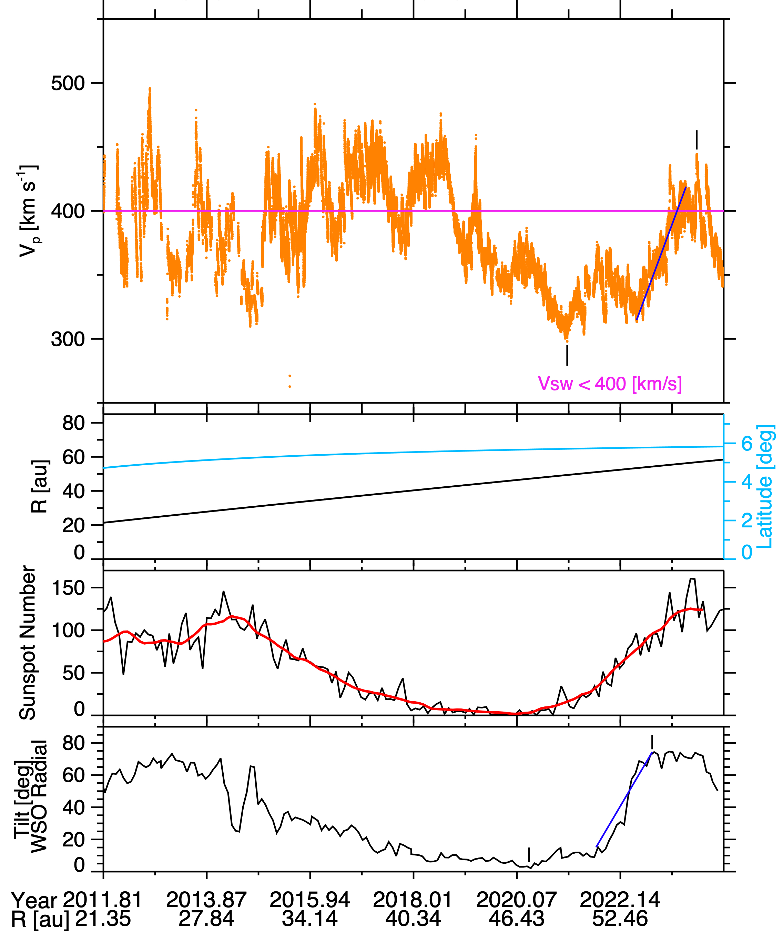
Long Interval of Slow Steady Wind At New Horizons
10/23/2011 – 03/16/2024
New Horizons
Interval of very slow wind at New Horizons from 2019 through early 2023.
Began in late 2018 at solar minimum and continued into the early rising phase of the solar cycle until late 2022.
Source of Slow Wind:
Not an indication of proximity to the termination shock.
Low current sheet tilt directed slow wind from coronal streamers towards New Horizons which was in the ecliptic.
Amount of slowing owing to the pickup of interstellar material on par with Voyager 2.
Local
Max Speed
Min 25.5% < 400 km s⁻¹
400 km s⁻¹
Speed
Recovery
Min Speed
V < 400 km s⁻¹
Max Tilt
Tilt Angle Recovery
Mini Tilt
Figure 7

Slide 7
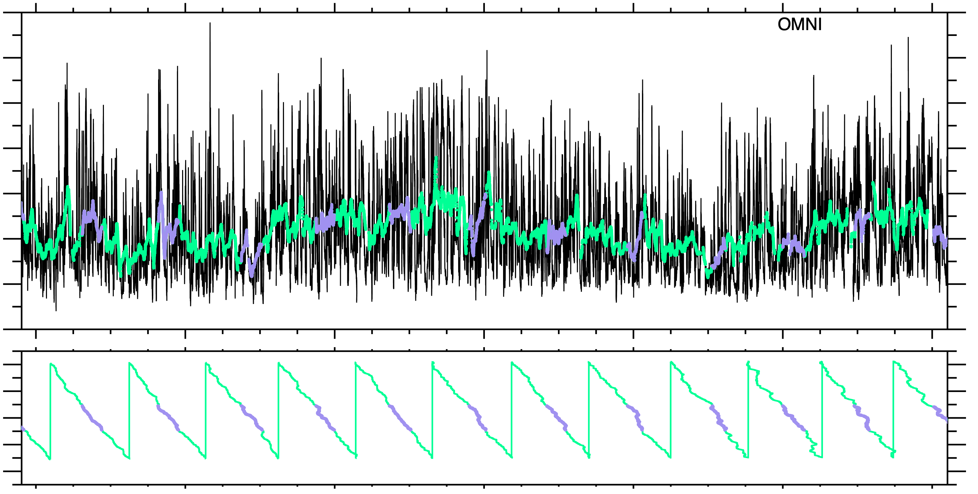

OMNI Speed Measurements at 1 au
1 hour averages black.
Green and purple are running solar rotation averages (25.38 days) where purple indicates NH & ACE are within +/- 45º.
OMNI observations at L1 near Earth (1 au) indicate the average solar wind speed decreased in 2018 and stayed low until late 2022.
From late 2022 through July of 2023 the wind speed increased.
10/23/2011 – 03/16/2024
OMNI
900
<V> > 400 km s⁻¹
<V> > 400 km s⁻¹
700
V_{p} [km s⁻¹]
500
300
400 km s⁻¹
<V> near or below 400 km s⁻¹
200
100
Δ Long [º]
0
-100
-200
2012
2014
2016
2018
2020
2022
2024
Many structures merge prior to reaching the outer heliosphere.
Figure 3

Slide 8
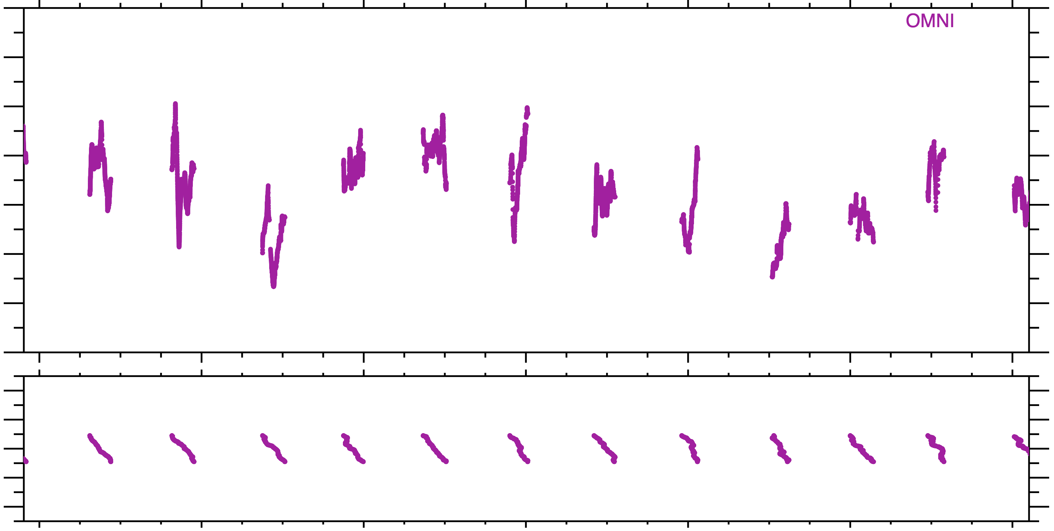
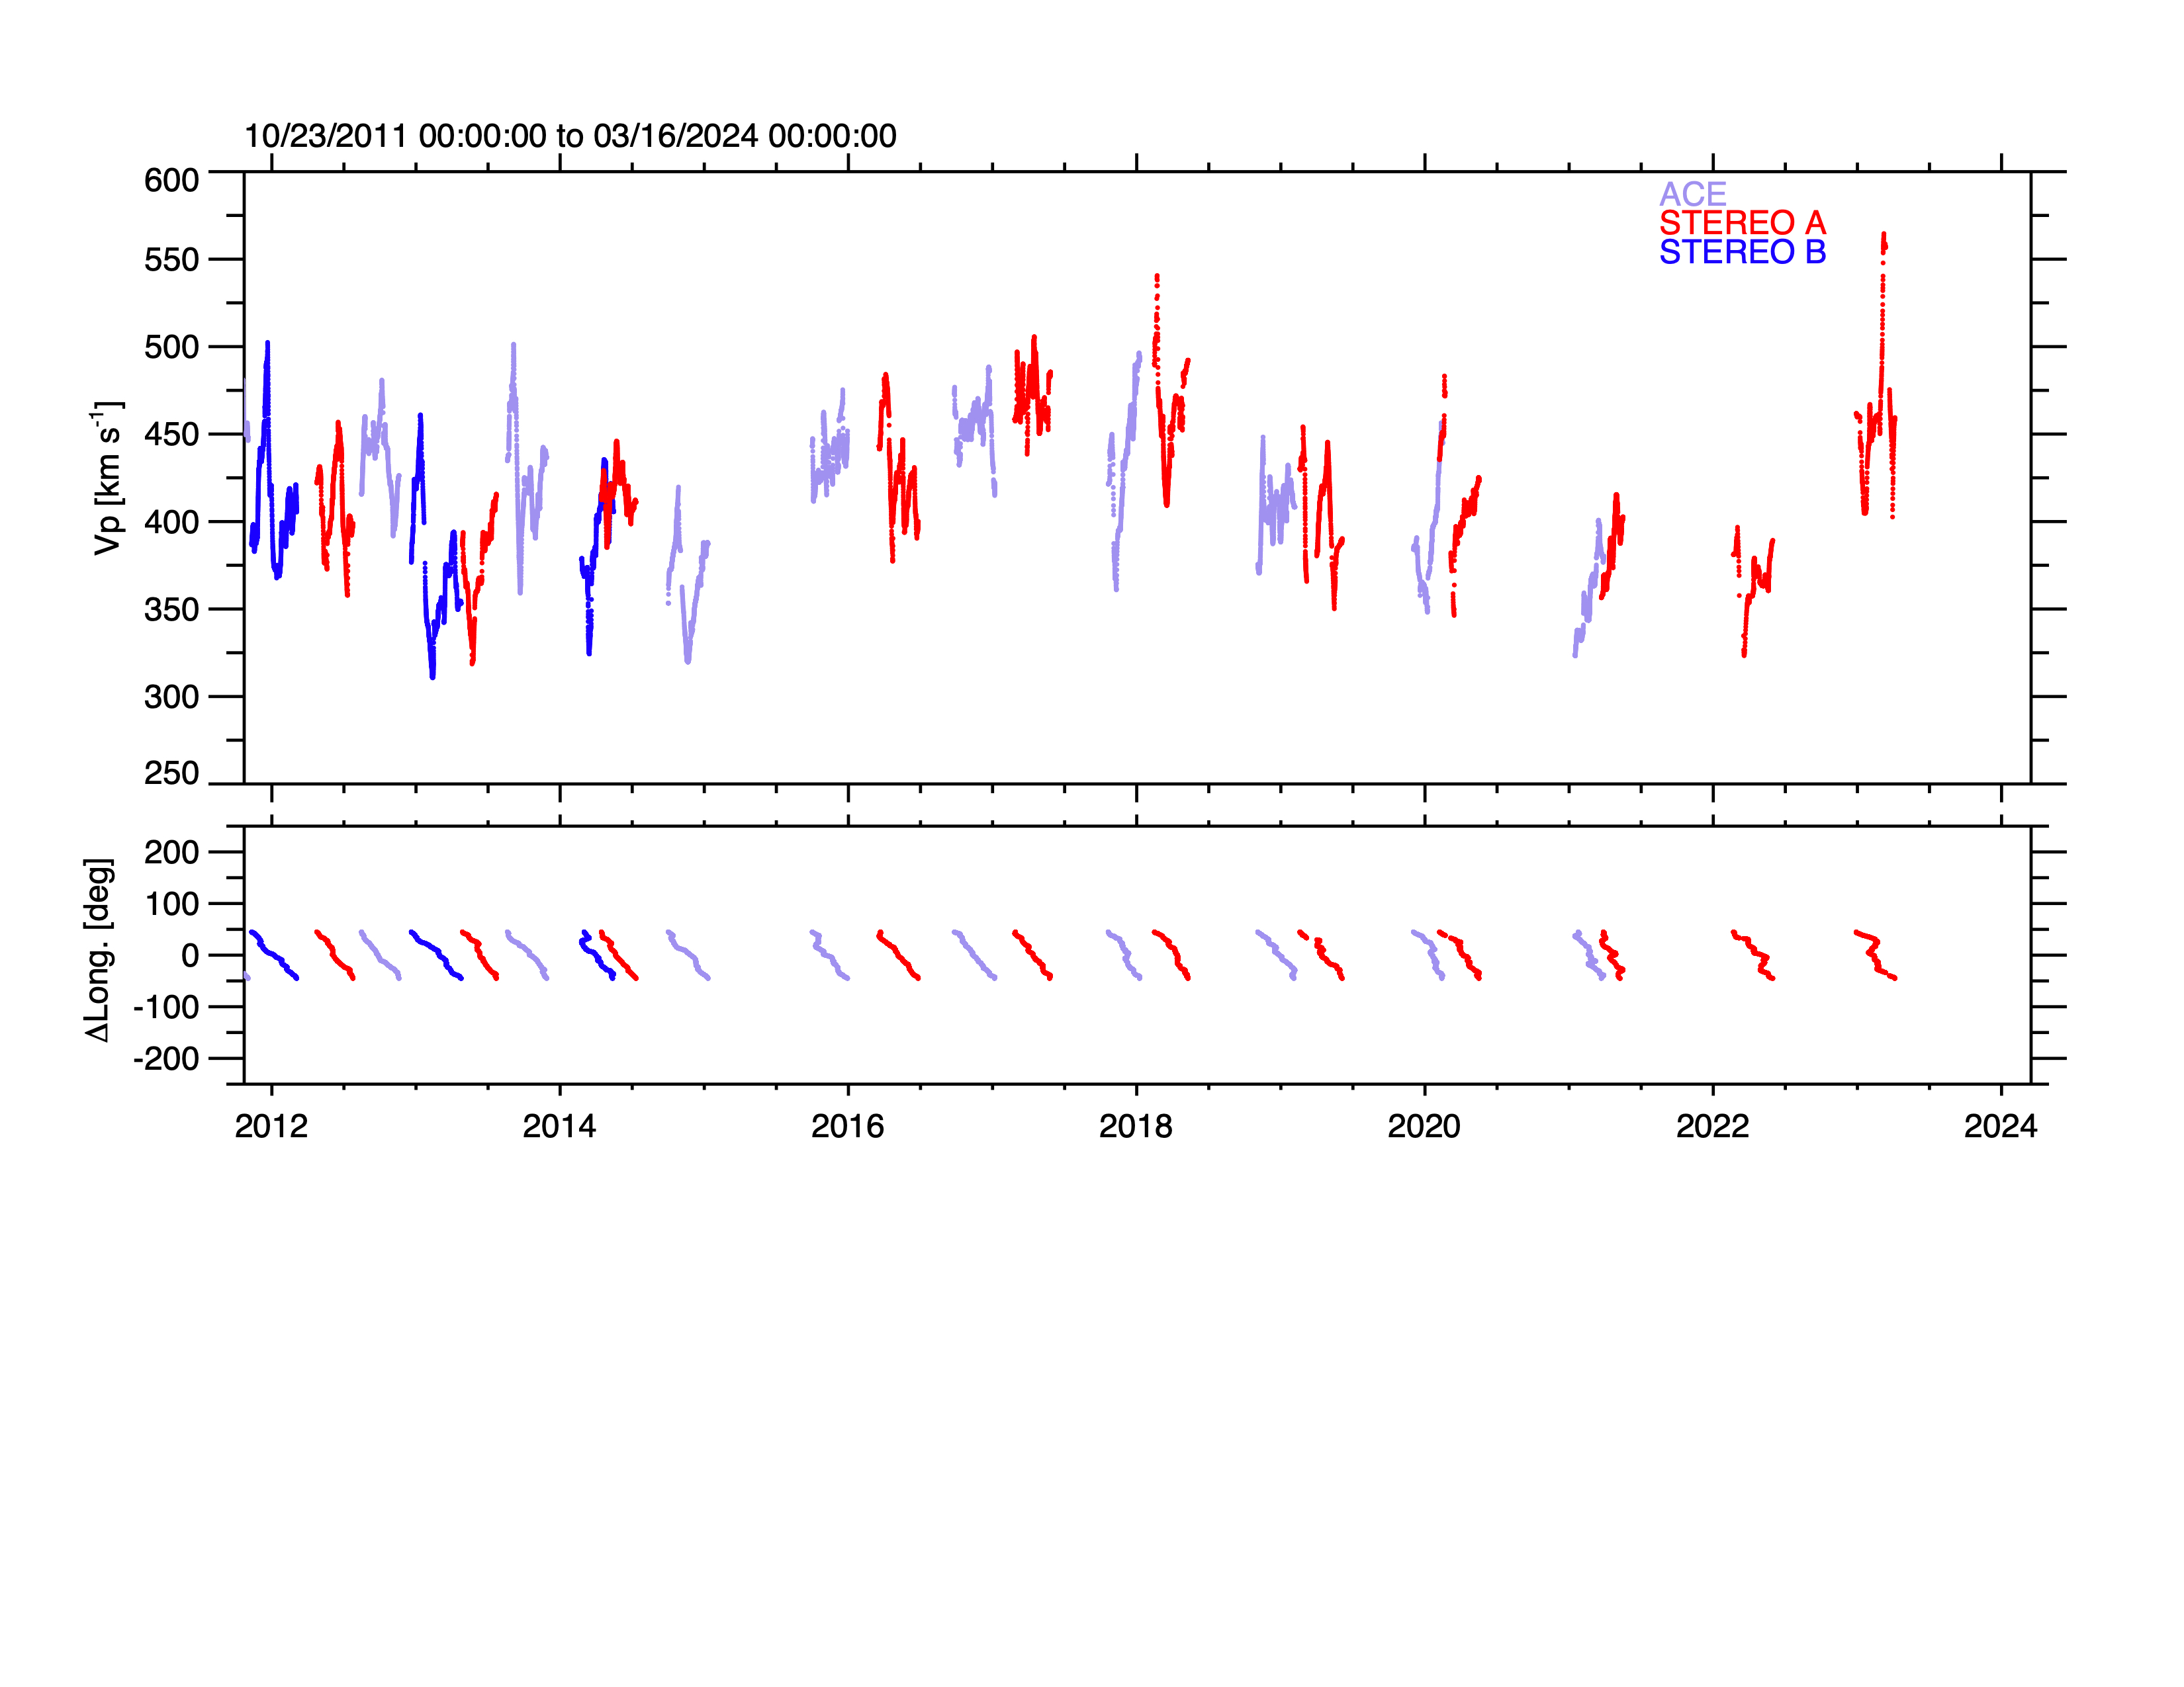
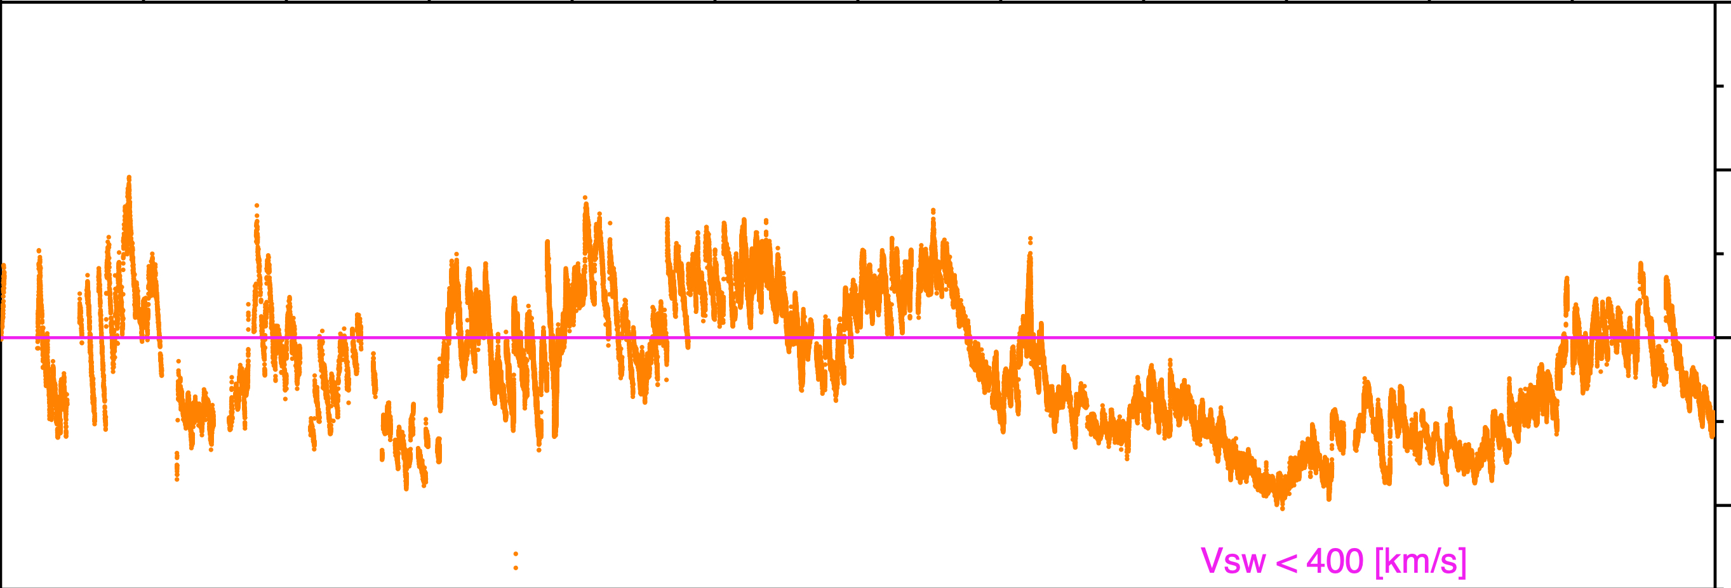
NH - 1 au Speed Comparison (NH No Averaging)
Running solar rotation averages (25.38 days) of the 1 au observations are show in purple (ACE), red (STEREO A) and blue (STEREO B).
Averaging the 1 au observations matches the New Horizons speeds fairly well without averaging (at recorded cadence) because the solar wind structures merge and are worn down as they propagate away from the Sun.
10/23/2011 – 03/16/2024
600
Averaged: ACE OMNI STEREO A STEREO B
Not Averaged: New Horizons
500
V_{p} [km s⁻¹]
400
400 km s⁻¹
300
V < 400 km s⁻¹
200
100
Δ Long [º]
0
-100
-200
2012
2014
2016
2018
2020
2022
2024
Figure 4

Slide 9
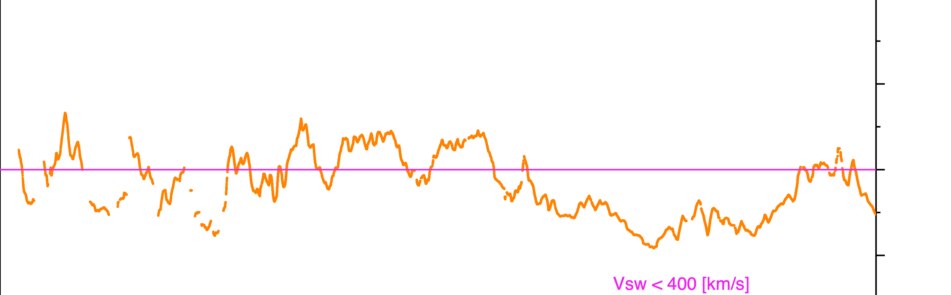
NH - 1 au Speed Comparison (NH With Averaging)
10/23/2011 – 03/16/2024
600
600
New Horizons
Averaged: ACE OMNI STEREO A STEREO B
Averaged: ACE OMNI STEREO A STEREO B New Horizons
Using the running solar rotation averages (25.38 days) on the New Horizons observations, it is clear that the solar wind at NH is consistently slower than at 1 au.
500
500
V_{p} [km s⁻¹]
V_{p} [km s⁻¹]
400
400
400 km s⁻¹
300
300
V < 400 km s⁻¹
200
200
100
100
Δ Long [º]
Δ Long [º]
0
0
-100
-100
-200
-200
2012
2014
2016
2018
2020
2022
2024
Figure 5

Slide 10
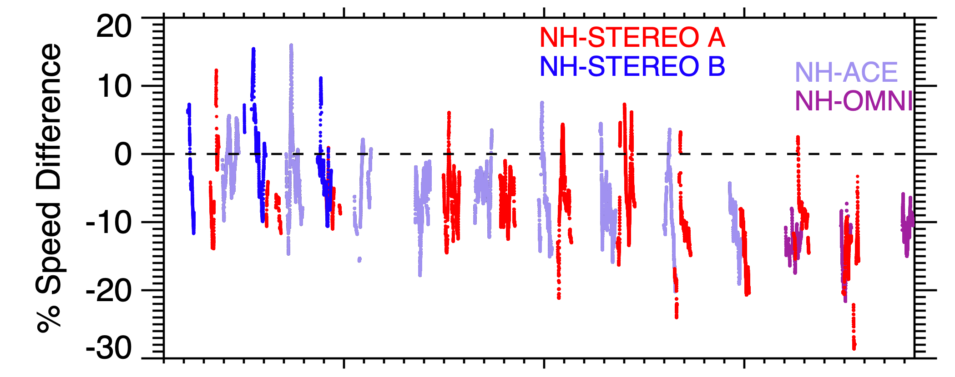
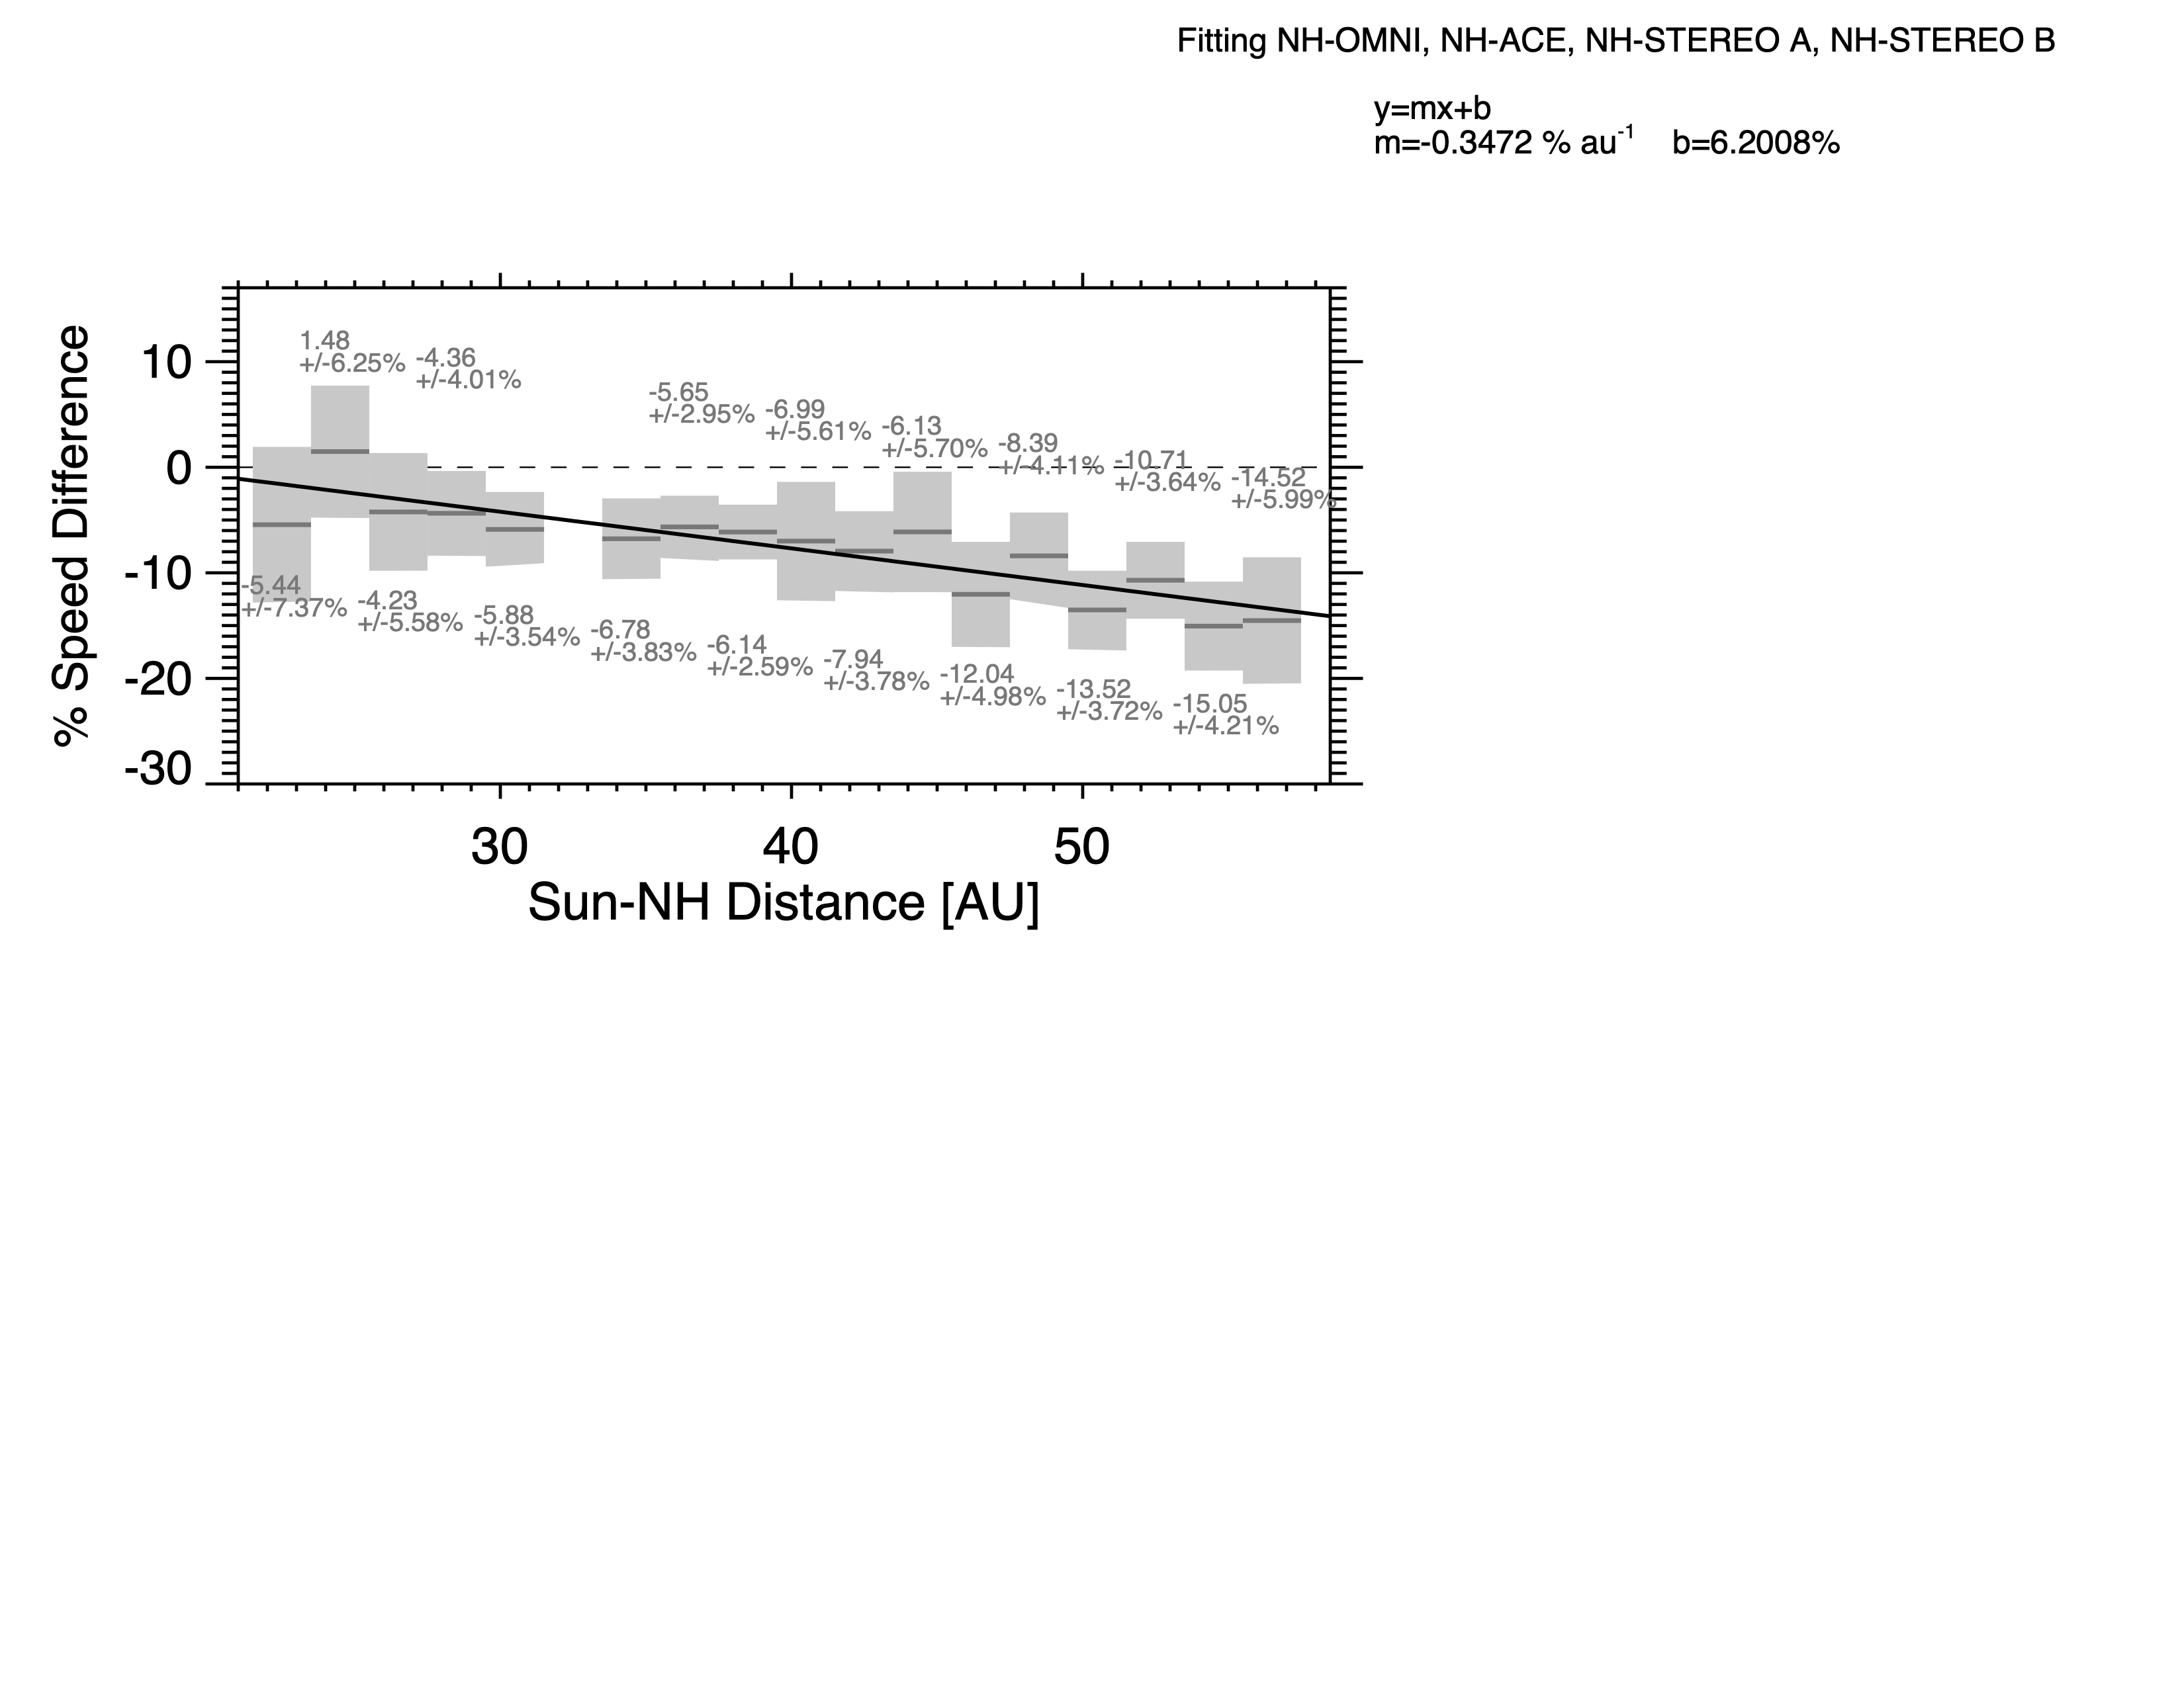
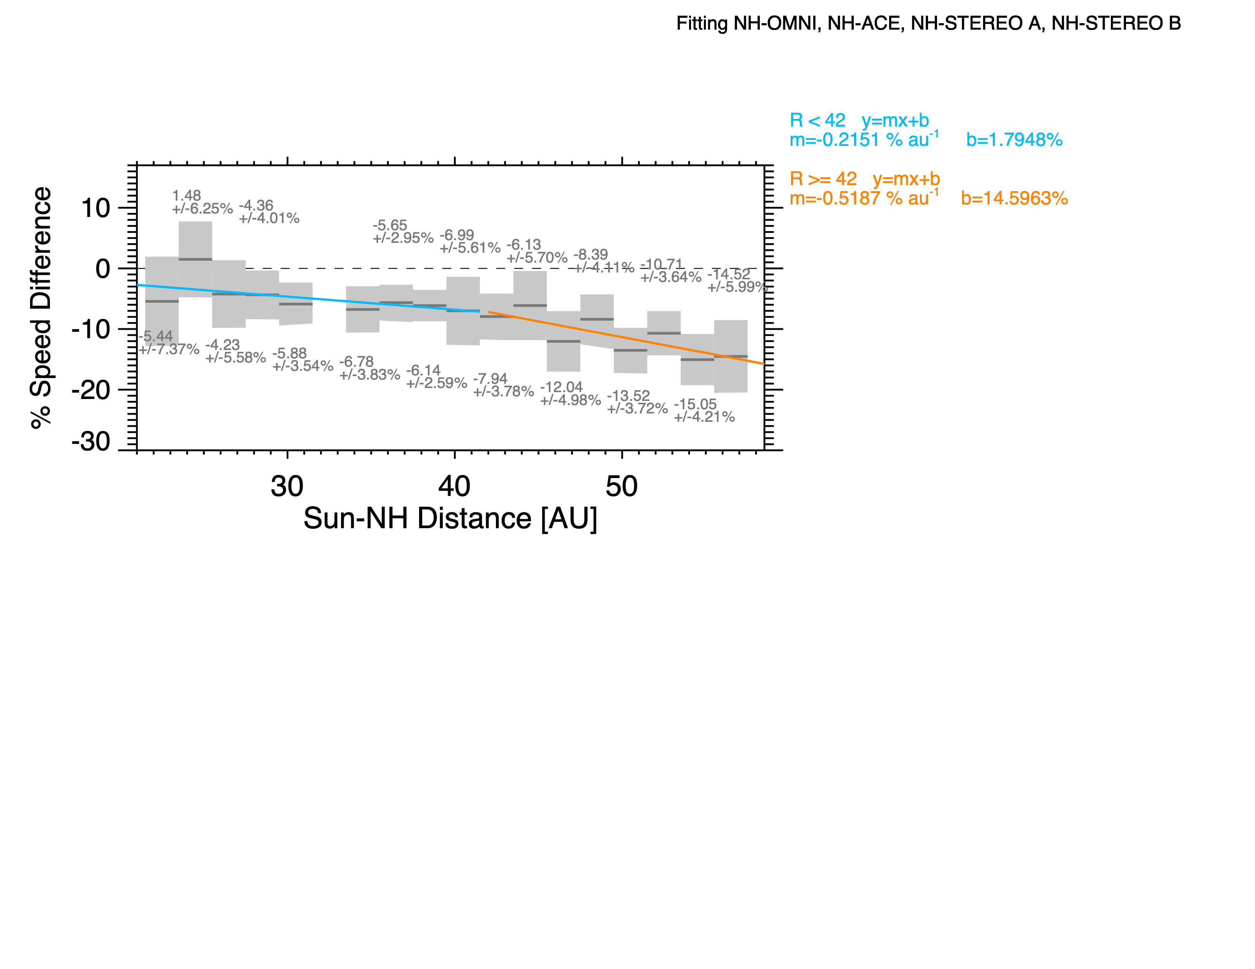
Percent Slowing Relative to 1 au
NH-STEREO A
NH-STEREO B
NH-ACE
NH-OMNI
Between 30-43 au the solar wind at NH was 5-7% slower than at 1 au (Elliott et al. 2019).
Recently, the amount of slowing has increased to be ~13 to 15% slower that at 1 au.
The amount of slowing in the solar wind owing to picking up interstellar material is gradually increasing.
Figure 6

Slide 11
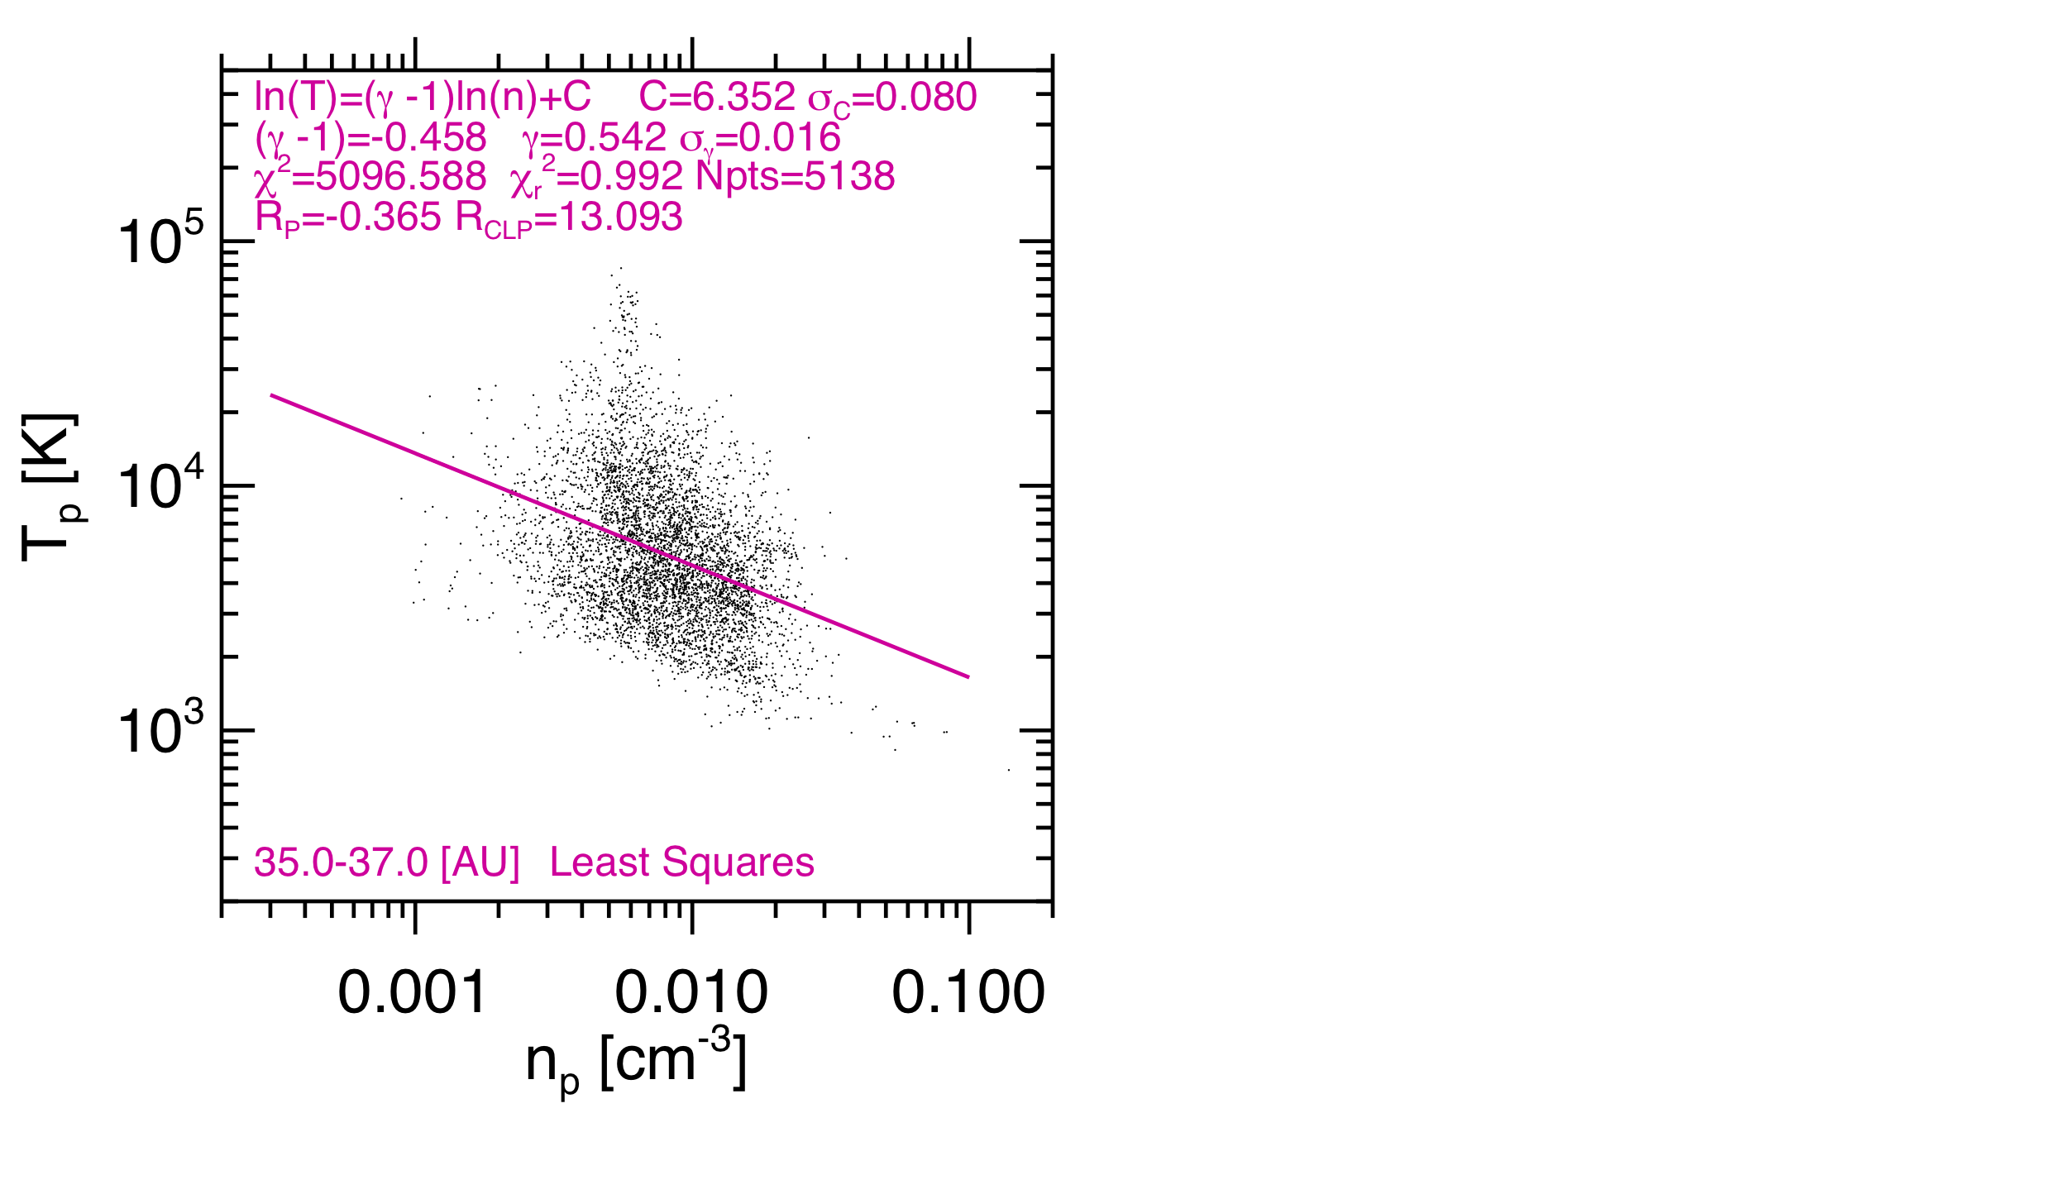
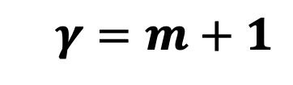
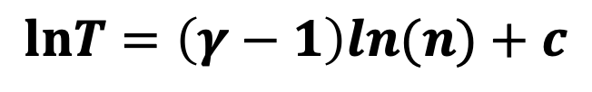

Determining the Solar Wind Index (𝜸): Method 1 & 2
Method 1
New Horizons
New Horizons
Elliott et al., 2019
Elliott et al., 2019
$$T=cn^{γ−1}$$
$$lnT=\left(γ−1\right)ln(n)+c$$
$$γ=m+1$$

Slide 12
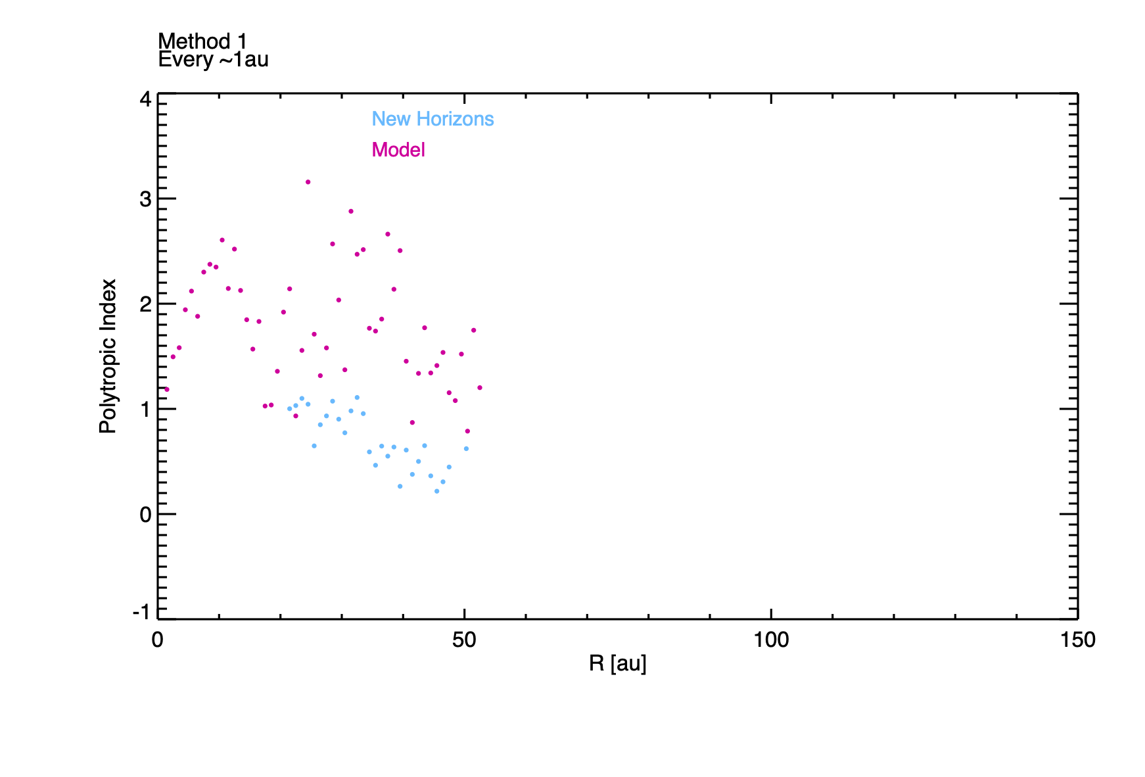
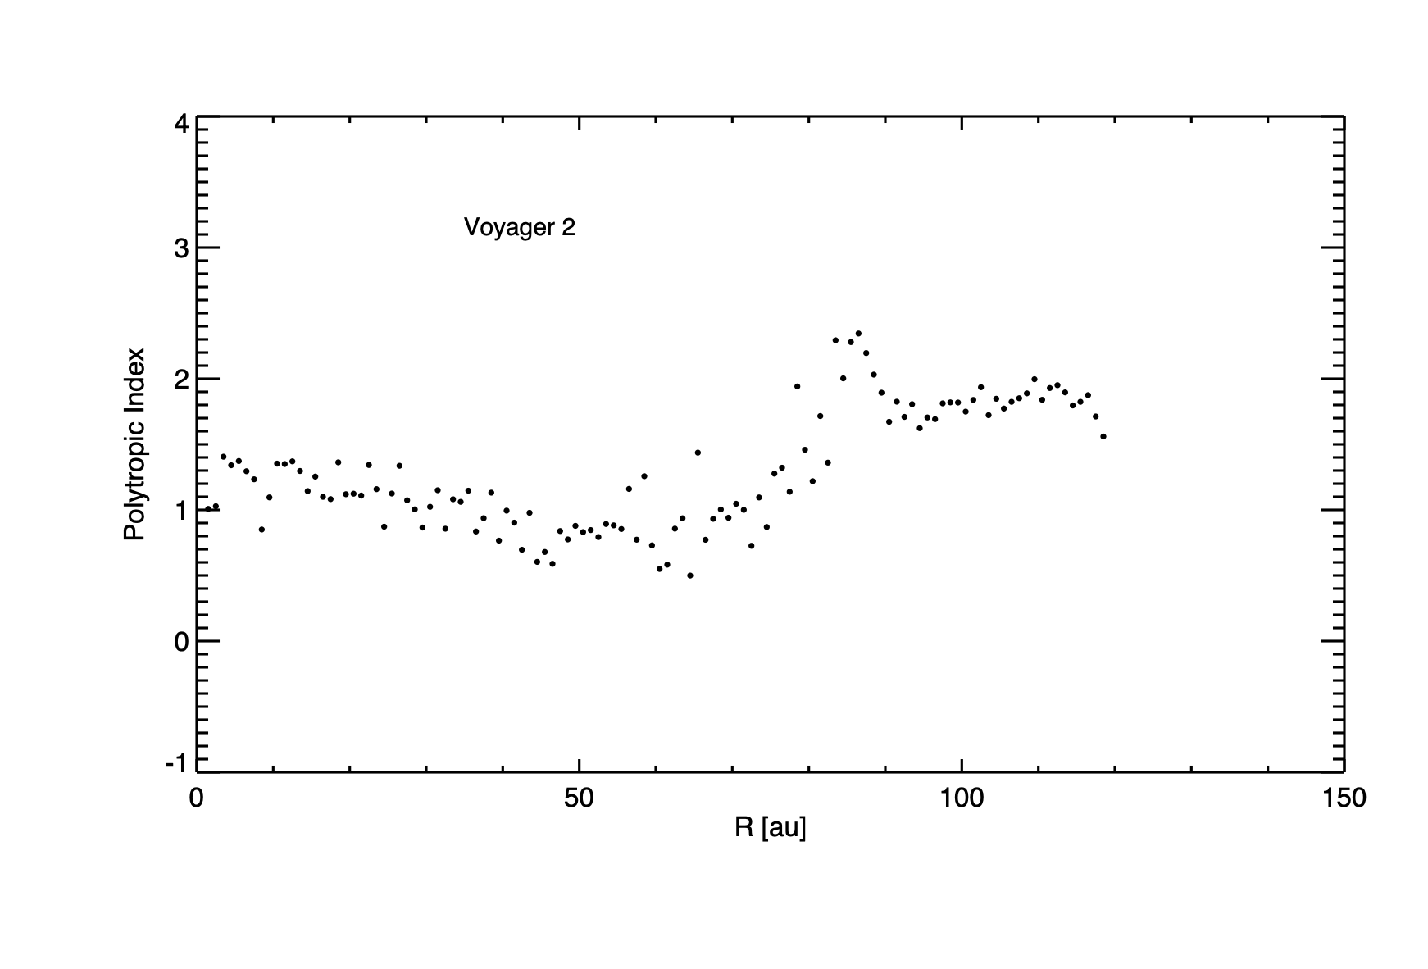
Solar Wind Polytropic Index (𝜸) Radial Profile
Termination
Shock
Voyager 2 results indicate that the index jumps up at the termination shock.
Need to add new data & assess other methods.

Slide 13
Options for Enhanced SWAP TS Particle Operations
All enhanced plans we evaluated would require significant data storage, and more DSN playbacks
We identified two options for SWAP
  Option 1: A simple low risk option
    Requiring more data volume, and DSN time
    No changes to flight software, table, or changes to commanding of the instrument.
  Option 2: A risker option
    Requiring more data volume, and DSN time than option 1
    Requiring additional work, testing, and funds to do those.
    Instrument flight software changes
    Changes to the command CAS/FRAGS
    Spacecraft flight software changes

Slide 14
SWAP Operations Planning: Option 1
Low Risk
  No flight Software or Table Changes
  No changes to commanding
Pickup Ions: Histogram daily downloads of 1 0x586 packet and 63 0x587 which provides a 29 minute cadence
Health and Safety: Summary packets (0x585) whick contain total count rate across the sweep, and housekeeping packets (0x580) at 1 per hour
Solar Wind: Adjust record rate of sets of 0x584 packets to meet data volume allocation
  Current Nominal operations
    800 Mbits per year: solar wind data (0x584) sweeps collected at 10, 20, and 30 min rates
  Increased data volume of
    1560 Mbits per year: solar wind data (0x584) sweeps collected at 2, 5, and 10 minute rates
    2160 Mbits per year: solar wind data (0x584) sweeps collected at 2, and 5 minute rates and a little bit of 1 minute rate data

Slide 15
Data Rates for Given Annual Data Volume Allocations
Nominal (800Mbits) |  |  |  |  |  | Target (1560 Mbits) |  |  |  |  |  | Target (2160 Mbits)
Option 1 |  |  | Option 2 |  |  | Option 1 |  |  | Option 2 |  |  | Option 1 |  |  | Option 2
Mode | Days | Mbits | Mode | Days | Mbits | Mode | Days | Mbits | Mode | Days | Mbits | Mode | Days | Mbits | Mode | Days | Mbits
10 min | 250 | 637 | 10 min | 283 | 721 | 5 min | 260 | 1291 | 2min | 40 | 489 | 2 min | 48 | 587 | 64 sec | 5 | 61
20 min | 115 | 161 | 30 min | 82 | 79 | 10 min | 105 | 267 | 5min | 100 | 497 | 5 min | 317 | 1574 | 5min | 122 | 1492
Total:798 |  |  | Total:799 |  |  | Total: 1558 |  |  | 10min | 225 | 573 | Total: 2161 |  |  | 10min | 238 | 606
Total:798 | 2161 | 2161 | Total:799 |  |  | Total: 1558 |  |  | Total: 1559 |  |  | Total: 2161 | 2161 | 2161 | Total: 2159
The only packet rate varied in the assessments above is the 0x584 used for solar wind processing.
For comparison, if we record all sweeps (64 sec rate for 0x584) for 1 year that would be ~8850 Mbits =8.85 Gbits
Rates for Other Packets:
0x585 summary 1 per hour
Set of 0x586 and 0x587 packets 1 per day containing 29 minute resolution histogram data used for pickup ion processing.
  Fastest rate possible for histograms
0x580 housekeeping 1 per hour
DV_Calcs Termination Planning.xlsx

Slide 16
SWAP Operations Planning (Option 2)
Higher Risk
  Instrument and Spacecraft Flight Software Changes, Instrument Commanding Changes
Additional Data Volume and DSN downlink compared to Option 1.
Pickup Ions: Histogram daily downloads of 1 0x586 packet and 63 0x587 which provides a 29 minute cadence
Health and Safety: Summary packets (0x585) whick contain total count rate across the sweep, and housekeeping packets (0x580) at 1 per hour
Solar Wind:
  Record SWAP solar wind data at highest possible rate 1 min (64 sec) rate and store in a different packet and data type so it could be downlinked once the TS crossing is downloaded.
    8850 Mbits per year: for with SWAP at 1 minute (64 sec rate)
  Simultaneously record SWAP solar wind data at a lower rate survey rate to be used to look for the TS crossing to decided what portion of 1 minute data to downlink.

Slide 17
Summary
An increase in the rate of slowing can be a supporting indicator that NH is close to the Termination Shock.
Based on Voyager 2 data an increase in the solar wind polytropic index for the temperature- density relationship is an indication that NH is near the Termination Shock.
To enhance the SWAP observations for the Termination shock crossing will require additional storage space and DSN downlink.

Slide 18
Backup

Slide 19
Scenario 1: Increased Data Volume Allocation
Low risk option; No flight software changes.
Increase the data volume and downlink allocation for particle instruments.
Choose intervals and data collection rates for SWAP 0x584 that stay within an increased evaluation. Keep other packets at current rates
Action: Run rate scenarios for the data volumes Helen sent on March 7, 2024
  Scenarios
  In 2025: 180 Mbits/month, ~2160 Mbits/year for SWAP, and the same for PEPSSI.
  In 2028: 130 Mbits/month, ~1560 Mbits/year for PEPSSI, and the same for SWAP.
  Current Nominal
  800 Mbits per year
This scenario 1 (would not require any changes to SWAP FSW; would only require changes to ground systems (planning, modeling, command sequence tools, etc) to set the higher rate

Slide 20
Data Rates for Given Annual Data Volume Allocations
Nominal (800Mbits) |  |  |  |  |  | Target (1560 Mbits) |  |  |  |  |  | Target (2160 Mbits)
Option 1 |  |  | Option 2 |  |  | Option 1 |  |  | Option 2 |  |  | Option 1 |  |  | Option 2
Mode | Days | Mbits | Mode | Days | Mbits | Mode | Days | Mbits | Mode | Days | Mbits | Mode | Days | Mbits | Mode | Days | Mbits
10 min | 250 | 637 | 10 min | 283 | 721 | 5 min | 260 | 1291 | 2min | 40 | 489 | 2 min | 48 | 587 | 64 sec | 5 | 61
20 min | 115 | 161 | 30 min | 82 | 79 | 10 min | 105 | 267 | 5min | 100 | 497 | 5 min | 317 | 1574 | 5min | 122 | 1492
Total:798 |  |  | Total:799 |  |  | Total: 1558 |  |  | 10min | 225 | 573 | Total: 2161 |  |  | 10min | 238 | 606
Total:798 | 2161 | 2161 | Total:799 |  |  | Total: 1558 |  |  | Total: 1559 |  |  | Total: 2161 | 2161 | 2161 | Total: 2159
The only packet rate varied in the assessments above is the 0x584 used for solar wind processing.
For comparison, if we record all sweeps (64 sec rate for 0x584) for 1 year that would be ~8850 Mbits =8.85 Gbits
Rates for Other Packets:
0x585 summary 1 per hour
Set of 0x586 and 0x587 packets 1 per day containing 29 minute resolution histogram data used for pickup ion processing.
  Fastest rate possible for histograms
0x580 housekeeping 1 per hour
DV_Calcs Termination Planning.xlsx

Slide 21
Scenario 2: Store solar wind count rate distributions in two packet types (Highest rate and Nominal Rate)
Higher risk option; Requires flight software changes.
Record SWAP solar wind data which are coarse-fine energy count rate distributions (sweeps) every 64 sec our highest rate 0x584, and the normal solar wind rates for 0x584 Coarse-Fine Sweeps.
This would mean creating a new SWAP packet type that would store the additional high rate data and in addition to our normal solar wind distributions stored in the 0x584 packets
To playback the high rate data near the Termination Shock separately from the normal solar wind data the spacecraft would have to store our solar wind distributions (coarse-fine sweeps) in two separate datatypes.

Slide 22
Implementation for Scenario 2 (1/3)
Ground system updates:
Create telemetry spreadsheet for new packet - integrate into MOC, SOC, and any other ground systems that use these spreadsheets
Or adjust code to reuse either 0x586 (1st histogram packet) or 0x585 (summary)
Update command spreadsheet with new command to control packet rate for new packet - integrate into MOC, SOC, planning tools, etc
Update CAS/FRAGs to include new rate command
Update planning, modeling, seqgen, etc tools for new commanding and packet
Update SwRI GSEOS instance for new command and packet

Slide 23
Implementation for Scenario 2 (2/3)
If we use an existing SWAP packet we still would need to change the spacecraft software to assign a new Data Type to play that data separately.
Packets that Could be Reallocated:
The SWAP 0x585 packet called the summary packet.
Primarily during Pluto and KBO daily for health and safety
  Total counts across the entire sweep.
  Come down during the realtime DSN contacts.
  Recorded rate 1 per hour.
The SWAP Histogram data has one 0x586 packet followed by 63 0x587 packets.
  Recorded 1 set of 64 packets per day
  0x586 holds meta data and some count rate data
  We can shift what is in 0x586 to 0x587 so that the first of those packets has the extra meta data.
  We would need to update the ground processing code to using only 0x587 for histograms
When not doing flybys, we typically use 0x584 SWAP packets used for solar wind science and STAT_A 004 spacecraft packets for health and safety.
  STAT_A 004 packets contain some SWAP count rate data, but come from random energy steps and no voltage information needed to identify the energy step.

Slide 24
Implementation for Scenario 2 (3/3)
Spacecraft updates
Add a 3rd Data Type (DT) for SWAP; route new packet to new DT; provide capability to downlink new DT (not sure whether this is an S/C software change, or just table updates)
Or reuse a current data type 0x586 (1st histogram packet) or 0x585 (summary packet)
SWAP FSW updates:
Implement new rate command (near clone of existing RTSCI rate command)
Implement new packet (clone of existing RTSCI packet, only ApID would change)
Implement test cases for new command/telemetry packet
Execute acceptance test, do release documentation
Planning and support for upload to SWAP

Slide 25
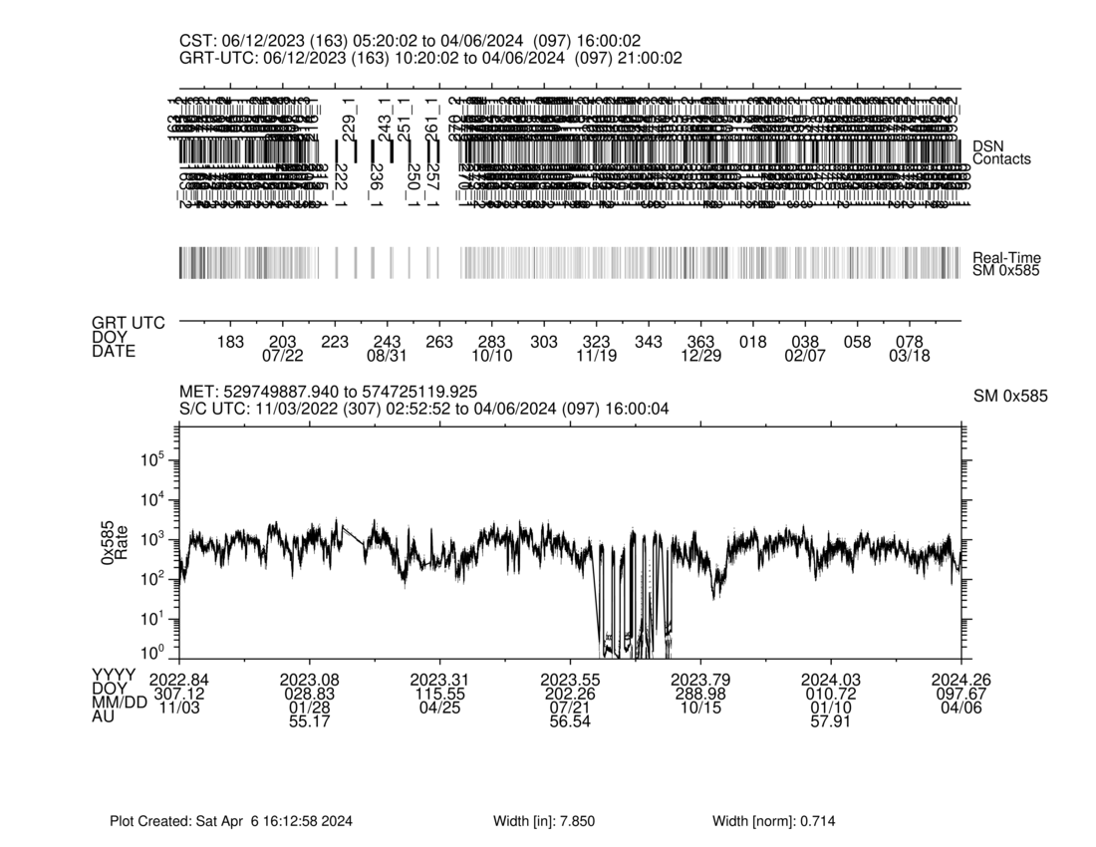
Health and Safety With 0x585 Packets

Slide 26
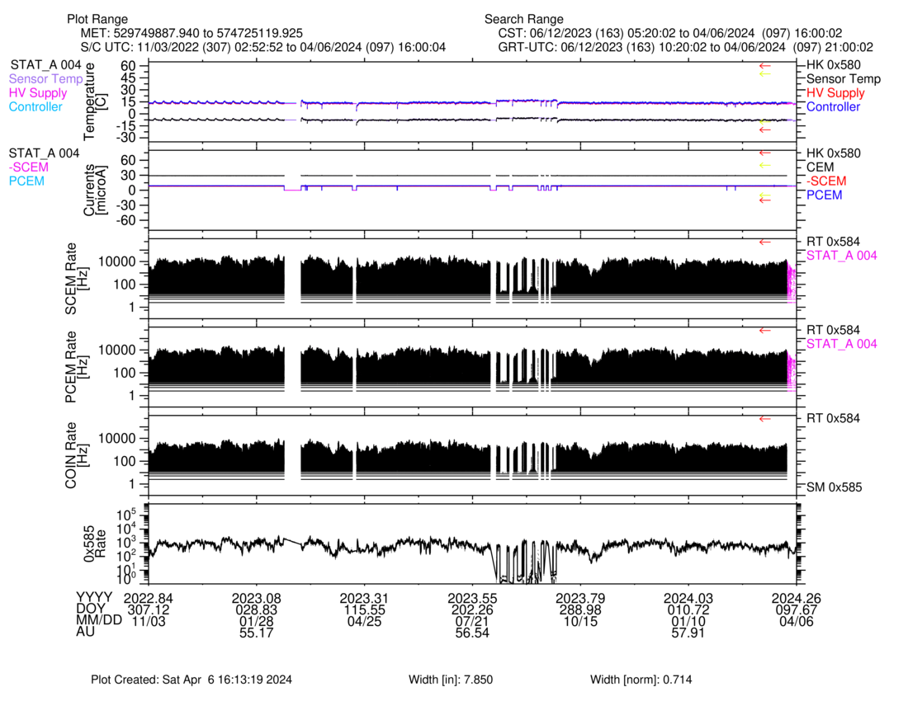
Health and Safety With Spacecraft (STAT_A 004) and Solar Wind Data (0x584)

Slide 27
Prior Older Slides
Containing some background information on how SWAP operates

Slide 28
SWAP Packets
0x584 (realtime)– hold counts taken at different energy steps, and this product is used to create solar wind data products.
  Each 0x584 packet holds count rates for 2 energy sweeps
  A full set of 64 0x584 packets contains data for a pair of energy sweeps.
  A pair of energy sweeps is typically a coarse sweep followed by a fine energy sweep centered on the peak in the coarse sweep.
  Both the coarse and fine sweeps have 64 energy steps, and combined have 128 energy steps collected over 64 seconds corresponding to 2 energy steps every second.
  The accumulation time for each count rate measurement is 390msec. This leaves a 110msec settling time gap between energy steps.
  We set how often record this sweep. We record every nth sweep pair.
    The SWAP “10min” mode records every 10th a coarse-fine sweep pair where 1 SWAP minute is 64 seconds such that one coarse-fine sweep spanning 64 seconds is collected every 640 seconds.
0x586/7 (histogram) – contains on board sums of the coarse scan count rates and the number of entries to determine the average coarse scan distribution. These are used to create pickup ion data products.
  A complete set is 1 0x586 packet and 64 0x587 packets.
  One packet holds many coarse energy scan count rate distributions.
  One set is stored once a day and used to produce 29 minute resolution pickup ion data measurements.
0x585 (summary) – contains information that characterize a sweeps such as the total counts in a sweep pair. This is used for health and safety. Typically we collect this once per hour.
0x580 (housekeeping) – contains instrument modes, states, and monitor values. Typically we collect this once per hour.

Slide 29
Standard SWAP Operations
0x585 (Summary; Health and Safety) once per hour
0x580 (Housekeeping; Health and Safety) once per hour
0x586/7 (Histogram; Pickup Ions) set once per SWAP day producing cadence of ~29 minutes
0x584 (Realtime; Solar Wind) set of coarse and fine sweep count rate energy distributions is recorded every n SWAP minutes where 1 SWAP minute is equal to 64 seconds.
  Adjusted according to our data volume allocation.
Daily Data Volume Depends on 0X584 cadence, which is chosen to fit within the SWAP data allocation.
SWAP 0x584 Collection Cadence | Time Between Sets of 0x584 [sec] | 0x584 Daily Data Volume [Mbits] | Daily Data Vol. 0x585 & 0x580 1 per hr 0x586/7 1 set per day (29 min ave) [Mbits] | Total Daily Data Volume [Mbits] | Total Data Volume For 365 days [Gbits]
64 sec | 64 | 24.19 | 0.135 | 24.33 | 8.88
2 min | 128 | 12.10 | 0.135 | 12.23 | 4.46
5 min | 320 | 4.84 | 0.135 | 4.97 | 1.82
10 min | 640 | 2.42 | 0.135 | 2.55 | 0.93
20 min | 1216 | 1.27 | 0.135 | 1.41 | 0.51
30 min | 1856 | 0.83 | 0.135 | 0.97 | 0.35
1 hour | 3649 | 0.42 | 0.135 | 0.56 | 0.20

Slide 30
Highest Rate Option
0x585 (Summary; Health and Safety) once per hour
0x589 (Housekeeping; Health and Safety) once per hour
0x586/7 (Histogram; Pickup Ions) set once per SWAP day producing cadence of ~29 minutes
0x584 (Realtime; Solar Wind) set of coarse and fine sweep count rate energy distributions is recorded every 64 seconds.
Total Data Volume Per Day ~24.33Mbits
Total Data Volume For 365 days ~8.88 Gbits

Slide 31
Options For Increased SWAP data at the Termination Shock (TS)
Give SWAP more data volume allocation so they can increase the data collection rates.
  Requires more space on the recorder for the additional data
  Requires additional downlink capability to playback the additional data.
Take SWAP solar wind data (0x584) at full rates (coarse-fine scan pair every 64 seconds store in a set of 64 packets )
  Would need a way to play back every n_{th} set of packets
  Problem this would take too many playback commands using our current method of commanding playbacks.
If we want to do special operations near the TS, we would then need to accurately forecast the TS location at least about 2 years ahead of time to do the load build planning since in hibernation we are doing 1 load build a year.

Slide 33
Solar Wind in the
Outer Heliosphere
H. A. Elliott (helliott@swri.edu), J. D. Richardson, T. K. Kim,
M. A. Dayeh, J. M. Sokół, P. C. Brandt, M. Opher,
D. J. McComas, M. E. Hill, P. Kollmann, F. Bagenal, A. Poppe,
S. A. Stern, R. McNutt, K. N. Singer, G. R. Gladstone, T. M. Becker
AIAC March 2024 Turin, Italy

Slide 34
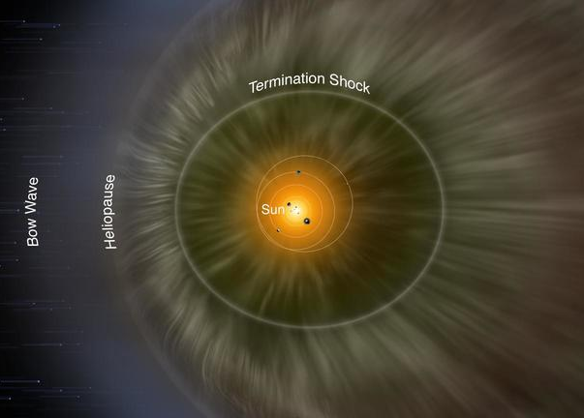
The Heliosphere
Inner heliosphere (r < 20 au) essentially filters & buffers the solar wind.
  Different speed structures interact & merge.
  Outer heliospheric solar wind is more steady.
Scale sizes increase & the amplitude of structures & episodic CMEs decrease in the outer heliosphere.
Beyond ~10 au the pickup ion thermal pressure is on par with solar wind thermal pressure.
Gradual Slowing & Heating
Filter
Modified Credit NASA/Adler Planetarium
Outer heliospheric solar wind is gradually slowed & heated out to the termination shock.

Slide 35
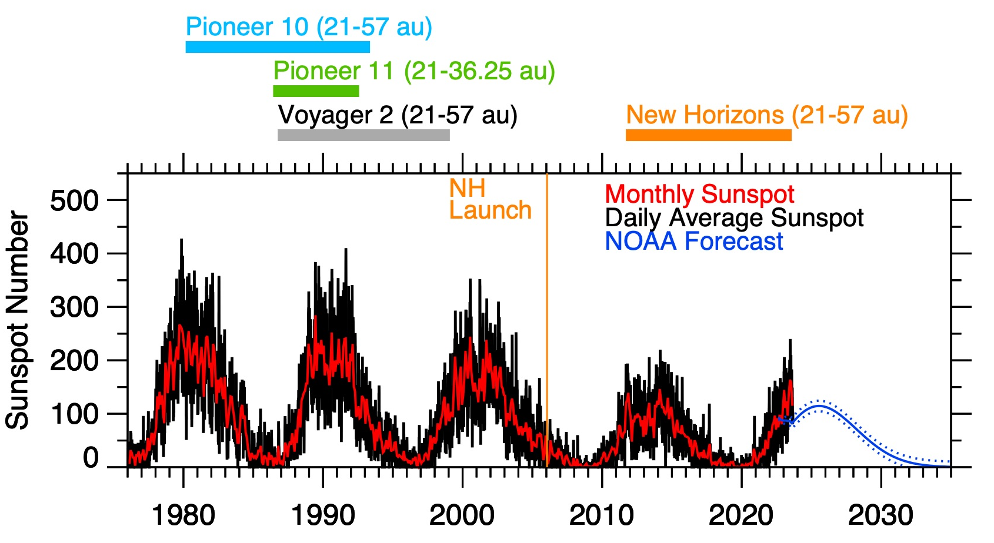
Outer Heliospheric Measurements & Solar Cycle
Pioneers 10 & 11 and Voyager 2 experienced a more active solar cycle.
New Horizons observations collected during a weak solar cycle.
New Horizons moves along same longitude as Voyager 2, but stays in the ecliptic headed towards the ENA ribbon.
Elliott et al. 2016

Slide 36
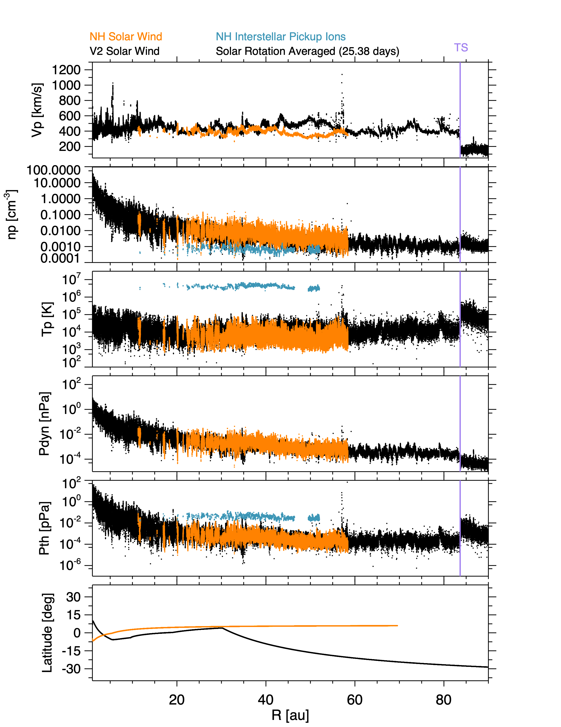
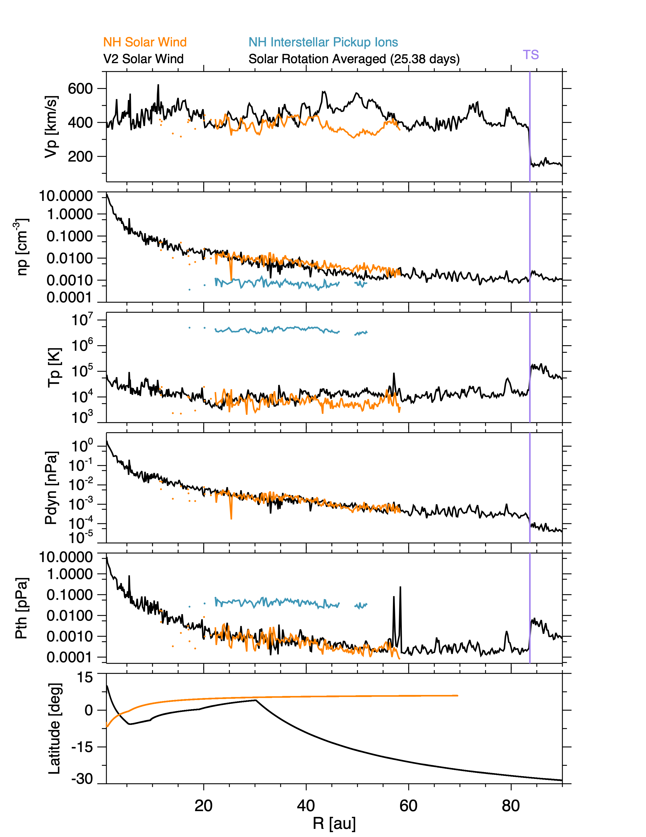
Radial Profiles of Solar Wind Plasma Properties
1200
NH Interstellar PUI
NH Solar Wind
TS
600
Solar Rotation Averaged (25.38 Days)
TS
1000
Vp [kms⁻¹]
Vp [kms⁻¹]
V2 Solar Wind
800
400
600
V2 Solar Wind
Slower, more dense & cooler wind in ecliptic at solar minimum.
400
200
200
NH Interstellar PUI
NH Solar Wind
100
np [cm⁻³]
np [cm⁻³]
1
1
0.01
0.01
0.0001
0.0001
7
7
6
6
5
Log₁₀(Tp) [K]
Log₁₀(Tp) [K]
5
4
4
3
2
3
30
15
15
New Horizons
0
New Horizons
Lat [deg]
Lat [deg]
0
Adapted from
Richardson et al. 2022
-15
Voyager 2
-15
Voyager 2
-30
-30
20
40
R [au]
60
80
20
40
R [au]
60
80
Outer heliospheric temperature is well above adiabatic & density expands at nearly the R⁻² spherical rate.
Between 41& 57 au NH observed slow steady wind and V2 was at higher latitudes observing faster wind.

Slide 37
Radial Profiles for Voyager 2 and New Horizons
Voyager 2
Solar Rotation Bins (25.38 Days)
1200
Low Variability
Beyond 20 au
TS
1200
Low Variability
Beyond 20 au
Vp [kms⁻¹]
1000
1000
Vp [kms⁻¹]
800
800
600
600
400
400
200
100
100
np [cm⁻³]
np [cm⁻³]
1
0.01
0.01
0.0001
0.0001
7
6
Log₁₀(Tp) [K]
Log₁₀(Tp) [K]
5
4
3
2
40
40
20
20
Lat [deg]
Lat [deg]
0
0
New Horizons
-20
Voyager 2
-20
-40
-40
20
40
R [au]
60
80
20
40
R [au]
60
80
Beyond 20 the variability of the solar wind has decreased significantly such that individual structures at 1 au are not readily apparent and have merged and worn down.

Slide 38
Solar Wind Pressure Profiles
Termination Shock
2
NH Interstellar PUI
NH Solar Wind
TS
0
NH Interstellar PUI
NH Solar Wind
TS
0
-1
Log₁₀(Pdyn) [pPa]
V2 Solar Wind
Log₁₀(Pdyn) [pPa]
V2 Solar Wind
-2
-2
-3
-4
-4
2
-5
1
0
0
-2
-1
-4
-2
Log₁₀(Pth) [pPa]
Log₁₀(Pth) [pPa]
-3
-6
-4
30
15
15
New Horizons
0
New Horizons
Lat [deg]
Lat [deg]
0
-15
Voyager 2
-15
Voyager 2
-30
-30
20
40
R [au]
60
80
20
40
R [au]
60
80
The decreasing spherically expanding density profile is apparent in the pressure profiles.
The average pressure profiles for Voyager 2 & New Horizons are similar despite differences in activity level and solar wind type.

Slide 39
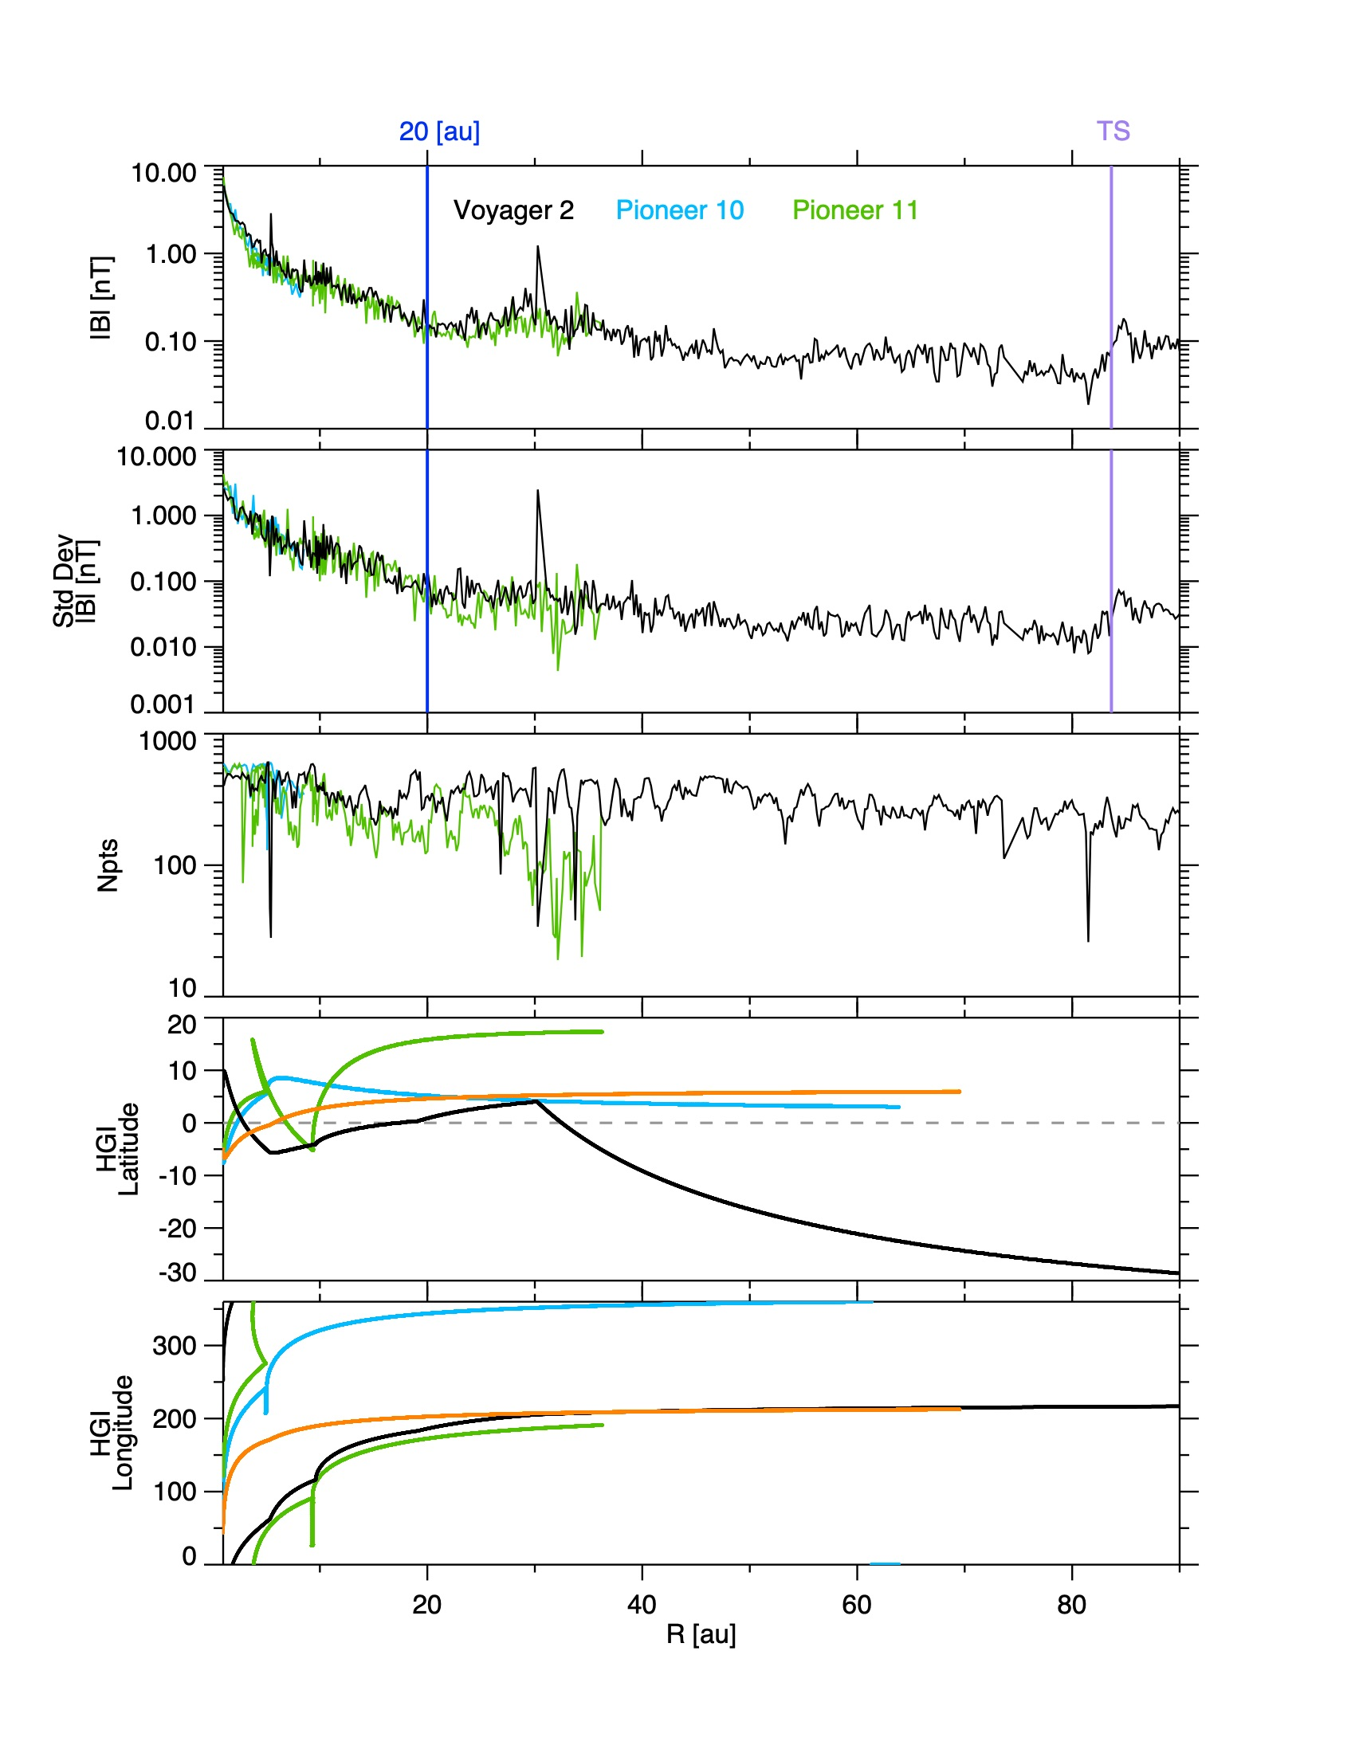
Interplanetary Magnetic Field Radial Profile
10
Low Variability Beyond 20 au
Pioneer 10
TS
The field strength and the field variability decrease with increasing distance.
The variability of the field strength decreases rapidly inside of 20 au.
Then field strength variability decreases less rapidly to ~50 au where it levels off until reaching the termination shock
1
Pioneer 11
|B| [nT]
Voyager 2
0.1
0.01
10
Std Dev |B| [nT]
1
0.1
0.01
0.001
20
10
Pioneer 11
0
Pioneer 10
Lat [deg]
-10
-20
Voyager 2
-30
20
40
R [au]
60
80

Slide 40
Increasing Interstellar H+ Pickup Ions Importance
PUI Density
New Horizons
The proton interstellar PUI density gradually decreases with distance, but the fraction relative to the total increases with distance.
The interstellar PUI thermal temperature increases with distance.
The interstellar PUI thermal pressure decreases slightly with distance, but the fraction relative to the solar wind dynamic pressure increases.
Ratio PUI to Total Density
PUI Thermal Temperature
PUI Thermal Pressure
Ratio PUI Thermal to SW Dynamic Pressure
McComas et al., 2021

Slide 41
Zoom of Voyager 2 Termination Shock Crossing
Voyager 2
TS
Slow decrease in speed on approach to Termination Shock (TS).
Sharp drop in speed at the TS.
Density and temperature elevated at beyond the TS.
V [km/s]
Speed decrease prior to TS
n [cm⁻³]
T [K]
|B| [nT]
DOY of 2007
Richardson & Stone 2009

Slide 42
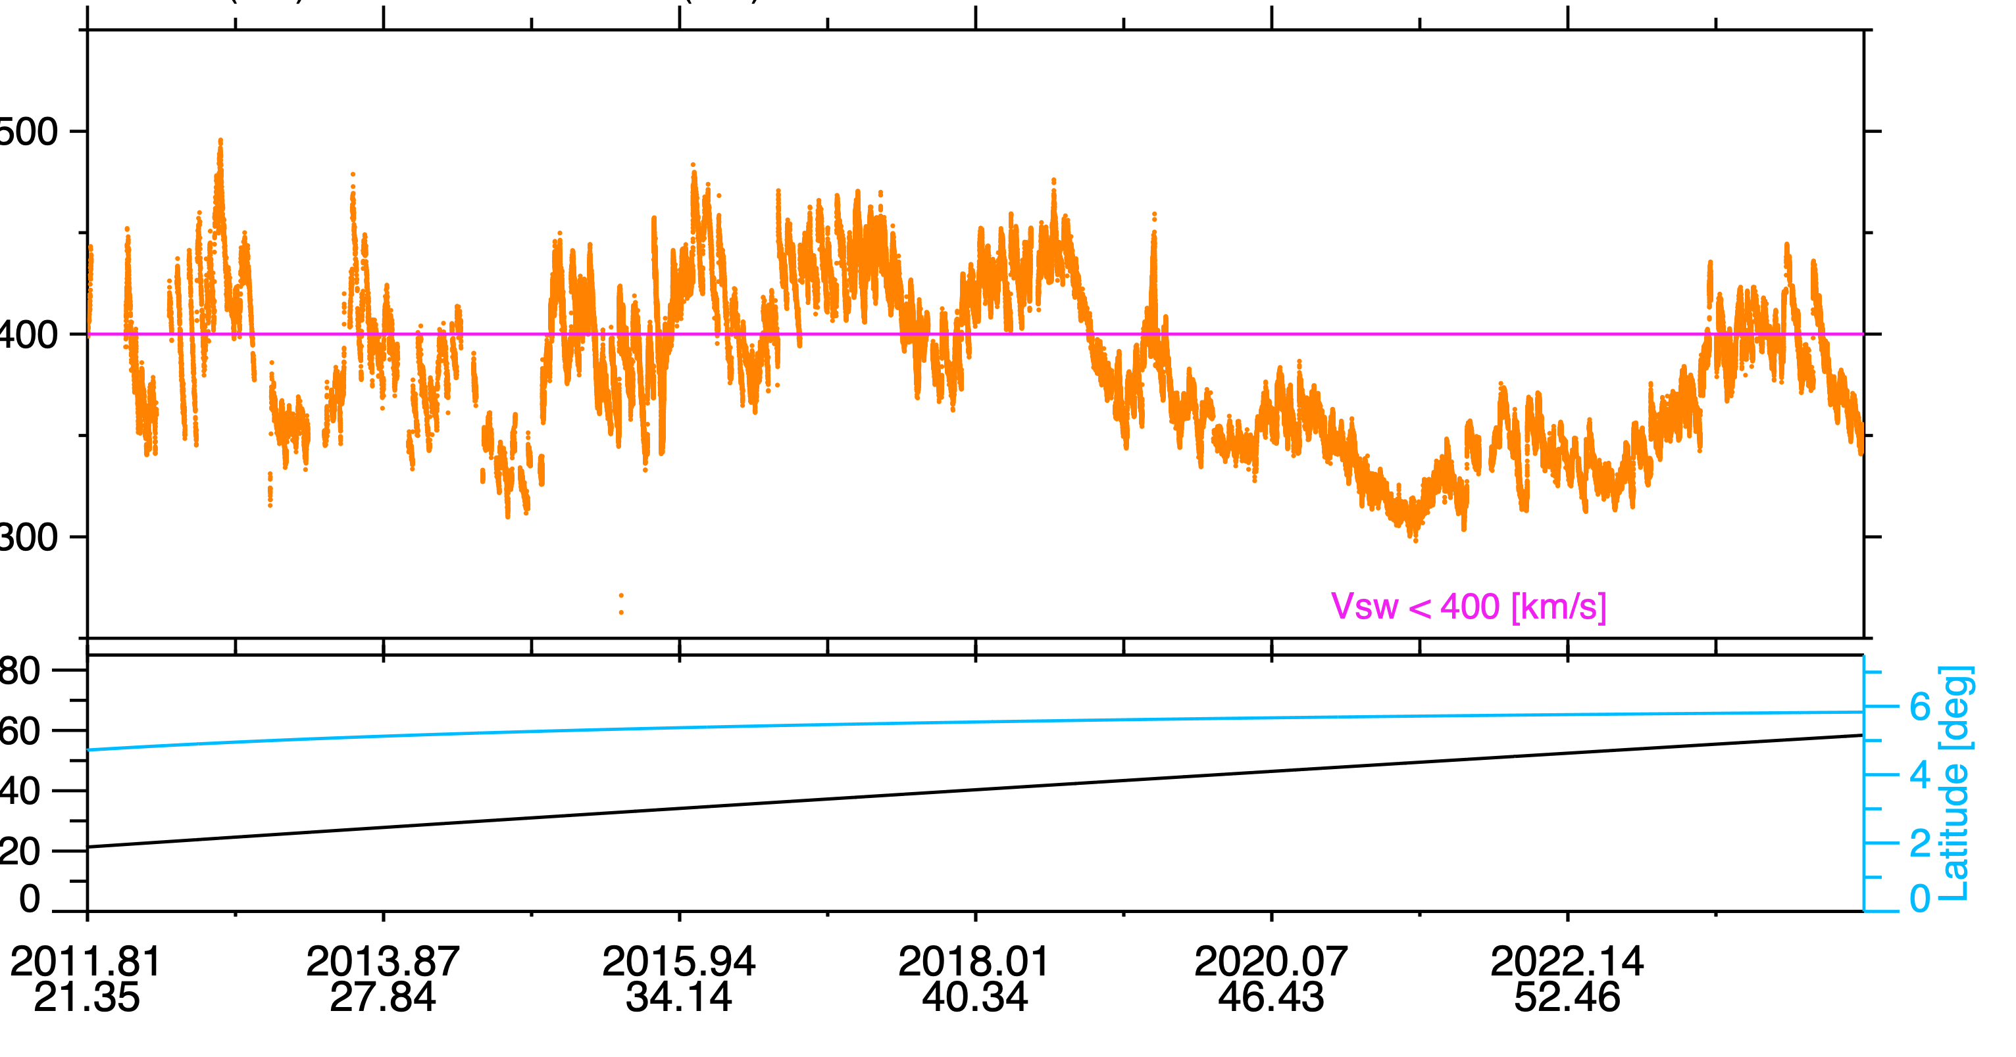
New Horizons Solar Wind Time Series
10/23/2011 – 03/16/2024
550
New Horizons
500
450
V_{p} [km s⁻¹]
400
Min 25.5% < 400 km s⁻¹
400 km s⁻¹
350
300
V < 400 km s⁻¹
80
R [au]
60
40
20
Figure 2

Slide 43

Long Interval of Slow Steady Wind At New Horizons
10/23/2011 – 03/16/2024
New Horizons
Interval of very slow wind at New Horizons from 2019 through early 2023.
Began in late 2018 at solar minimum and continued into the early rising phase of the solar cycle until late 2022.
Source of Slow Wind:
Not an indication of proximity to the termination shock.
Low current sheet tilt directed slow wind from coronal streamers towards New Horizons which was in the ecliptic.
Amount of slowing owing to the pickup of interstellar material on par with Voyager 2.
Local
Max Speed
400 km s⁻¹
Speed
Recovery
Min Speed
V < 400 km s⁻¹
Max Tilt
Tilt Angle Recovery
Mini Tilt
Figure 7

Slide 44
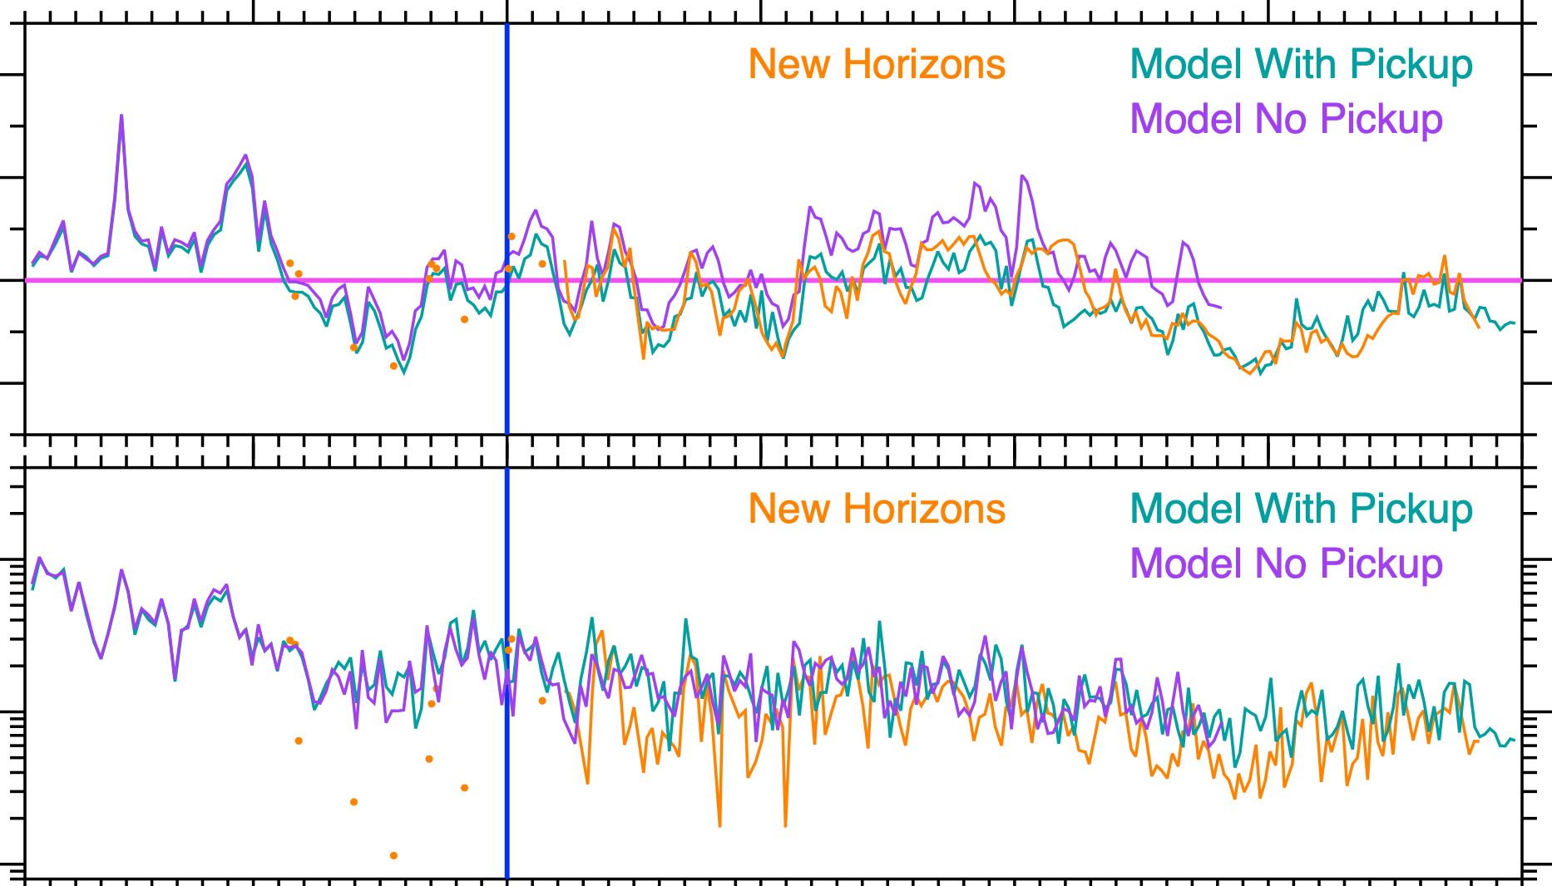
Solar Wind Speed – Model Comparison
600
Multi-scale Fluid-kinetic Simulation Suite (MS-FLUKSS) model (Borovikov et al., 2013; Pogorelov et al., 2014).
Solar wind and pickup ions treated as a single fluid governed by the MHD equations.
The interstellar neutral hydrogen atoms determined using mulit-component Euler equations.
The inner boundary at 1 au is driven using the OMNI solar wind observations (Kim et al., 2016).
500
400
[km s⁻¹]
V_{p} [km s⁻¹]
400
300
100
Std Dev Vp [km s⁻¹]
10
1
10
20
30
40
50
Sun – NH Distance [au]
The simulation and observation speeds match well.
The variability drops off slightly slower in the model than in the speed measurements.
Figure 8

Slide 45
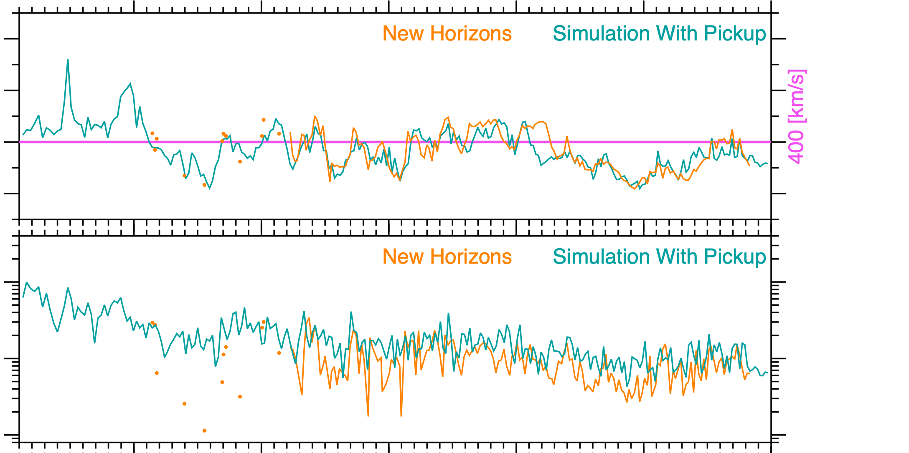
Solar Wind Speed – Model Comparison
600
Multi-scale Fluid-kinetic Simulation Suite (MS-FLUKSS) model (Borovikov et al., 2013; Pogorelov et al., 2014).
Solar wind and pickup ions treated as a single fluid governed by the MHD equations.
The interstellar neutral hydrogen atoms determined using mulit-component Euler equations.
The inner boundary at 1 au is driven using the OMNI solar wind observations (Kim et al., 2016).
Solar Rotation Averaged (25.38 days)
500
400
[km s⁻¹]
V_{p} [km s⁻¹]
400
300
100
Std Dev Vp [km s⁻¹]
10
1
10
20
30
40
50
Sun – NH Distance [au]
The simulation and observation speeds match well.
The variability drops off slightly slower in the model than in the speed measurements.

Slide 46
Summary and Conclusions
Inner heliosphere acts as filter inside of 20 au.
Beyond 20 au:
    Solar wind is less variable & dominated by larger scale, but smaller amplitude features.
    Multiple structures at 1 au merged to create one large lower amplitude structure in the outer heliosphere.
Interstellar pickup ions (PUI) become increasingly important with increasing distance accounting a large fraction of the pressure and energy.
    PUI slow and heat the solar wind in the outer heliosphere & modify interplanetary shocks.
The spherical expansion of the solar wind produces a decreasing radial density profile that goes as r⁻²
Slowing of the solar wind in the outer heliosphere is subtle.
Gradual Slowing & Heating
Filter
Modified Credit NASA/Adler Planetarium
The amount of slowing in the solar wind in the outer heliosphere compared to 1 au was 5-7% slower from 30-43 au, and is 13-15% slower from 50 - 58 au.

Slide 47
Backup

Slide 48
Outer Heliospheric Solar Wind Coverage
Outer Heliosphere Plasma Observations
Heliocentric Aries Ecliptic/Solar Ecliptic
TS
TS
Figure 1

Slide 49
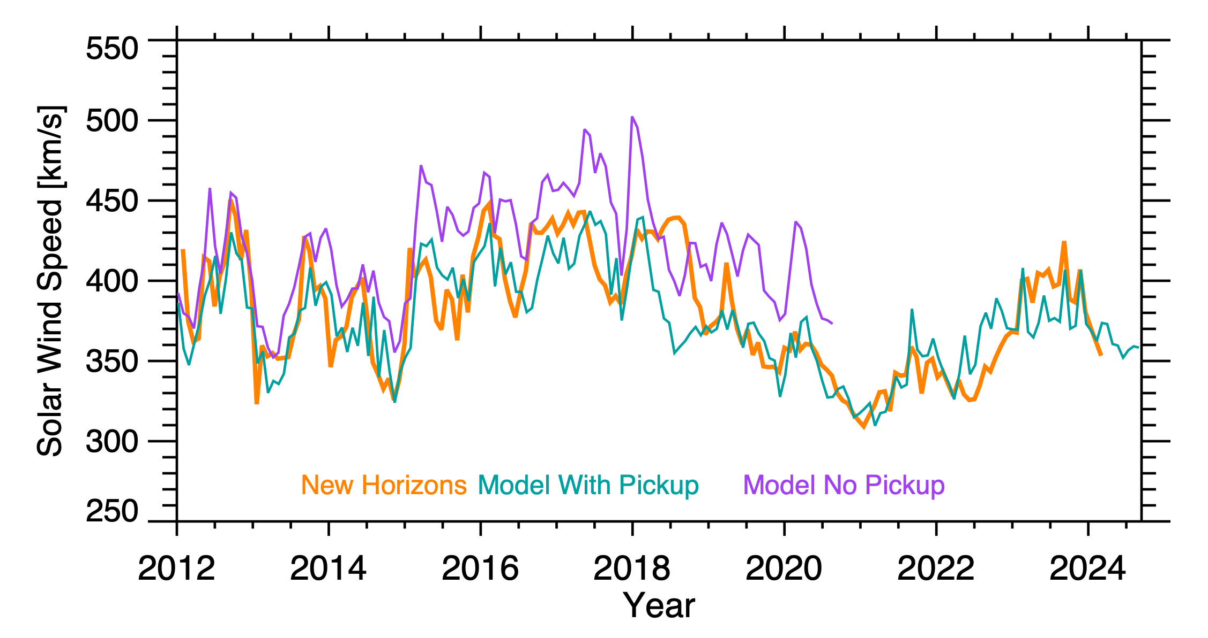
Model and New Horizons Speed Comparison (Zoom)

Slide 50
Temperature-density Relationship Index

Slide 51
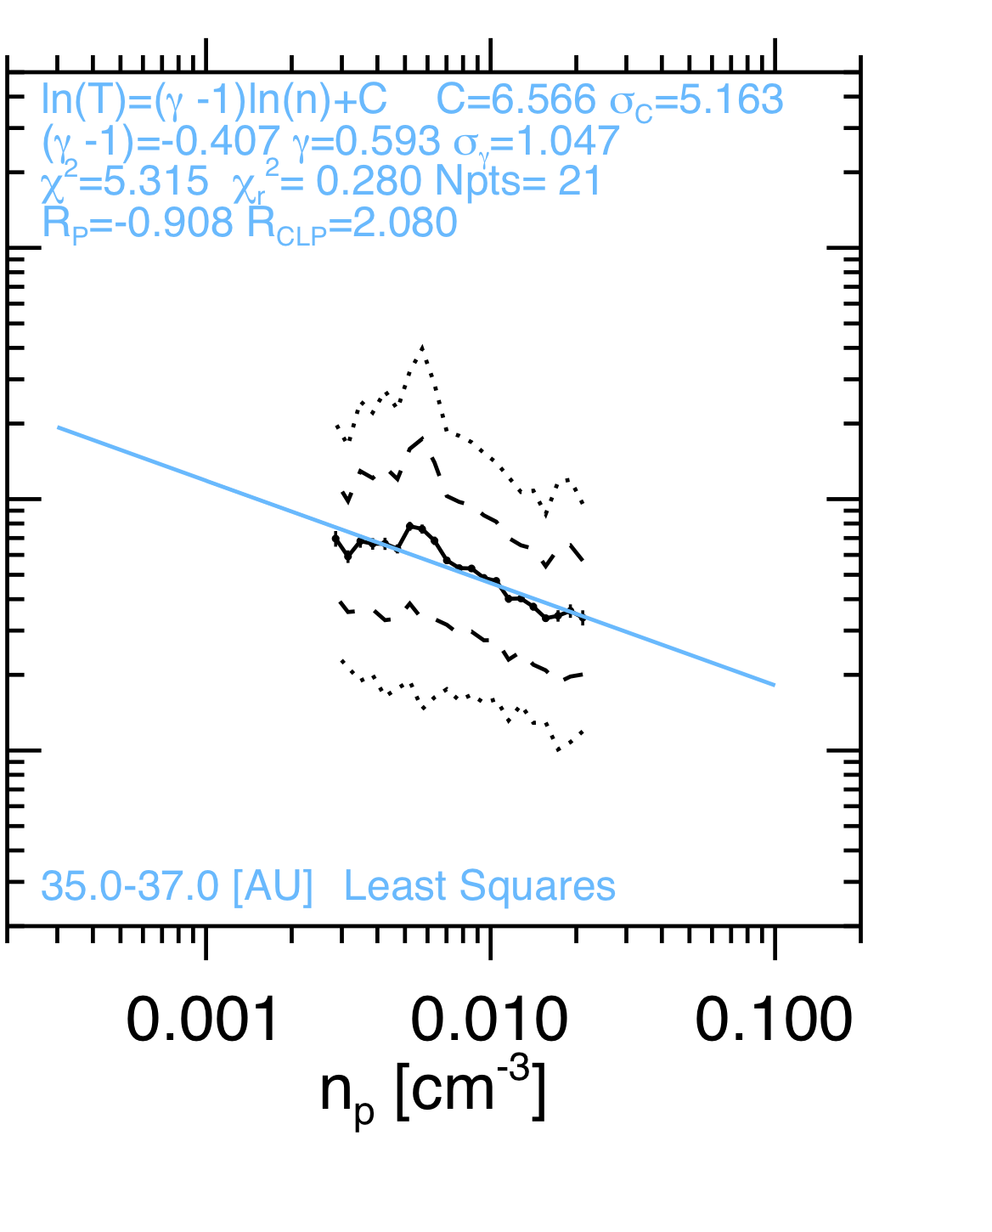
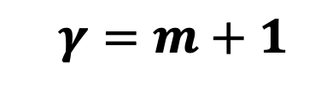
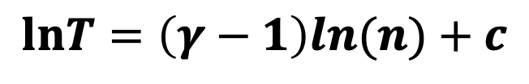

Determining the Solar Wind Index (𝜸): Method 1 & 2
Method 1
Method 2
Elliott et al., 2019
$$T=cn^{γ−1}$$
$$lnT=\left(γ−1\right)ln(n)+c$$
$$γ=m+1$$

Slide 52
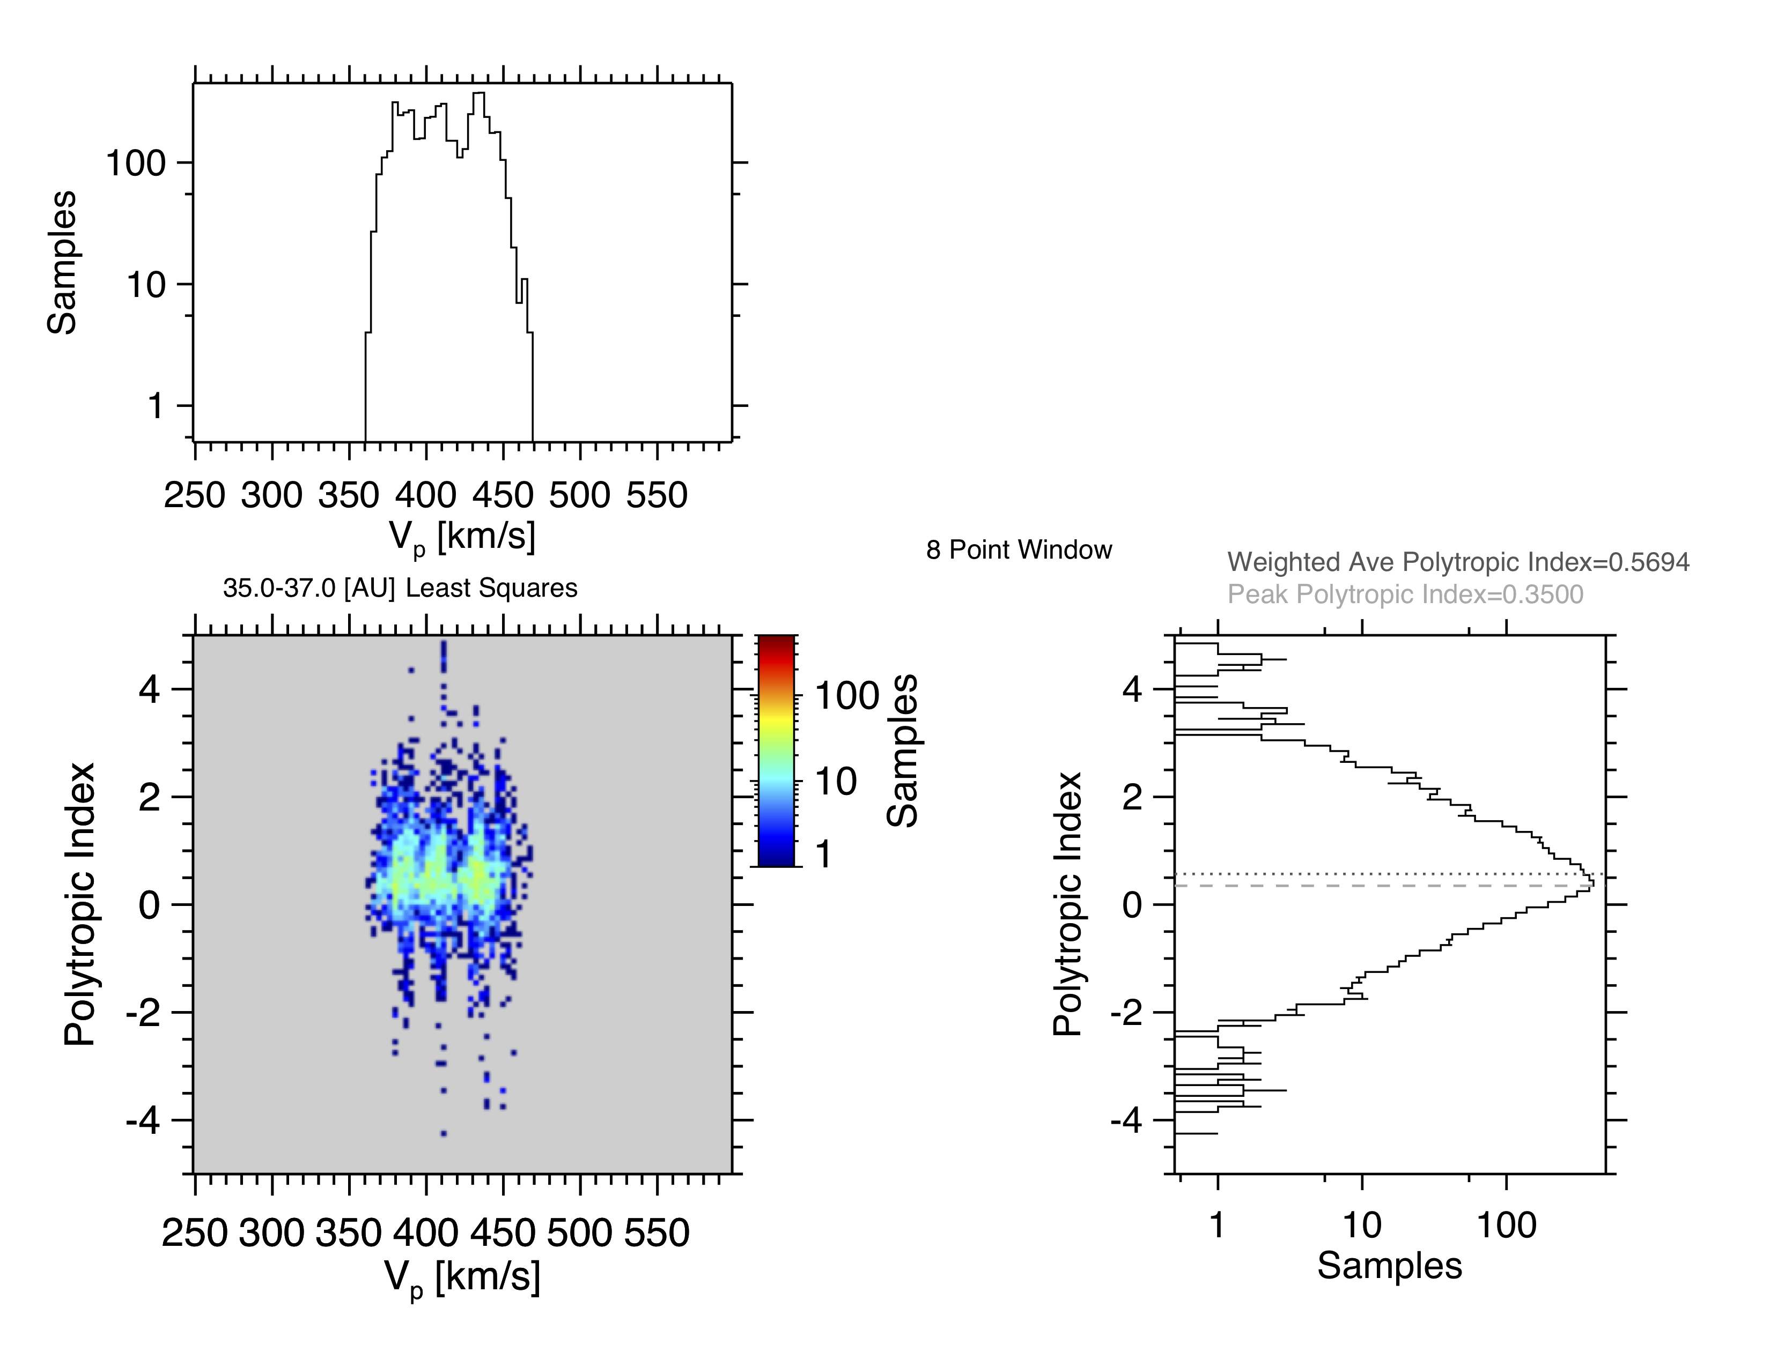
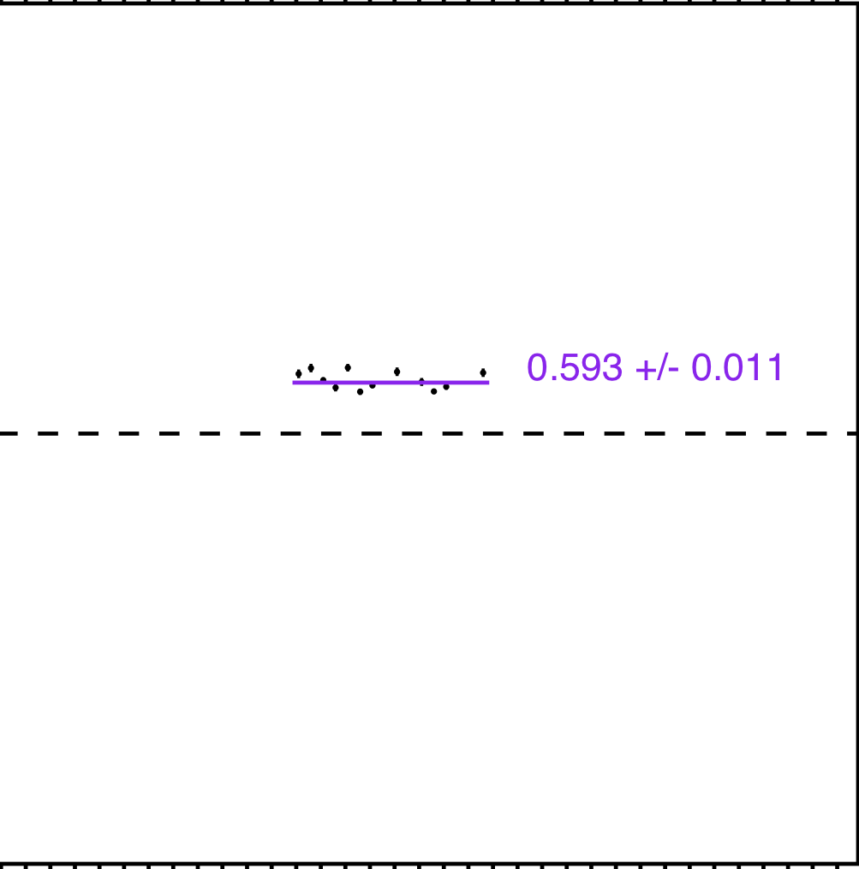
Determining the Solar Wind Index (𝜸): Method 3
Method 3
Average 𝛾_{sw} Over Speed (8 point T-n Fits)
1-D
Samples
In V Bins
Fit 8 pairs of T & n measurements at a time using an running 8 point window for the entire data set.
For a given radial distance range we average the polytropic index 𝜸_{sw} over speed.
Samples
2-D
Samples In
V & 𝛾_{sw} Bins
(𝛾_{sw})
<𝛾_{sw}>_{v}
Elliott et al., 2019

Slide 53
Solar Wind Polytropic Index (𝜸) Radial Profile
New points show the index leveling off with increasing distance.
If the overall plasma and the index go to zero in the sheath then the trend in the index can be used to estimate changes in the termination shock distance.
Need to add new data & assess other methods.

Slide 54
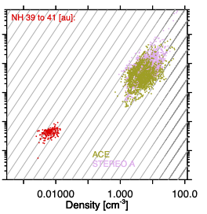
Examine Polytropic Index for SW+PUI with Distance;
Total (SW +PUI) Pressure Vs Density
NH 39 – 41 [au]
Outer
Heliosphere
Elliott et al., 2019
Elliott et al., 2019
Assume at 1 au no pickup with IMAP we will have pickup at 1au
Used SW and PU at NH.
The gray lines indicate adiabatic lines.
The inner heliospheric data is relatively close to adiabatic.
The outer heliosphere data departs from adiabatic.
The inner and outer heliosphere do not line along a common adiabatic line.

Slide 55
Solar Wind Polytropic Index Radial Variation
Livadiotis and McComas, 2023

Slide 56
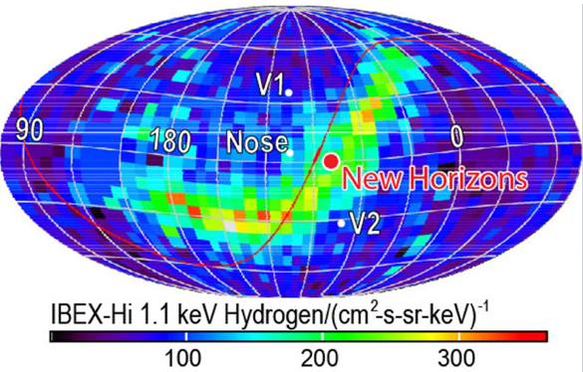
Few Missions Have Explored the Outer Heliosphere
Adapted from McComas et al.,2009
New Horizons is moving along the same longitude as Voyager 2, but remaining in the ecliptic headed towards the ENA Ribbon.
New Horizons is currently the only spacecraft exploring the outer heliosphere and Kuiper Belt.
Elliott et al., 2016
McComas et al., 2009

