Slide 1
A termination shock crossing unlike voyager 1 & 2
Erick Powell, Merav Opher, Matt Hill, Kostas Dialynas, New Horizons Team (TBD)
Ph.D. Candidate Boston University/SHIELD Drive Science Center

Slide 2
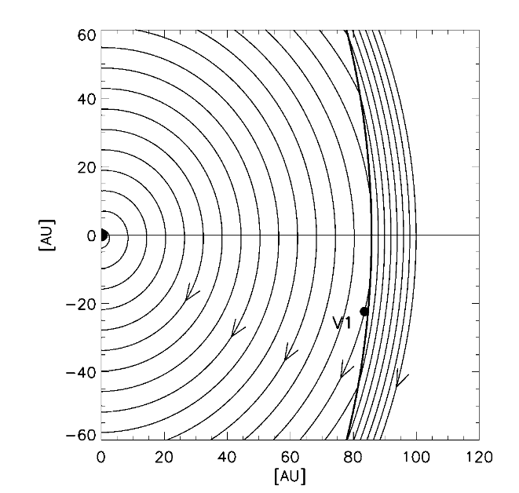
Termination shock and Heliopause “Bluntness”
Rather than spherical, the termination shock is “blunt”
This causes magnetic field lines to connect to the TS prior to crossing
Termination Shock Accelerated Particles (TSP) beam along these field lines and indicate that the spacecraft is approaching the TS
Jokipii et al. 2004

Slide 3
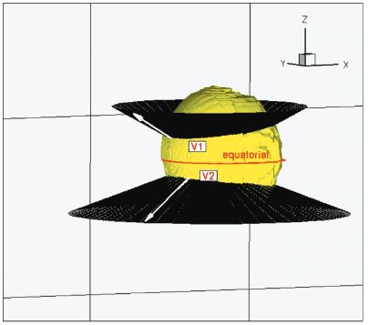
Opher et al. 2006 prediction
Opher et al. 2006 used a magnetohydrodynamic simulation to predict:
Voyager 2 would see TSP sooner and
Voyager 2 TSP streaming from opposite direction compared to Voyager 1
Opher et al. 2006

Slide 4
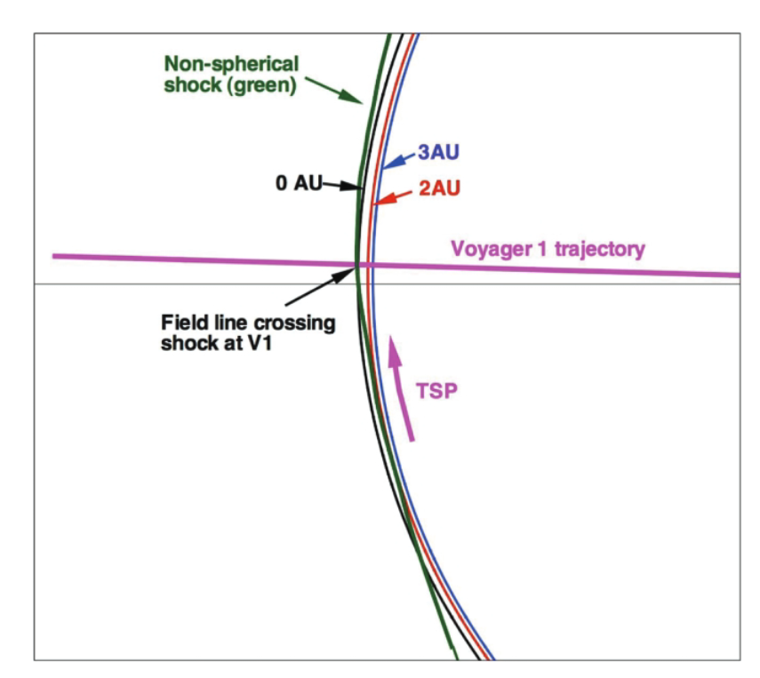
Opher et al. 2006 → Voyager 1 TS crossing
Field lines from 0 years (0 AU) and 0.6 years (2 AU) from crossing show connectivity with the TS
Field lines greater than 1 year (3 AU) prior to crossing do not connect to TS
Particles flow in the -T direction
Opher et al. 2006

Slide 5
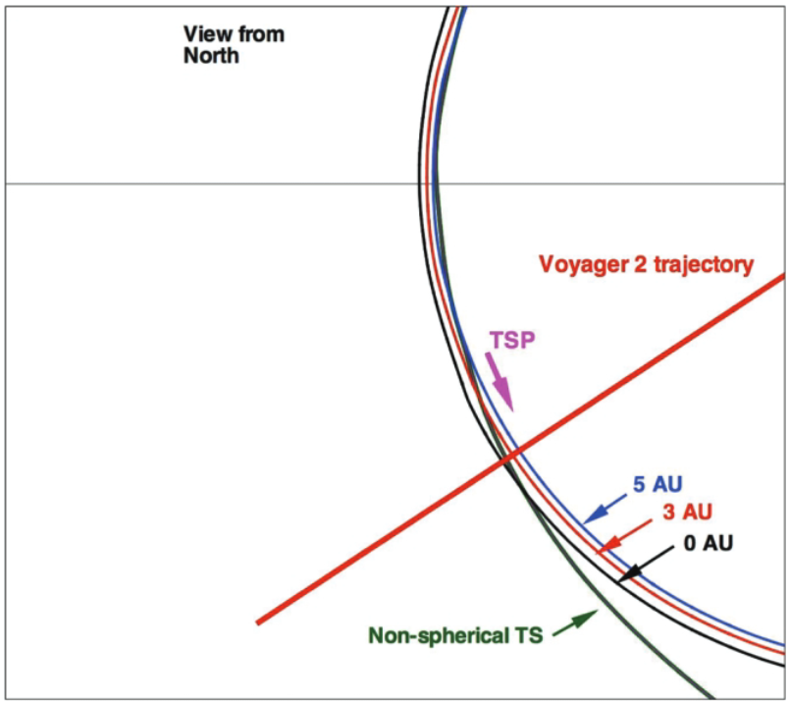
Opher et al. 2006 → Prediction for Voyager 2 crossing
Prediction:
Voyager 2 would see particles accelerated at the Termination shock flow in opposite direction as Voyager 1 (+T)

Slide 6
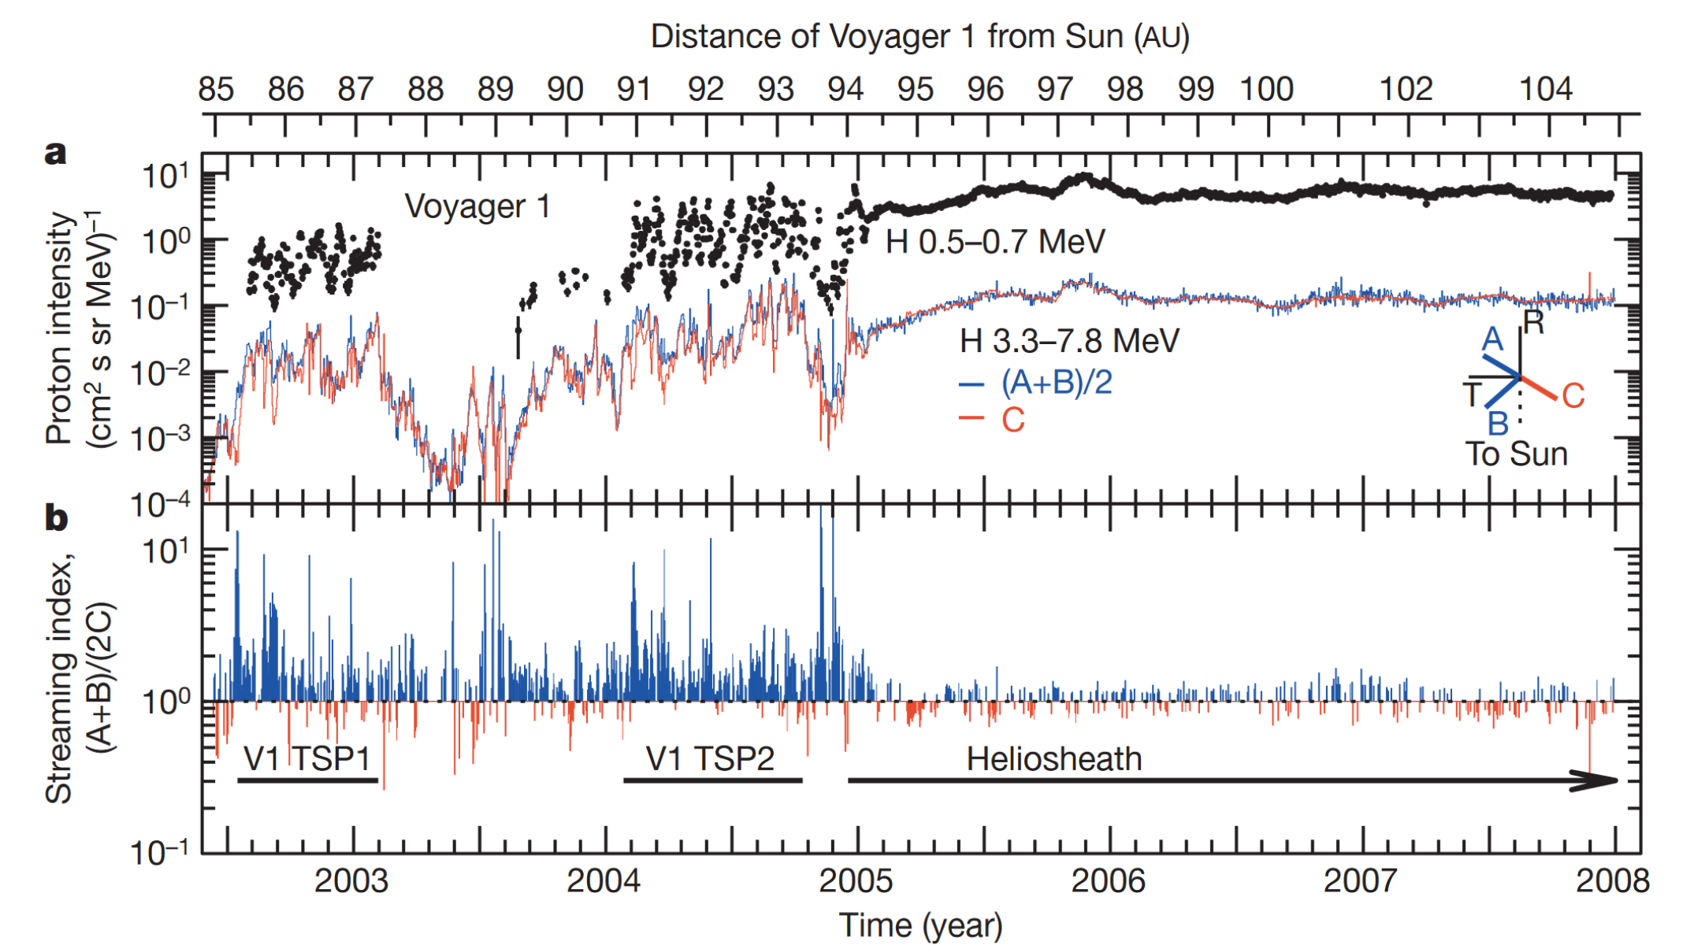
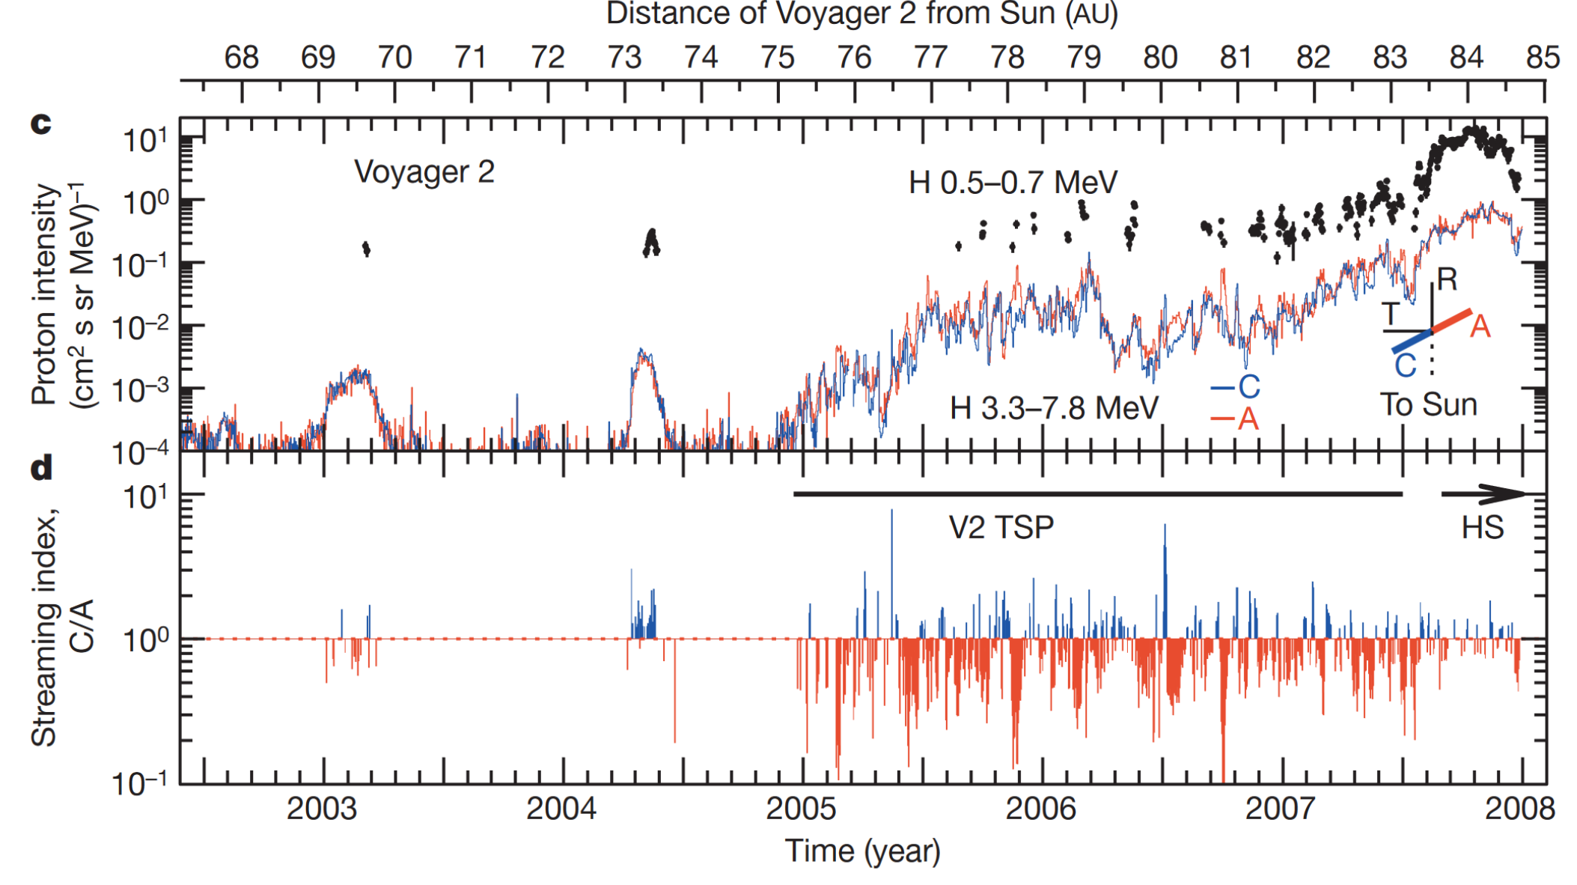
Observations supporting Opher et al. 2006
Voyager 1 saw strong beaming in the –T direction (Stone et al. 2008)
Voyager 2 saw strong beaming in the +T direction (Stone et al. 2008)

Slide 7
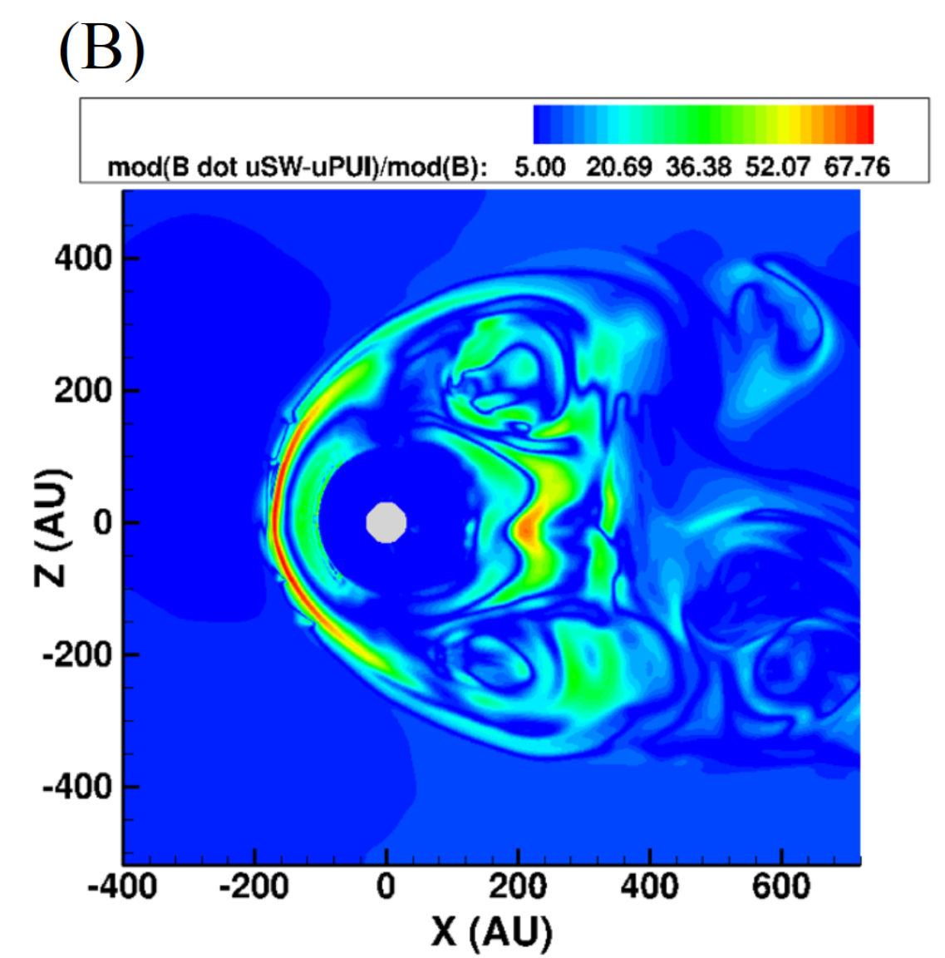
Model advancement
BU model is very different from 2006
Including but not limited to:
Separate Pick-Up Ion fluid
Kinetic neutrals

Slide 8
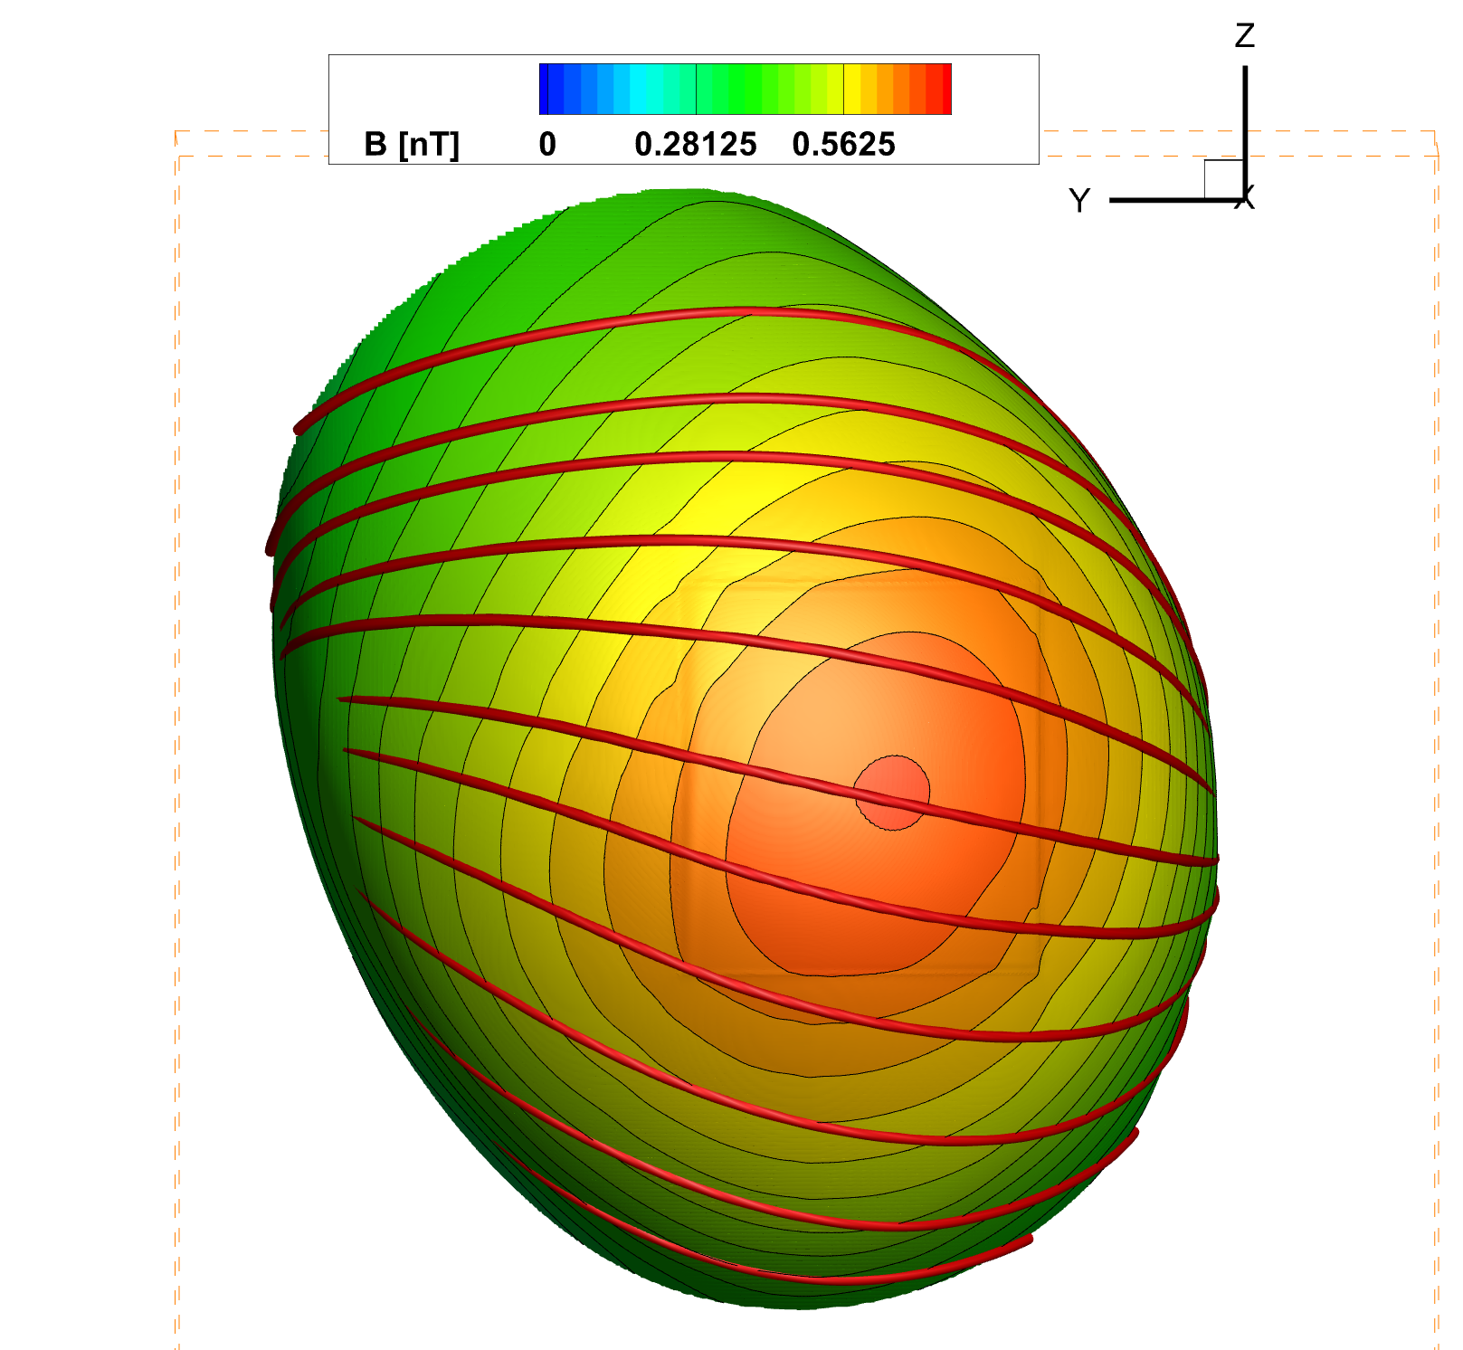
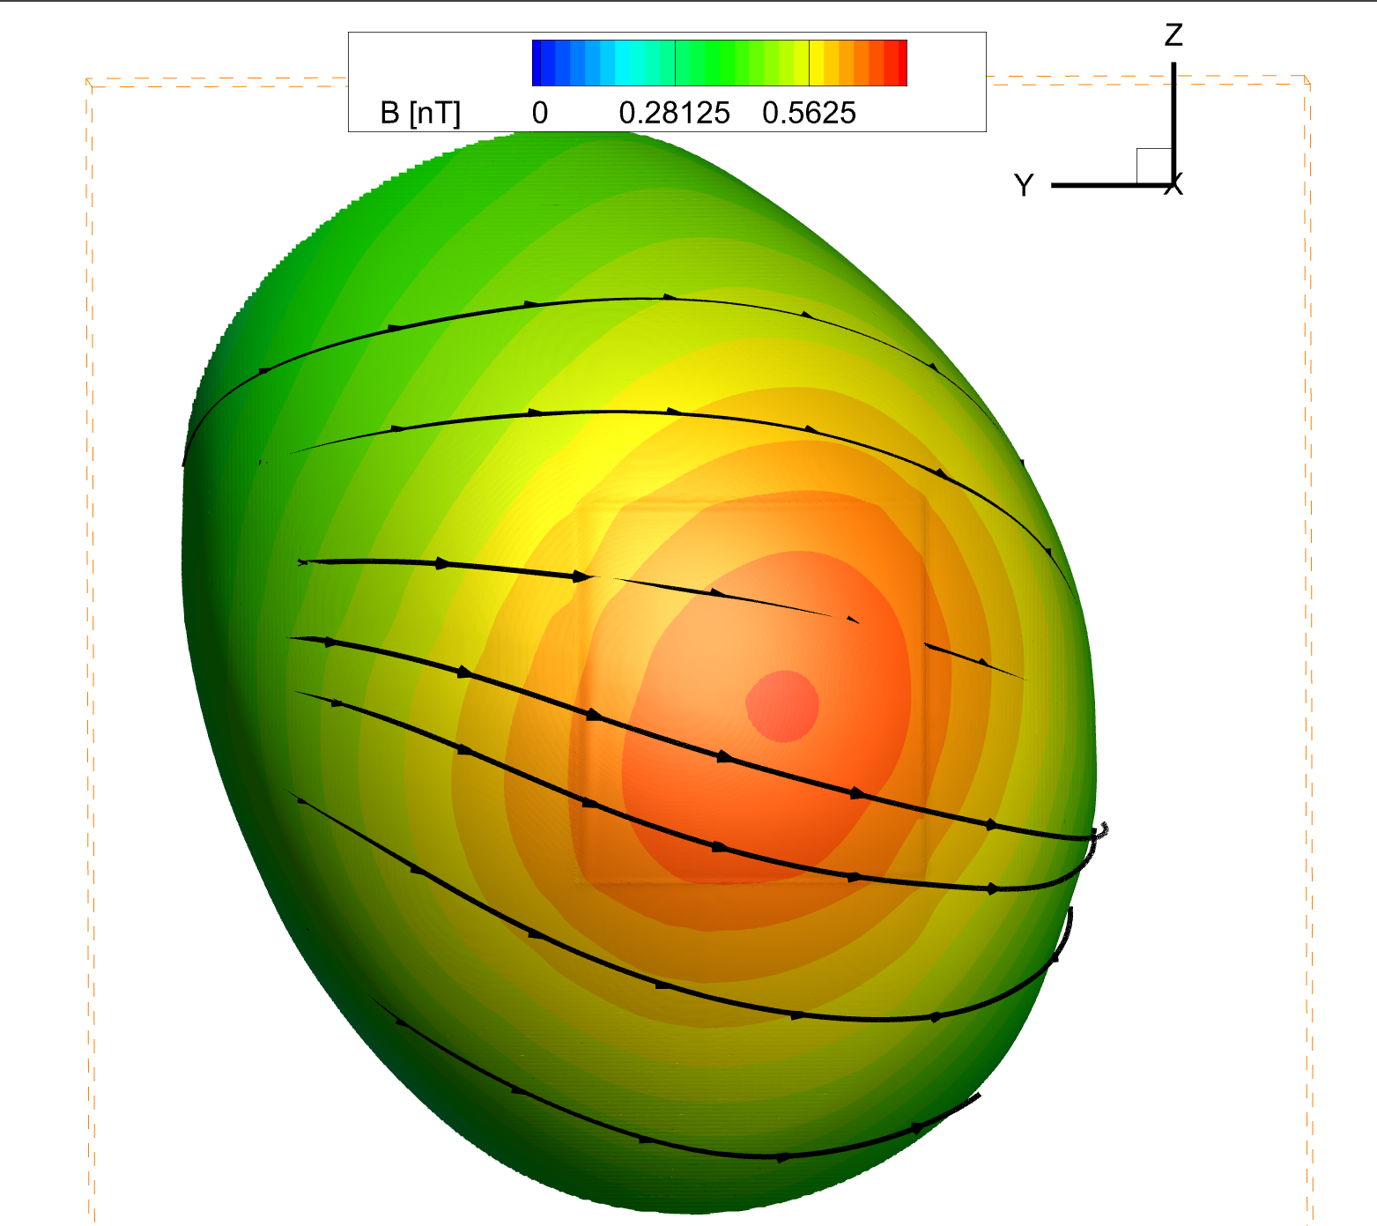
Heliopause magnetic field build up
Due to the magnetic field in the ISM, magnetic pressure builds up at the heliopause
This pressure in turn compresses the termination shock asymmetrically
The compression of the TS can enhance the distance the magnetic field lines connect to the TS
Heliopause

Slide 9
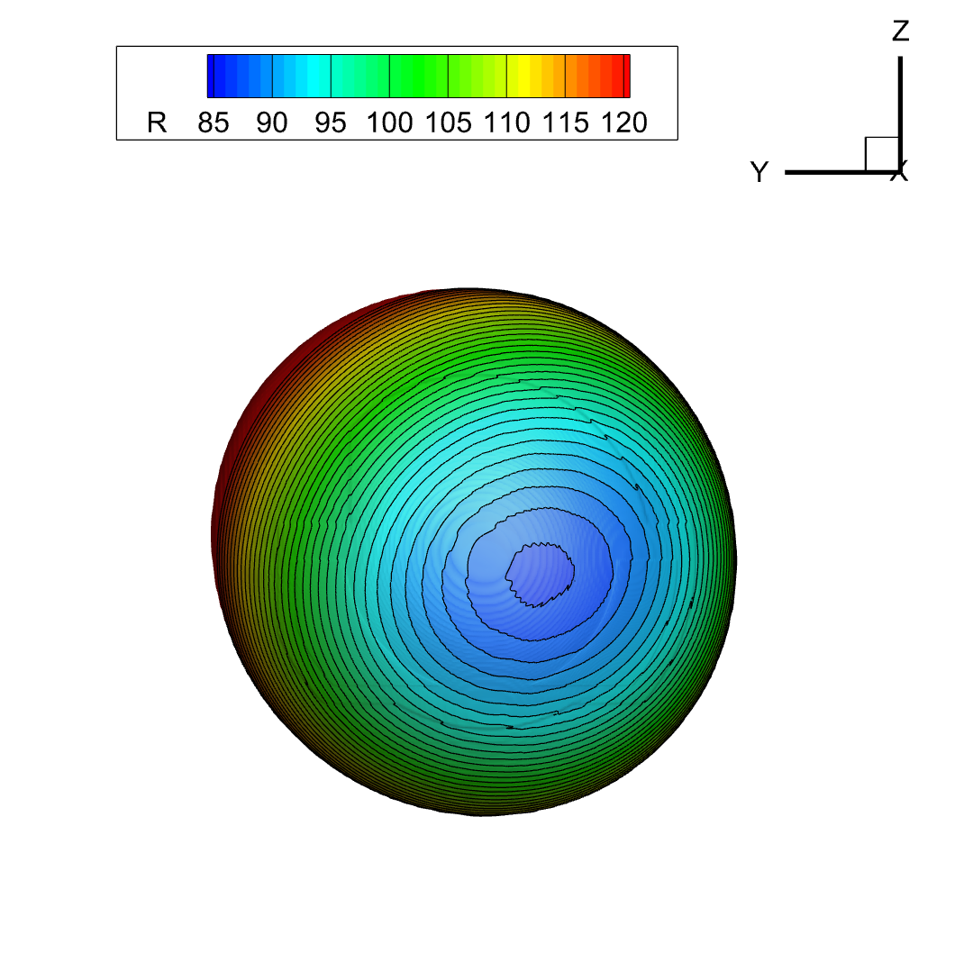
Interstellar magnetic field pushes termination shock in
Termination shock
Heliopause

Slide 10
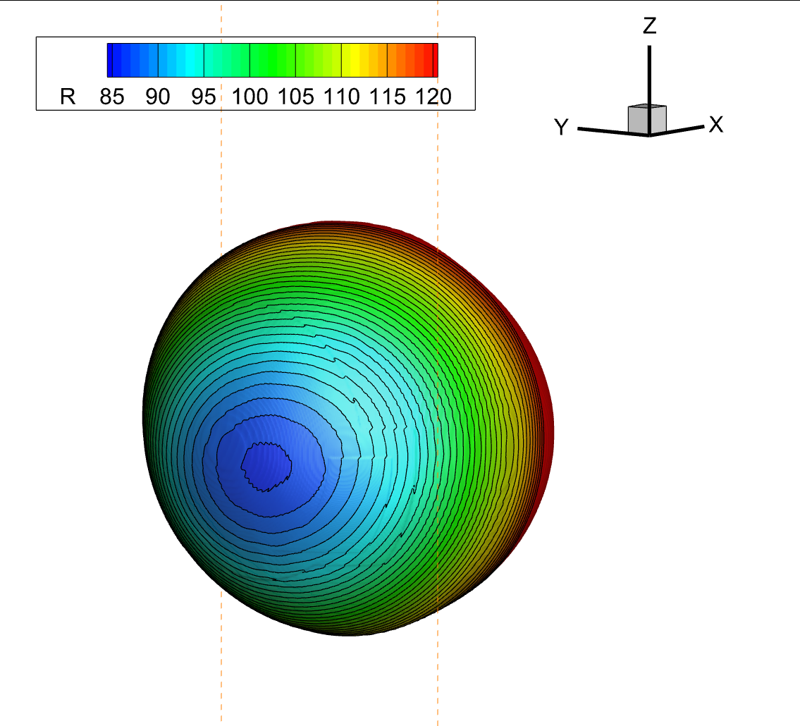
Termination shock shape
Termination shock surface- contours of radial distance
TS is asymmetric due to magnetic field at Heliopause
V_{ISM}
V_{ISM}
Termination shock

Slide 11
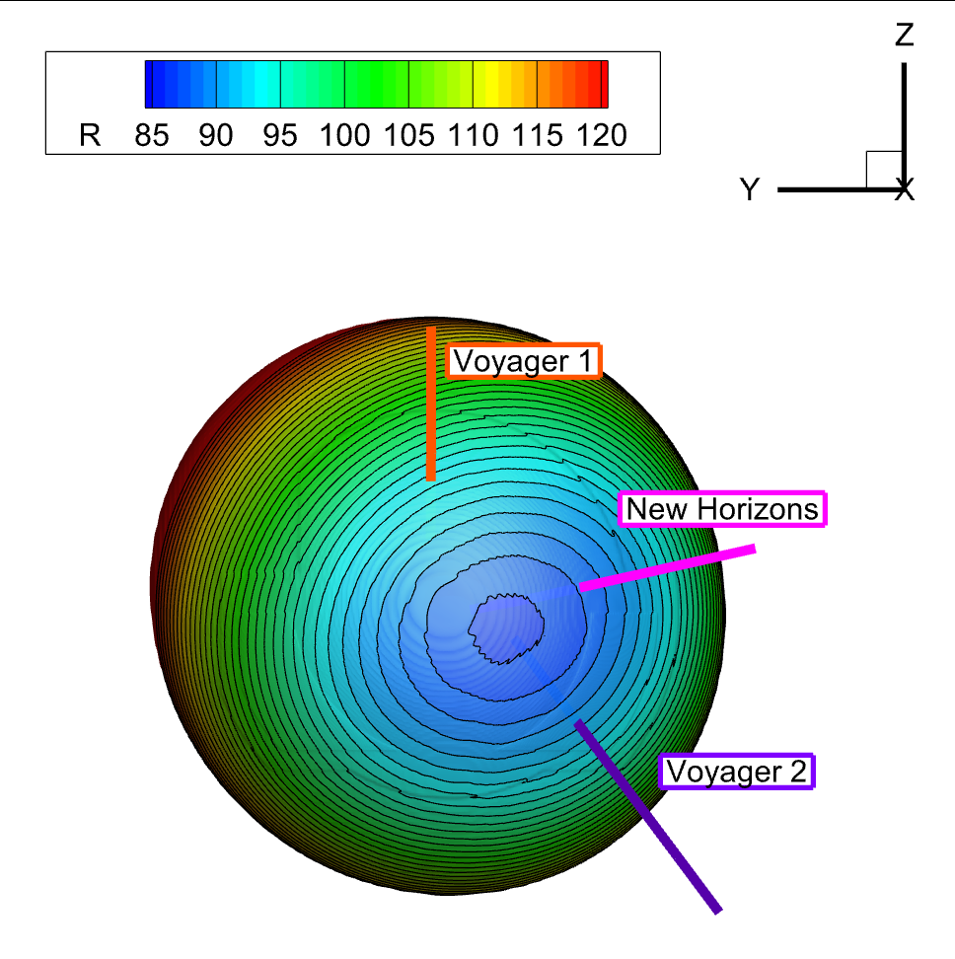
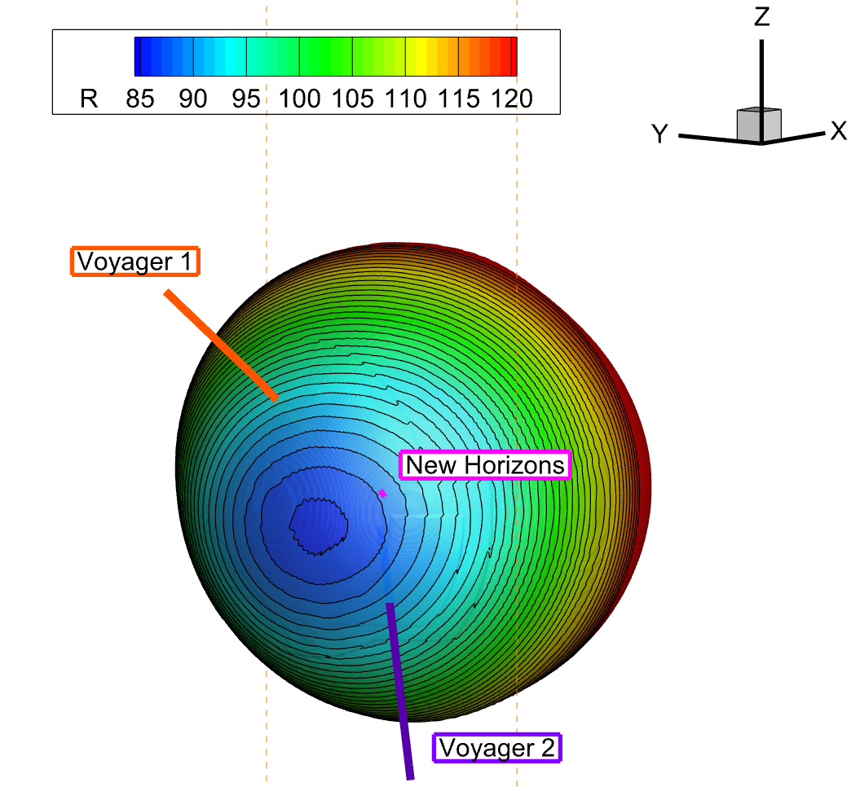
New Horizons trajectory closest to minimum TS distance
New horizons trajectory close to V2 longitude, but near the ecliptic
Closer to the closest point of the TS
Termination shock

Slide 12
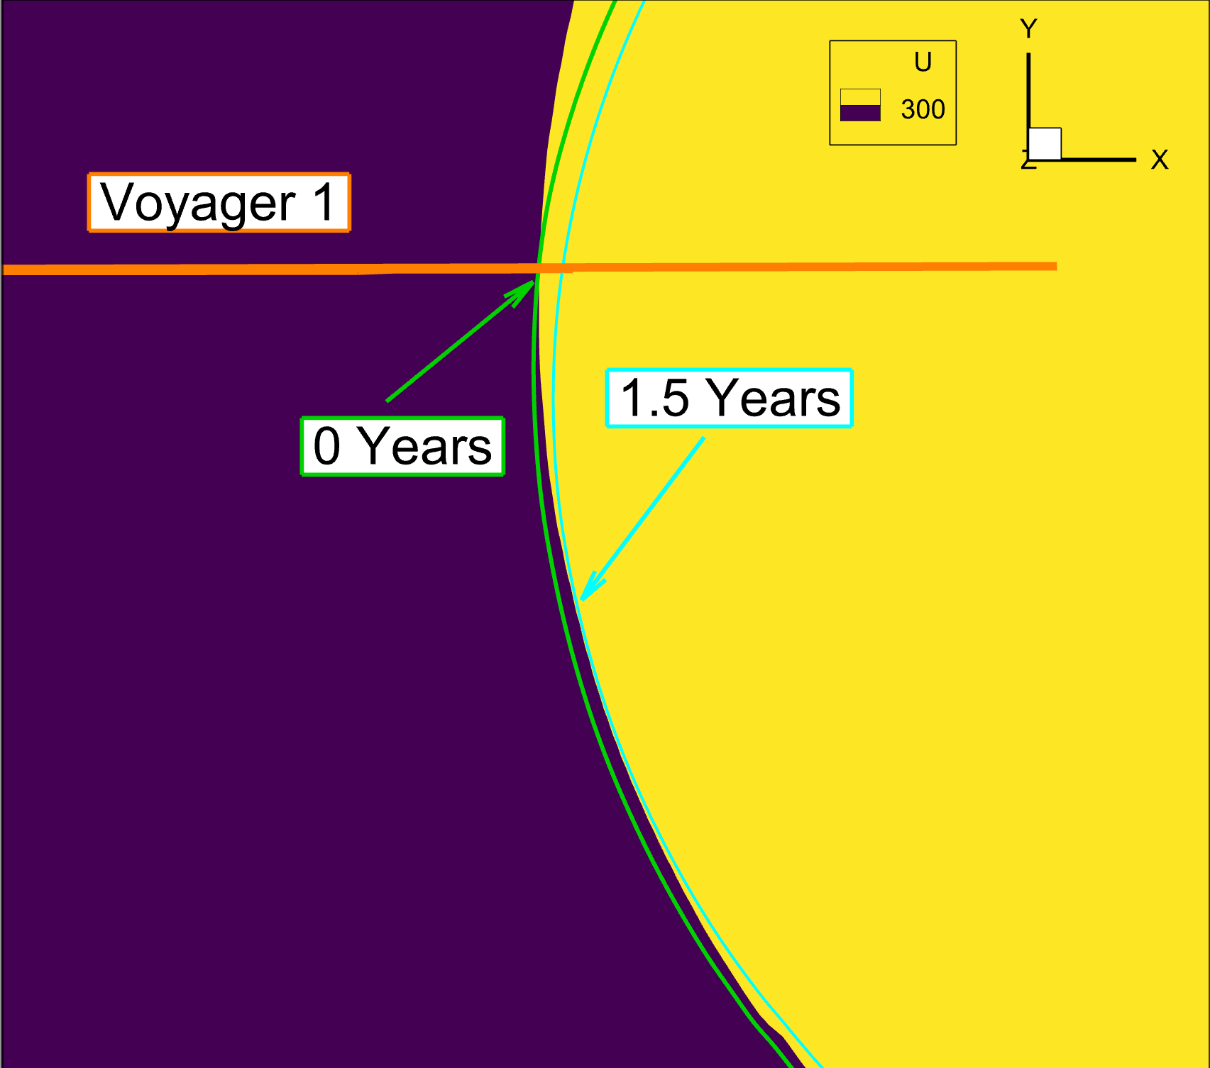
How far away does Voyager 1 connect to TS
Plane parallel to solar equator
Voyager 1 sees a 1.5-year (4.5 AU) warning of the TS crossing
Particles flow in the -T direction

Slide 13
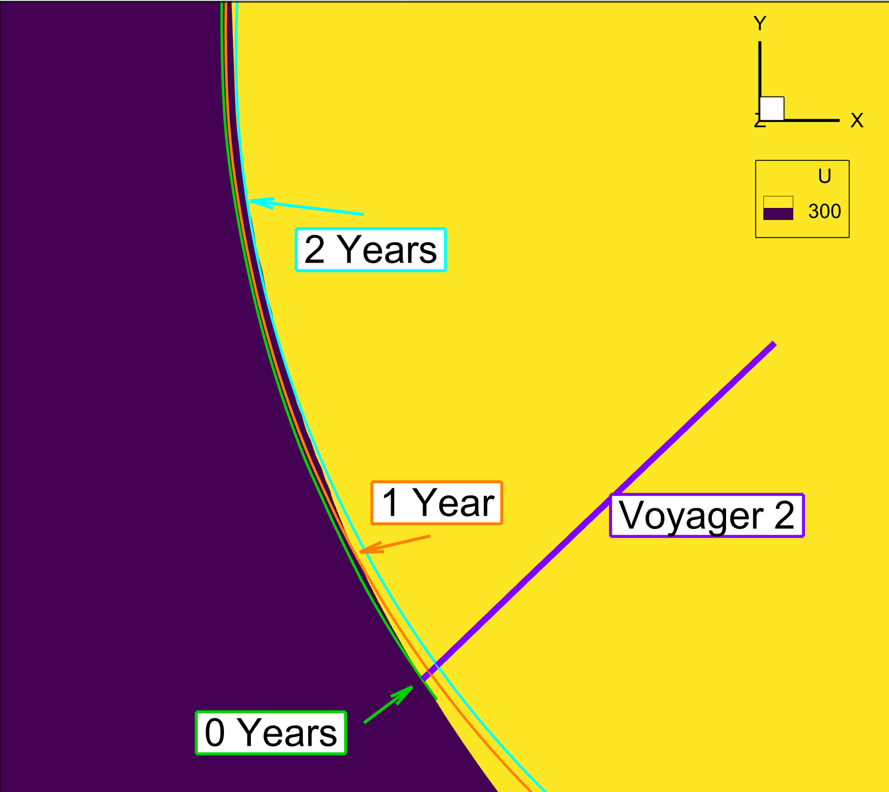
How far away does Voyager 2 connect to TS
Plane parallel to solar equator
Voyager 2 has a two-year (6 AU) warning of crossing
Particles flow in the +T direction
More time than Voyager 1 like observations suggest

Slide 14
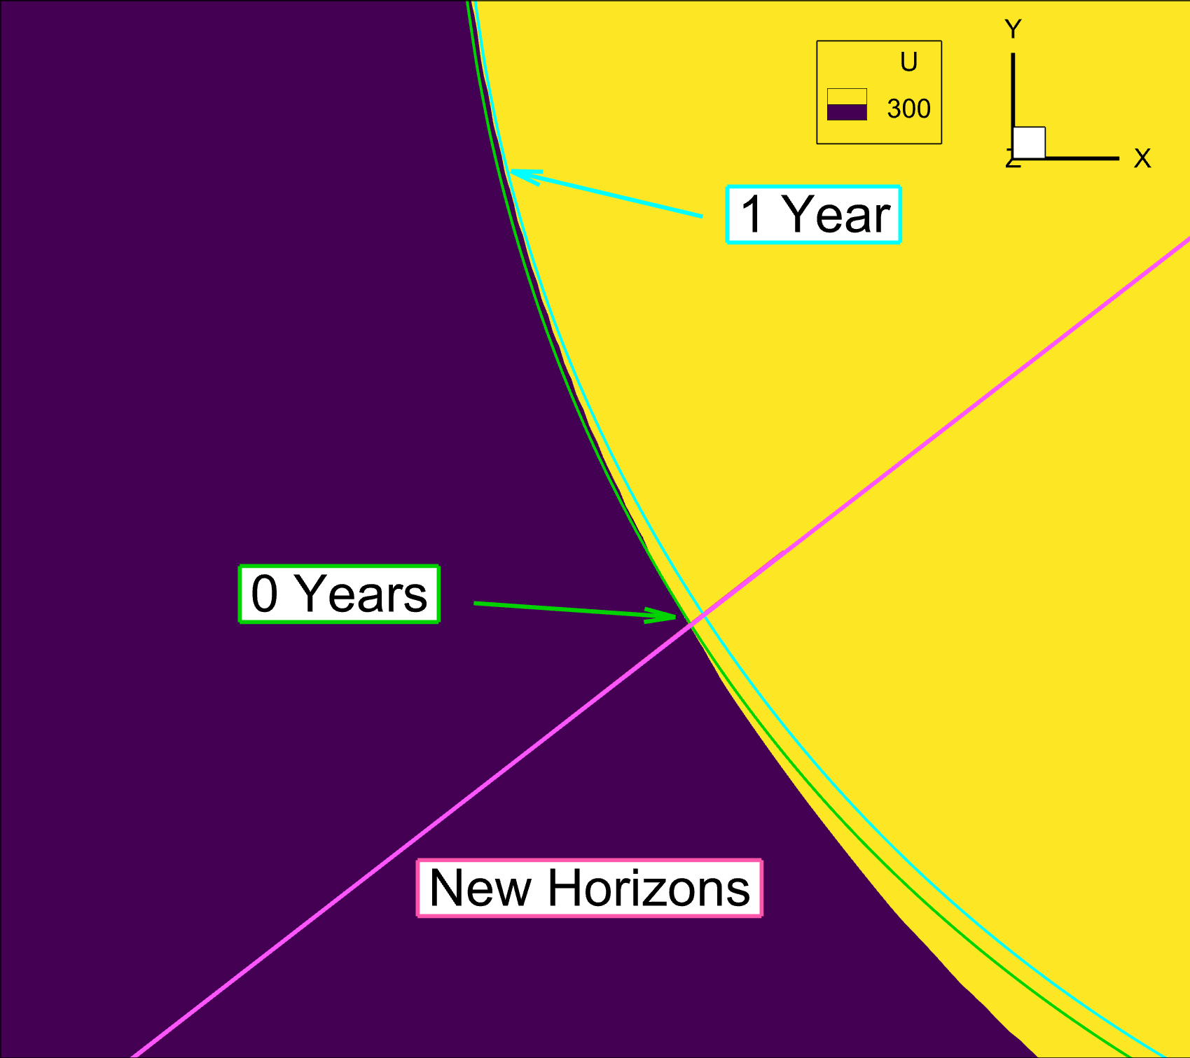
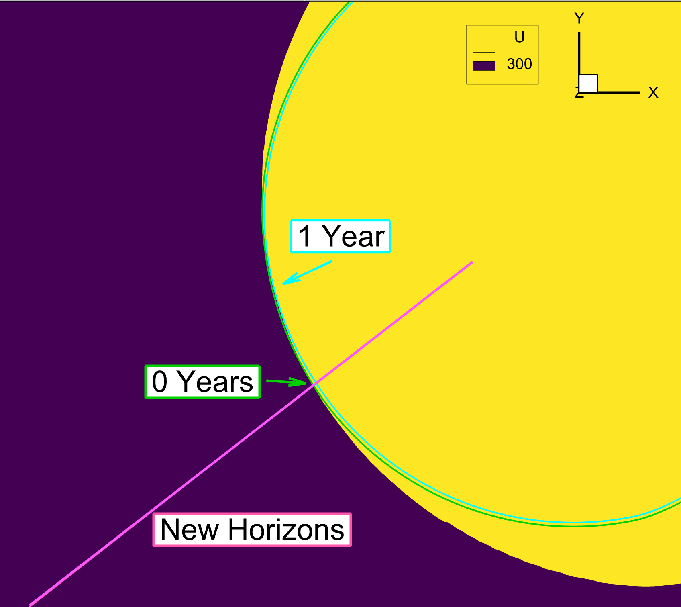
How far away does New Horizons connect to TS
Plane parallel to solar equator
New Horizons has a one-year (3 AU) warning of crossing
Particles flow in the +T direction
Particles will come from the same direction as Voyager 2 but with less warning

Slide 15
Summary of crossings
Similar to Opher et al. 2006:
We see beaming in the same direction as observations
Voyager 2 has a longer warning
New Horizons:
Particles will beam in the same direction as Voyager 2
New Horizons will have less warning than Voyager 1 or Voyager 2
 | Voyager 1 | Voyager 2 | New Horizons
Opher et al. 2006 | 3 AU / -T direction | 5 AU / +T direction | N/A
This work | 4.5 AU / -T direction | 6 AU / +T direction | 3 AU / +T direction

Slide 16
Thank You
Empowell@bu.edu

