Slide 1
Physics of the Heliospheric Termination Shock and What Might be Observable by New Horizons
G.P. Zank
University of Alabama in Huntsville

Slide 2
Location, Location, Location
Washimi et al, 670: L139–L142, 2007; Washimi et al, MNRAS, doi:10.1111/j.1365-2966.2011.19144.x, 2011
AU
V1
V2

Slide 3
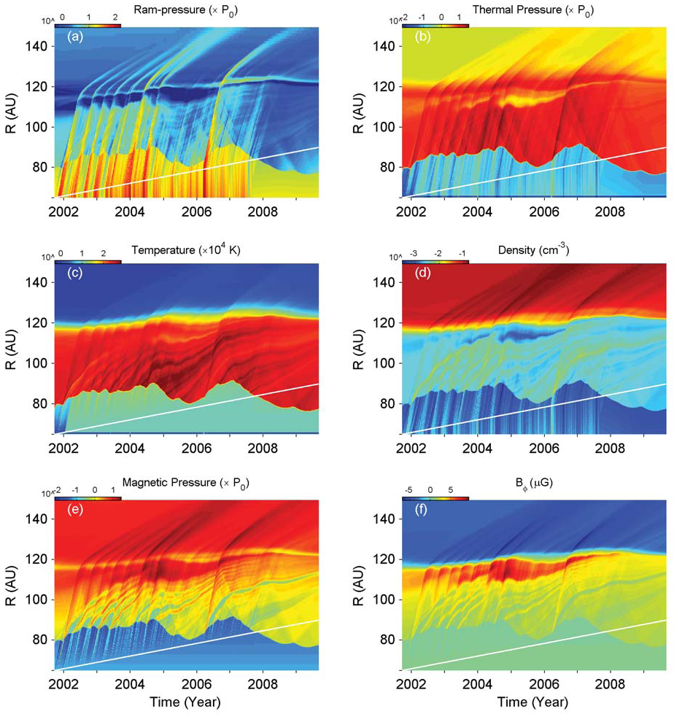
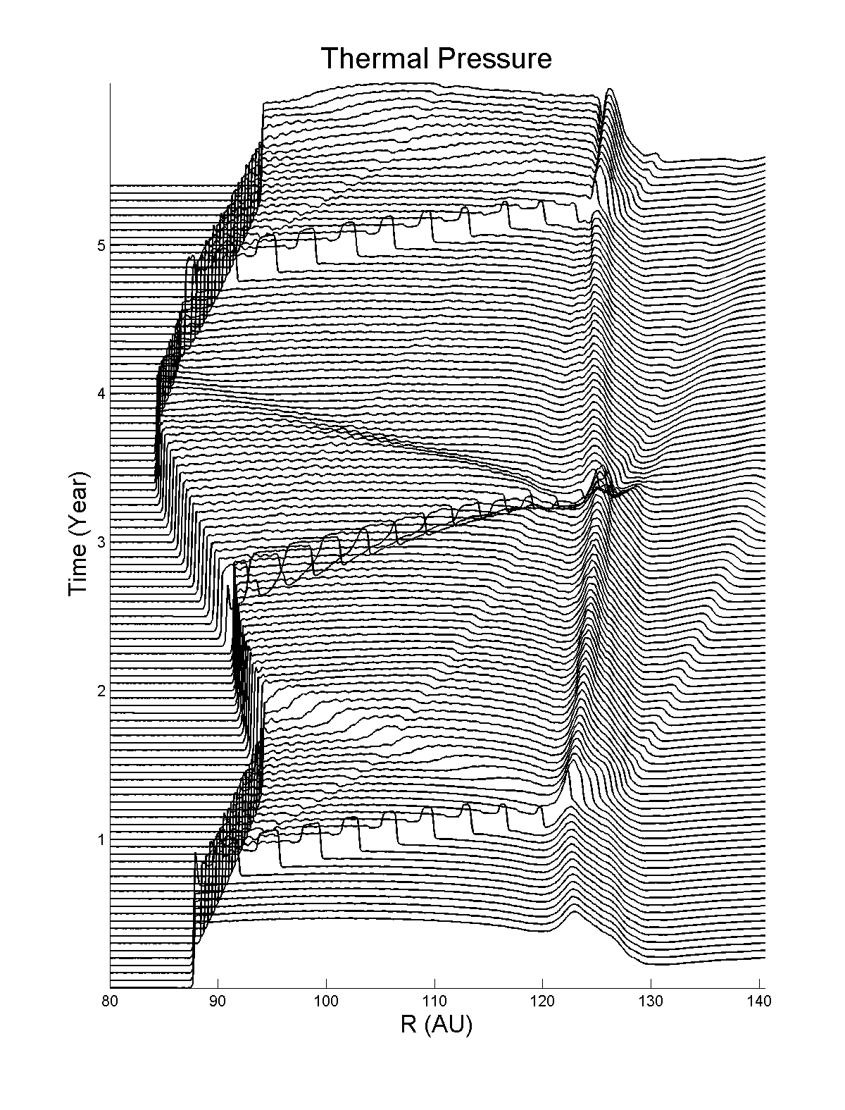
THE DYNAMICAL HTS:
Voyager 2
Pressure pulses
Incident on TS
1
2
3
4
Years

Slide 4
Summary of HTS response
Highly dynamical response of HTS to realistic interplanetary disturbances based on V2 observations (3D, time-dep model with neutral H). HTS response very non-Markovian.
HTS geometry nominally quasi-perp but highly variable ➔ TSP events – inward shock speed for V2 estimated to be ~55 km/s and TSP events present from ~ 2 years prior to crossing.
Characterized by a highly disturbed inner heliosheath, dominated by ~10 major disturbances. Interesting correlations with energetic electrons observed by V1 and V2.
NH SWAP plasma observations will identify multiplicity of structures and role of PUIs will be exceptionally interesting and PEPSSI critical to assess TSPs/
URGENTLY NEEDED: Simulations corresponding to Washimi et al 2007, 2011

Slide 5
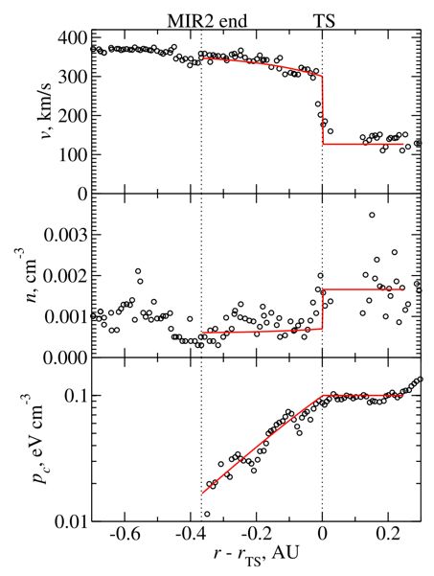
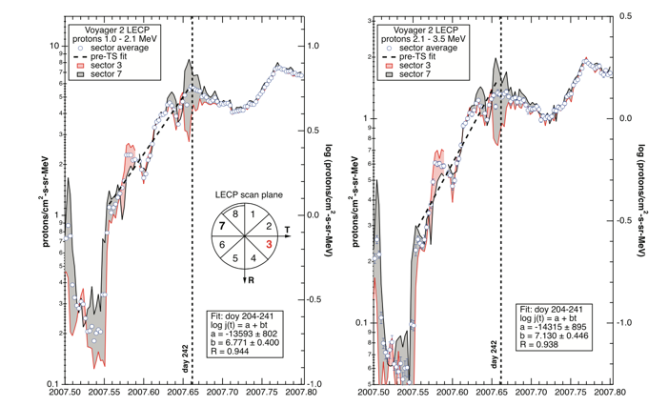
Overview of basic HTS Scale sizes
Florinski et al, GRL, doi:10.1029/2009GL038423, 2009
Essentially two scales:
HTS precursor scale corresponding to ACR diffusion scale length L_diff ~ K/U
Subshock scale corresponding to PUI scales with superimposed smaller scale structure
Effectively diffusive …
Fitted diffusion coefficient ~ 10²⁰ cm²/s for 1 – 3.5 MeV
Theory ➔ 4 X 10¹⁹ cm²/s (Zank et al 2006)
=> precursor scale ~ 0.35 au
However, for inward HTS speed ~60 km/s ➔ precursor scale ~ 1.77 au

Slide 6
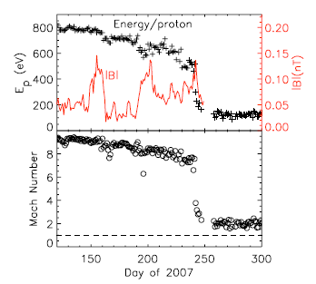
Essentially two scales:
HTS precursor scale corresponding to ACR diffusion scale length L_diff ~ K/U
Subshock scale corresponding to PUI scales with superimposed smaller scale structure
Most of the solar wind flow energy does not go into the solar wind plasma.
The fast mode Mach number near the TS.
Richardson et al 2008

Slide 7
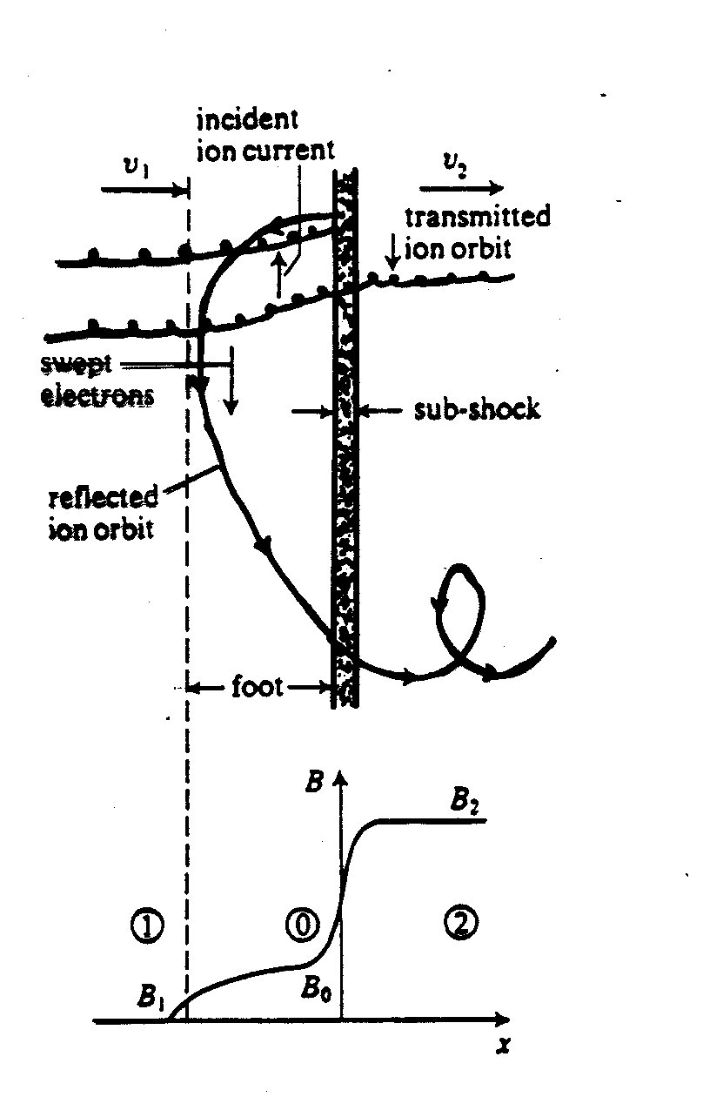
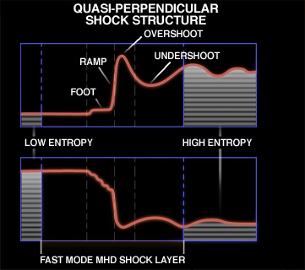
BASIC PHYSICS of the HTS subshock:
Zank et al JGR 1996
Zank et al 2010, Burrows et al 2010

Slide 8
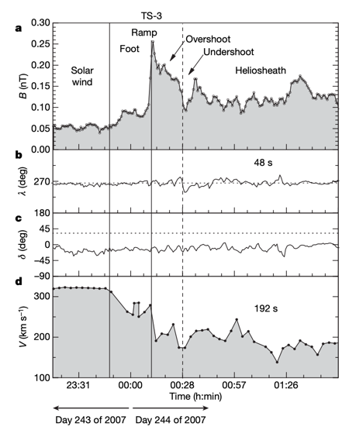
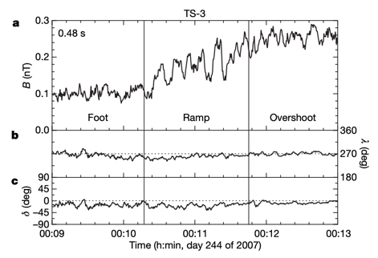
Voyager 2 observations of the HTS
Burlaga et al. 2008
TS-3 is a supercritical quasi-perpendicular shock. The magnetic field strength profile shows the classical features of a supercritical quasi-perpendicular shock: a “foot”, “ramp”, “overshoot”, “undershoot”, and smaller oscillations. (Right) The internal structure of the ramp of TS-3. Note oscillatory structure in the foot and ramp.

Slide 9
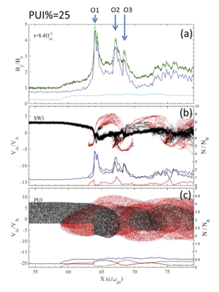
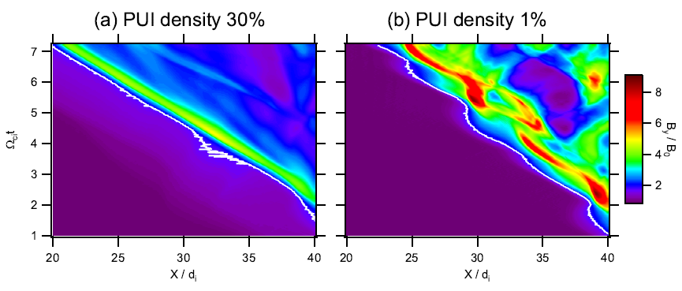
PIC Simulations
Magnetic field magnitude plots (left) by Oka et al., 2010 where the white curves indicate shock front position, and (right) stack plots by Lembege & Yang 2016.
PUI foot ~ PUI gyroradius, SW proton foot ~ cold SW ion gyroradius, ramp scale as several election inertial lengths

Slide 10
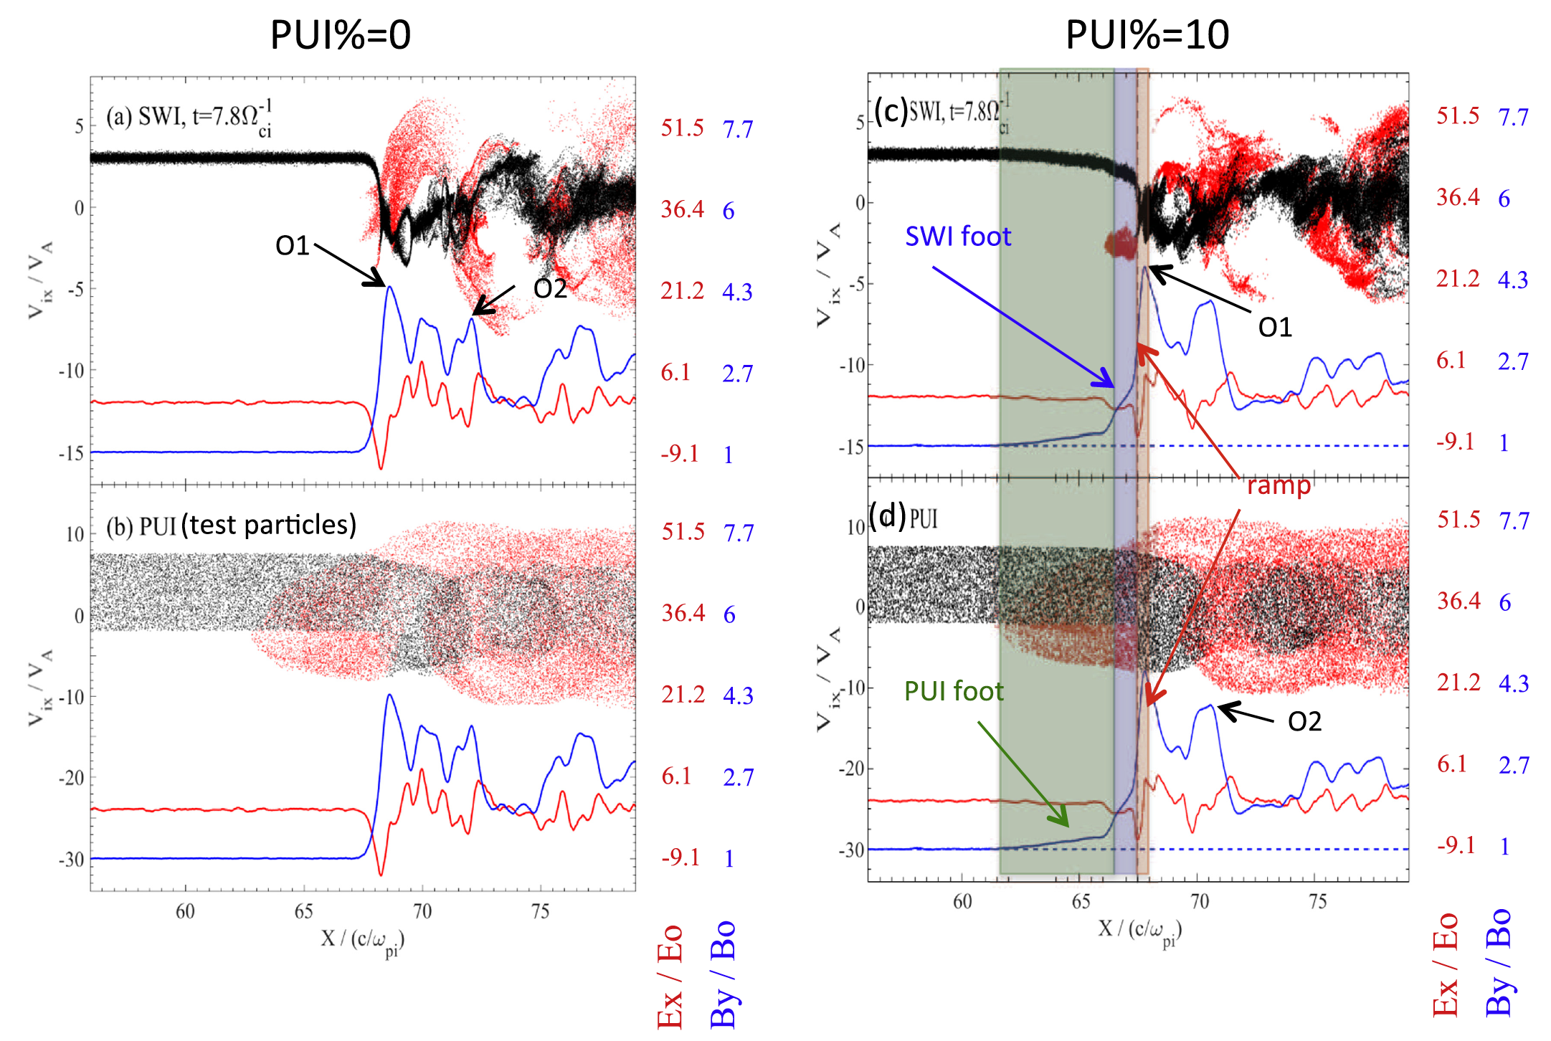
Further detail from Lembege & Yang 2016
Absent PUIs, shock structure is determined by SW protons, and the transition scale is narrow, being only a few c/ω_{pi}.
Reflected PUIs produce an extended PUI foot.
Resulting pressure gradient forces SW protons to decelerate – essentially forming a form of precursor on scale length of PUI length scale.
Possible additional acceleration of PUIs diffusively will yield an additional diffusive length scale to shock structure (Motafavi et al 2018).

Slide 11
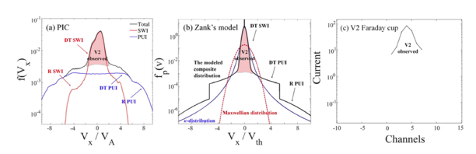
Total velocity distribution for the ions (black curve) downstream of the heliospheric termination shock. The contribution to the full distribution function by solar wind ions and PUIs is identified by the red and blue curves respectively. The red shaded region corresponds to the solar wind ion distribution over the range that Voyager 2 can observe these particles.
The heliosheath particle distribution (black) predicted and modeled by Zank et al. 2010. The Maxwellian (red) and κ (blue) distributions with the same temperature and particle density are shown for reference.
The cool core of the ion distribution observed by Voyager 2 downstream of the TS-3 heliospheric termination crossing.

Slide 12
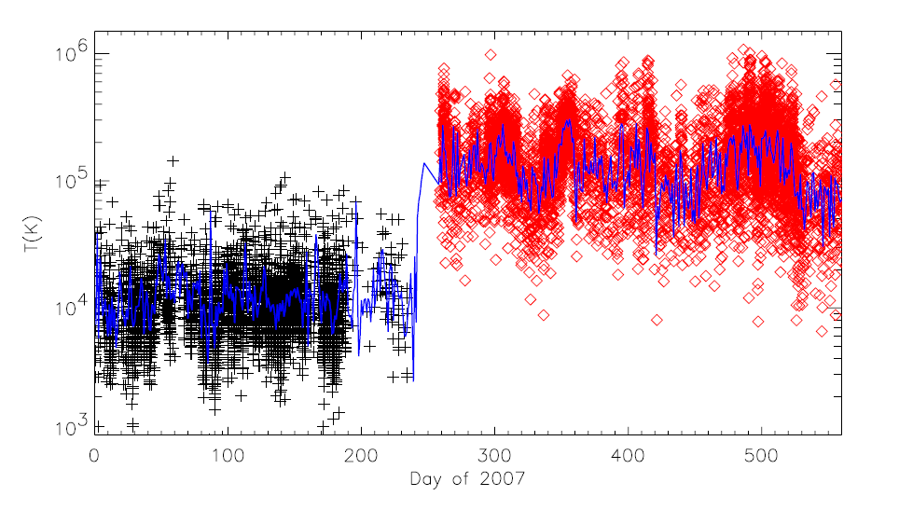
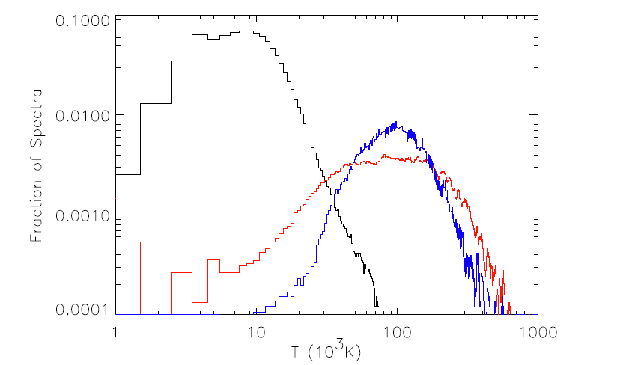
The temperatures observed by V2 in the solar wind and heliosheath. The points show high-time-resolution data and the lines show daily averages.
Richardson et al., 2008
Histograms of the temperature distributions in the solar wind and the heliosheath. The black shows the solar wind distribution, the red shows the heliosheath distribution, and the blue shows the distribution of the solar wind temperature multiplied by 13, the ratio between the upstream solar wind and downstream heliosheath temperatures.

Slide 13
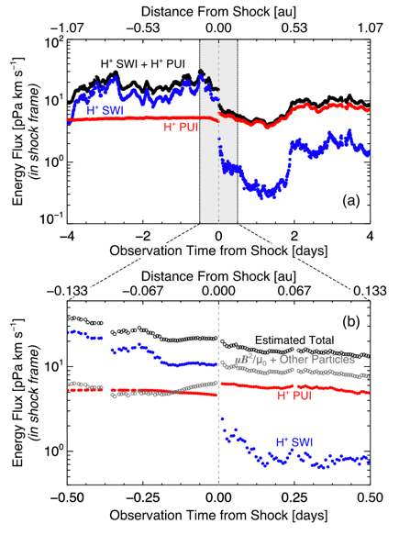
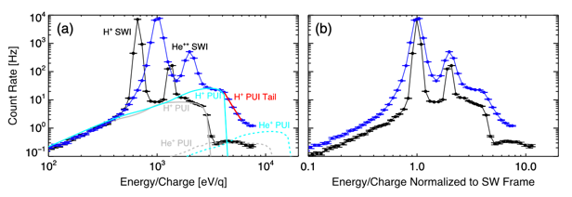
Existing New Horizons Observations
Zirnstein et al, PRL, 2018
Gradual reduction in SW flow speed and simultaneous heating of SW protons observed ahead of shock, ➔ upstream energetic particle pressure gradient.
SW protons lose ∼85% of their energy flux across the shock and PUIs preferentially heated.
PUI tail downstream of shock. Energy flux of all PUIs approximately six times that of SW protons.
PUIs, including suprathermal tail, contain almost half of the total downstream energy flux in the shock frame.

Slide 14
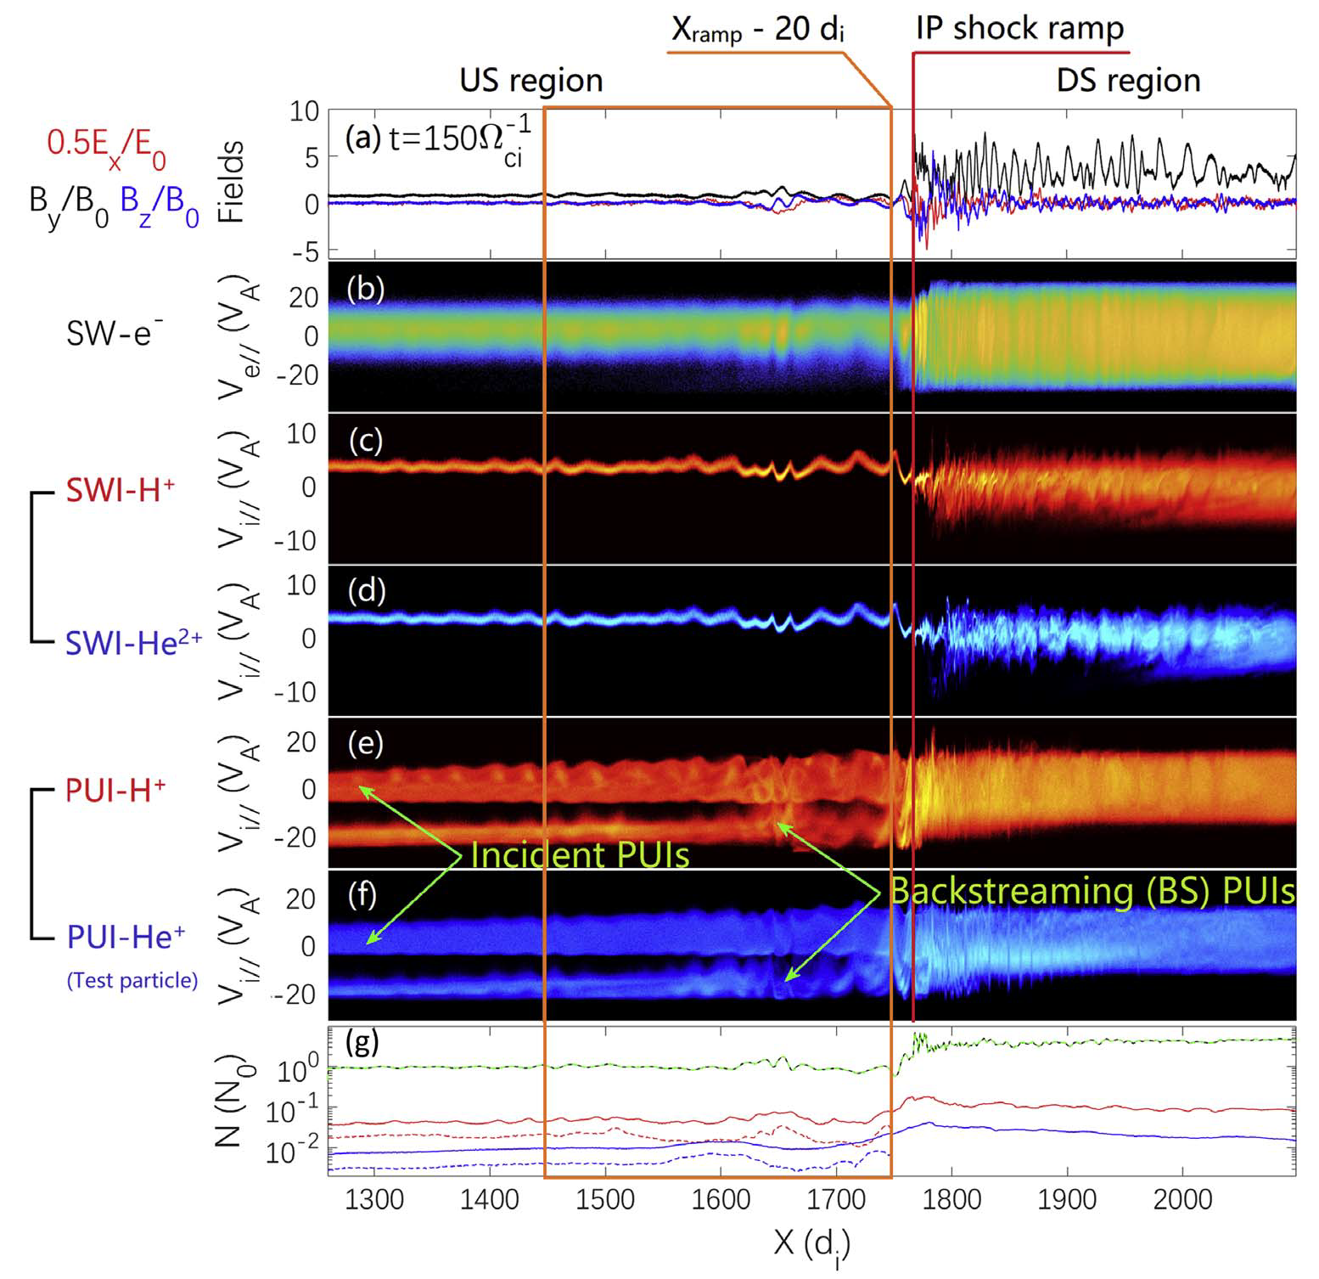
Motivated by NH observations of extended backstreaming PUIs in vicinity of shocks, Lembege et al 2020 used 1D full PIC simulation for an IP shock in the outer heliosphere (~30au).
Oblique shock (Θ_{Bn}=55○).
Clearly backstreaming PUIs, but no backstreaming SW ions.
Basic physics of oblique shocks likely similar to that of quasi-perp shocks in terms of shock microphysics and hence TSP physics likely corresponds to preferential reflection of PUIs by cross-shock potential.
Lembege, Yang, & Zank, ApJ 2020

Slide 15
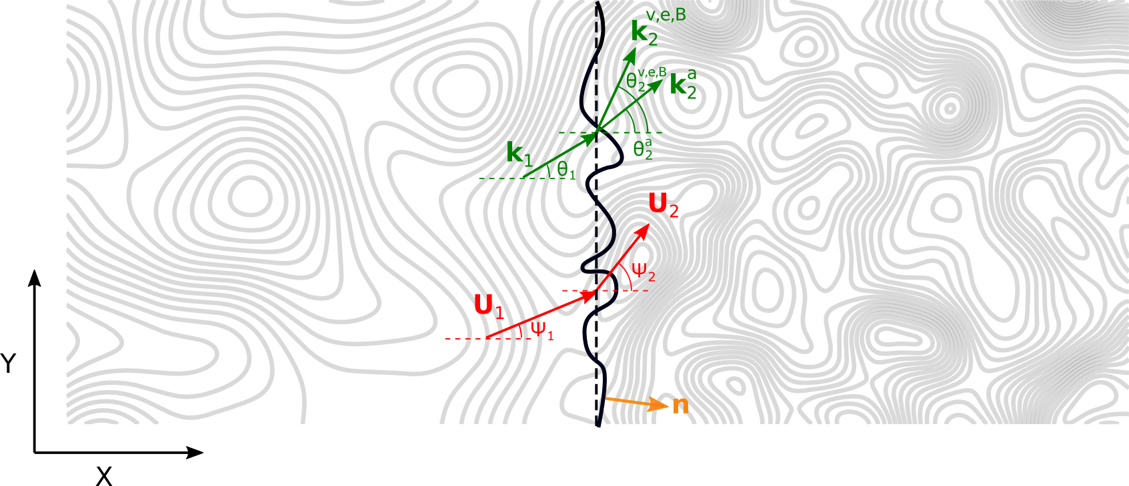
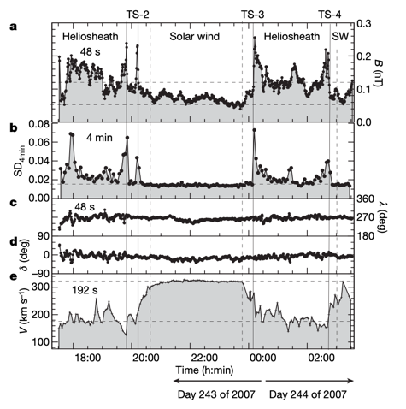
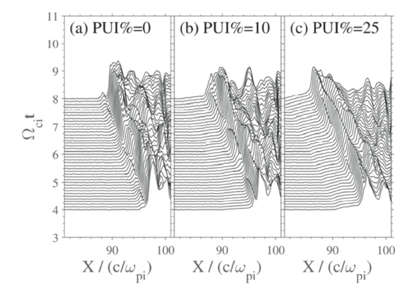
Effect of Turbulence on the HTS
The mean magnetic field B₀ = B₀z is in/out of the page.

Slide 16
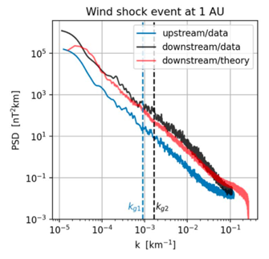
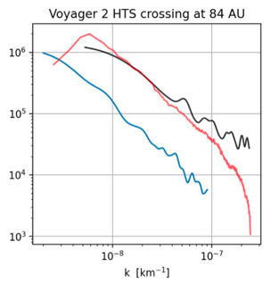
Turbulence Downstream of the HTS
Comparison of theoretical (red) and observed downstream (black) magnetic variance spectra for Wind and Voyager 2 is excellent.
Enhancement in downstream spectral intensity and the spectral slope well captured by theory.
Only Wind plasma data of sufficient resolution that it can be used to determine kinetic energy and density variance spectra upstream and downstream of the shock.
Can NH provide sufficiently high resolution observations to derive plasma spectra?

Slide 17
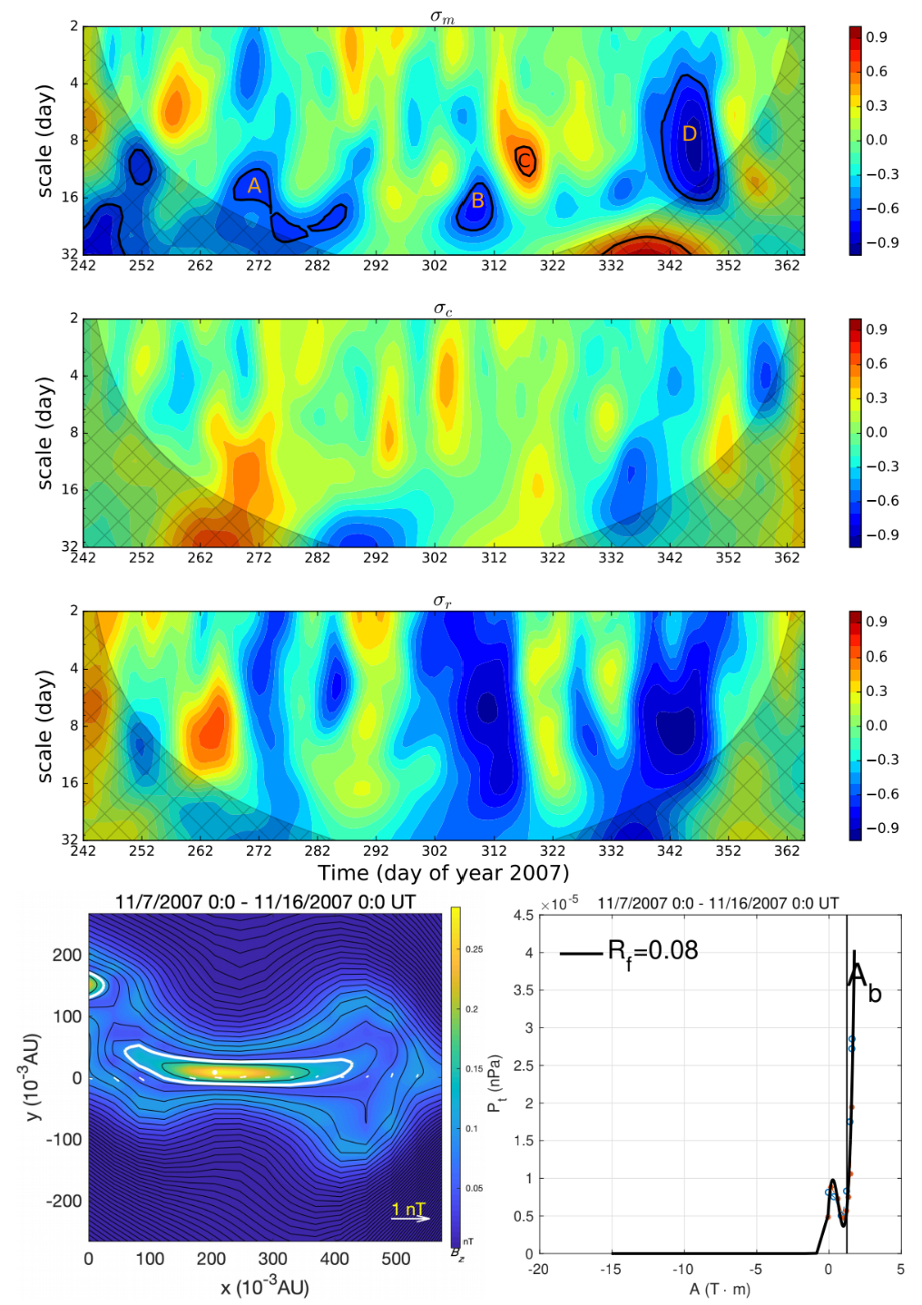
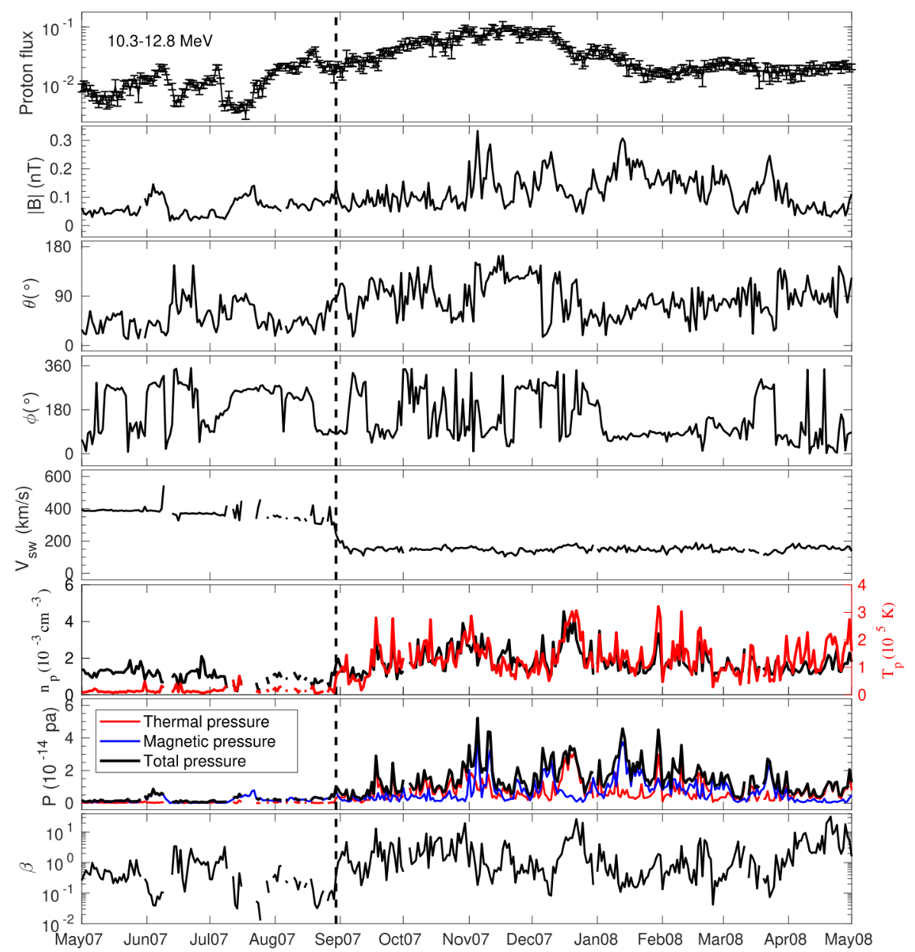
LECP Voyager 2 observations
Zhao et al ApJ 2019

Slide 18
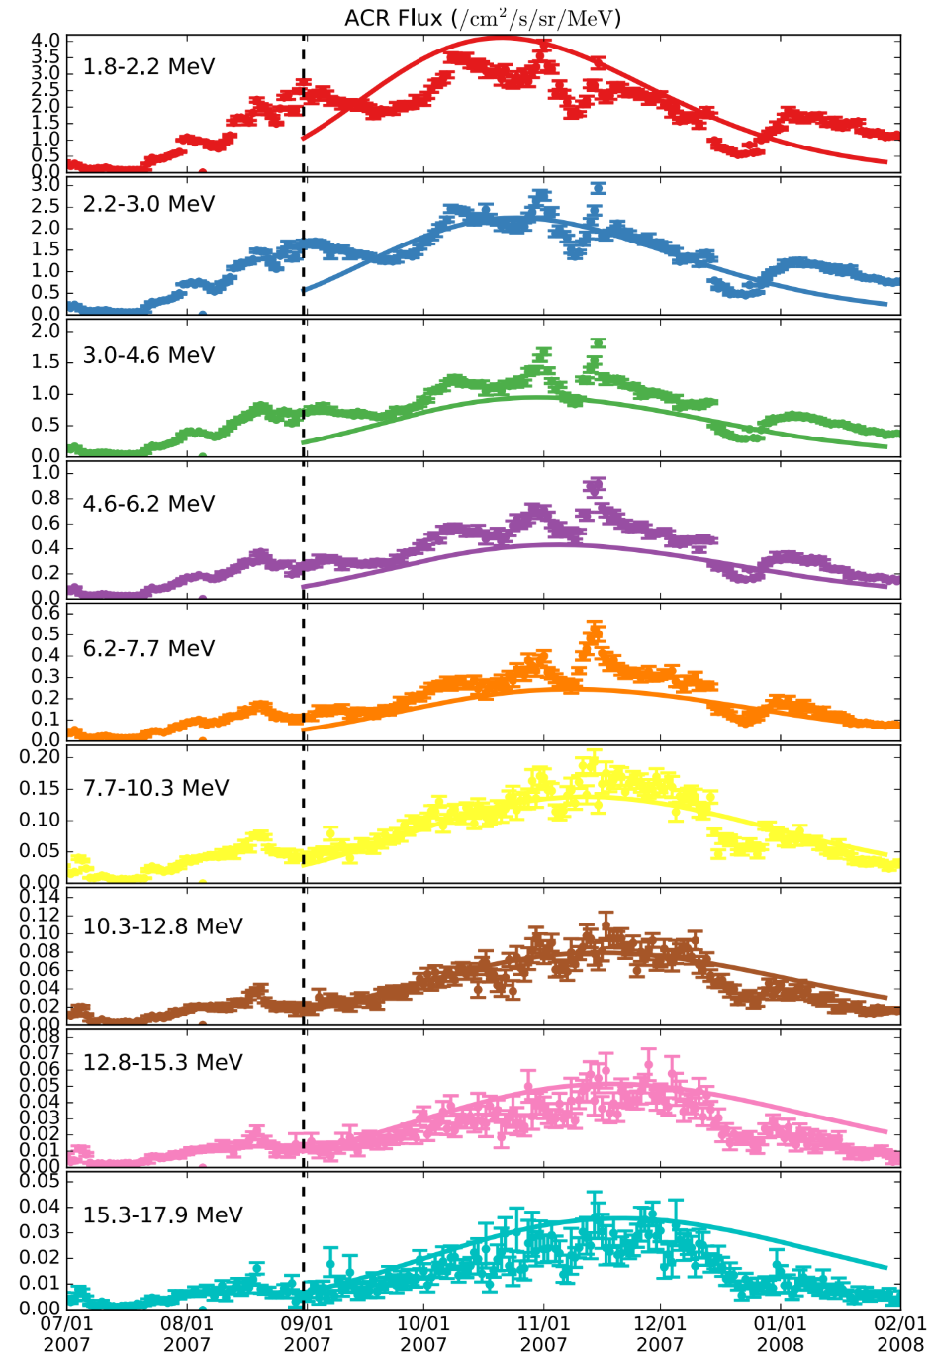
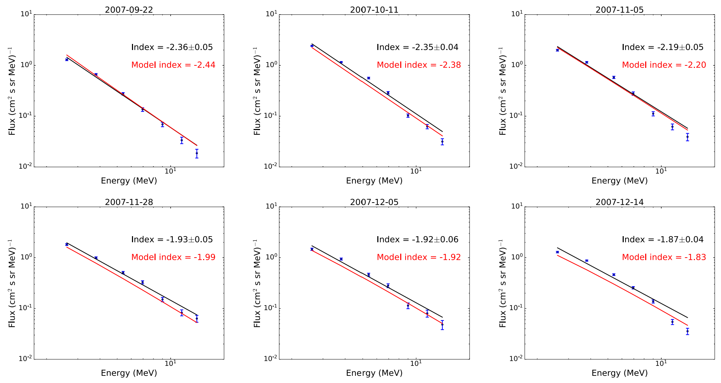
ACR acceleration
Observed ACR energetic particle spectrum ~ 100 days after the HTS crossing shows agreement with our reconnection-based stochastic particle acceleration model (Zank et al. 2014, 2015; Zhao et al. 2019b).
f(x)

Slide 19
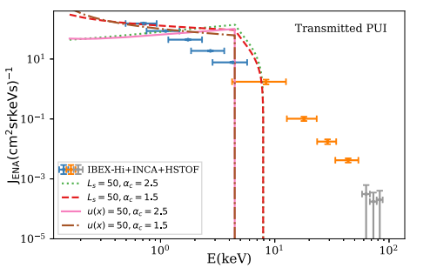
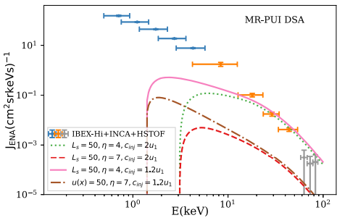
Connecting Energetic PUI and Energetic Particle Data to ENA Spectra
Wang et al ApJ 2023
Current theory of ENA creation exploits the PUI population transmitted (direct transmission, reflection + transmission) to form ENAs up to ~ 4 keV (left)
Wang et al 2023 add MRI/shock surfing as injection mechanism for DSA, which produces higher energy spectrum for creation of ENAs – yields spectral break at about 4 – 6 keV in ENA spectrum
PUI spectra and low-energy energetic ion spectra a critical measurement

Slide 20
Some Time Scales
Precursor: Diffusion time scale for 1 – 3.5 MeV protons ~ 22.6 hours
Scale size 0.35 au ➔ Observation time of ~ 911 hours
Subshock foot: 0.1 nT B, Gryrofrequency ~ 10⁻² – 10⁻³ rad/s, PUI gyroradius ~ 37,000 km
Foot scale size ~ 37,000 – 80,000 km ➔ observation time 38 – 60 minutes (this will be affected by the shock speed itself so it may be less – for V2, the foot was traversed in about 23 minutes). If we take a shock moving inward at ~50 km/s (consistent with the V2 TS3 shock) ➔ 10 minutes observation time for NH to see foot.

