Slide 1
The New Horizons Lyα All-Sky Map
Randy Gladstone
SwRI
15 May 2024
STM #56
APL

Slide 2
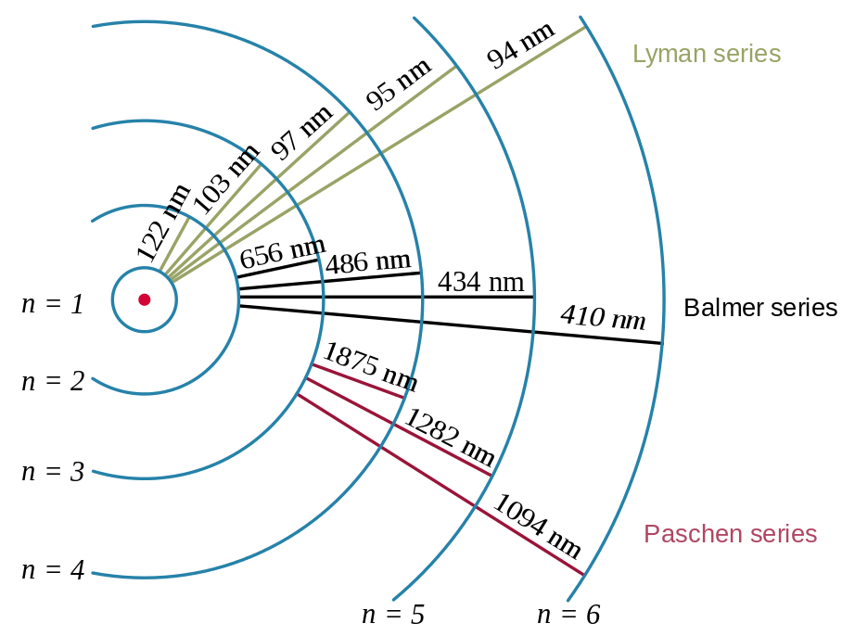
Lyman alpha
Lyman alpha (Lyα) photons result when H atoms transition from the n=2 to the n=1 electronic energy levels (121.6 nm)
Since this is the simplest transition in the simplest atom, Lyα emissions are ubiquitous throughout our solar system and the universe
Credit: Wikipedia, A_hidrogen_szinkepei.jpg: User:Szdori

Slide 3
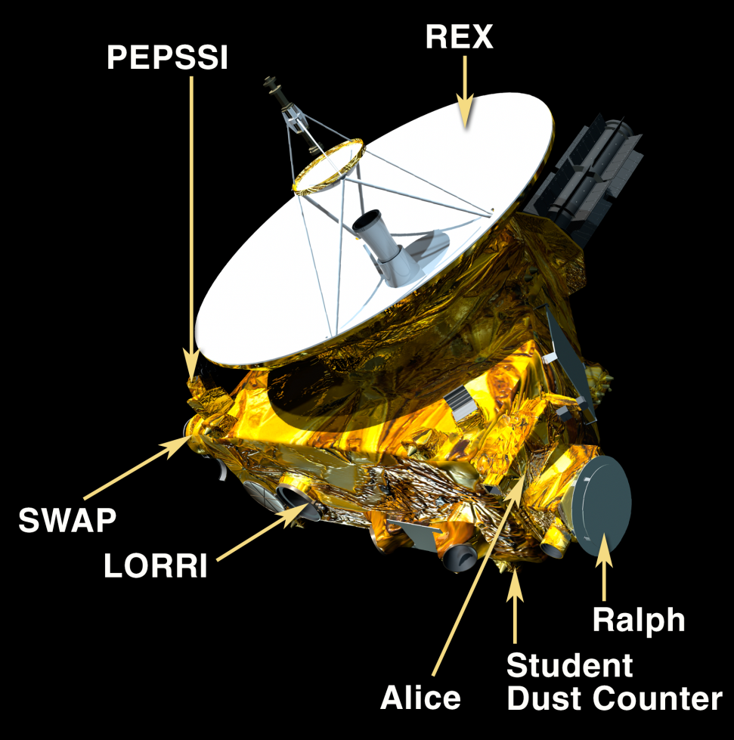
New Horizons & Alice Instrument
Ralph: Color Camera & NIR Spectral Imager
Alice: Ultraviolet Spectral Imager
LORRI: HiRes Panchromatic Camera
REX: Radio Science Experiment
SWAP: Solar Wind At Pluto
PEPSSI: Energetic Particles
SDC: Student Dust Counter
Alice Performance
Mass: 4 kg
Power: 4 W
Spectral Range: 52-187 nm
Spectral Res.: 0.36 nm
Spatial Res.: 0.6°
Aperture: 4 x 4 cm²
Binning: 1024 spectral x 32 spatial bins

Slide 4
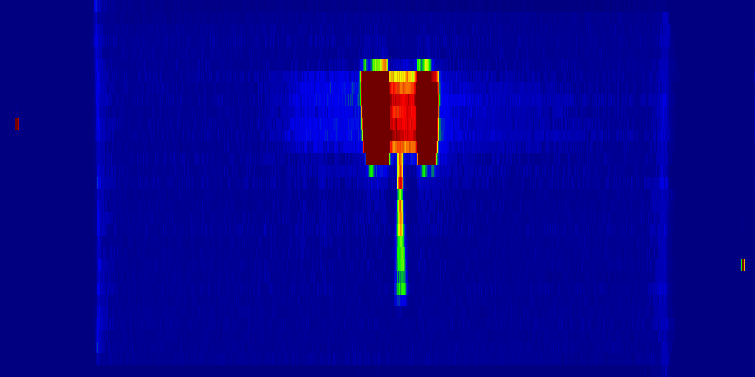
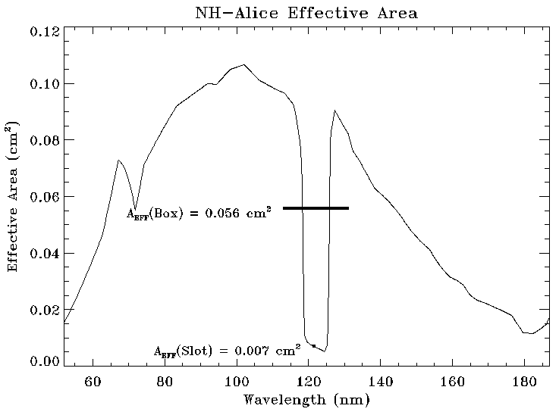
Alice Slit Shape & Effective Area
KBr photocathode
CsI photocathode
Left: A 1-hour Alice spectral image of the upwind direction (1/28/2017) shows the 4°x0.1° “slot” + 2°x2° “box” slit shape, lit up by IPM Lyα
Right: A_{EFF} vs. wavelength, showing the “Lyα gap” containing the slot, and the spillover of IPM Lyα in the box onto the KBr and CsI photocathodes; sensitivity S = 4.9±0.1 counts/s/R (cf., for V1 UVS, S ~ 0.01 counts/s/R)

Slide 5
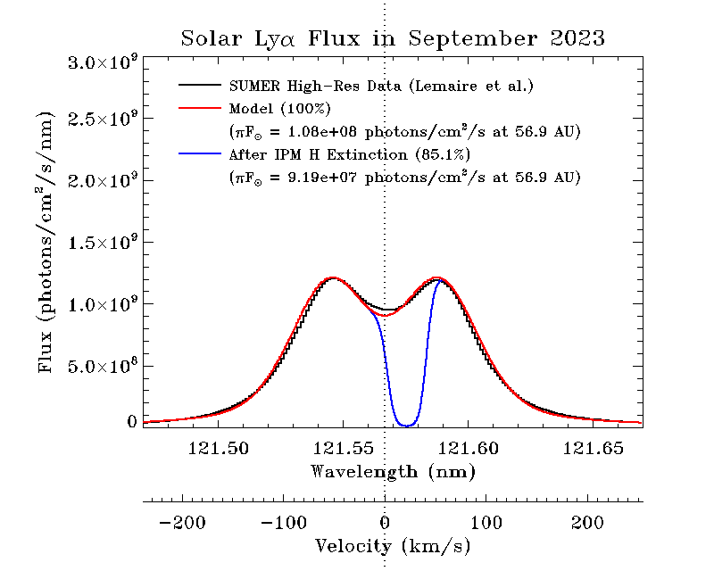
Solar Lyα Line Profile

Slide 6
New Horizons Trajectory & IPM Data
IPM Lyα observations on a single great circle were made with Alice during cruise to Pluto, at solar ranges of 7.6, 11.3, & 17.0 AU
6-great-circle Lyα scans of the sky were made near Pluto flyby, at solar ranges of 32.7 & 32.9 AU, and similar scans are made every year or so
The first 6 were on 1/28/2017 (37.6 AU), 9/19/2017 (39.5 AU), 3/3/2019 (43.8 AU), 8/30/2019 (45.2 AU), 4/27/2020 (47.2 AU), 9/29/2021 (51.3 AU) (a 30º-wide “proof-of-concept” sector scan was also made); most recently, the all-sky map was made 9/2-11/2023 (56.9 AU)

Slide 7
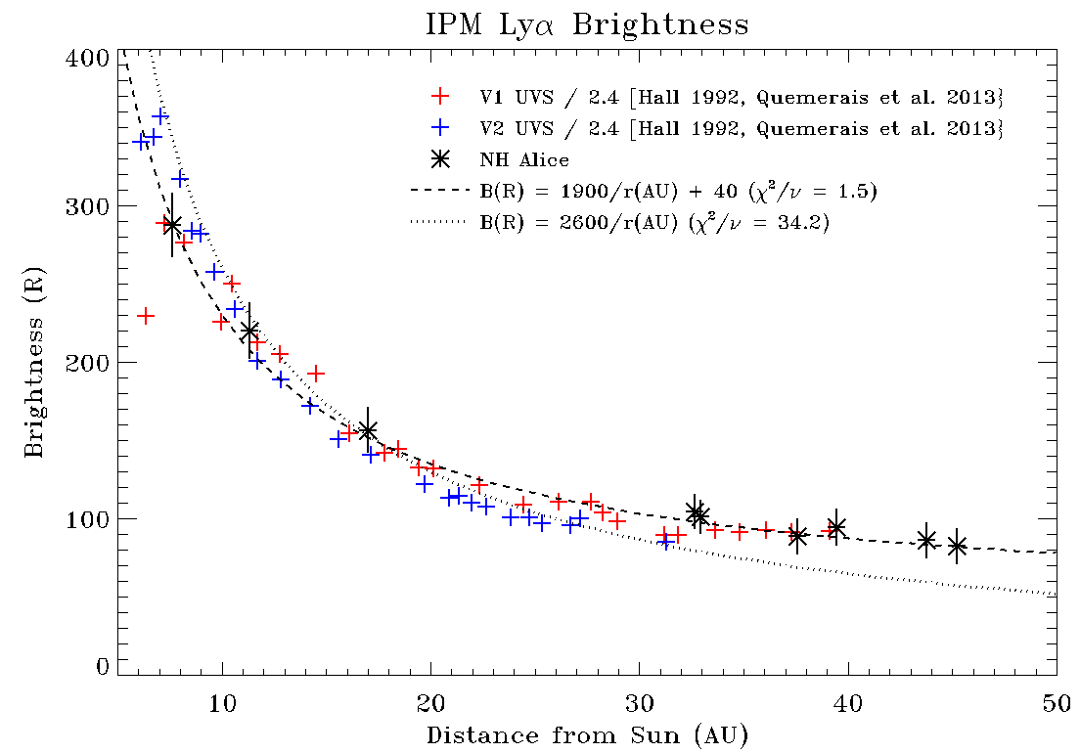
IPM Lyα vs Solar Distance
The IPM Lyα brightnesses are scaled by 3.0x10¹¹ / F_{SUN} (photons/cm²/s at 1 AU), to account for solar variability
The upstream-looking NH data are quite reasonably fit by a d_{SUN}⁻¹ profile plus a constant ~40-R source further upstream (as suggested by Hall et al. [1993] & Katushkina et al. [2017])
Scaling of Voyager 1 data down by 2.4x (as suggested by Quémerais et al. [2013]) works very well, although it has been challenged by Ben-Jaffel & Holberg [2016]

Slide 8
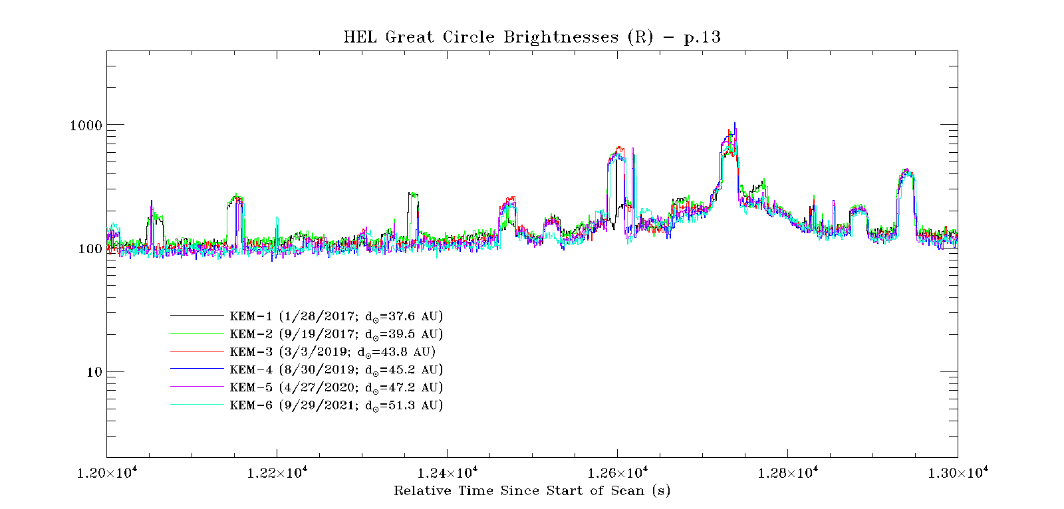
Lyα Background Scan - Zoom
Lyα Brightness (Rayleighs)
This plot shows 1000 seconds worth of Alice count rate data from the same small portion (about 1/36th) of the existing 6-great-circle observations, color-coded by date
The observations are mostly consistent with each other, but small differences in pointing result in some stars going through the Alice “box” (the ~20-s wide peaks) in one observation and through the Alice “slot” (the ~1-s wide peaks)

Slide 9
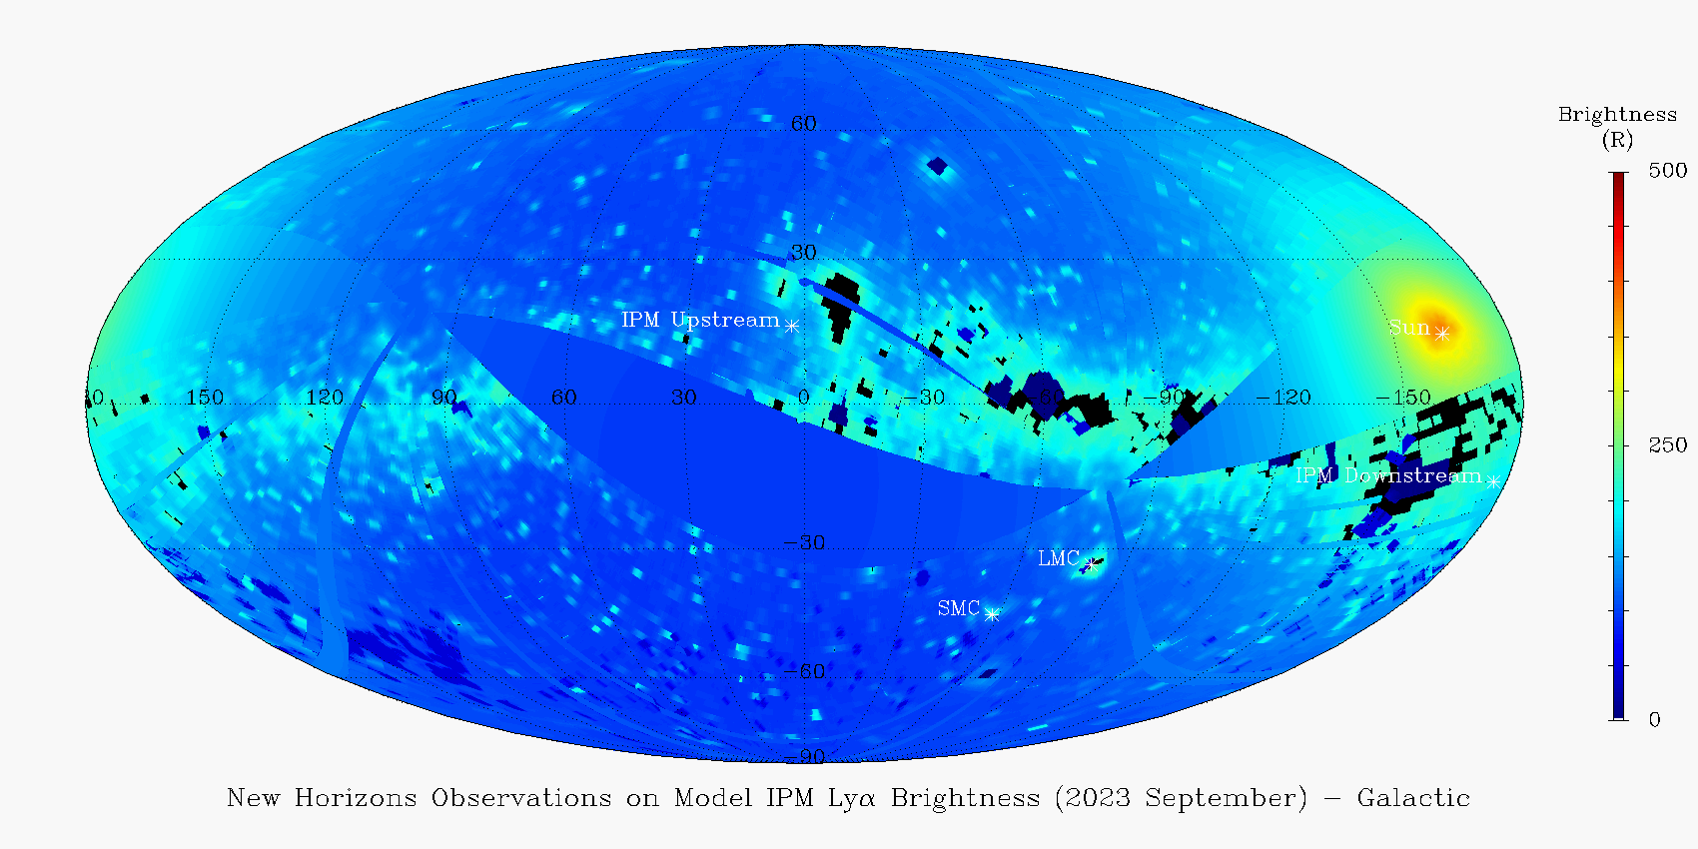
IPM Lyα in Galactic Coordinates
The 75-great circle scan obtained by Alice in September 2023 is shown overlaid on Wayne Pryor’s “hot” model Lyα IPM background (including multiple scattering of solar Lyα and 43 R galactic Lyα background); the good fit shows that brightness variations will likely be at ~10-20 R level
This version of the map uses median filtering of the brightnesses

Slide 10
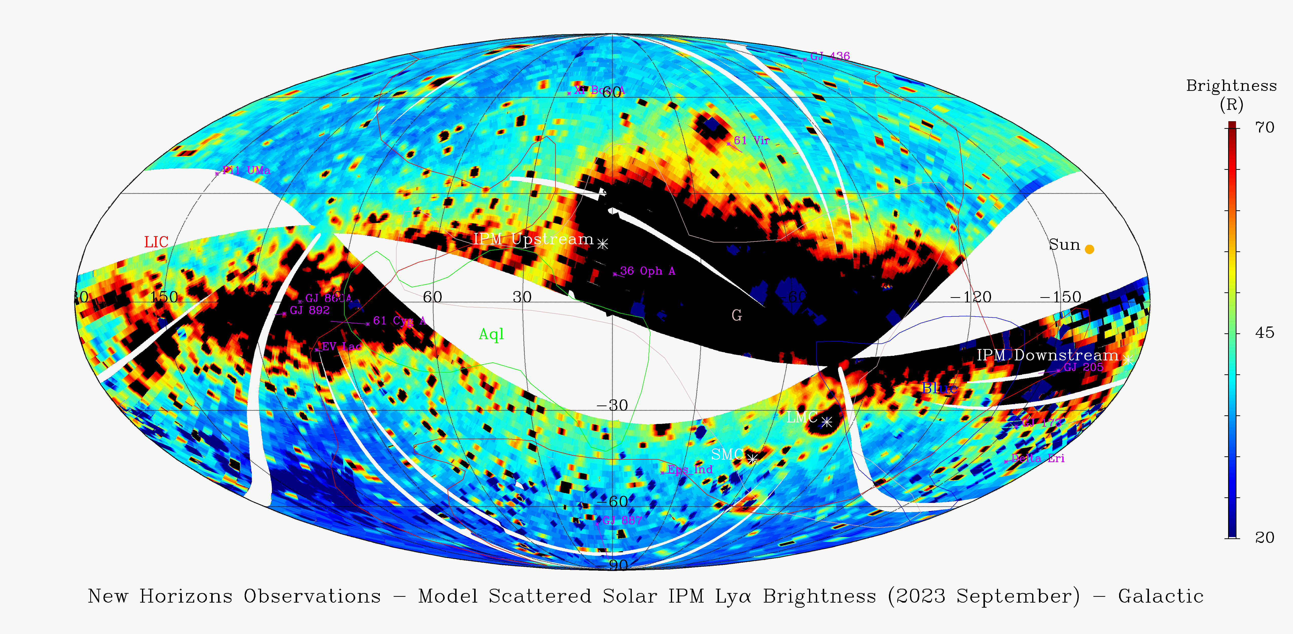
Residual Lyα
Subtracting Wayne Pryor’s model map of scattered solar Lyα leaves a residual map which is due to a galactic background of ~43 R plus any diffuse sources and sinks in the LISM & heliosphere
The ecliptic north pole is at (l,b) = (96.4º,29.8º); the pole of all the Alice great circles is at (l,b) = (101.4º,18.2º)

Slide 11
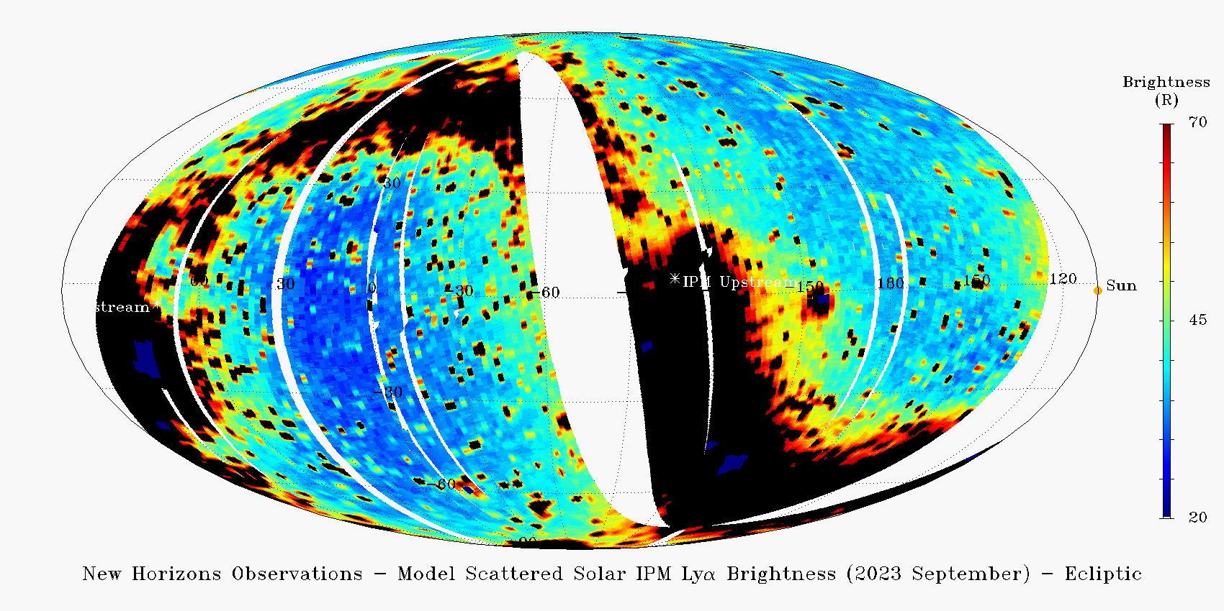
Residual Lyα
Same residual procedure as earlier, here shown in ecliptic coordinates centered on the anti-Sun direction; i.e., toward the ecliptic coordinates of (λ,β) = (287.8º,2.0º)
The IPM upstream and downstream directions are indicated
The galactic north pole is at (λ,β) = (180.0º,29.8º)

Slide 12
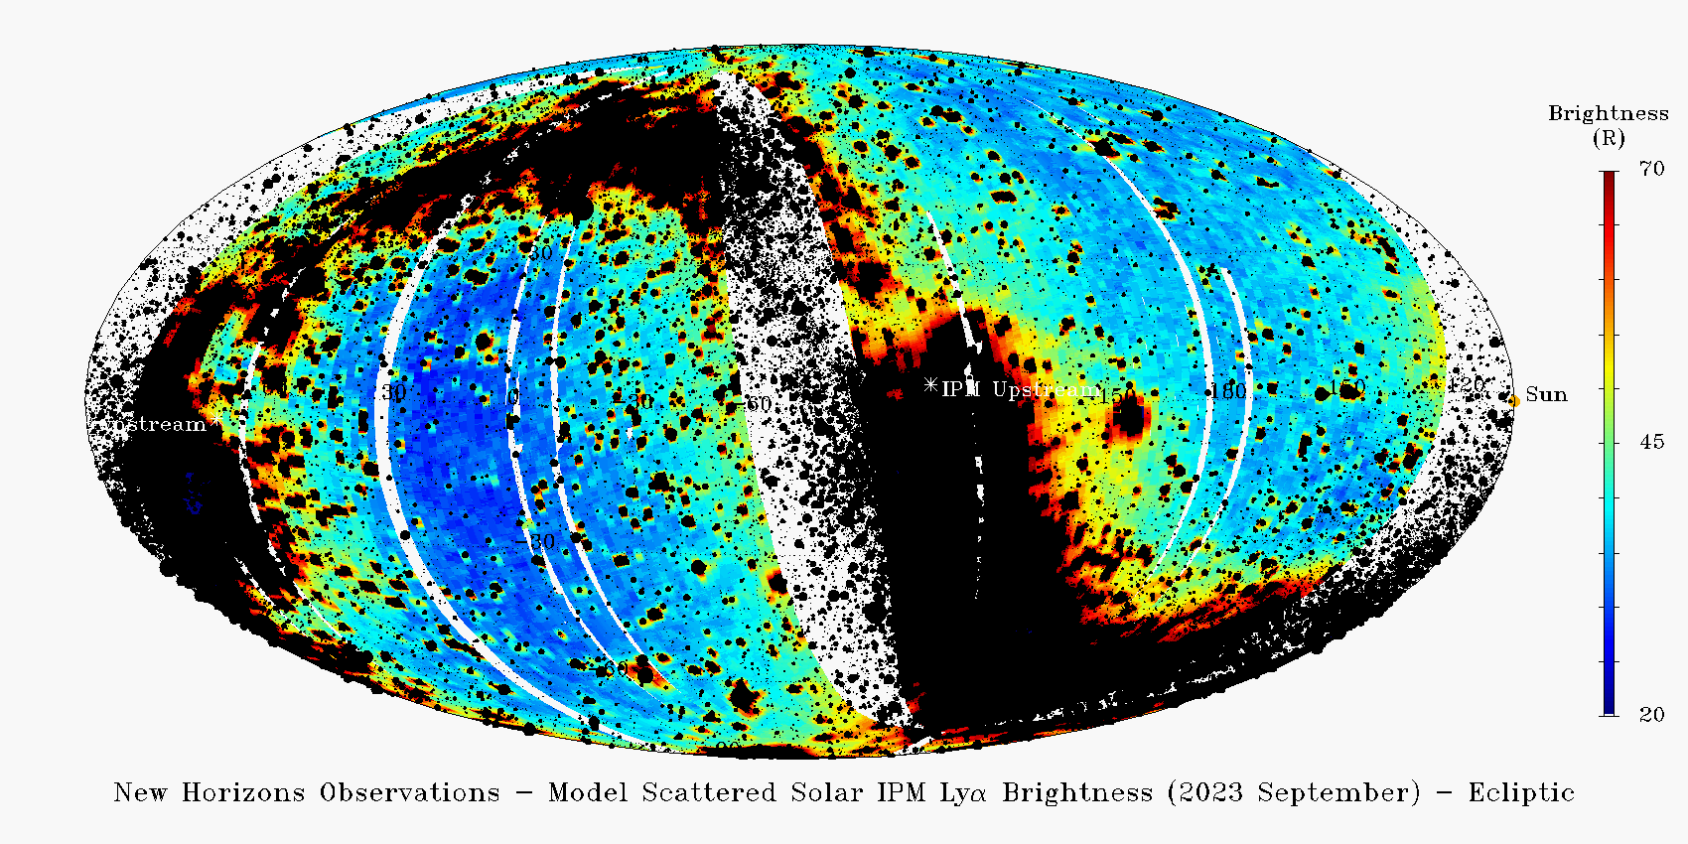
Residual Lyα
Same residual procedure as earlier, here shown in ecliptic coordinates centered on the anti-Sun direction; the IPM upstream and downstream directions are indicated
Added star map of ~90,000 brightest UV stars, as black circles (larger size indicates brighter expected Alice count rates) [Velez et al. 2024]

Slide 13
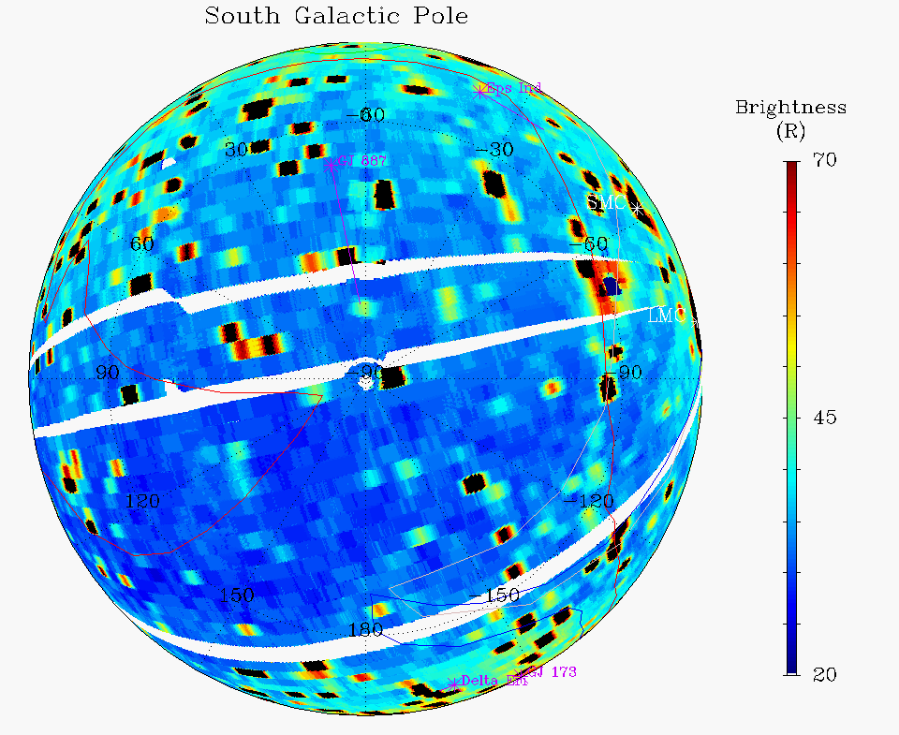
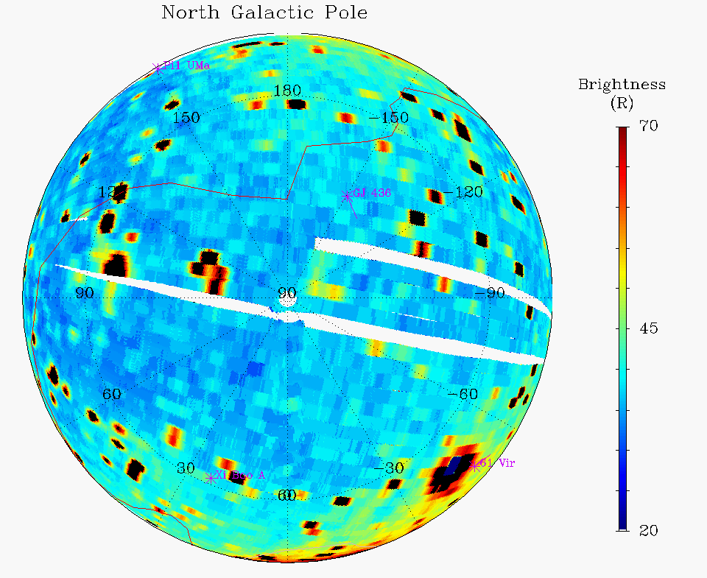
Residual Lyα Polar Maps
The darkest regions of the sky are at the galactic poles, which are not well-displayed in the Mollweide projection – here we present polar views of the residual Lyα map (with median filtering)
These maps contain the galactic background along with any other nearby emission and/or absorption by shocks and/or LISM clouds or hydrogen wall, and are the best places to search for such structures

Slide 14
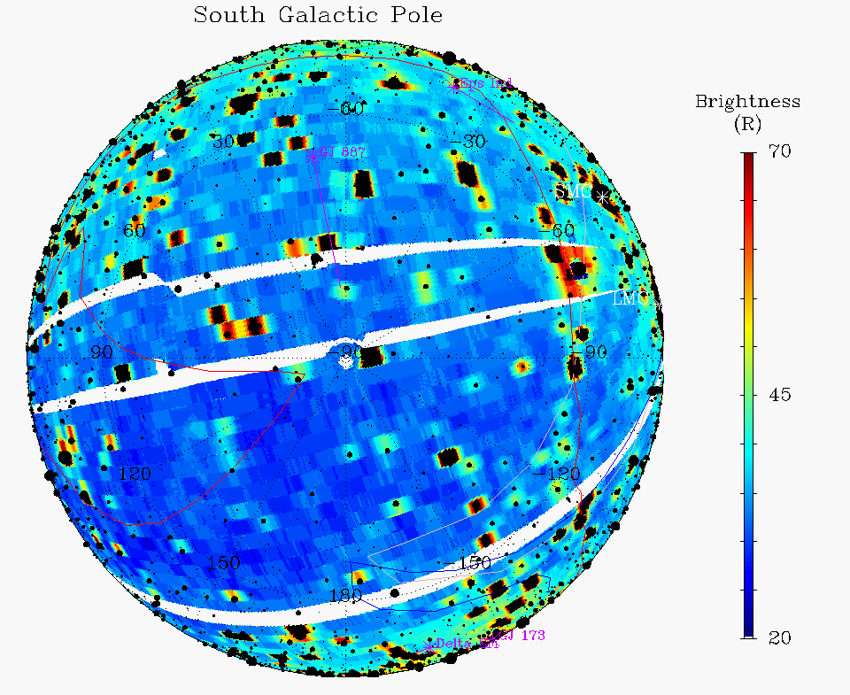
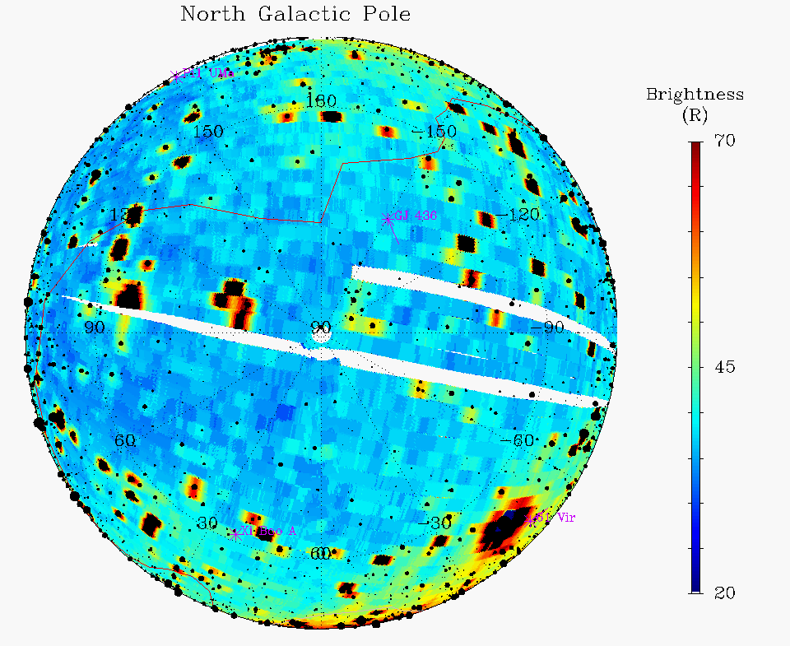
Residual All-Sky Polar Maps
Same polar maps shown here with known UV-bright stars added
Although no change in background is apparent at the previously mapped LISM cloud structures, the maps of the polar regions do show a distinct difference in average residual brightness, with the south pole vicinity at ~30 R and the north pole vicinity at ~40 R
Can this be modeled with a simple model of scattering in the LISM?

Slide 15
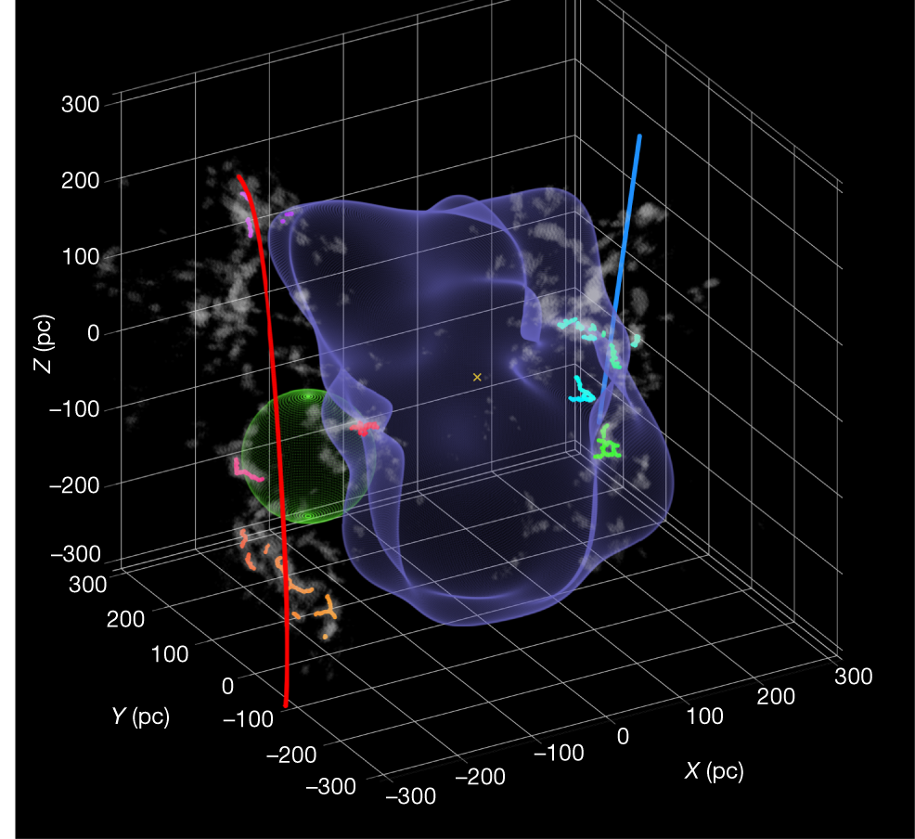
Local Bubble
Out in the LISM, the Sun is currently in a low-density region known as the Local Bubble (LB), where the H density is ~0.1 cm⁻³
The shape is roughly cylindrical, with a radius of ~150 parsecs (pc), and is ~600 pc top to bottom
At the walls of the LB the H density is much larger (3-10 cm⁻³); the top & bottom may open to intergalactic space
Clusters of hot, bright stars (i.e., star-forming regions) are at several locations around the wall of the bubble (contributing to the low LB density by photoionization)
[Zucker et al., 2022]

Slide 16
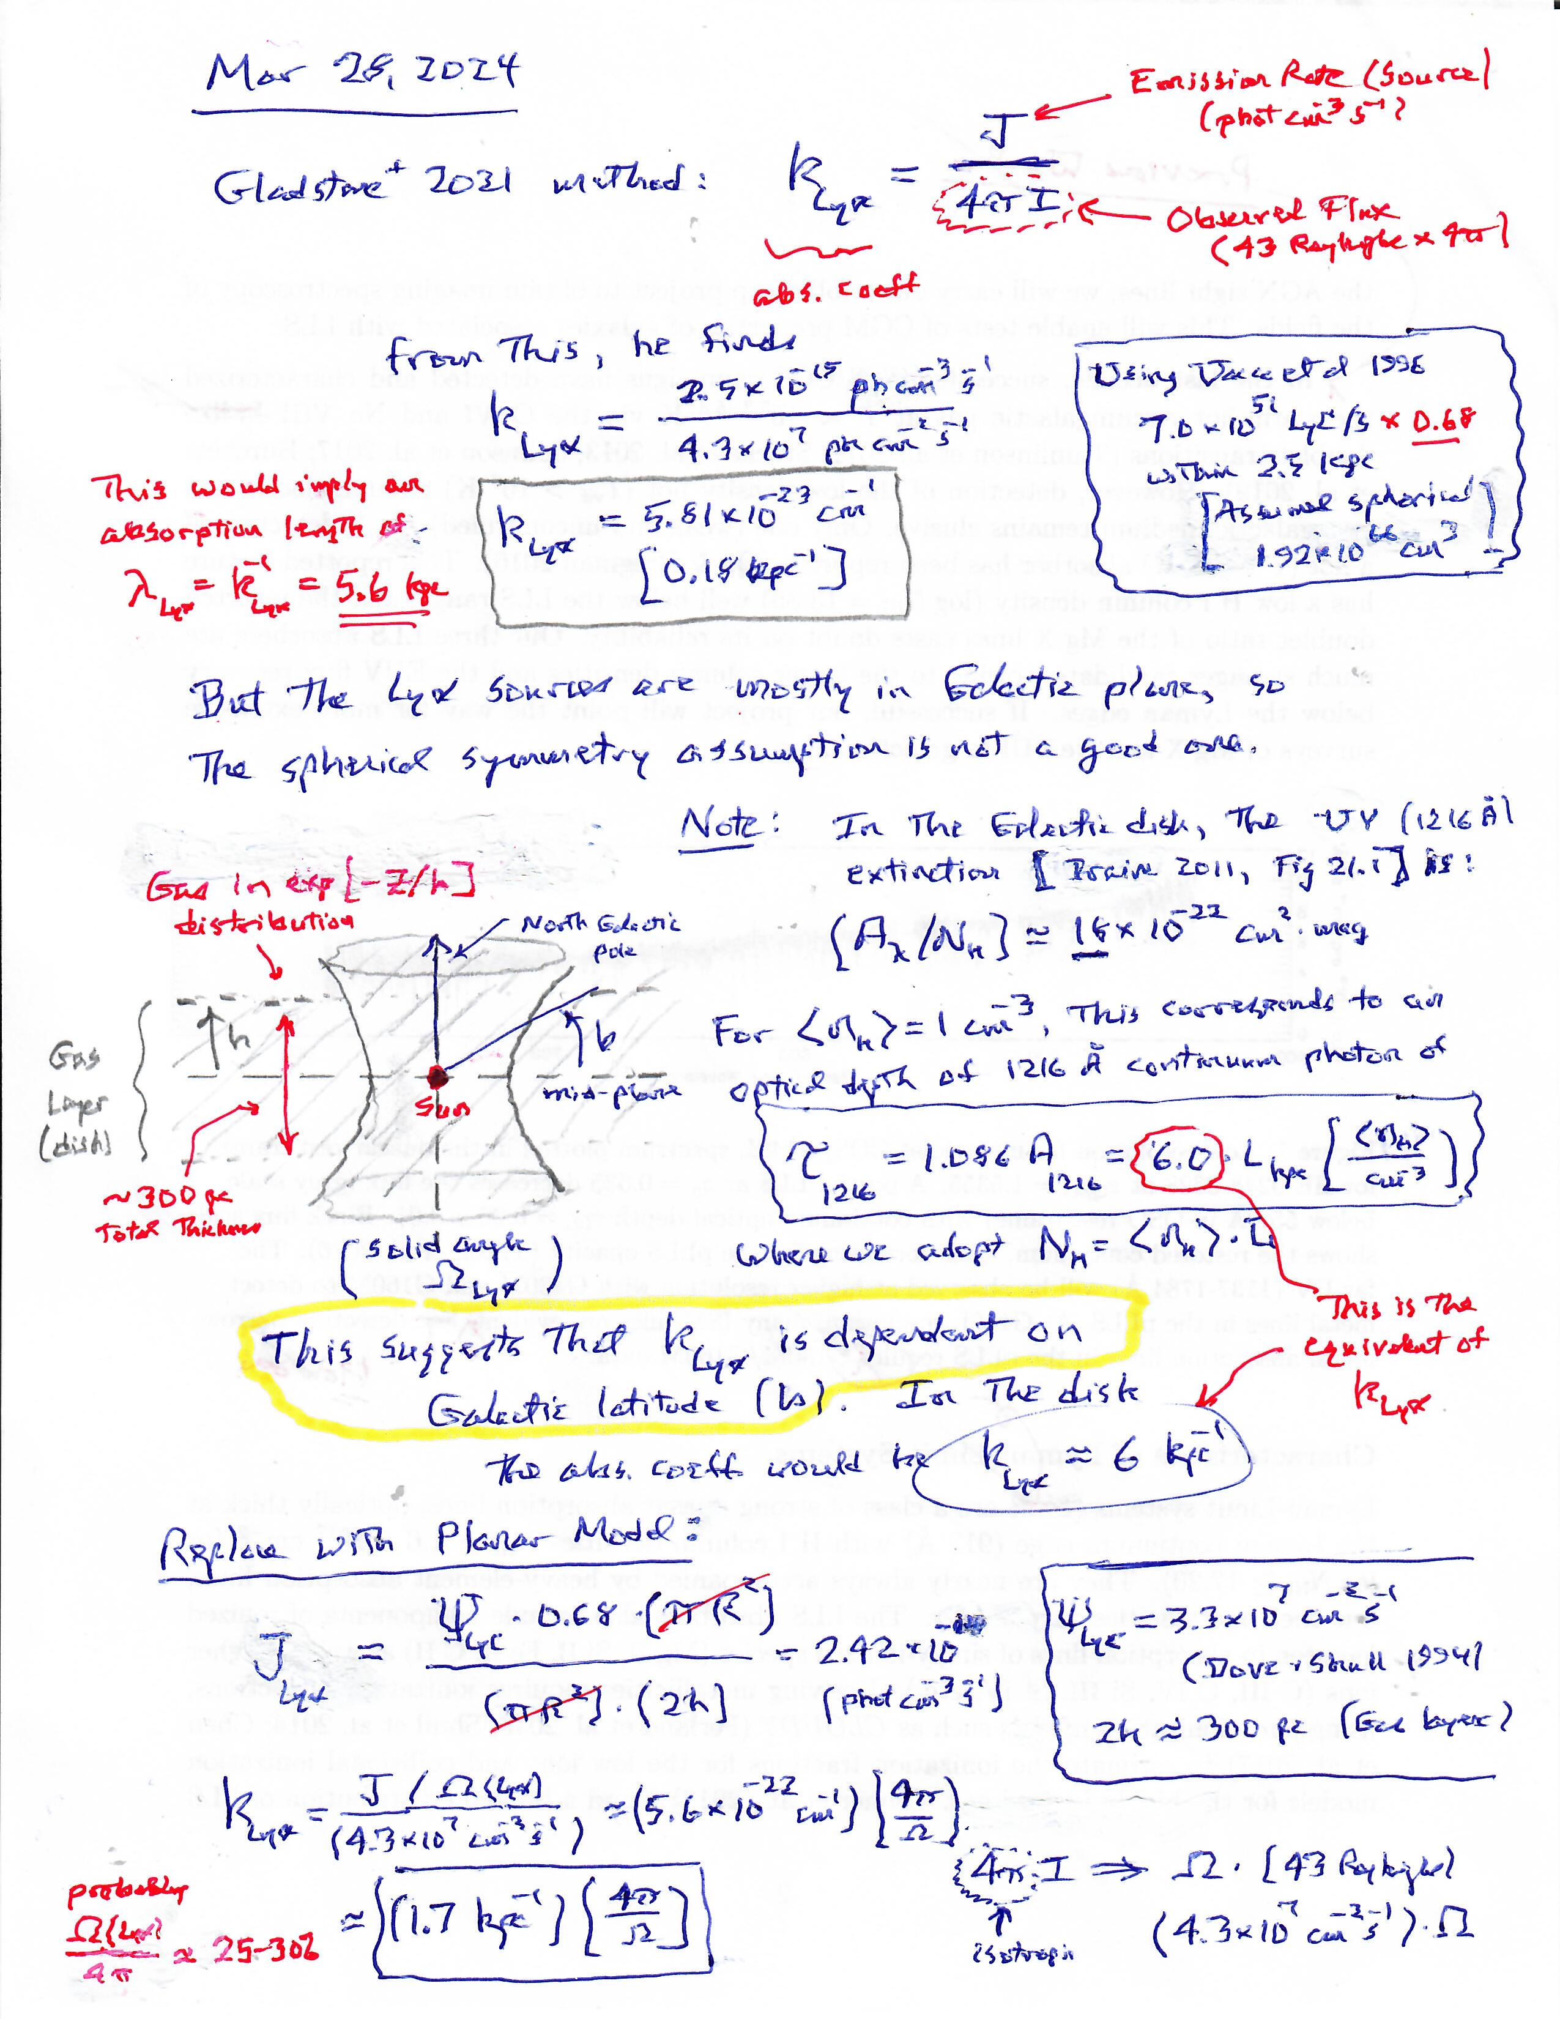
Simple LISM model
Mike Shull recently commented on the 43-R galactic background we reported on in 2021
He found that in the LISM we should have used a ~10× larger Lyα volume emission rate (2.4×10⁻¹⁴ photons/cm³/s, rather than 2.5×10⁻¹⁵ photons/cm³/s)
Since LISM disk is only ~600 pc thick, the Lya brightness may be controlled by disk thickness, rather than dust absorption (e.g., the revised distance for dust τ=1 is ~1/1.7 kpc⁻¹ = 590 pc)
A simple slab RT model could model Lyα scattering in the LISM, and be used to test various explanations for the N/S asymmetry seen by New Horizons

Slide 17
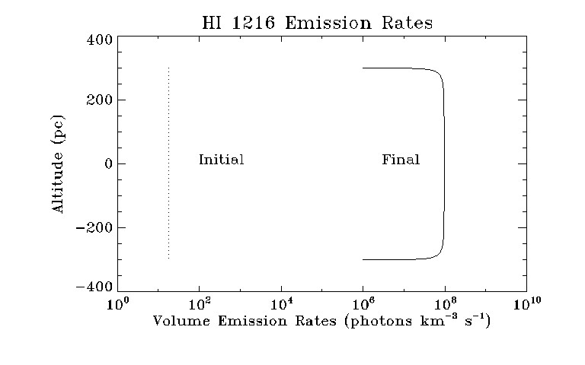
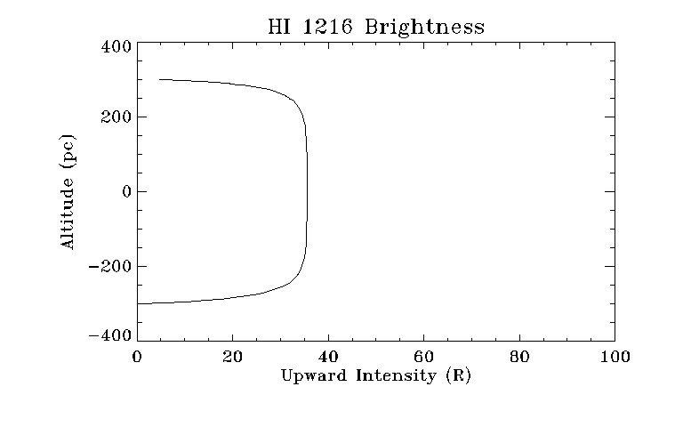
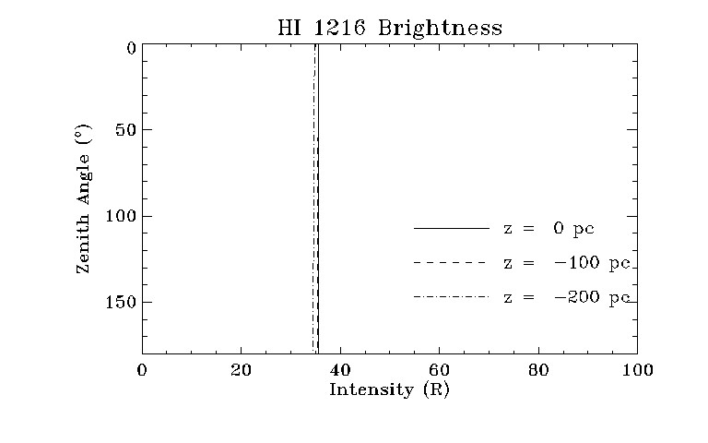
Simple Slab Models – Lyα, uniform V
These simple slab models use a resonance line RT code with angle-averaged partial frequency redistribution, which can handle extremely optically thick plane-parallel scattering problems
In the plots on the right, the upper panel shows the initial (nascent) and final (after scattering) volume emission rate of Lyα photons in a slab that is 600 pc thick, the middle panel shows the downward-looking brightness throughout the slab (which is close to 40 R for our best guess at the H density & T, and k_{abs}), the lower panel shows zenith angle scans at a few locations in the slab
While the overall brightness is close to what is observed by Alice, it is very isotropic!

Slide 18
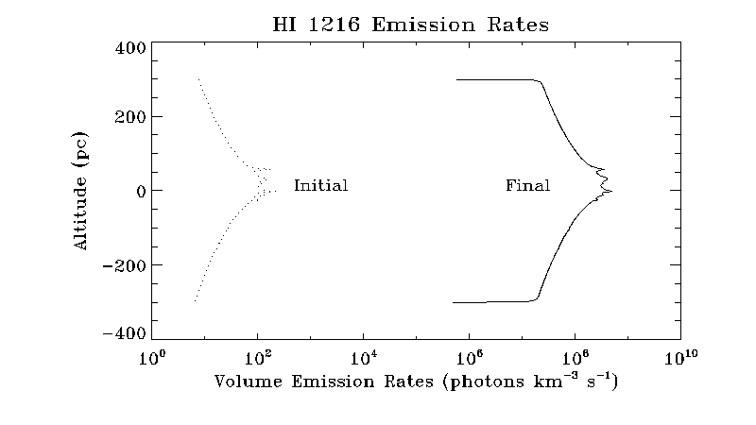
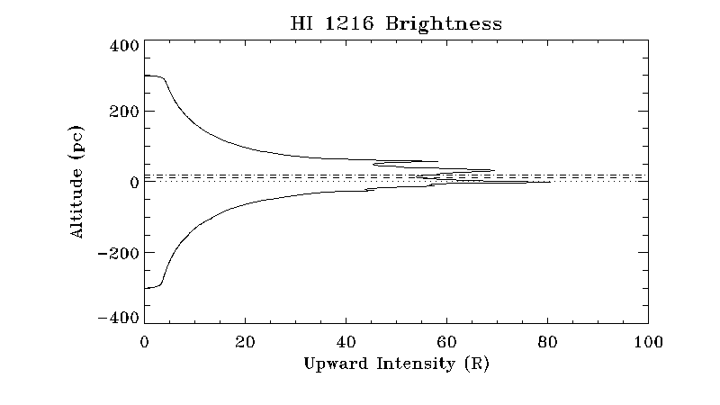
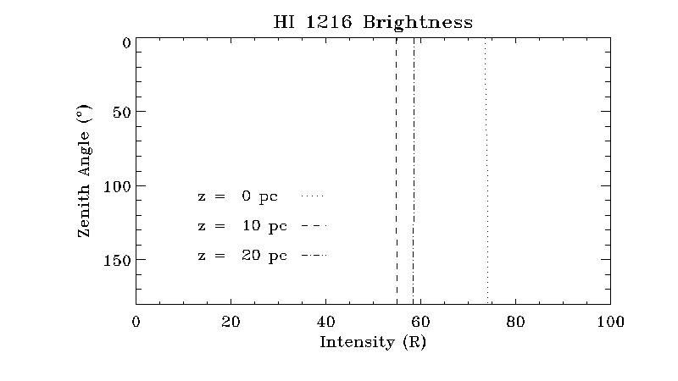
More Complex Slab Models – variable V
These plots show the same model, but with the initial volume emission rate estimated by the ionizing stellar flux (i.e., λ<91 nm) in the LB (modeled as a 150-pc radius cylinder that is 600-pc tall), as a function of z (height north of the disk)
As before, the upper panel shows the initial & final volume emission rate of Lyα photons, the middle panel shows the downward-looking brightness (which is closer to 60 R in this model, since there are more sources in plane of the disk), and the lower panel shows zenith angle scans at a few altitudes in the slab (the Sun has recently been estimated to be at z~17 pc)
However, even where the brightness is increasing with z (dashed horizontal lines), the resulting N/S asymmetry at any given location is only ~2 R

Slide 19
Conclusions & Next Steps
For KEM2 we have produced an all-sky Lyα map (at 2º resolution), which shows no obvious diffuse absorption or emission structures, either near the heliopause or in the more distant LISM; but we are still playing with the data (e.g., inverse filtering to improve our spatial resolution of the diffuse Lyα signal)
It would be very useful for IPM modelers to simulate what their models would predict for the all-sky Lyα brightnesses at the location of New Horizons in September 2023
As far as modeling the RT goes, the lesson seems to be that while the overall brightness is close to what is observed by Alice, explaining the ~10-R N/S brightness asymmetry is not very easy! Still need to follow up on other sources of for the asymmetry (e.g., asymmetry in solar Lya emissions)
There are still a few improvements to be made to the RT slab models, but we will soon begin writing up a paper describing the all-sky Lya map

