Slide 1
New Synoptic Observations of the Cosmic Optical Background with New Horizons
Marc Postman (STScI)
Tod Lauer (NOIRLab)
Joel Parker (SWRI)
John Spencer (SWRI)
Harold Weaver (JHU-APL)
Michael Shull (CU / UNC)
Alan Stern (SWRI)
& the New Horizons Team
NH Science Team Meeting
JHU Applied Physics Lab
May 2024
Notes:
Fancy way of asking how dark does the sky get, how much light do we get from the Universe, which is an integral over all star formation and BH accretion over the age of the Universe

Slide 2
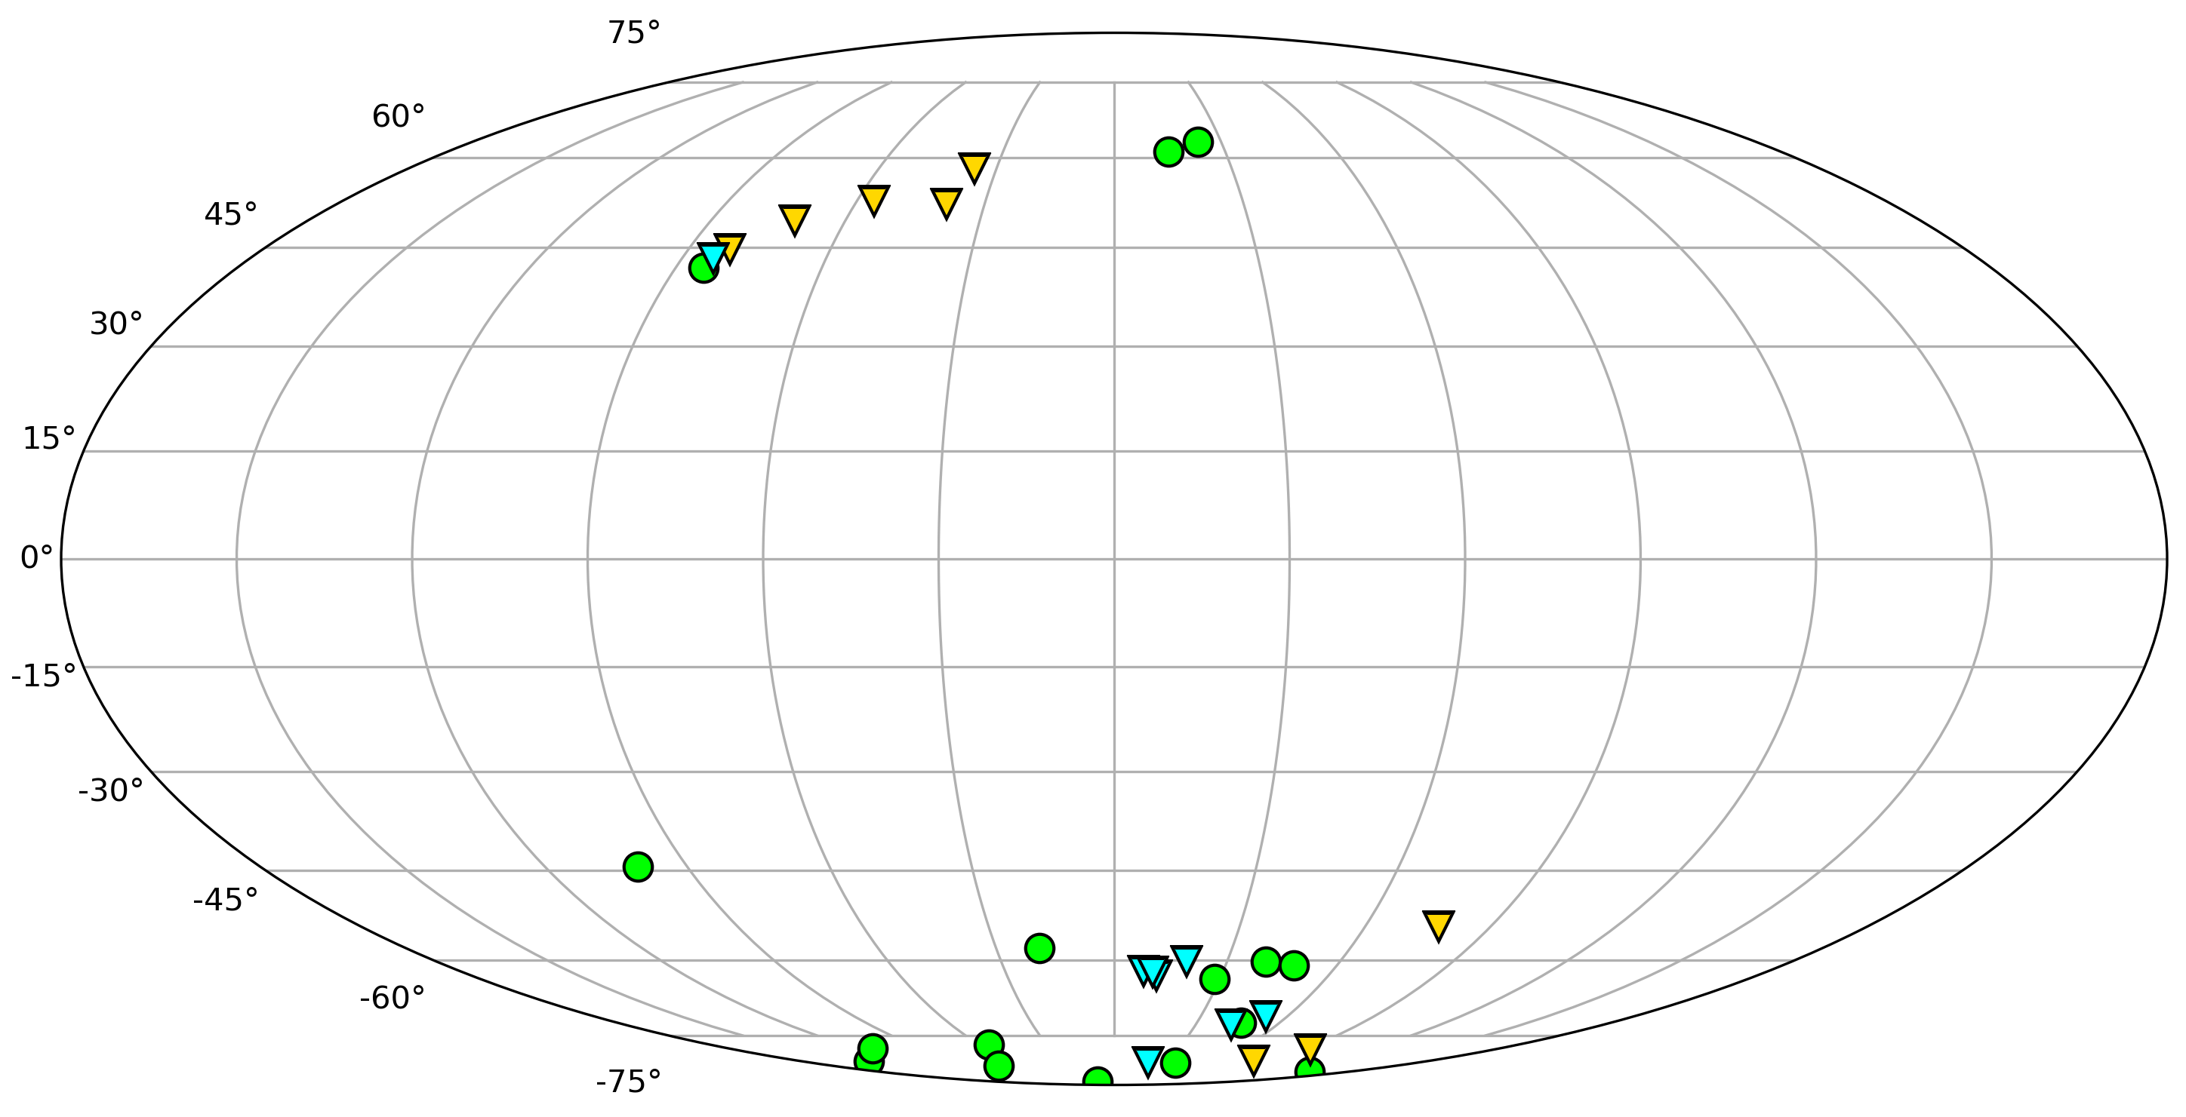
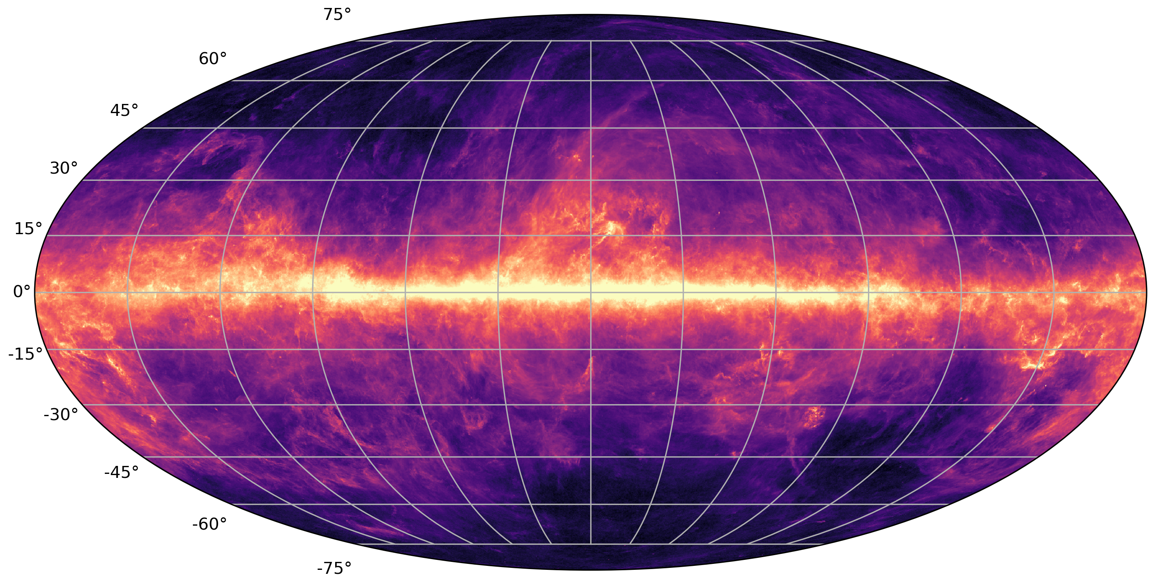
KEM2 COSMIC OPTICAL BACKGROUND SURVEY FIELDS
KEM2 COB Fields
DGL Calibration Fields
SSL Calibration Fields
150
120
90
60
30
0
330
300
270
240
210
Sky image: Planck 350 micron all-sky intensity map

Slide 3
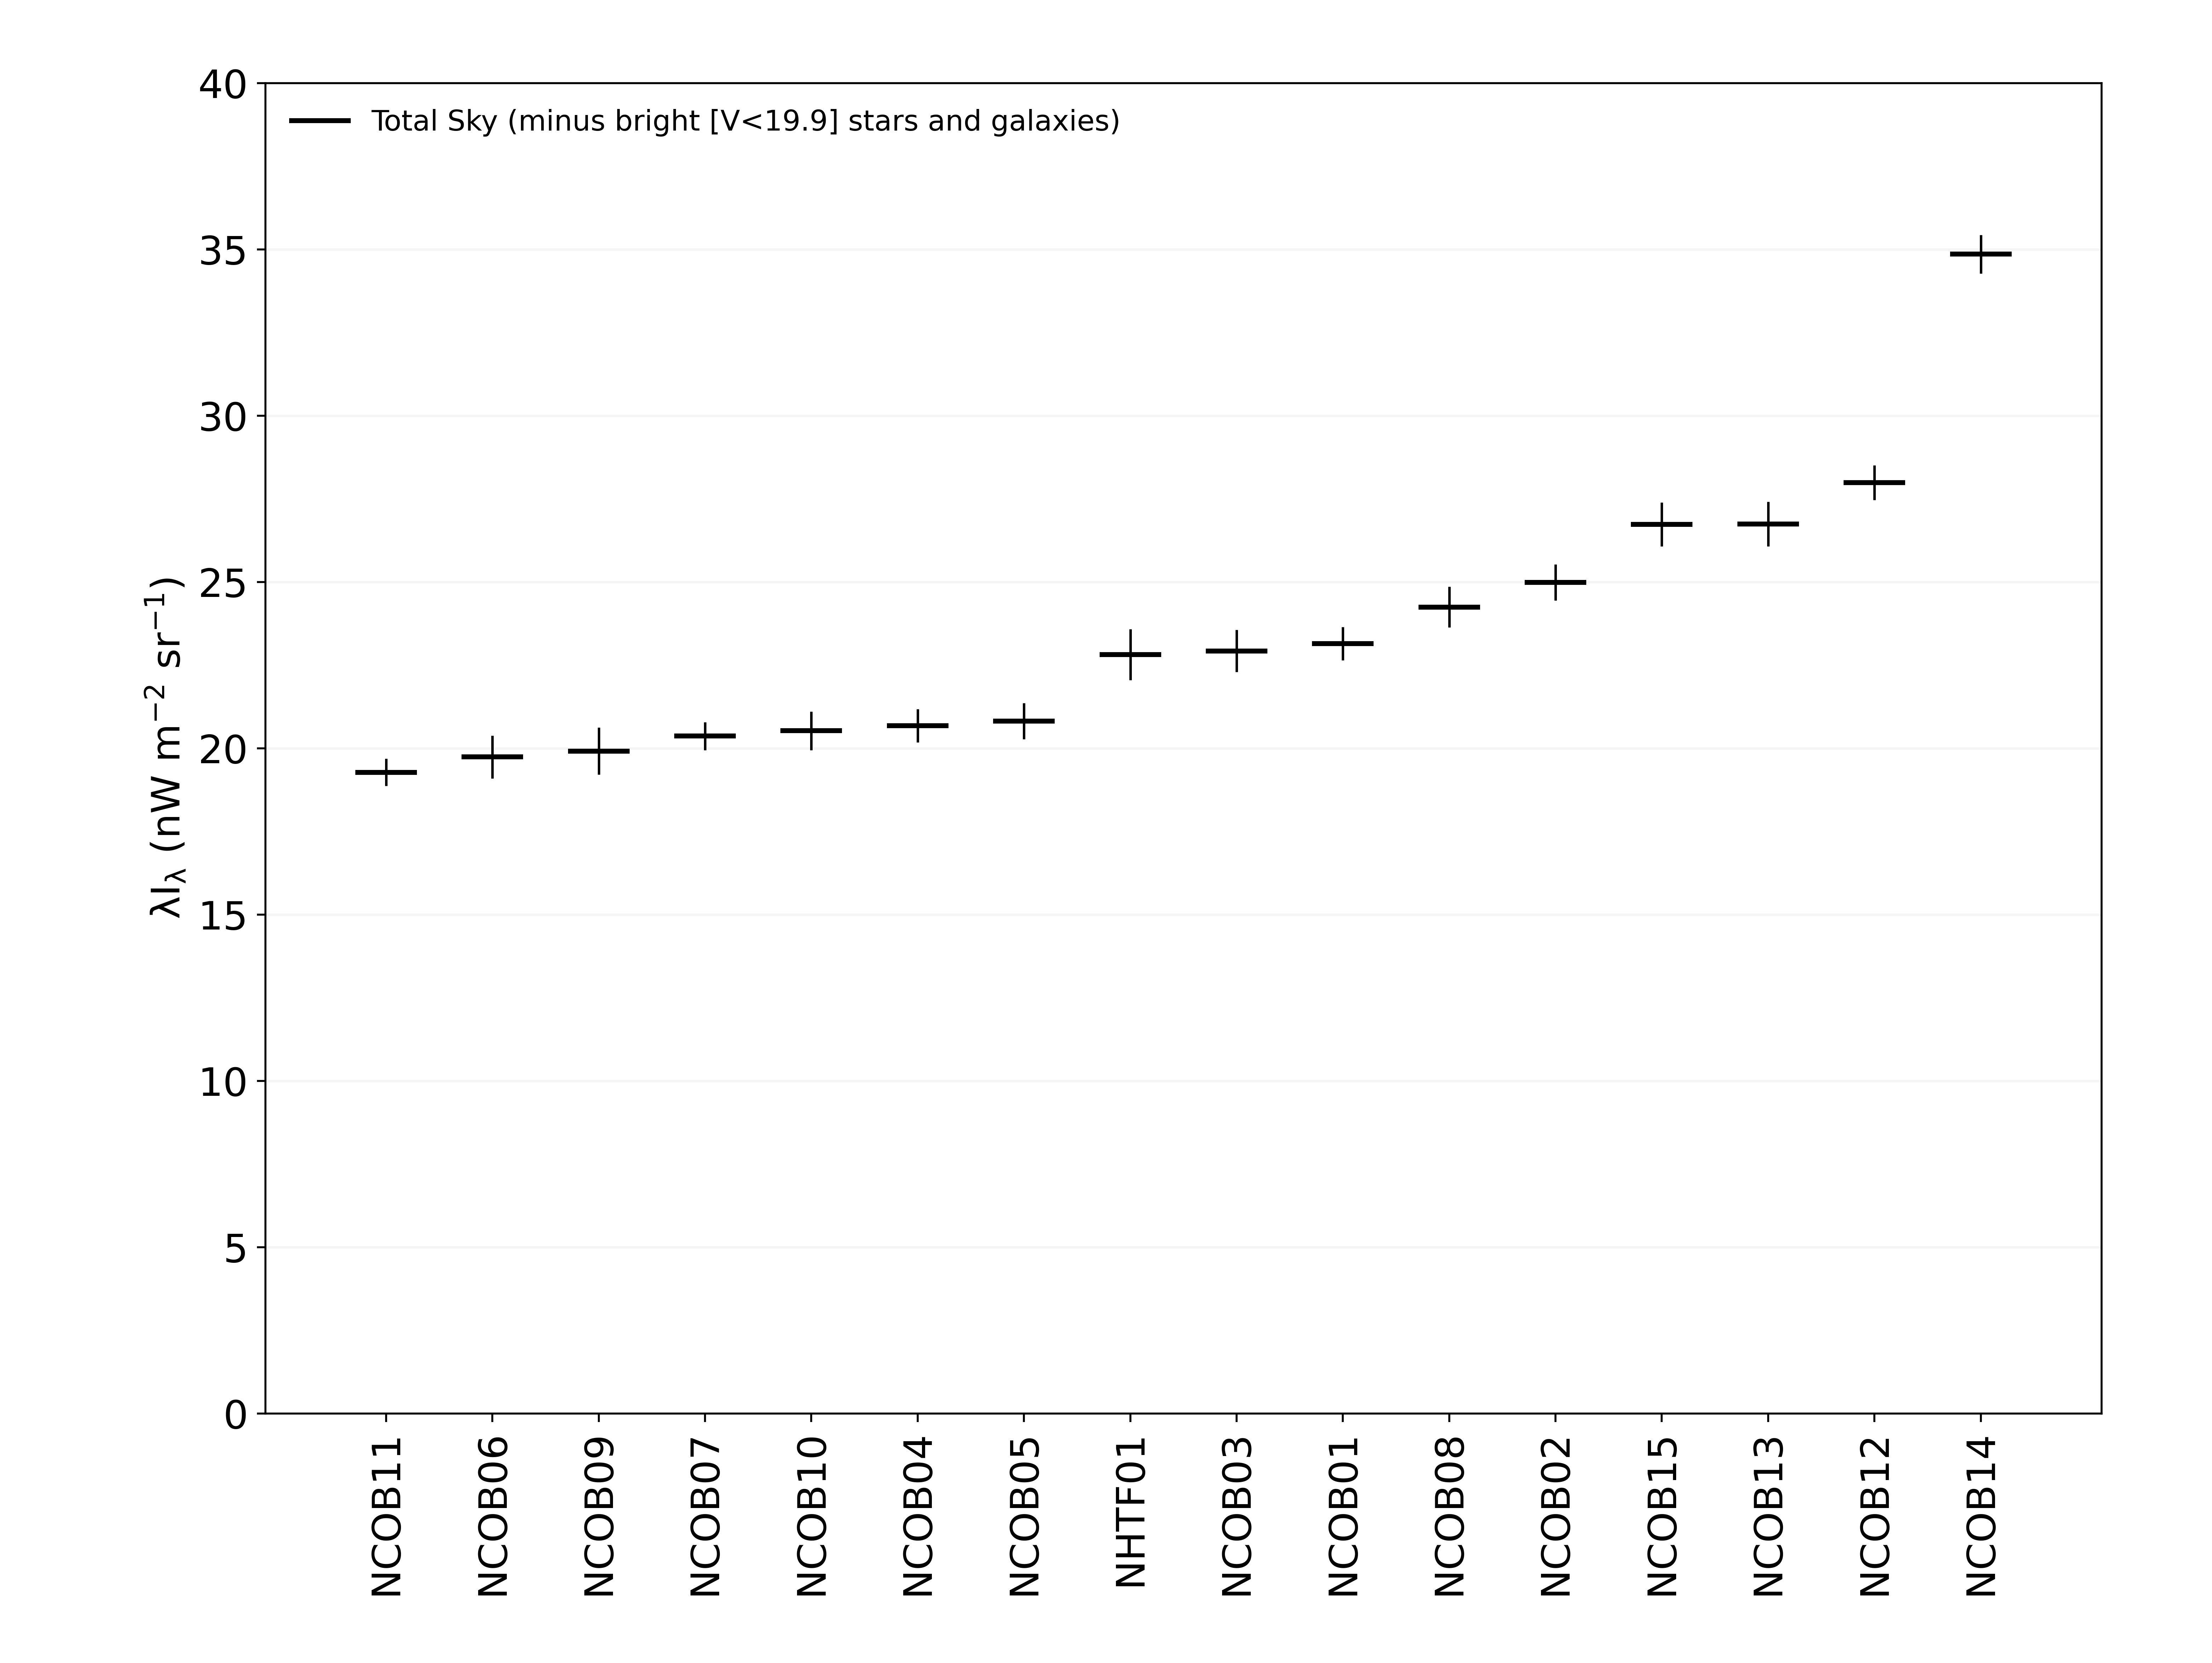
Detection of the Cosmic Optical Background
Can we account for all the flux in every field from known instrumental and astrophysical sources?
If so, then the source of the COB is the known census of galaxies.

Slide 4
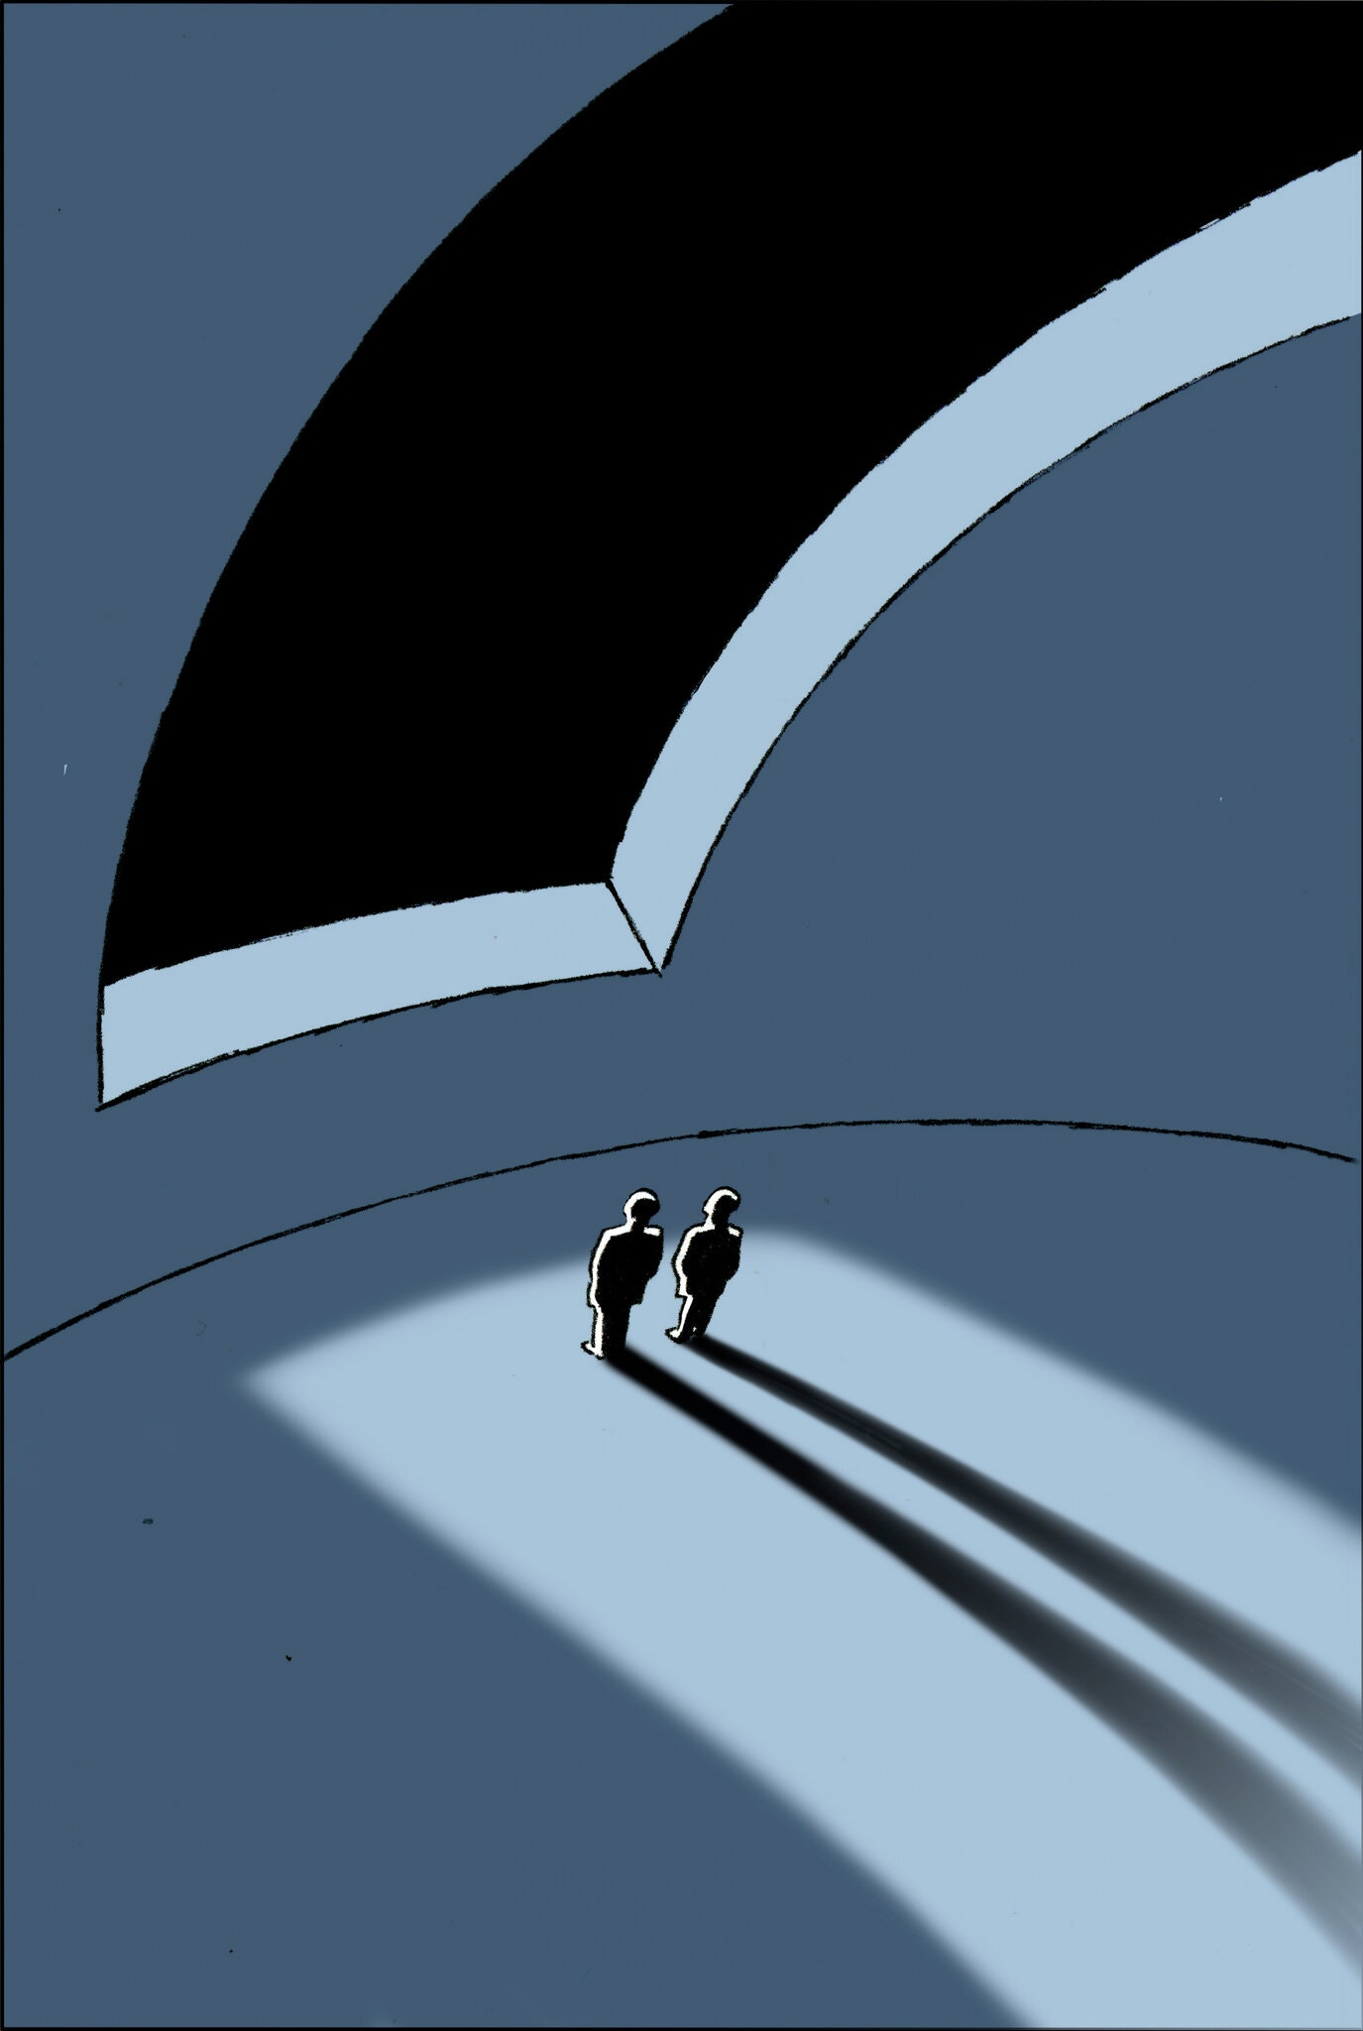
Detection of the Cosmic Optical Background
Preview of results:
COB = 11.08 ± 1.65 $nW m^{−2}{sr}^{−1}$(6.7σ)
COB – IGL = 2.81 ± 2.03 $nW m^{−2}{sr}^{−1}$(1.4σ)
Where IGL = integrated light from known galaxies with V ≤ 30 mag (8.17 ± 1.18 $nW m^{−2}{sr}^{−1}$)
We thus cannot falsify the hypothesis that the COB is due entirely to the integrated light from galaxies.

Slide 5
The Components of the Detected Sky Level
Integrated Starlight (ISL) = light from faint stars below the LORRI detection limit (V=19.9).
Integrated Galaxy Light (IGL) = light from faint galaxies below the LORRI detection limit (V=19.9).
Diffuse Galactic Light (DGL) = optical starlight reflected/scattered off of dust in the Milky Way.
H-alpha emission from the interplanetary and interstellar medium (from WHAM survey).
Scattered Light (SSL + SGL) = light that is scattered into the LORRI detector from off-axis stars and bright galaxies.
Stars and galaxies within the LORRI FOV that are above the detection limit (V=19.9) are masked out and excluded from total sky signal.

Slide 6
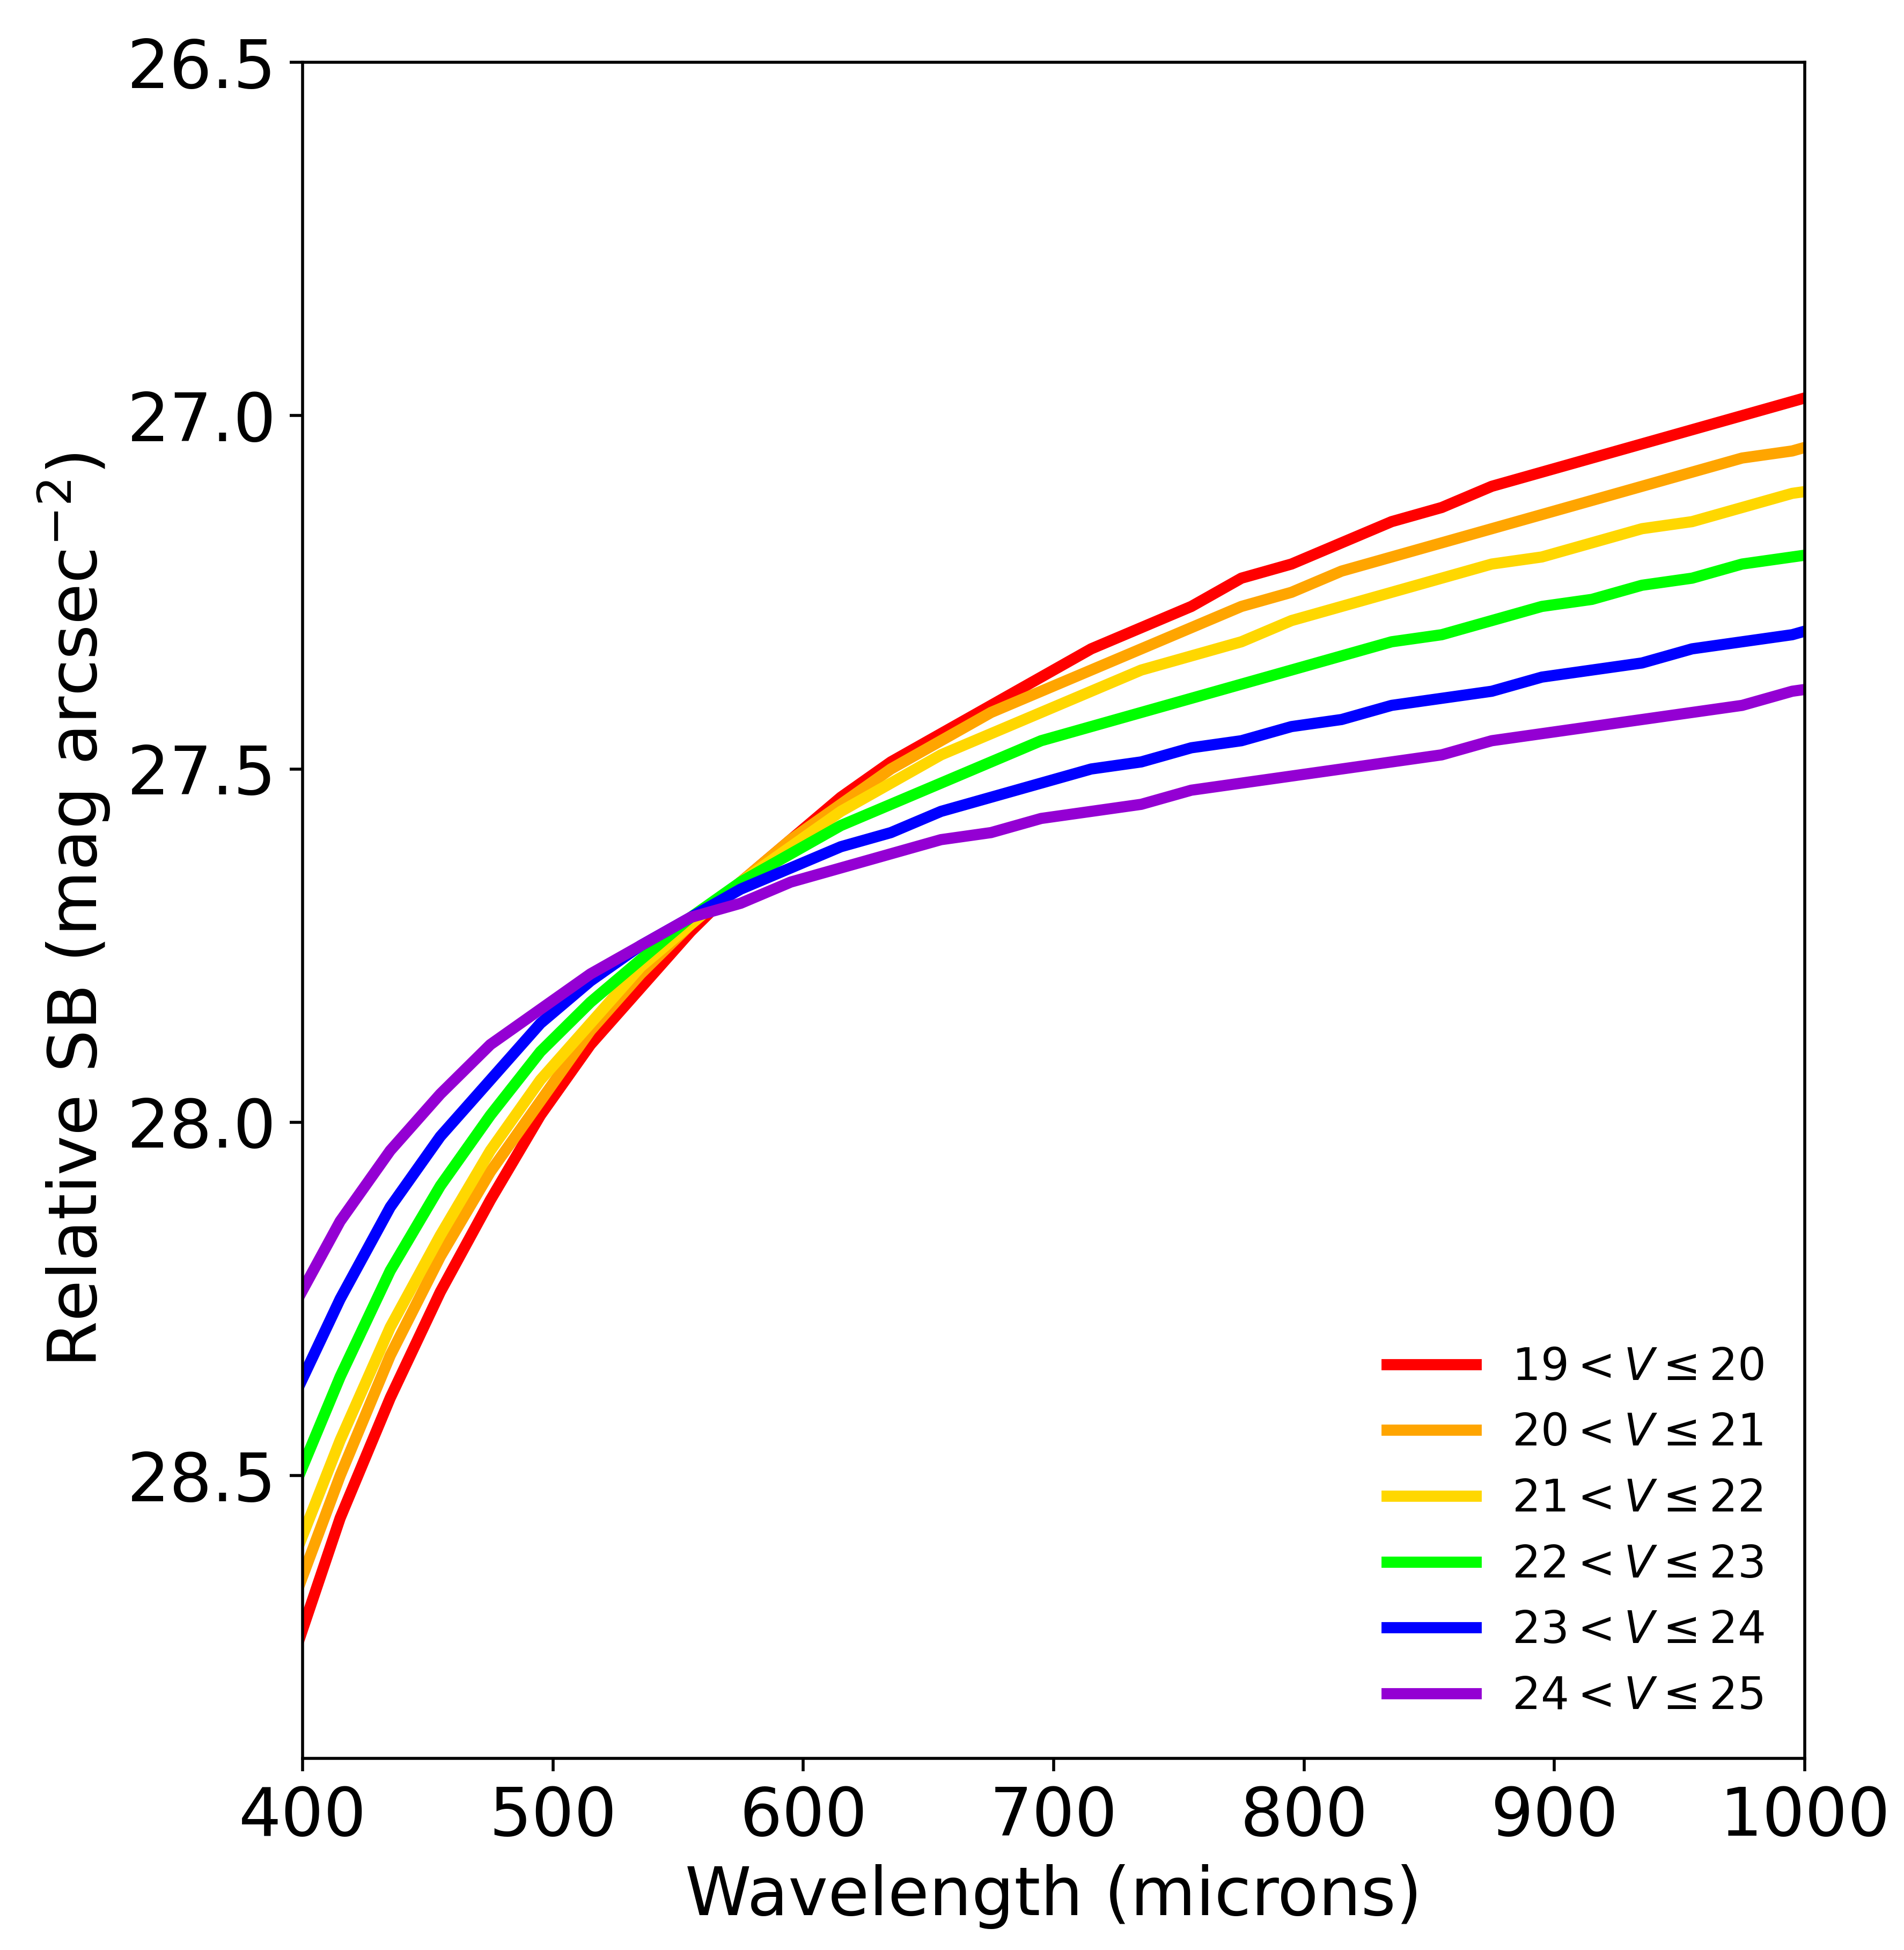
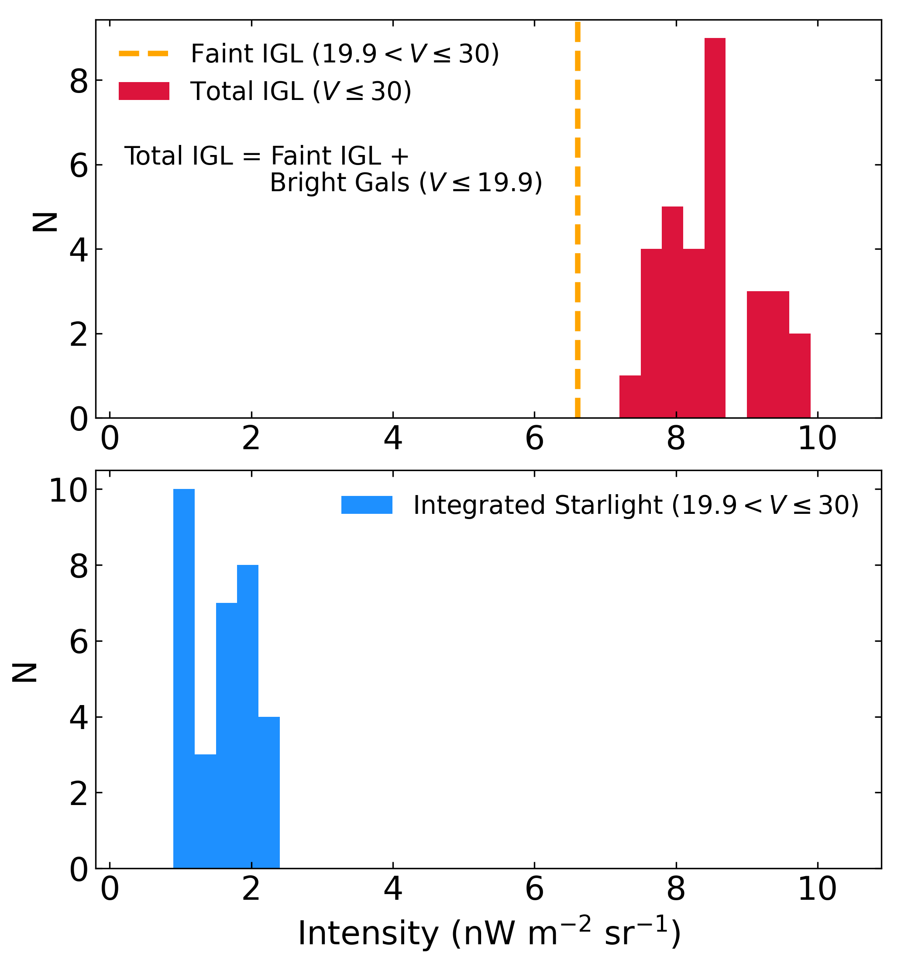
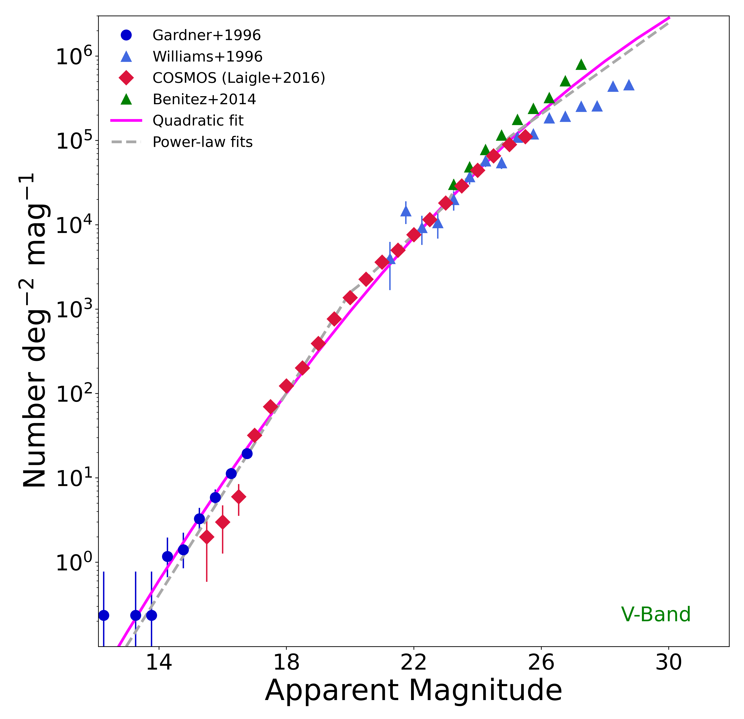
Integrated Star and Galaxy Light
Source counts are computed over range 19.9 < V ≤ 30 based on power law fits to either observed or simulated source counts. We then compute the integrated V-band SB from these sources on the sky over that flux range.
SEDs are derived using UBVRIZJHK photometry as a function of magnitude, normalized to the above SB.
For galaxies: we use COSMOS2016 and a variety of other catalogs. For stars: we use TRILEGAL simulations.
The IGL and ISL are then computed using normalized SEDs over the LORRI response (weighted by N(m)).
Total IGL shown below includes bright (V ≤ 19.9) galaxies (from DESI / DECam Legacy Survey data).
Mag-dependent SEDs
(from COSMOS2016)

Slide 7
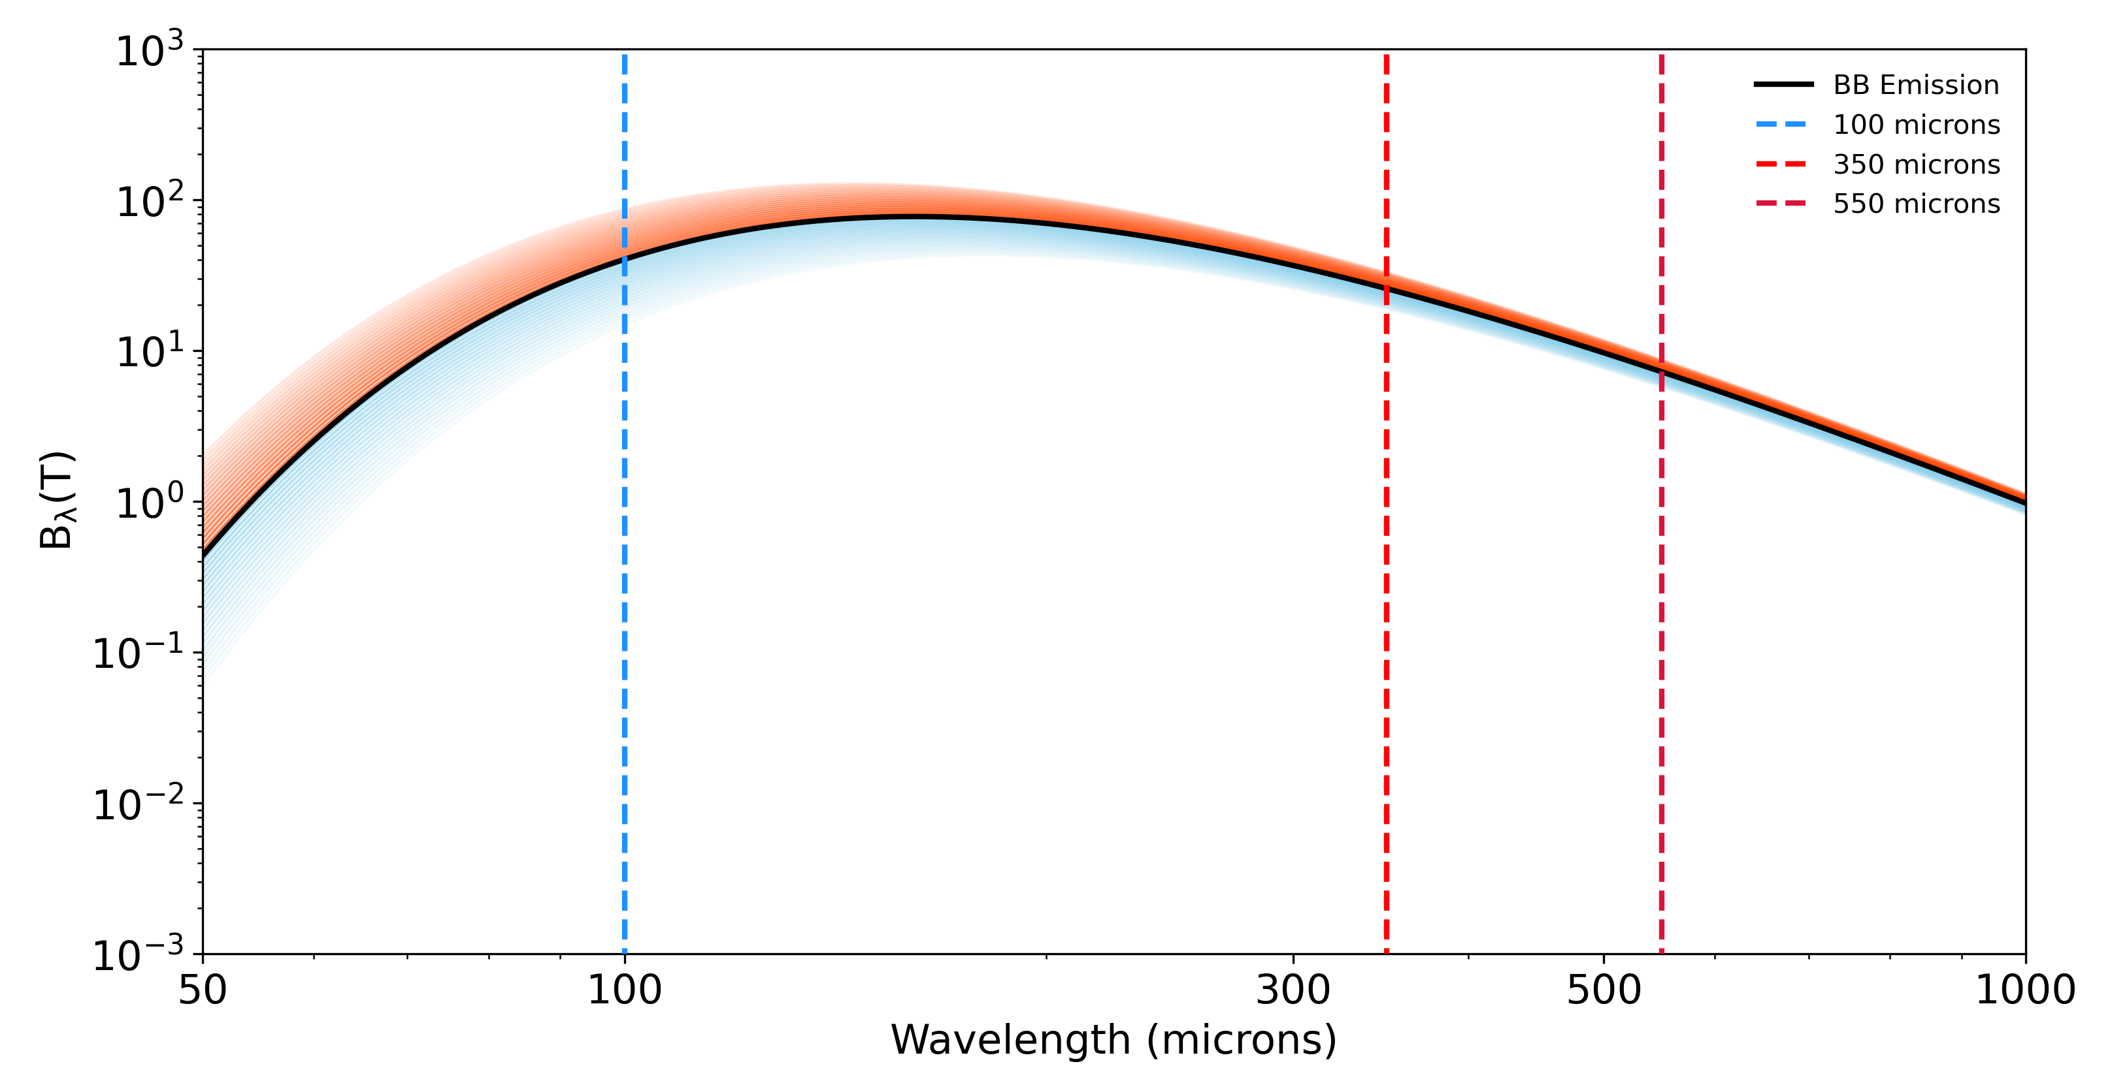
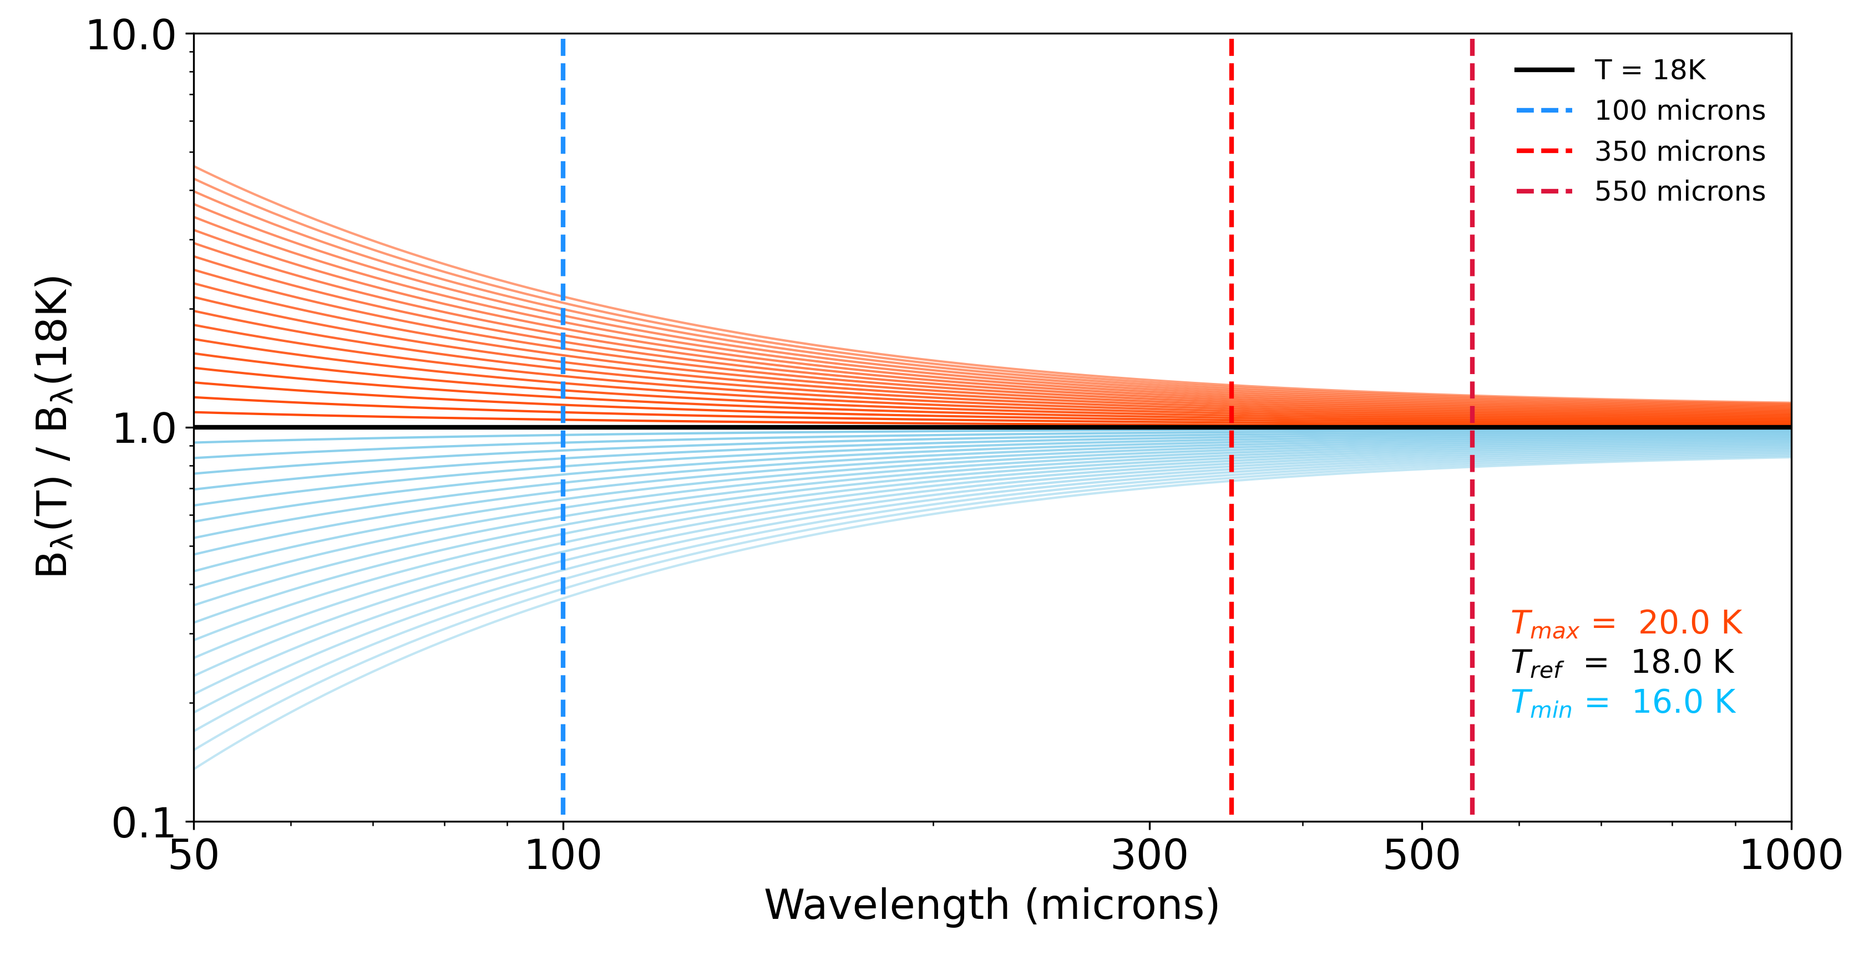
The Diffuse Galactic Light – FIR Intensity Relation
We use FIR emission to estimate the amount of diffuse optical light that scatters off of dust in the Milky Way.
This diffuse optical light can account for 30% - 50% of the total sky signal we detect with LORRI.
We initially used the 100 μm data from IRAS but we switched to 350 μm and 550 μm data from Planck for the current work:
100 μm lies on the Wien side of the BB curve for interstellar dust whereas 350, 550 μm lie on the Rayleigh-Jeans side.
350, 550 μm flux is less susceptible to dust temperature variations than 100 μm flux.
CMB dominates background

Slide 8
The Diffuse Galactic Light – FIR Intensity Relation
We use FIR emission to estimate the amount of diffuse optical light that scatters off of dust in the Milky Way.
This diffuse optical light can account for 30% - 50% of the total sky signal we detect with LORRI.
We initially used the 100 μm data from IRAS but we switched to 350 μm and 550 μm data from Planck for the current work:
The mean cosmic infrared background (CIB) level is more precisely measured at these longer wavelengths. The CIB level must be subtracted from all FIR fluxes to get the MW dust component.
DGL+ = Total Sky – IGL – ISL – SSL – SGL - Hα
where
IGL = light from faint galaxies below detection limit
ISL = light from faint stars below detection limit
SSL = Scattered light from off axis bright stars
SGL = Scattered light from off axis bright galaxies
Hα = local emission from ISM (<0.3 nW m⁻² sr⁻¹)
DGL+
FIR flux
- CIB
Notes:
The mean cosmic infrared background (CIB) level is more precisely measured at 350 and 550 μm than at 100 μm. This CIB level must be subtracted from all FIR fluxes to get the MW dust component.

Slide 9
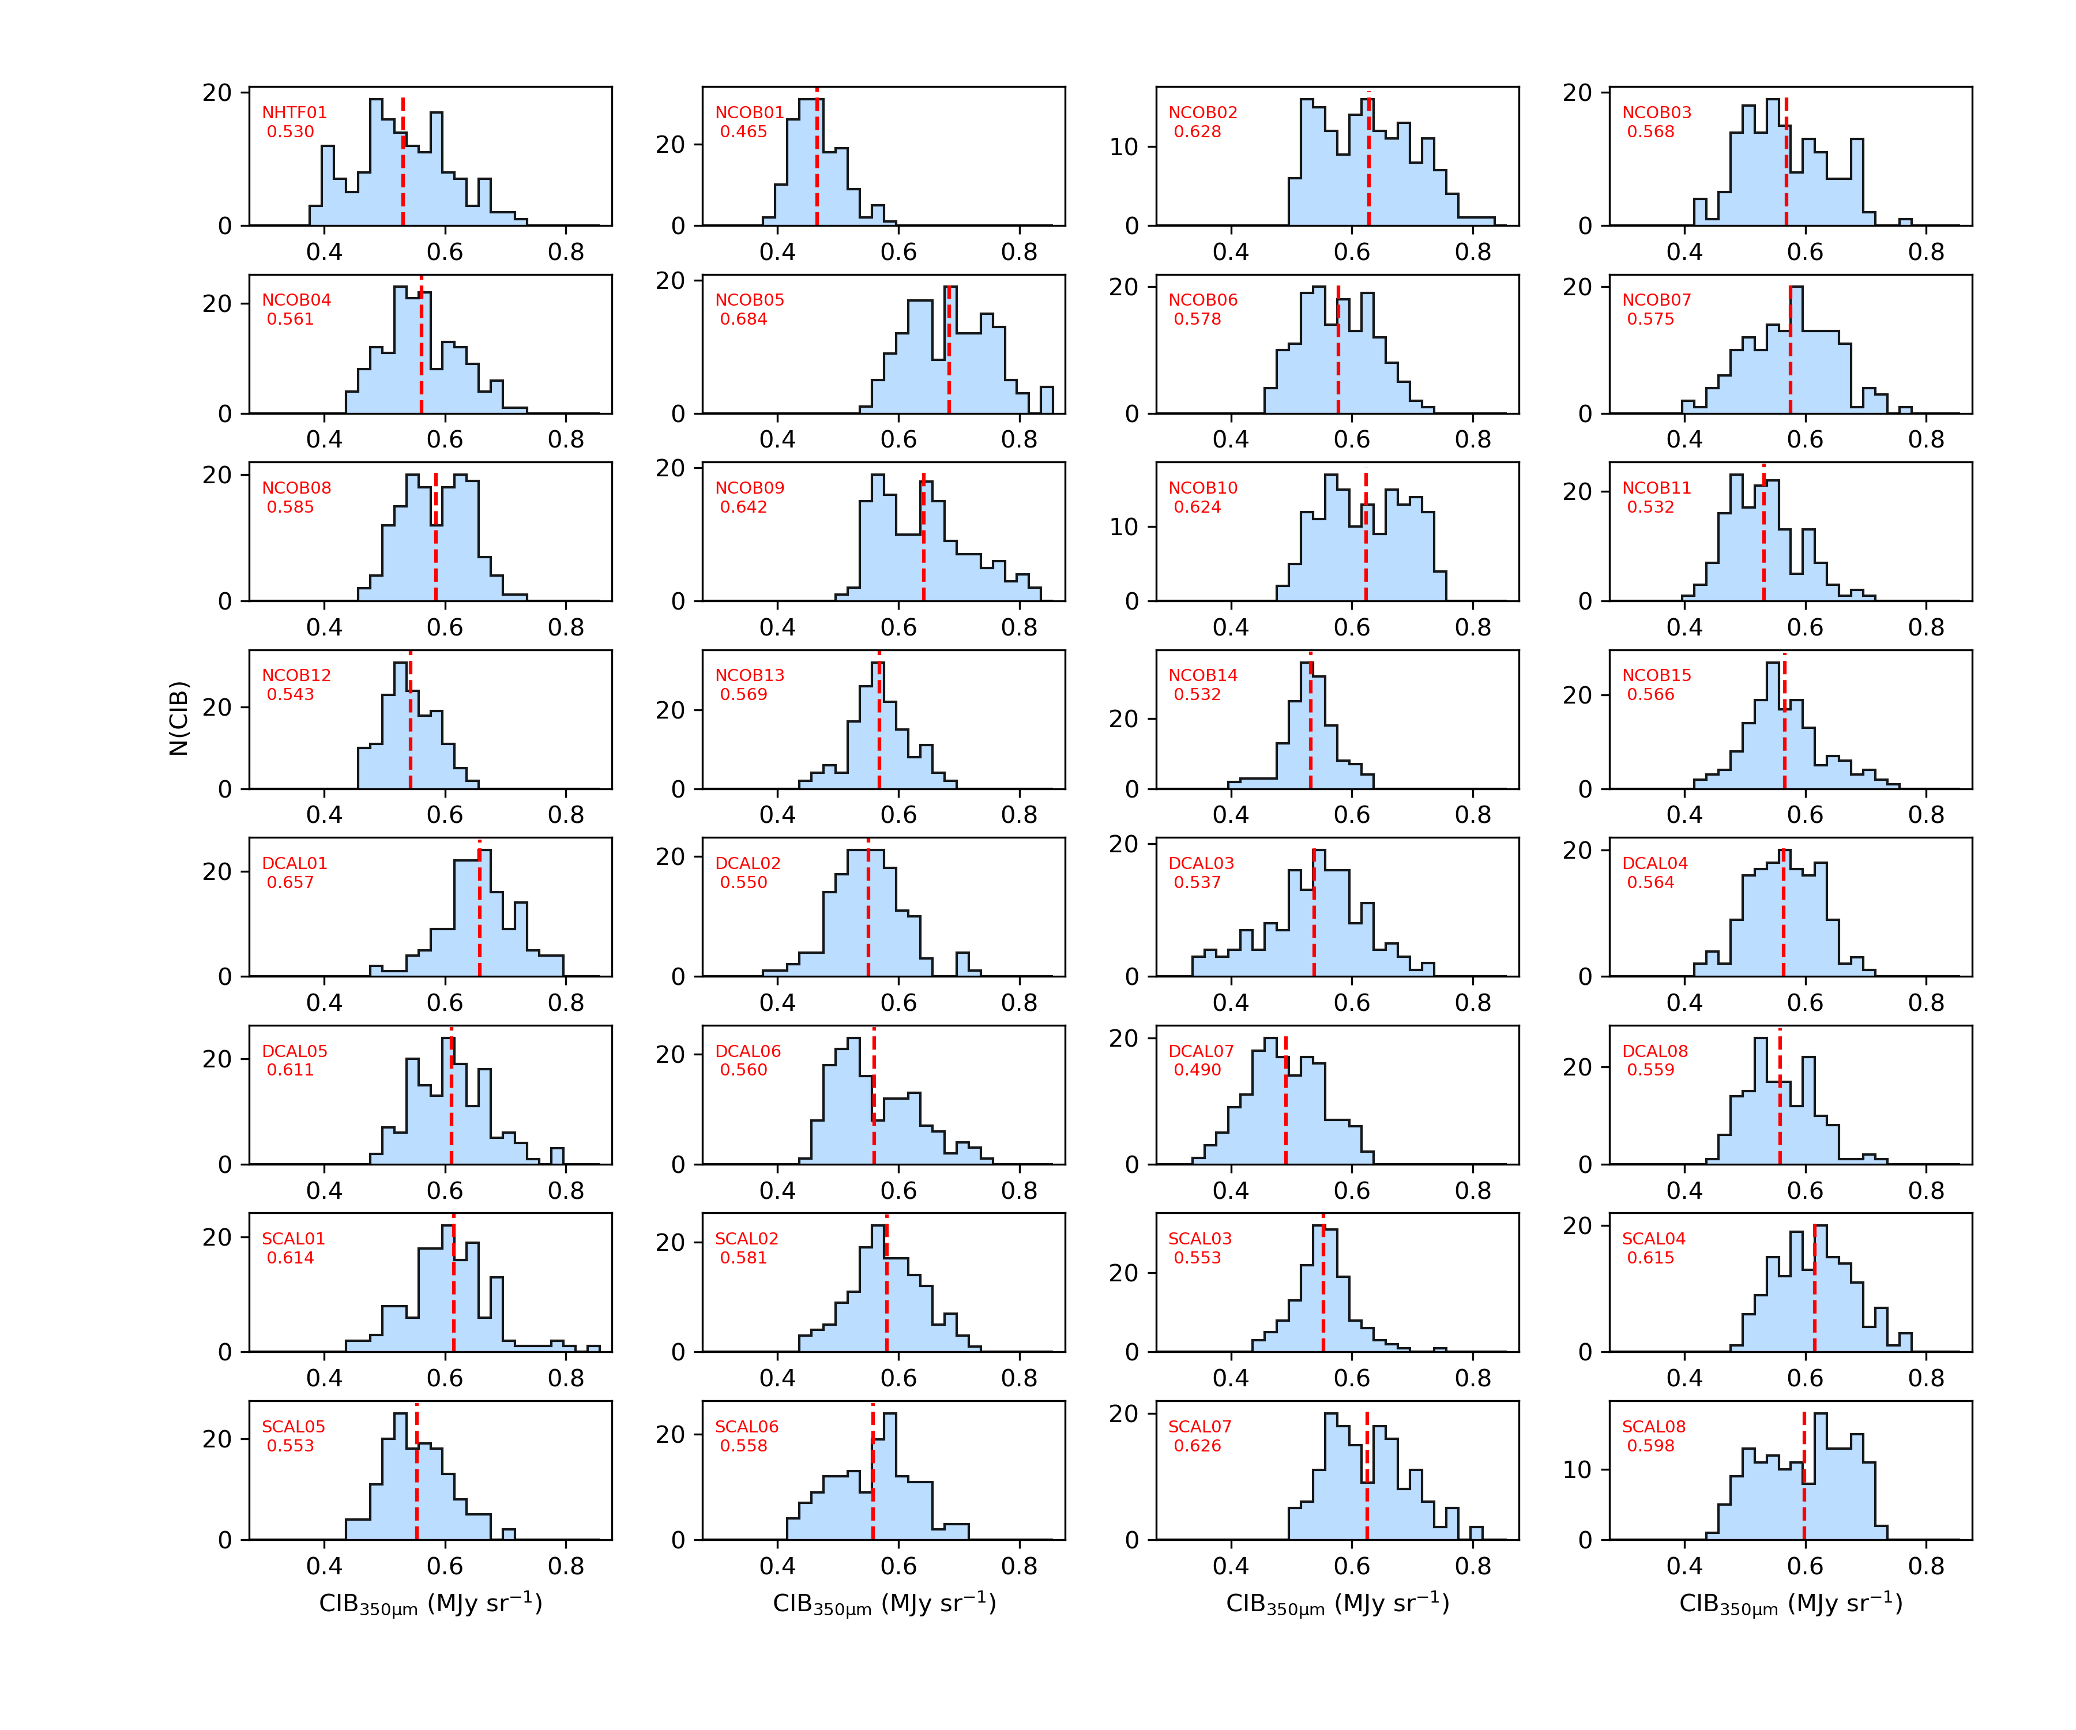
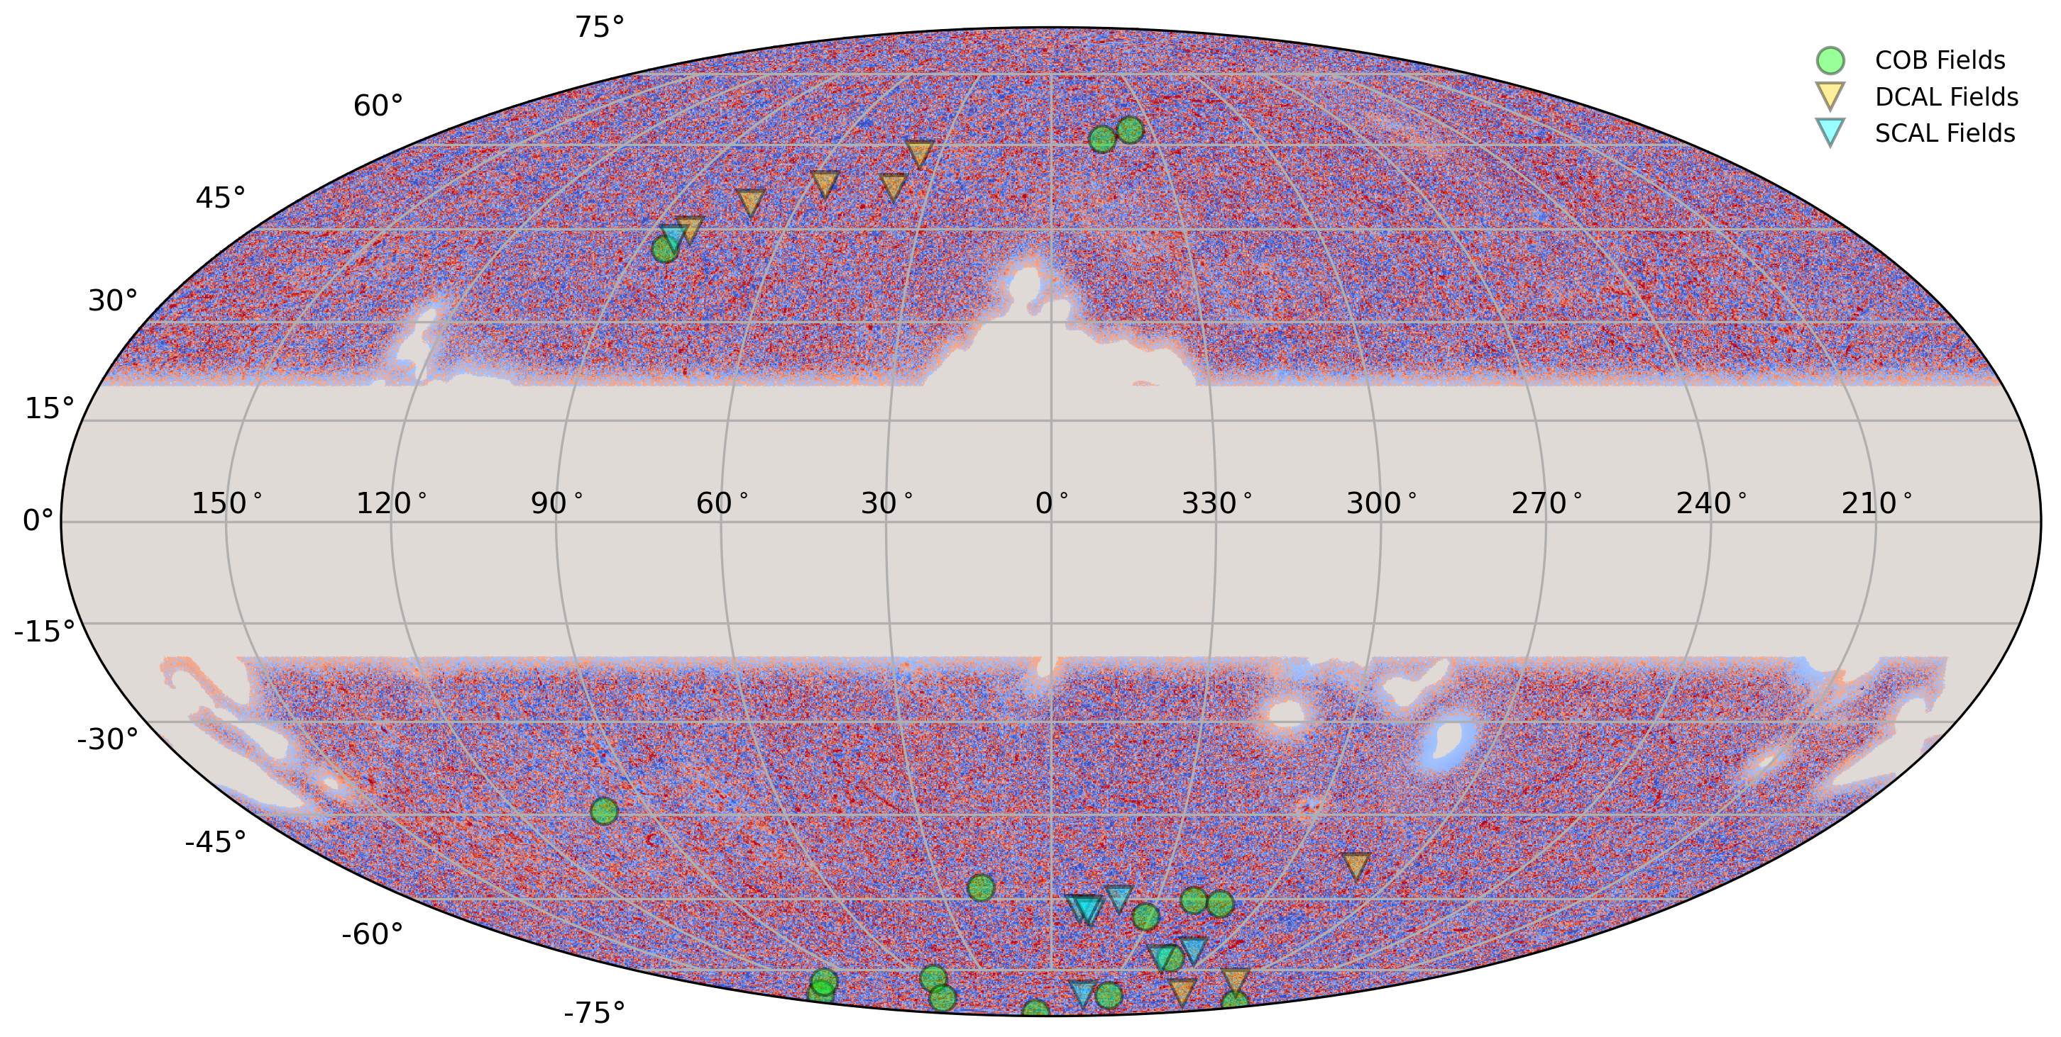
Determining the Cosmic IR Background (CIB) level for each field
CIB intensity distribution at each KEM2 field position
}
Adopt the 857 GHz (350 μm) monopole value = 0.576 ± 0.034 MJy/sr
Adopt the 545 GHz (550 μm) monopole value = 0.371 ± 0.009 MJy/sr
Use Planck GNILC CIB residual maps to add the observed deviations from these monopole levels.
GNILC = Generalized Needlet Internal Linear Combination (Planck Collaboration 2016)
Odegard et al. 2019

Slide 10
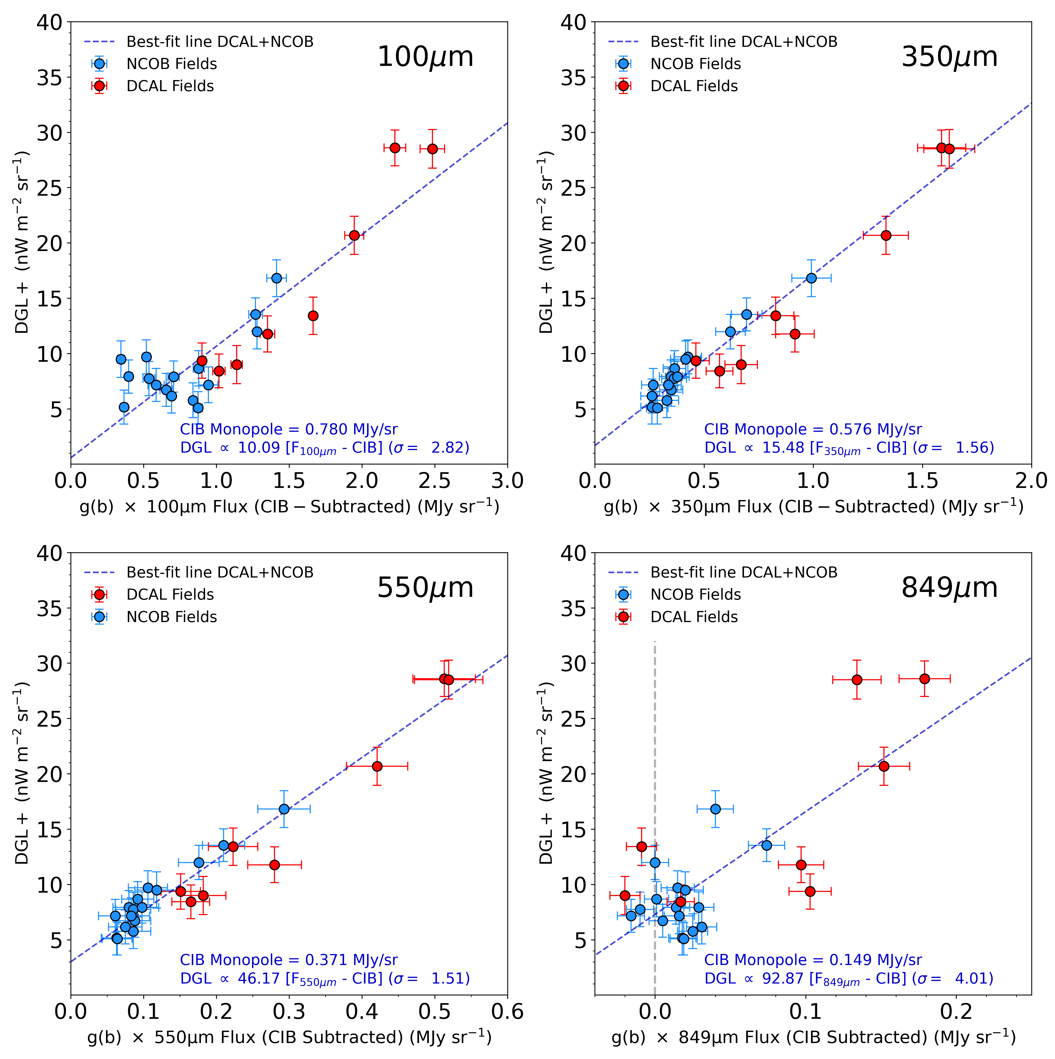
The Diffuse Galactic Light – FIR Intensity Relation
DGL+ = Total Sky – IGL – ISL – SSL – SGL - Hα
where
IGL = light from faint galaxies below detection limit
ISL = light from faint stars below detection limit
SSL = Scattered light from off axis bright stars
SGL = Scattered light from off axis bright galaxies
Hα = local emission from ISM (<0.3 nW m⁻² sr⁻¹)
Lowest scatter at 550 microns with next best
trend at 350 microns.
Wavelength (μm) | RMS Scatter
100 | 2.82 nW m⁻² sr⁻¹
350 | 1.56 nW m⁻² sr⁻¹
550 | 1.51 nW m⁻² sr⁻¹
849 | 4.01 nW m⁻² sr⁻¹
Notes:
The mean cosmic infrared background (CIB) level is more precisely measured at 350 and 550 μm than at 100 μm. This CIB level must be subtracted from all FIR fluxes to get the MW dust component.

Slide 11
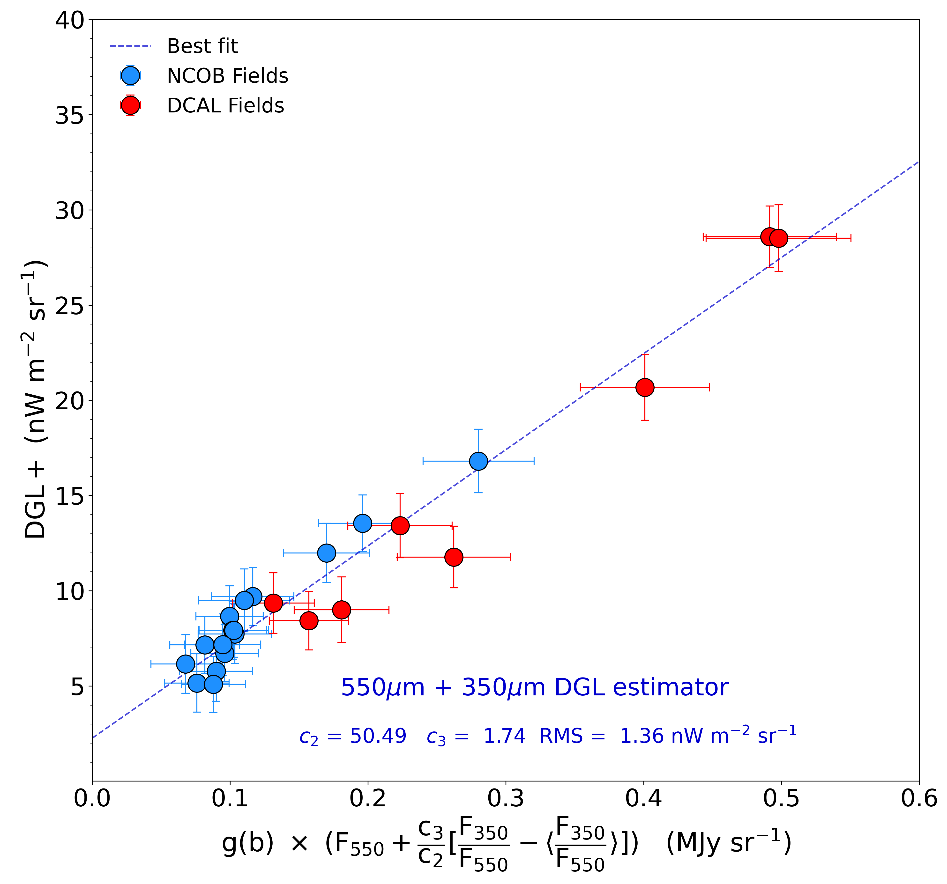
The Diffuse Galactic Light – FIR Intensity Relation
DGL+ = Total Sky – IGL – ISL – SSL – SGL - Hα
where
IGL = light from faint galaxies below detection limit
ISL = light from faint stars below detection limit
SSL = Scattered light from off axis bright stars
SGL = Scattered light from off axis bright galaxies
Hα = local emission from ISM (<0.3 nW m⁻² sr⁻¹)
DGL+ Estimator:
$= c_{1}+ {(c}_{2} g\left(b\right)F_{550})+(c_{3} g\left(b\right)[\frac{F_{350}}{F_{550}}−\left\langle \frac{F_{350}}{F_{550}}\right\rangle ]$)
where $g(b)$ = geometric phase function and
best fit coefficients are:
c₁ = 2.26 nW m⁻² sr⁻¹
c₂ = 50.49 (nW m⁻² sr⁻¹)/(MJy sr⁻¹)
c₃ = 1.74 nW m⁻² sr⁻¹
RMS = 1.36 nW m⁻² sr⁻¹
Notes:
The mean cosmic infrared background (CIB) level is more precisely measured at 350 and 550 μm than at 100 μm. This CIB level must be subtracted from all FIR fluxes to get the MW dust component.

Slide 12
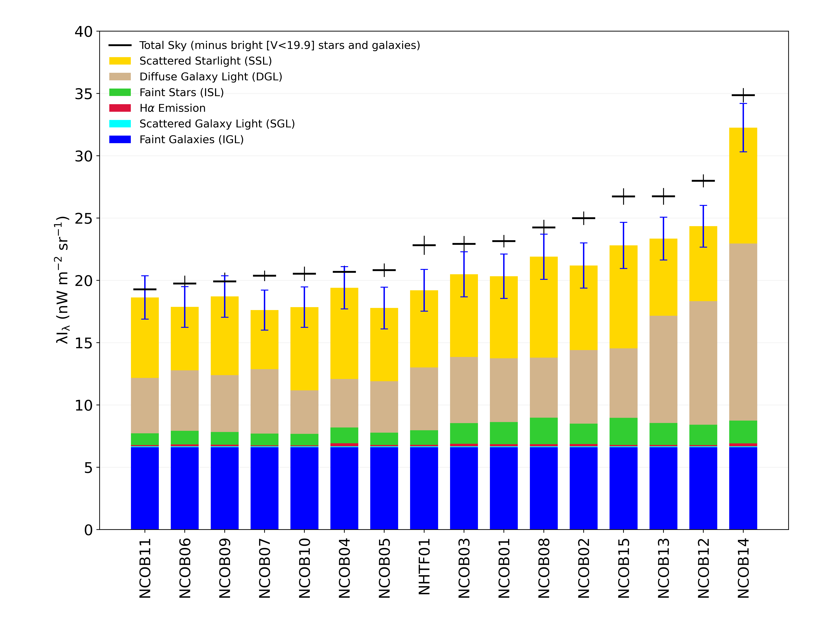
The Components of the Detected Sky Level

Slide 13
Propagation of the systematic and random errors
Parameter | Random Error | Systematic Error
Integrated faint galaxy light (IGL) | ✓ | ✓
Integrated faint star light (ISL) | ✓ | ✓
Scattered starlight (SSL) | Negligible | ✓
Scattered galaxy light (SGL) | Negligible | ✓
Total sky level | ✓ | ✓
Diffuse Galactic light (DGL) | ✓ | ✓
H-alpha intensity | ✓ | Negligible
FIR photometry | Negligible | ✓
CIB monopole value | Negligible | ✓
DGL – FIR Relation | ✓ | ✓

Slide 14
Propagation of the systematic and random errors
Begin with measured total sky, SSL, SGL, IGL, ISL, FIR flux values for each field
…
…
NCOB Field 1
NCOB Field 3
NCOB Field 4
NCOB Field 7
NCOB Field 15
NCOB Field 2
NCOB Field 5
NCOB Field 6
NCOB Field 16
Run 10,000 times
Add Field-specific Random Errors**
Add Systematic Errors to all fields**
Compute DGL – FIR fit for this realization
Compute COB for each field from this realization
Compute sky residual (COB-IGL) for each field from this realization
**Random and systematic error values are randomly drawn from Gaussian distributions with the appropriate dispersions.

Slide 15
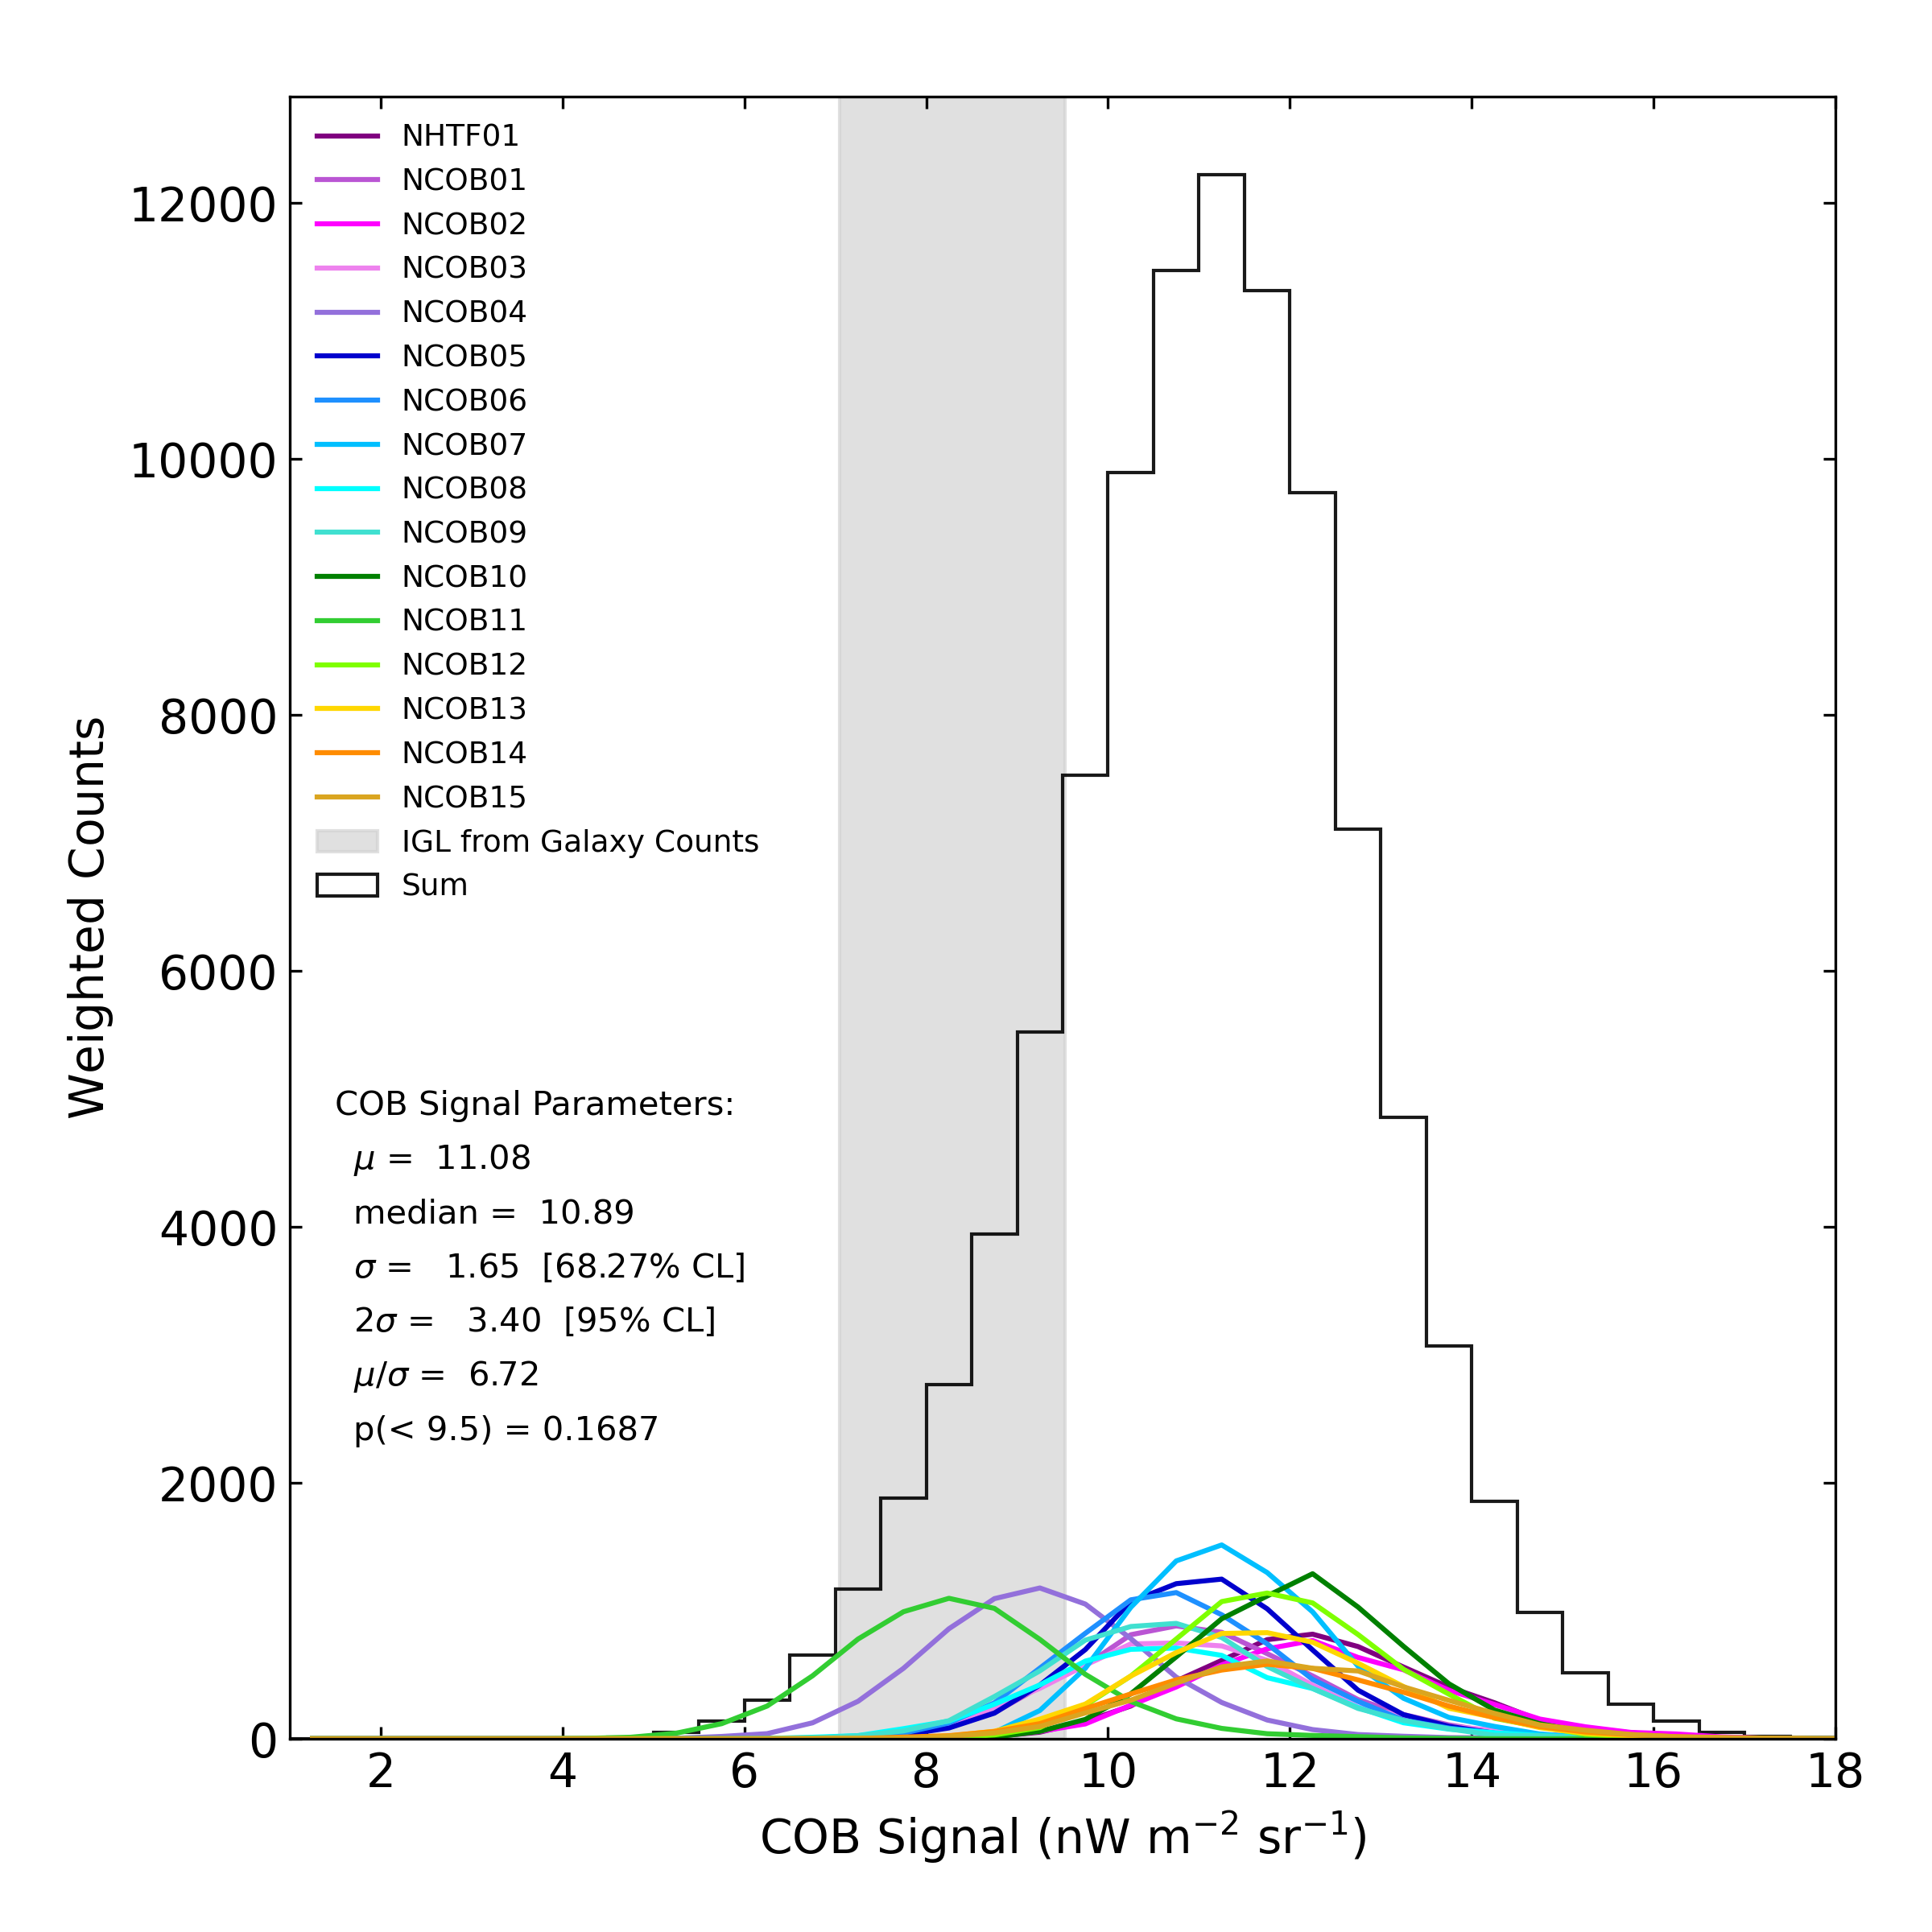
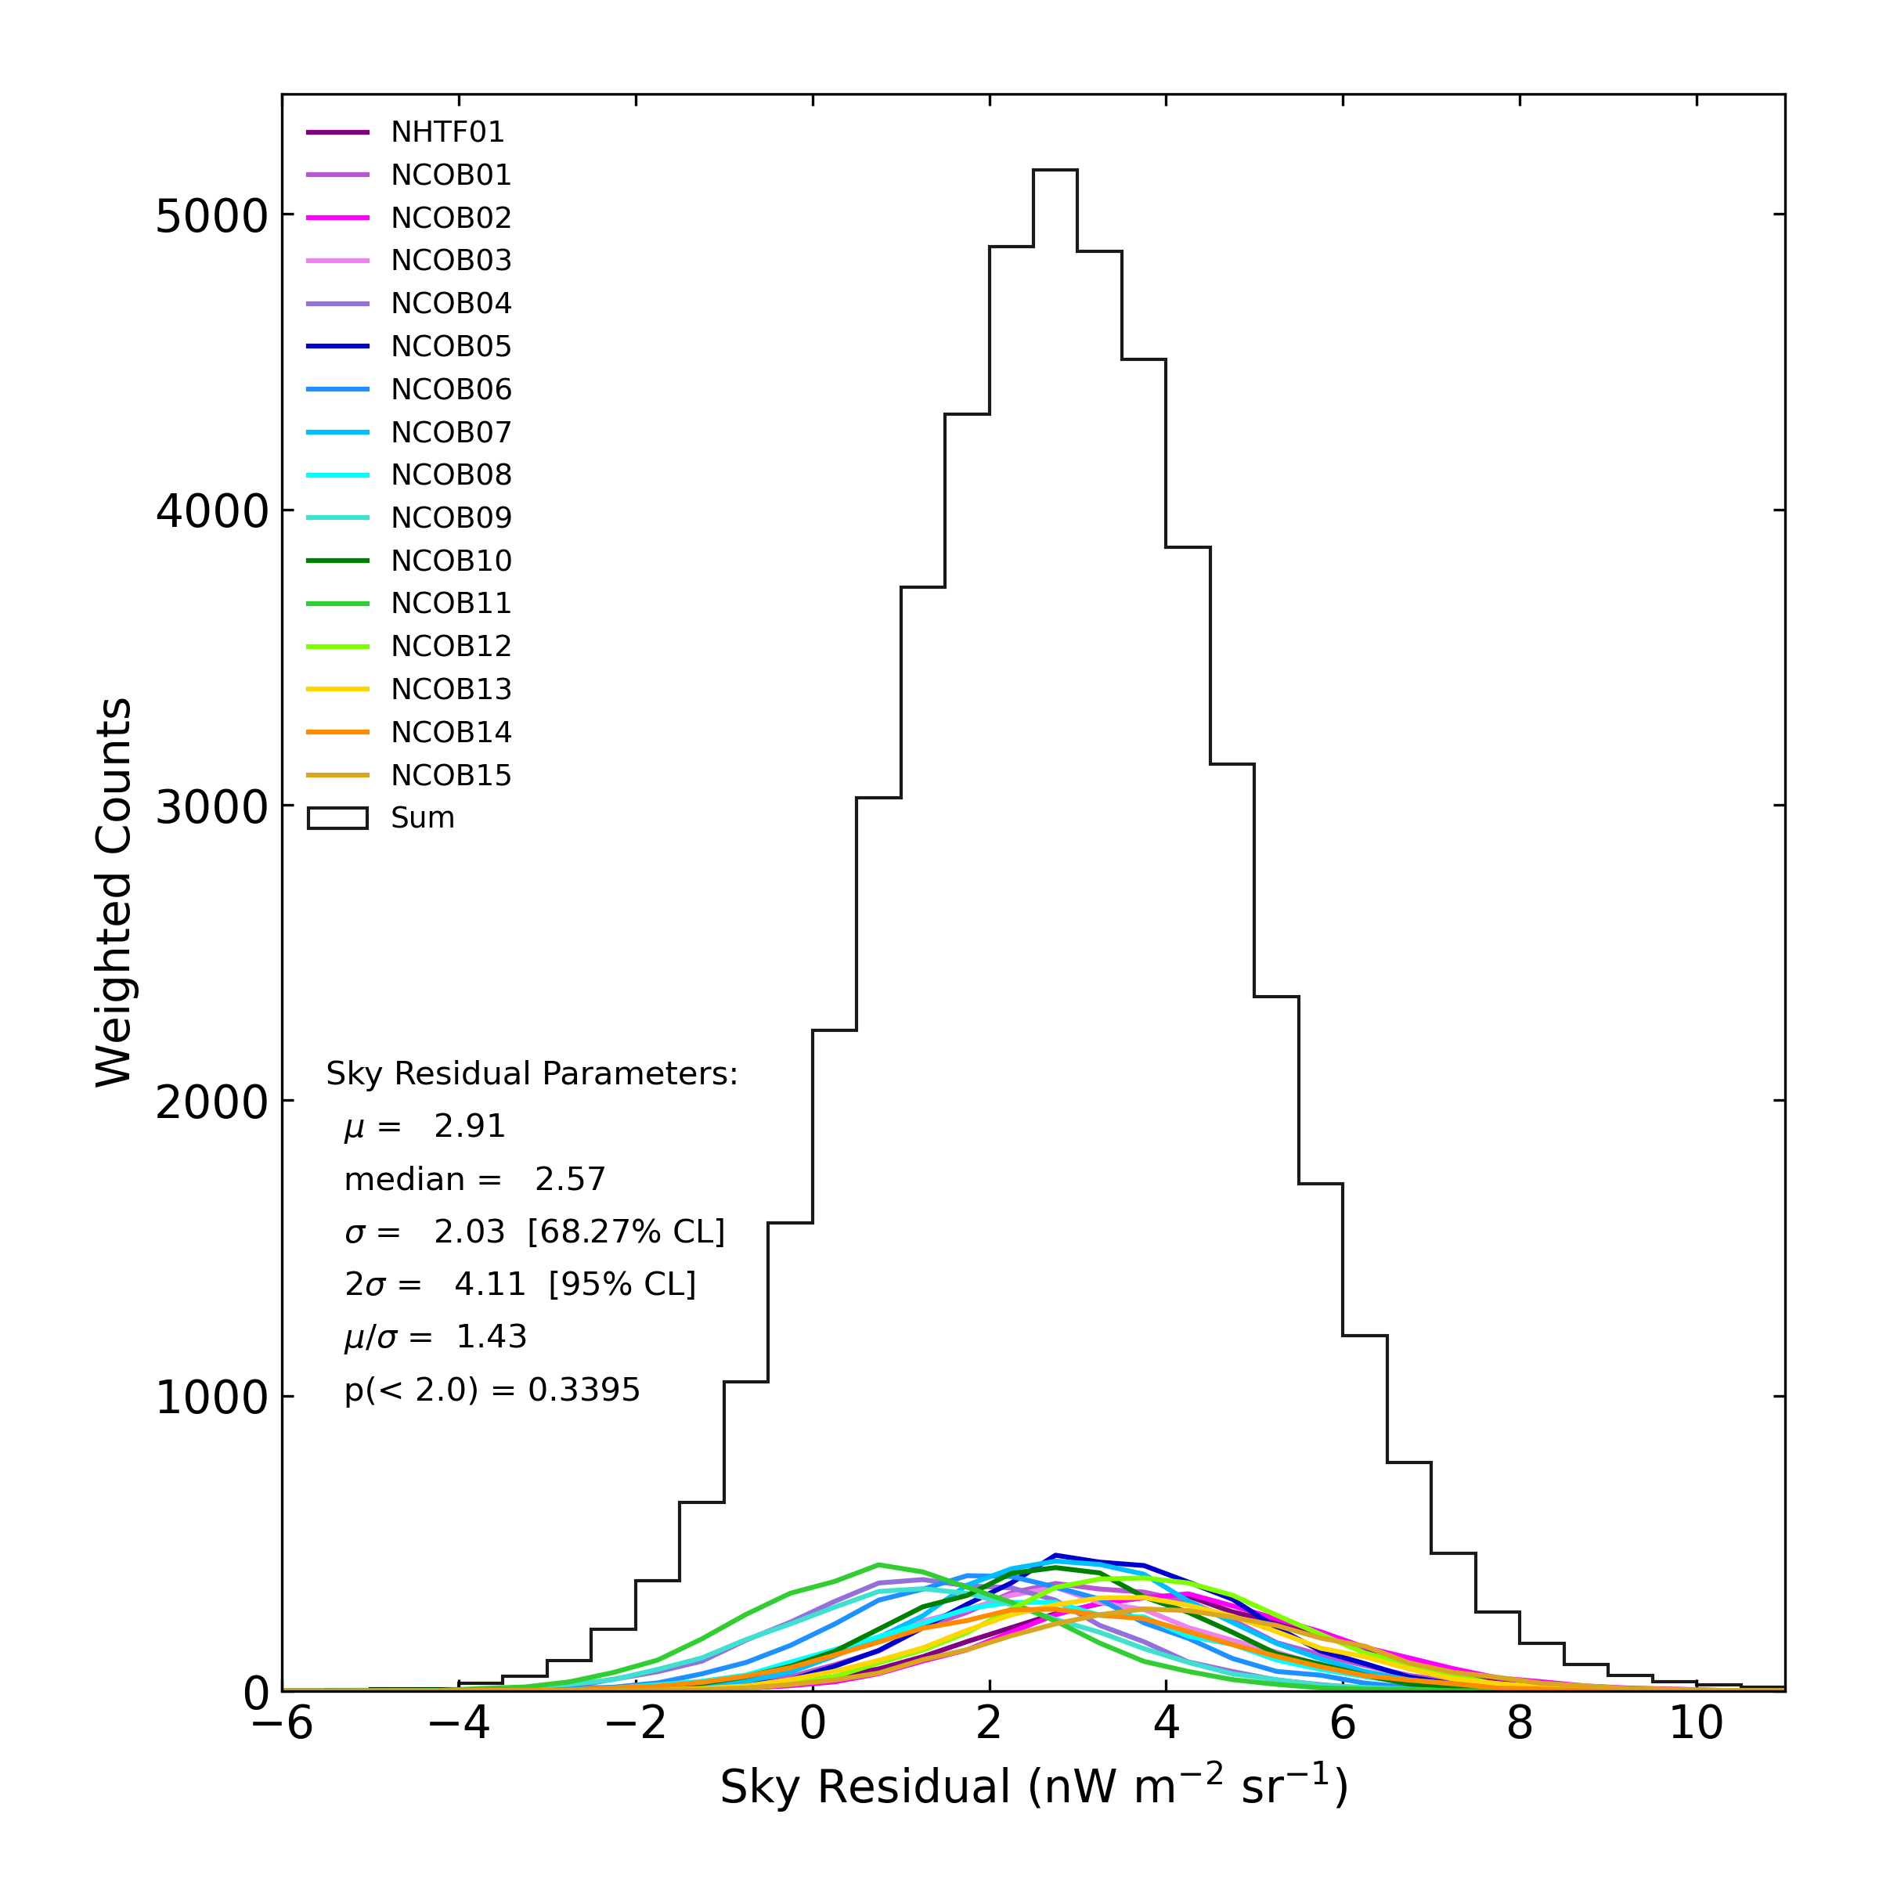
NH Results: COB detected at 6.7 sigma
Individual field probability distributions are weighted by the inverse square of the uncertainties in COB and ∆COB
COB = 11.08 ± 1.65
ΔCOB = COB - IGL
ΔCOB = 2.91 ± 2.03
IGL from deep galaxy counts

Slide 16
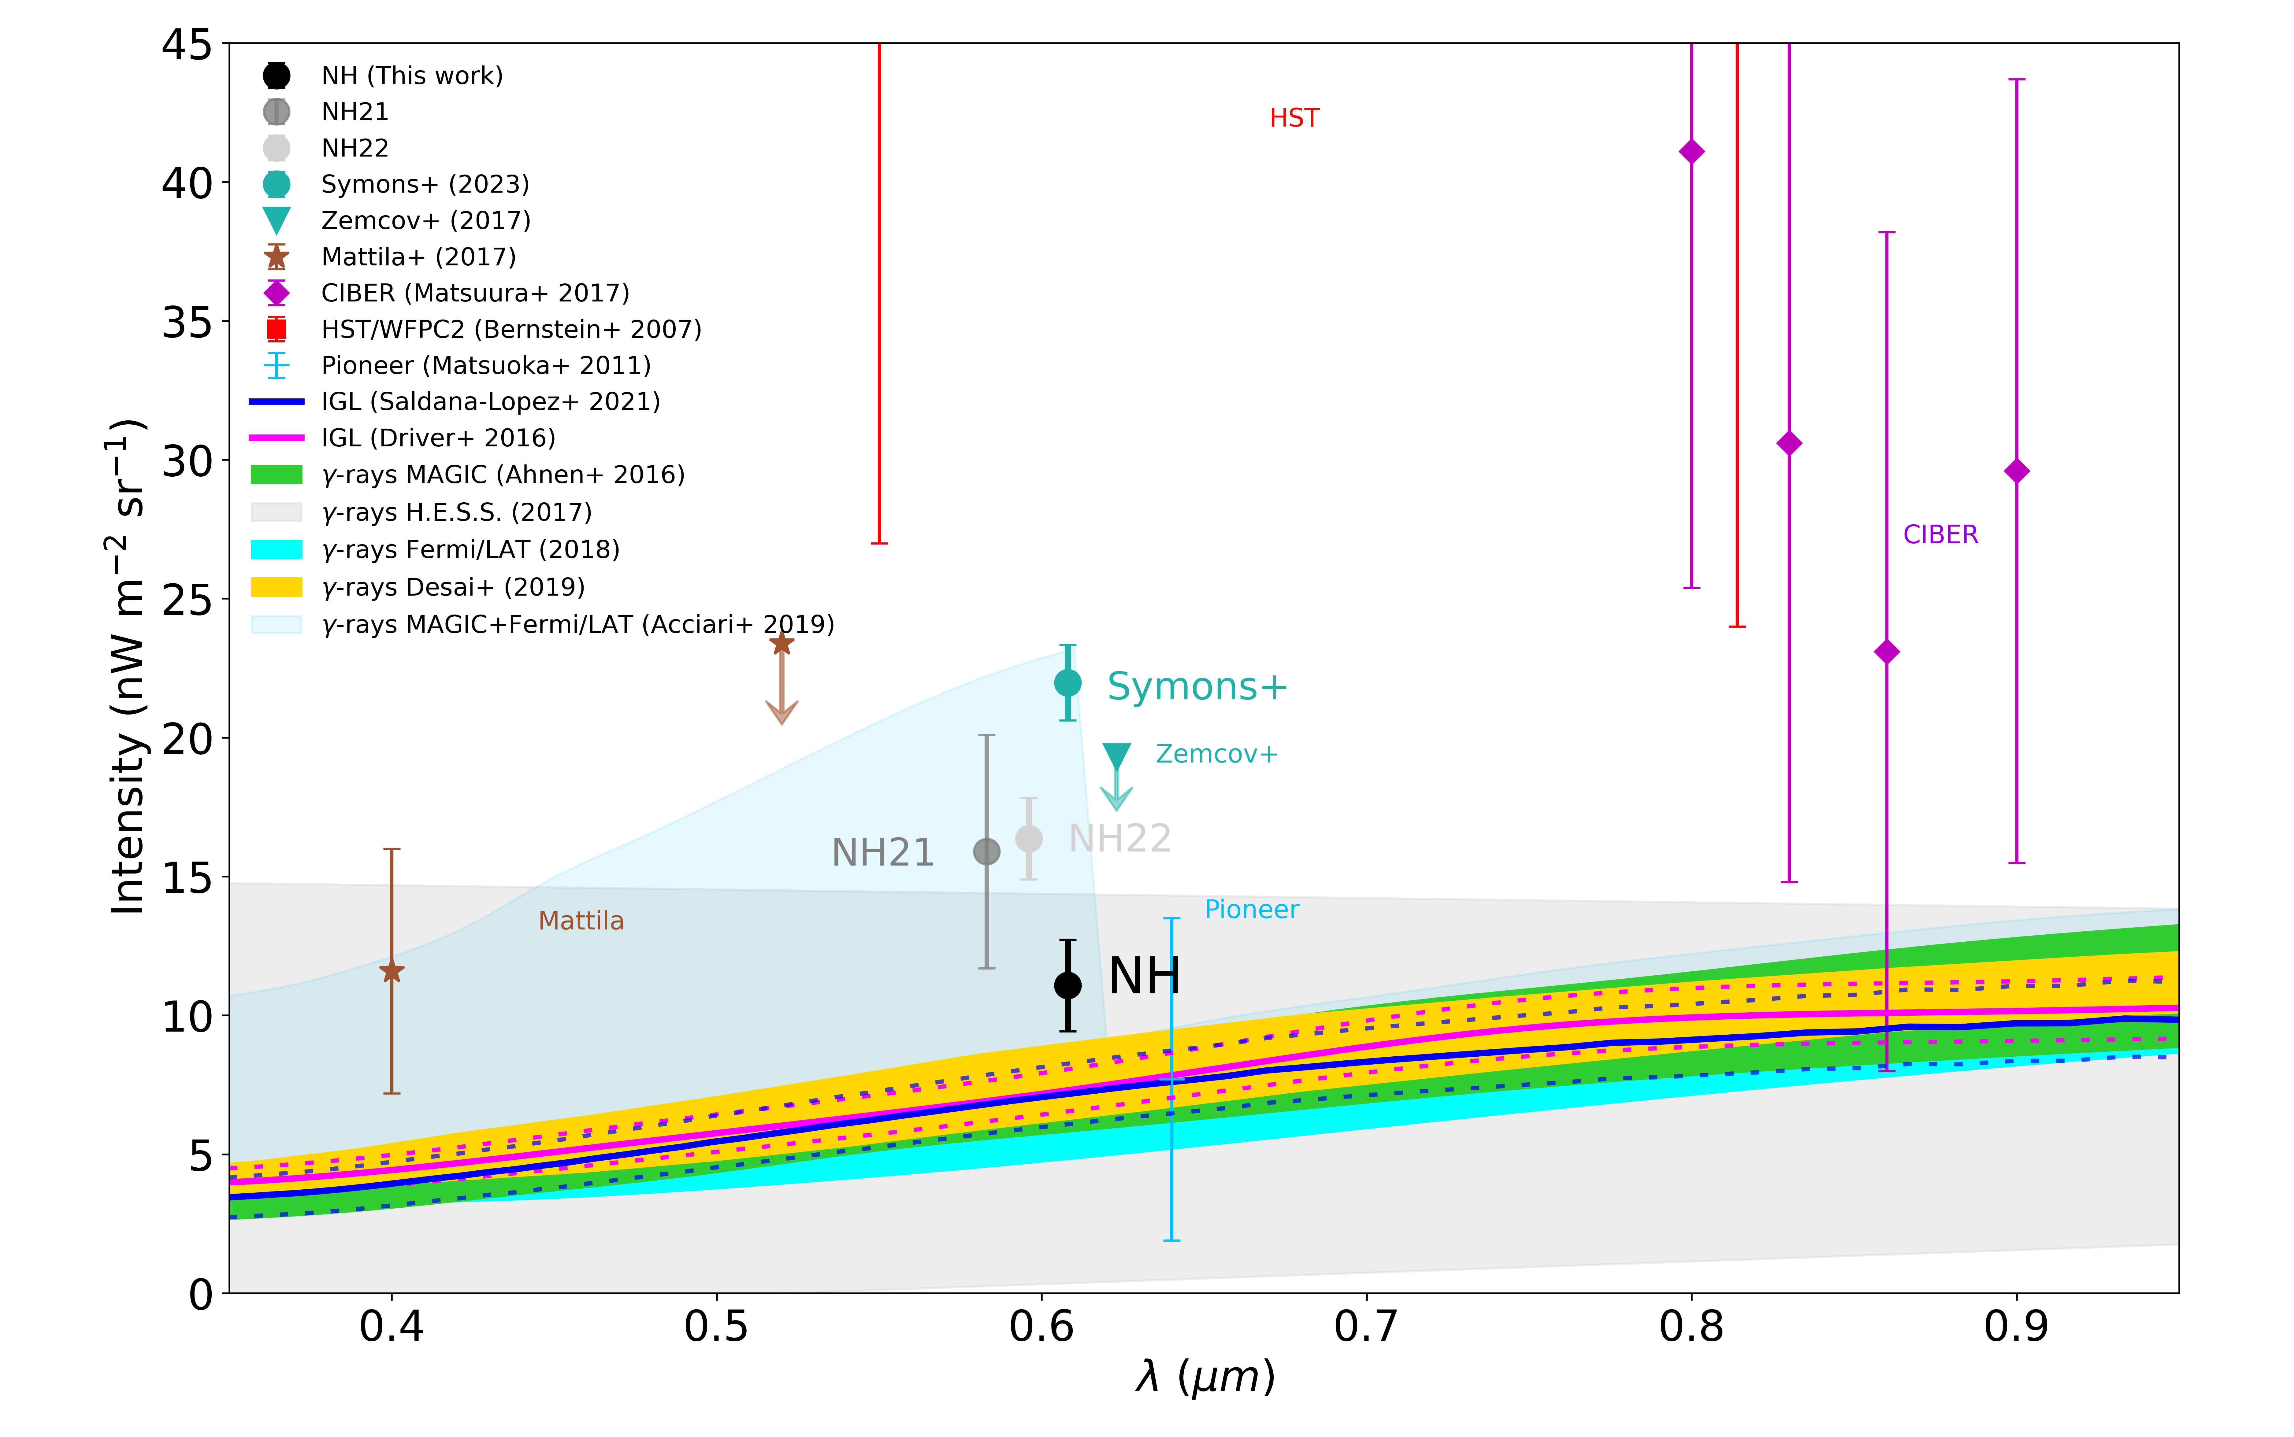
Comparison to Previous Results

Slide 17
Comparison to Previous Results

Slide 18
Robustness of Results
Scatter ~ 0.12 nW/m2/sr

Slide 19
Summary
We have developed a DGL estimator using 350 and 550 micron imaging from the Planck satellite. Scatter is 1.36 $nW m^{−2}{sr}^{−1}.$ Potentially useful for studies of LSB objects or other EBL surveys as well.
We have definitively detected (6.7 sigma) the cosmic optical background in the LORRI bandpass (0.4 – 0.9 microns):
COB = 11.08 ± 1.65 $nW m^{−2}{sr}^{−1}$
Our derived COB is higher than that predicted from deep galaxy counts (8.17 ± 1.18 $nW m^{−2}{sr}^{−1}$) but the difference is not significant (1.4 sigma):
∆COB = (COB – IGL) = 2.91 ± 2.03 $nW m^{−2}{sr}^{−1}$
To explain the above residual as extragalactic in origin would require a ~30% increase in light from galaxies or intergalactic space. Driver et al. (2016) suggested a diffuse component to the optical EBL could be present at the 20% level, possibly due to low surface brightness galaxies and/or intrahalo light.
Paper submitted to the Astrophysical Journal on April 4, 2024

