Slide 1
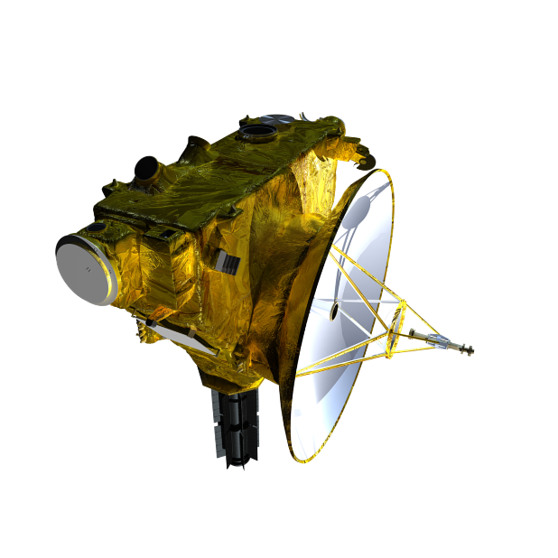
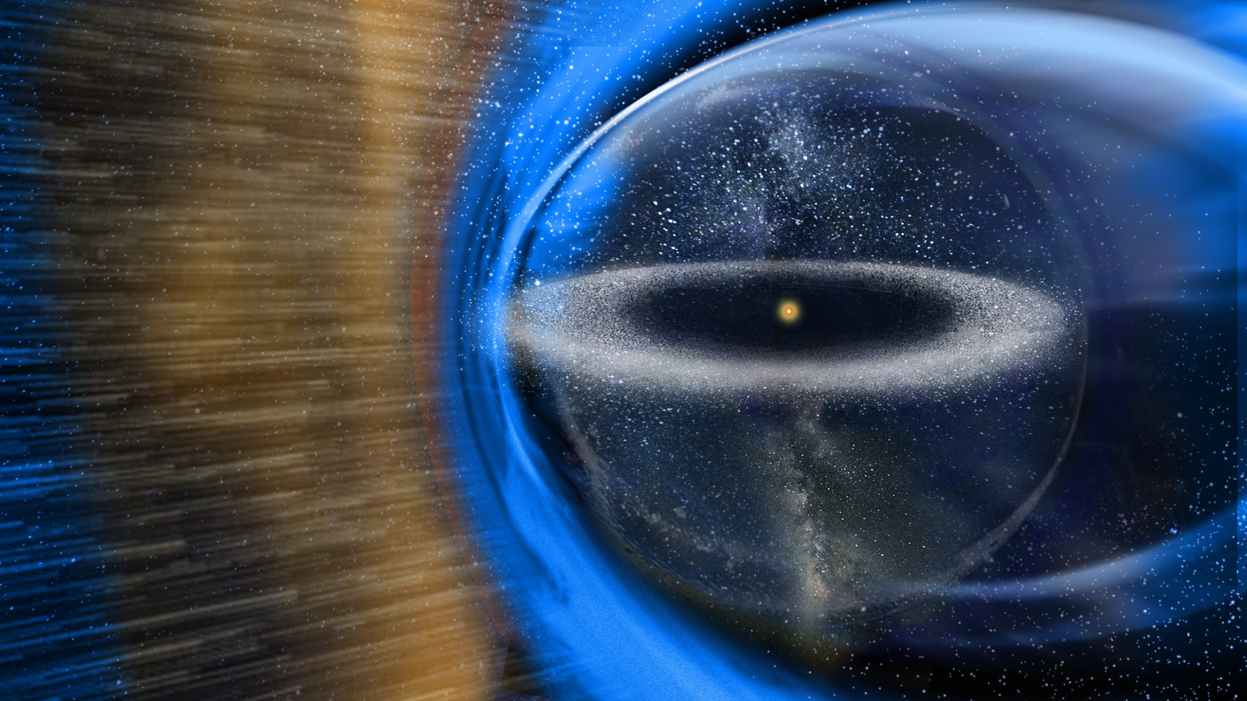
56th New Horizons Science Team Meeting
08:25EDT 15 May 2024

Slide 2
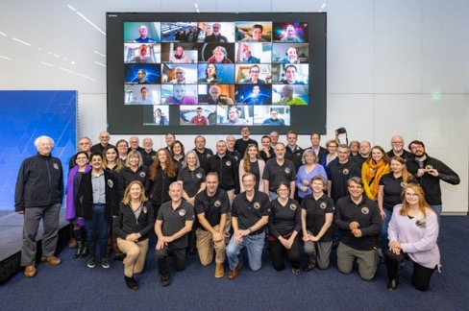
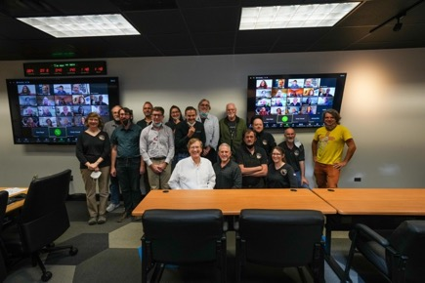
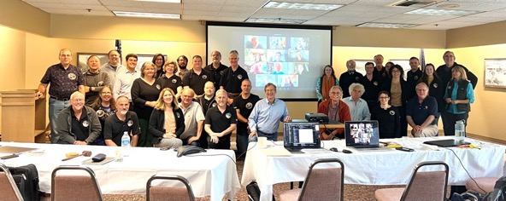
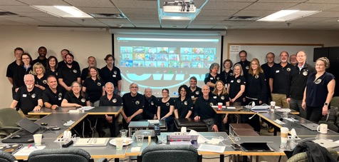
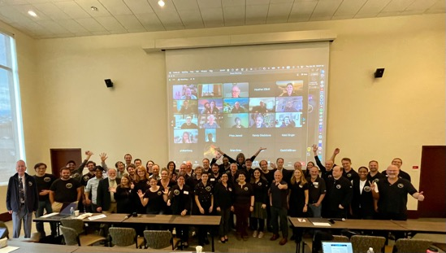
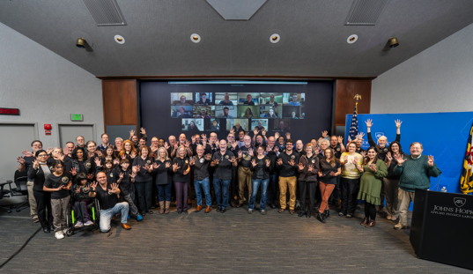
Welcome to the 56th Meeting!
STM#52, APL, MD
STM#49, Michoud, LA
STM#51, Wallace, ID
STM#50, St. Louise, MO
Team Photo, please!
STM#55, APL, MD
STM#53, SwRI, Boulder, CO
STM#54, Boston, MA

Slide 3
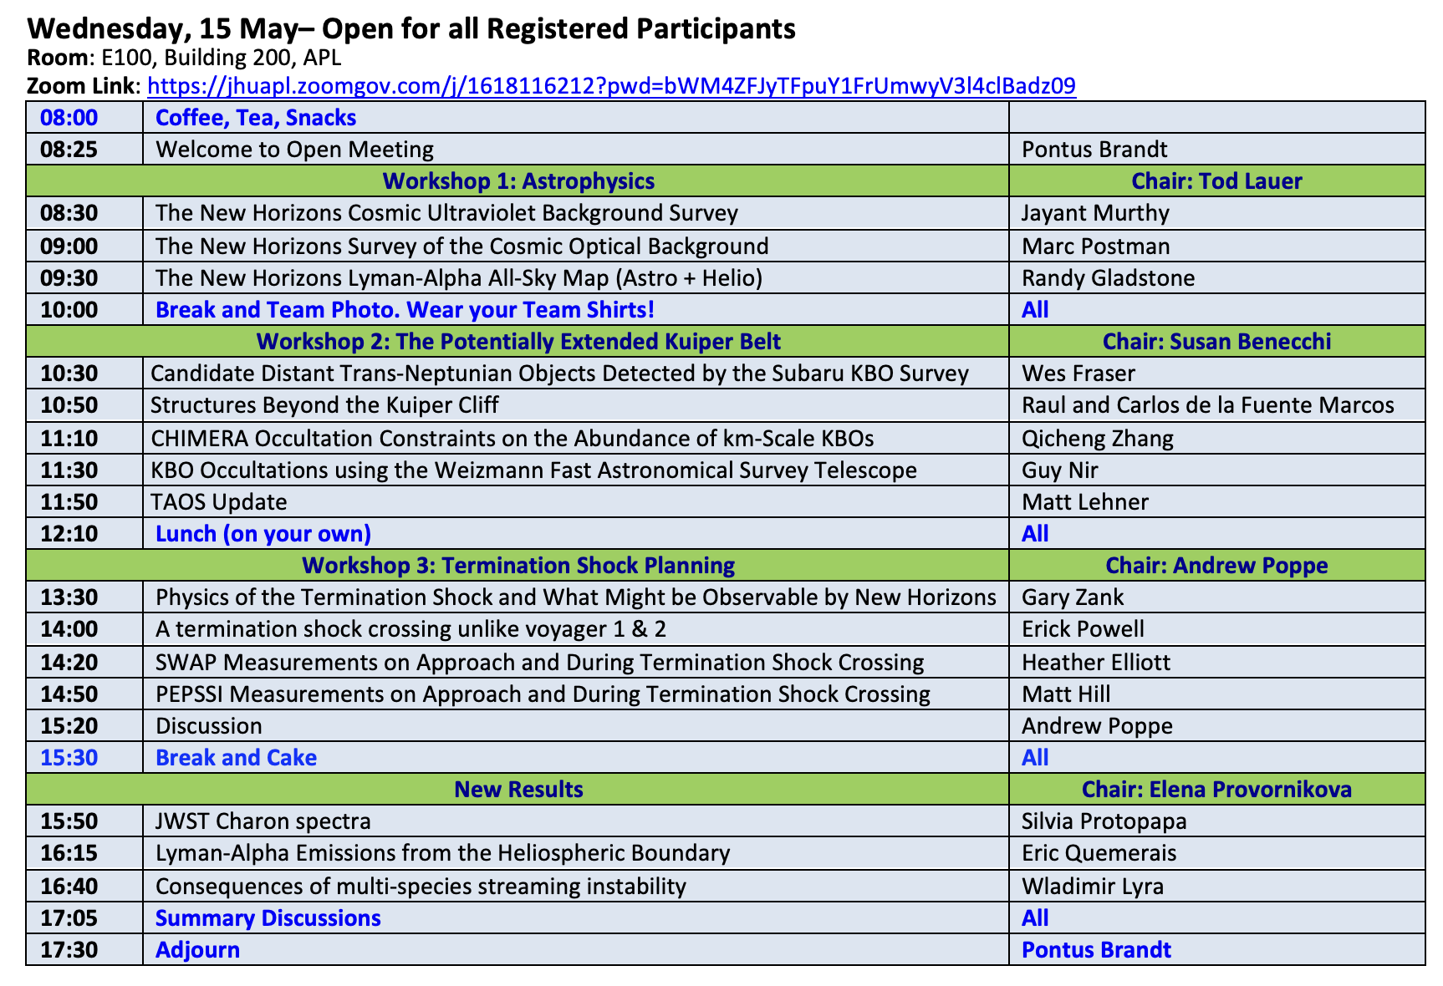
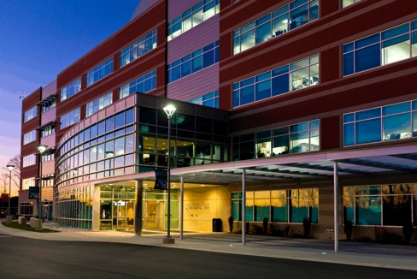
56th Science Team Meeting
Building 200 Room E100
Auditorium in the Lobby

Slide 4
Morning Brief
Meeting is being recorded!
Badge in at guard desk!
Need badges to access break-out rooms
Rules of the Road
Do not socialize science or mission news!
Send presentations to Pontus Brandt!
Questions?
Lisa.turner@jhuapl.edu and/or pontus.brandt@jhuapl.edu

Slide 5
Break and Photo!
Resuming 10:30 EDT with
Workshop#2: The Potentially Extended Kuiper Belt

Slide 6
At Lunch!
Resuming 13:30 EDT with
Workshop#3: Termination Shock Planning

Slide 7
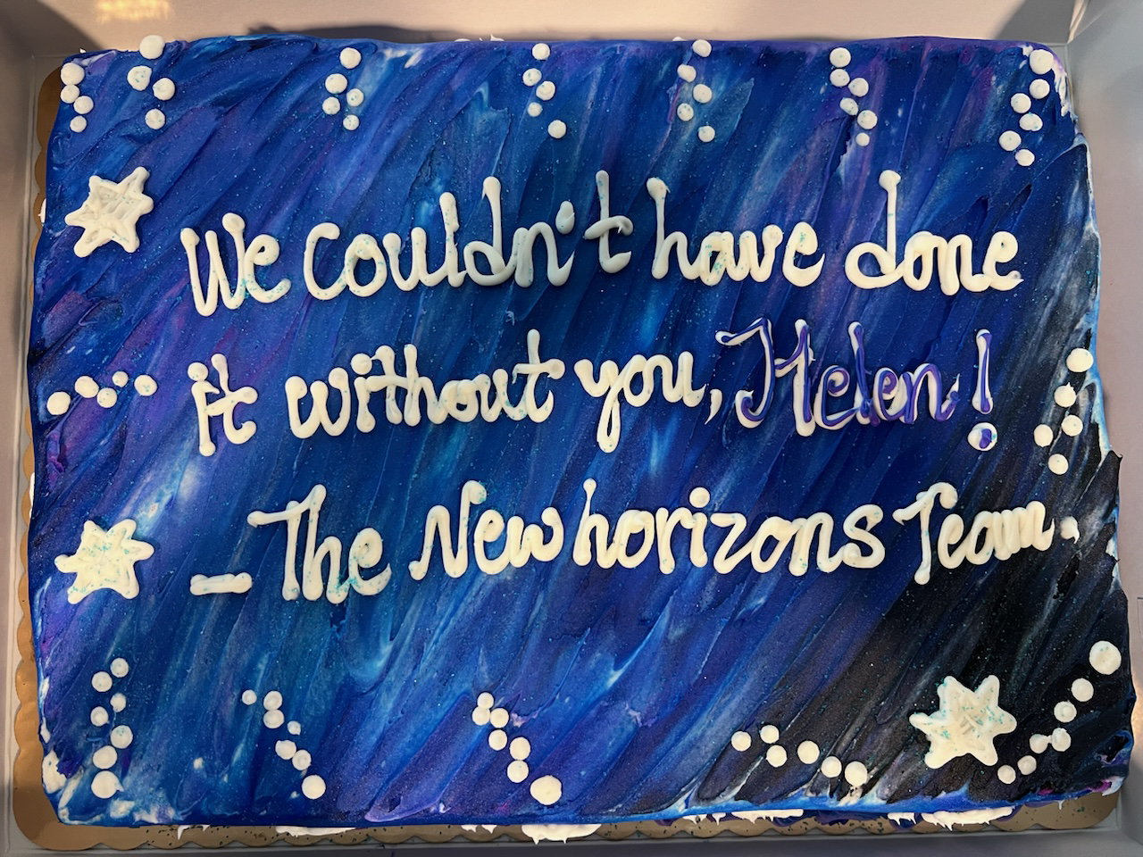
Break and Cake!
Resuming 15:50 EDT
Congratulations Helen!

